Slide 1
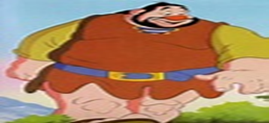
English Day 4: WALT: create my own atmospheres through settings
Jimmy would like some more ideas for his writing. Can you find research other settings which create different atmospheres? You may like to copy and paste pictures from the internet or draw your own picture to create the effect.
If you are copy and pasting, aim for at least 3 more settings.
Write the atmosphere the picture creates and brainstorm some describing words for it.
Ideas for different atmospheres you could look for:
Busy/bustling, quiet, powerful and stormy, magical, creepy

Slide 2
Notes for Maths
Discovery – Children to work independently.
Share – This page shows you different ways the discovery question could have been answered.
Think Together – Complete and then discuss with an adult to consolidate and deepen understanding.
Practice – children practice the skills they have learnt. Please complete 2 of the 3 slides of practice. (Pick the 2 pages you think will challenge you the most!)

Slide 4
Lesson 9 – WALT: Use Roman Numerals to 100.
Can you spot any patterns in the Roman Numerals? Why isn’t 4 written as IIII?
Why do you think 4 is written as IV and 6 is written as VI? Can you see the connection?
Why is the number on the coin 34 and not 36?

Slide 5
Can you see how the numbers are formed? Could you continue beyond 20?
Why does the part-whole model help? What would you do next?

Slide 6
Where do you see Roman Numerals in real life?
How do you read a clock? What is the time if the big hand is pointing to XII?
What is the time if the minute hand is pointing to VI? Do all clocks have IV for 4?

Slide 7
Can you make your own numbers using these digits?

Slide 8
Practice Questions

Slide 12
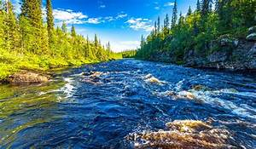
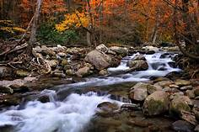
The River by Valerie Bloom
The River's a wanderer.
A nomad, a tramp,
He doesn't choose one place
To set up his camp.
The River's a winder,
Through valley and hill
He twists and he turns,
He just cannot be still.
The River's a hoarder,
And he buries down deep
Those little treasures
That he wants to keep.

Slide 13
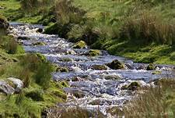
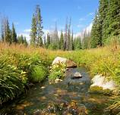
The River by Valerie Bloom
The River's a baby,
He gurgles and hums,
And sounds like he's happily
Sucking his thumbs.
The River's a singer,
As he dances along,
The countryside echoes
The notes of his song.
The River's a monster
Hungry and vexed,
He's gobbled up trees
And he'll swallow you next.

Slide 14
Day 4 Reading WALT: create my own version of a poem
We are going to think about what else your river could be.
Could it be a driver, a dancer, a chatterbox, a gymnast?
Is it keen to please? Eager to get to another river and the sea who are its friends? Is it like a coach or a lorry as it transports materials downstream?
You can use any of the above ideas or create some of your own – we know that you have some super ideas and thoughts!
Now try and create 1 or 2 more verses of the poem trying to use the same rhythm; don’t worry if it does not rhyme.

Slide 15
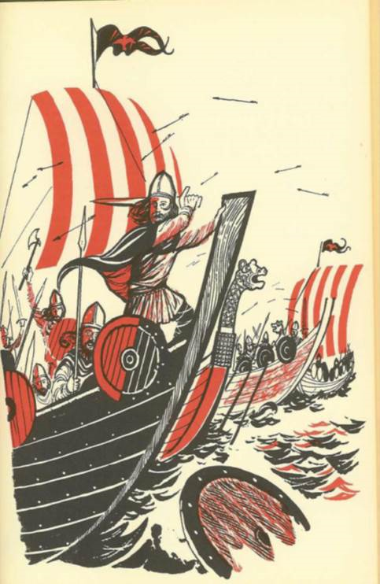
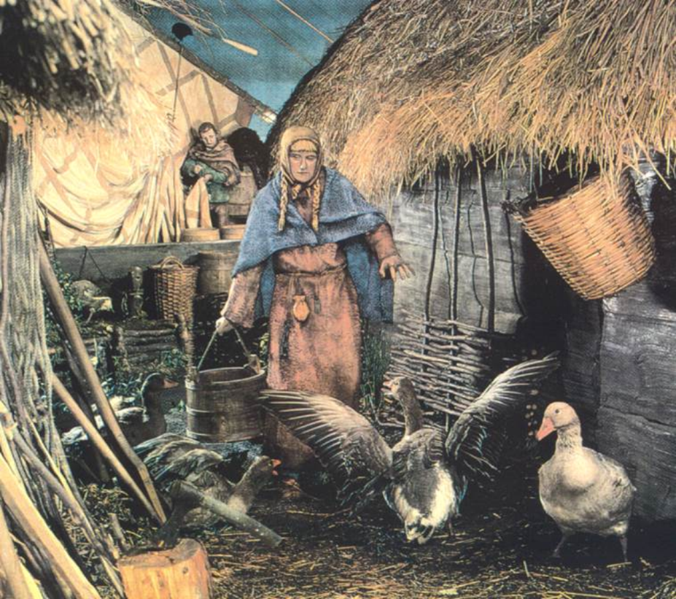
Were the Vikings raiders or settlers?

Slide 16
So what were the Vikings really like? This book was written in 1965. What sort of people does it say they were?
Rampaging Vikings, or Norsemen, from northern lands now known to us as Norway, Sweden, and Denmark, in their determination to (become) traders, merchants, and seamen, overran ..southern Europe, like a plague upon the inhabitants.
They shamelessly robbed the islands we now refer to as Great Britain and Ireland. So fierce were these Norsemen that many of the priests were said to close their sermons with a prayer: "God, deliver us from the fury of the Northmen."
ALL bad

Slide 17
Then we have this book written 30 years later. How is it different?
Extract from Atlas of World History for Young People, published in 1997
They raided coastal settlements, murdering and terrorizing the native populations and plundering their monasteries, returning to their homelands laden with treasure.
In the mid-9th century, instead of returning home, Viking raiders began to make permanent settlements. They were good farmers, adapting themselves to the culture of the peoples they conquered …
Though fearless warriors, the Vikings were also fine craftsmen, producing fine swords and beautiful woodcarvings.
Mixture of good and bad
Started off bad, but became more peaceful and friendly

Slide 18
Account 1
Extract from A History of the World For Young Readers, published in 1965
Account 2
Extract from Atlas of World History for Young People, published in 1997
What might have happened between the time these two books were written to explain why our view of the Vikings has changed?

Slide 19
So which book do you think this picture comes from - the one from1965 or 1997?

Slide 20
8-year olds from Norway and Sweden want your help
In schools in Scandinavia today there are lots of 8 year olds who have a very different view of what their ancestors, the Vikings were like. They are unhappy about they way they are portrayed in English history books and want you to write an information text to show all the facts.
It’s up to you how you present your thinking.

Slide 21
First, let’s look at the facts

Slide 22
Look at the facts, it may help to organise your facts like this:

Slide 23
Look at the facts, do you think it is better to organise your facts like this?

Slide 24
You can present your information in any style you like.
You might do a Zig-Zag book which shows what you first thought they were like on the first ‘page’ and then on the last page show what you really think they were like. Inside you could draw pieces of evidence which show why we need to change our minds.

Slide 25
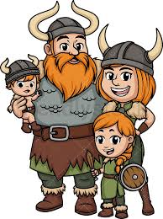
If you decide to make a book you may want to start your book with a drawing………..
Good luck and be creative!

