Slide 1
Day 5: WALT: Describe a setting.

Slide 2
Today we are going to focus on the castle in the picture. What might it be used for and who might use it? Create a character who either lives in it or goes in to explore it. Describe what it is like inside – is it grand? Crumbling and rundown? Sleek and sophisticated? Aim to write two paragraphs describing what it is like inside. Focus on using the power of 3 for effect e.g. The door into the castle was vast, imposing and solid as a rock. The main hall in the castle was elegant and majestic, yet it had an air of mystery enclosing it.

Slide 3
Discovery – Children to work independently.
Share – This page shows you different ways the discovery question could have been answered.
Think Together – Complete and then discuss with an adult to consolidate and deepen understanding.
Practice – children practice the skills they have learnt. Please complete 2 of the 3 slides of practice. (Pick the 2 pages you think will challenge you the most!)

Slide 4
Lesson 5 – WALT: Represent 4 digit numbers.
What place value do you think each alien represents?
Can we exchange our 1000’s for 10’s, 100’s or 1’s to create 7420 in different ways

Slide 5
How can you count the total? What would you count first? Why?
How many ‘ones’ are in a thousand block?
How does exchanging help us find more answers?

Slide 6
How many thousands blocks do I need?
What happens if there are 0 hundreds?
How can saying the number out loud help you to write in words?

Slide 7
How does the base 10 equipment match to the part whole model?
Which part do you focus on first?

Slide 8
Practice Questions

Slide 11
Reading
This week we will be reading through the text, ‘Here be Dragons’ by Pie Corbett which is an instructional text.
There will be various activities to complete from it during the week.

Slide 12
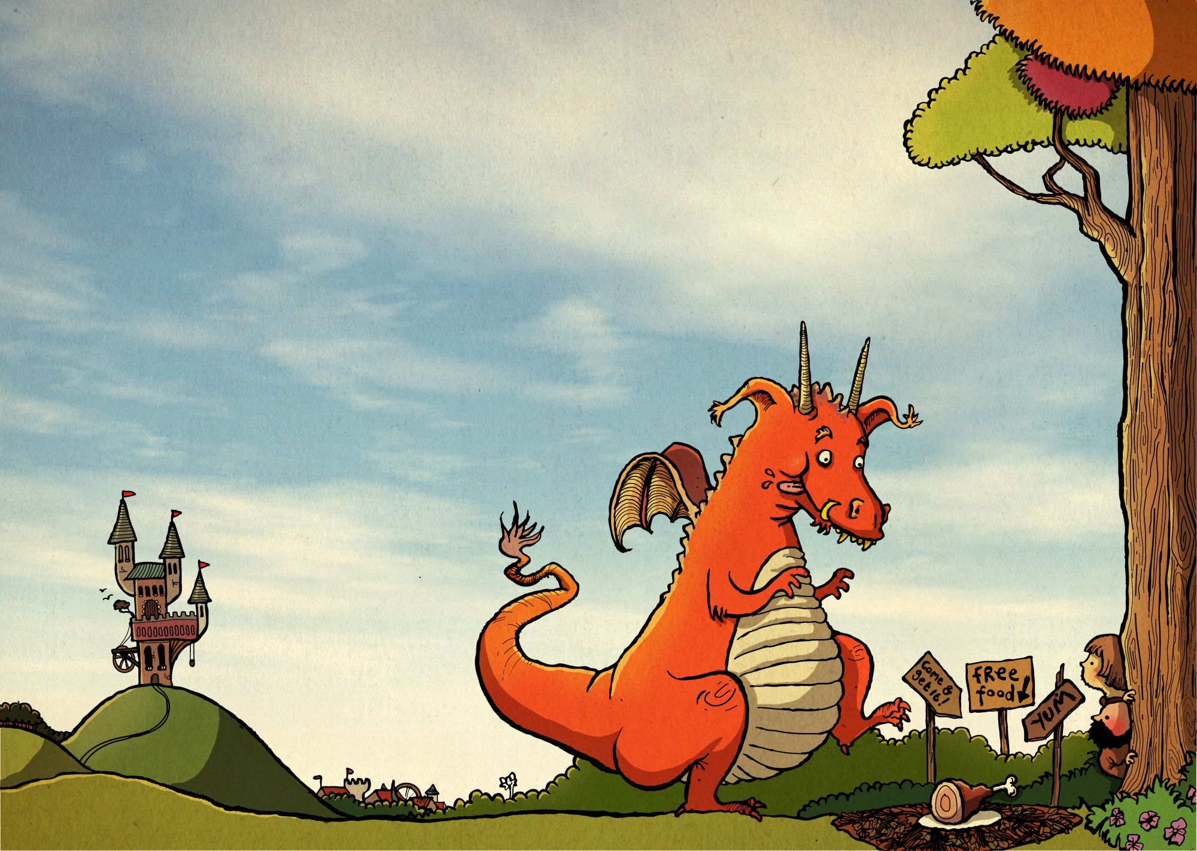
Day 5: WALT write instructions for our character
Write a set of instructions about your dragon on a topic of your
choice.
This could be the same as the model text, how to trap a dragon, how to
look after a dragon; or different, e.g. how to get your dragon to fly, how to teach your dragon to roar, how to train your dragon at meal times etc.
Use bullet points or numbers to help structure your work.
Have fun thinking of creative ideas!

