Slide 1
Day 4: WALT: use word classes to create sentences.

Slide 2
We have a different setting today. Choose a noun, e.g. the moon. Then an adjective for the moon, e.g. ghostly. Finally a verb for the moon, e.g. stared. Put this together to create a sentence – adjective + noun + verb. The ghostly moon stared. Add an adverb and lengthen the sentence if you can, e.g. The ghostly moon stared over the peaceful valley.
Complete this activity with other nouns in the picture.

Slide 3
Notes for Maths
Discovery – Children to work independently.
Share – This page shows you different ways the discovery question could have been answered.
Think Together – Complete and then discuss with an adult to consolidate and deepen understanding.
Practice – children practice the skills they have learnt. Please complete 2 of the 3 slides of practice. (Pick the 2 pages you think will challenge you the most!)

Slide 4
Lesson 4 – WALT: Count in 1000’s
How many boxes of lemon sweets are there?
How many sweets are there in each box?
Should we count in 10’s, 100’s or 1000’s? Why?

Slide 5
How many sweets does each box represent? How can you use this number to find the total number of sweets?
How can you use part A to help you answer part B?

Slide 6
How many boxes of strawberry and lemon sweets are there? How many sweets are in each box?
How can the numbers shown help us?

Slide 7
Practice Questions

Slide 10
Reading
This week we will be reading through the text, ‘Here be Dragons’ by Pie Corbett which is an instructional text.
There will be various activities to complete from it during the week.

Slide 11
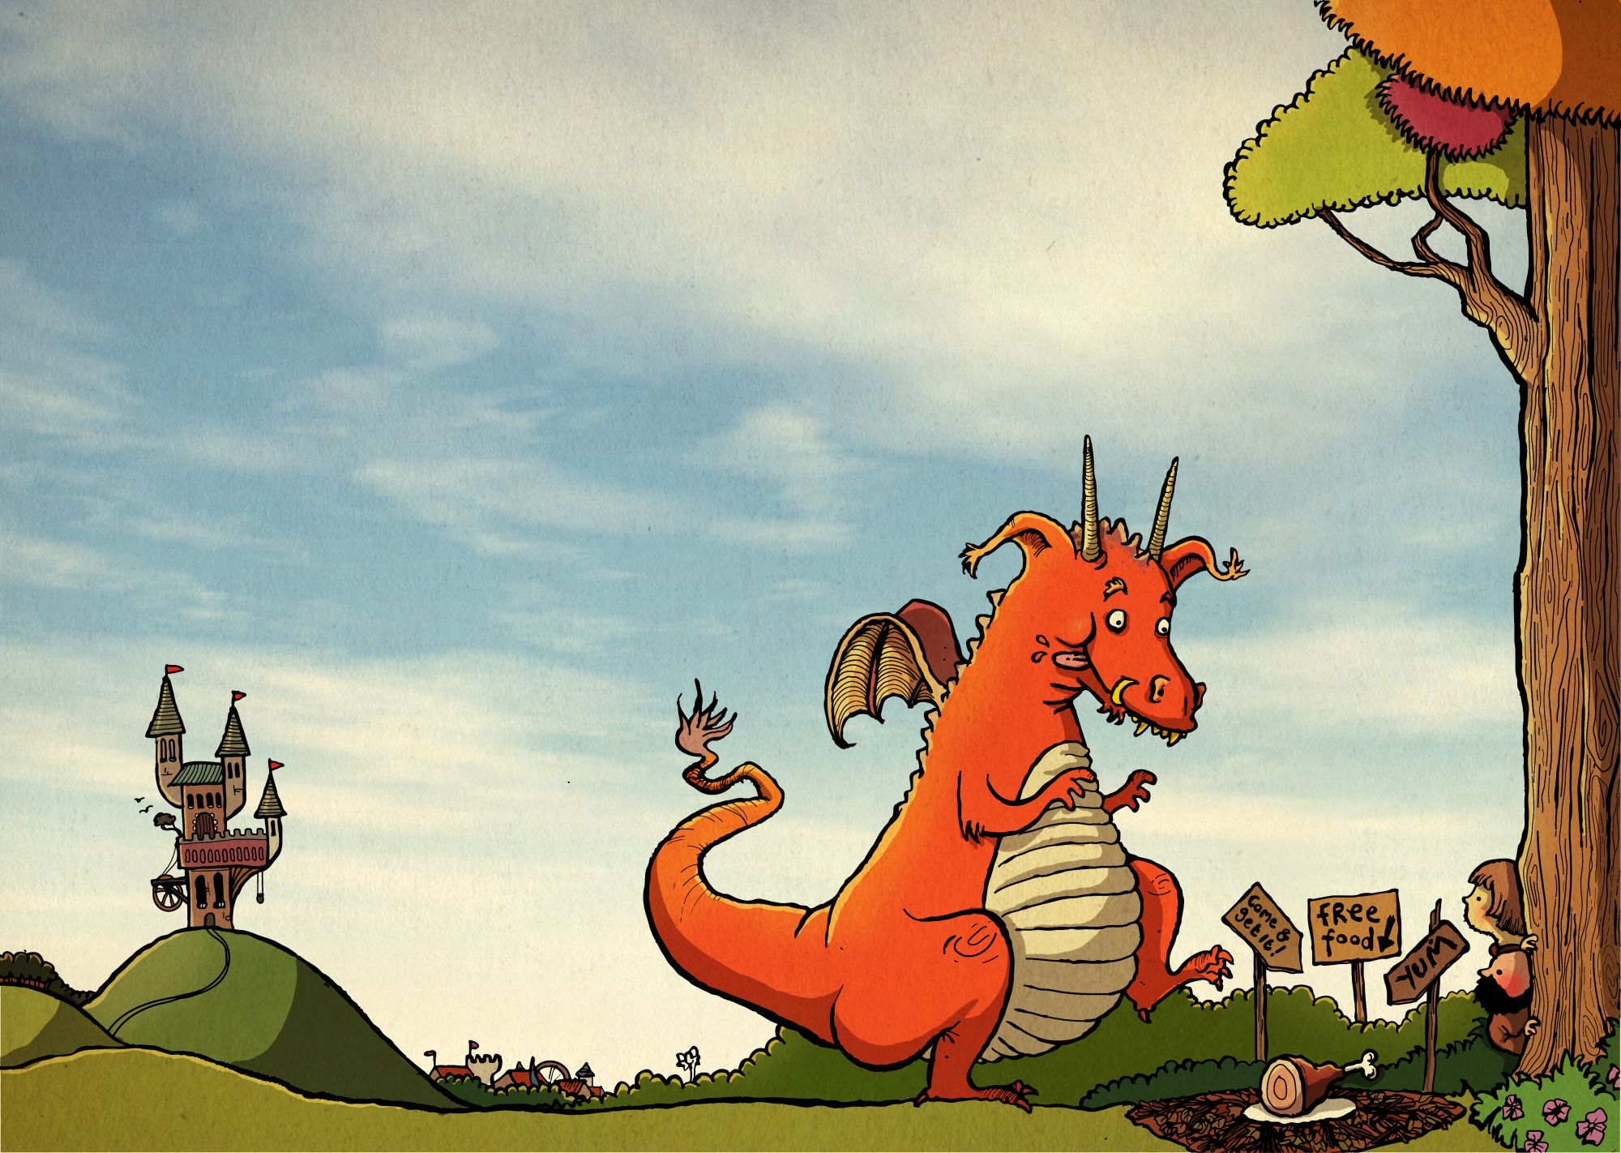
Day 4 WALT: create a character
Design and draw your own dragon. Label its features; try to use
some powerful vocabulary for it e.g. extendable claws, a
retractable tail, fiery orange, wings that glitter in the light…

