Slide 1
Day 2: WALT: Choose adjectives to describe a setting

Slide 2
Look at the picture below of a setting. Write a list of the nouns you can see, e.g. clouds, sand. For each noun write a variety of adjectives to describe them, e.g the candy floss clouds, the golden sand. Use an online or paper thesaurus to help you.

Slide 3
Notes for Maths
Discovery – Children to work independently.
Share – This page shows you different ways the discovery question could have been answered.
Think Together – Complete and then discuss with an adult to consolidate and deepen understanding.
Practice – children practice the skills they have learnt. Please complete 2 of the 3 slides of practice. (Pick the 2 pages you think will challenge you the most!)

Slide 4
Lesson 2 – WALT: Round any number to the nearest 10.
What do we mean by the nearest 10?
Which two tens does 48 lie between?
Which two tens does 48 lie between?
If 60 is the nearest 10, what could the number of snakes be?

Slide 5
How does a number line help us to round?
Is it easier to round the number of fish than the number of monkeys? Why?
Does a number line help us to round the number of monkeys?

Slide 6
What will the tens be either side of the number?
Can we place these numbers on a number line?

Slide 7
3c) Does the number round up or down? How is this number different?

Slide 8
Practice Questions

Slide 11
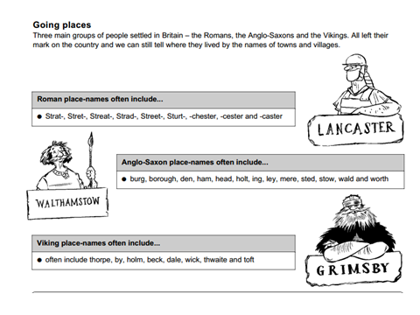
Calling all Year 4 history detectives!
Your challenge is to find where the Vikings settled and think about how we know.

Slide 12
Reading
This week we will be reading through the text, ‘Here be Dragons’ by Pie Corbett which is an instructional text.
There will be various activities to complete from it during the week.

Slide 13
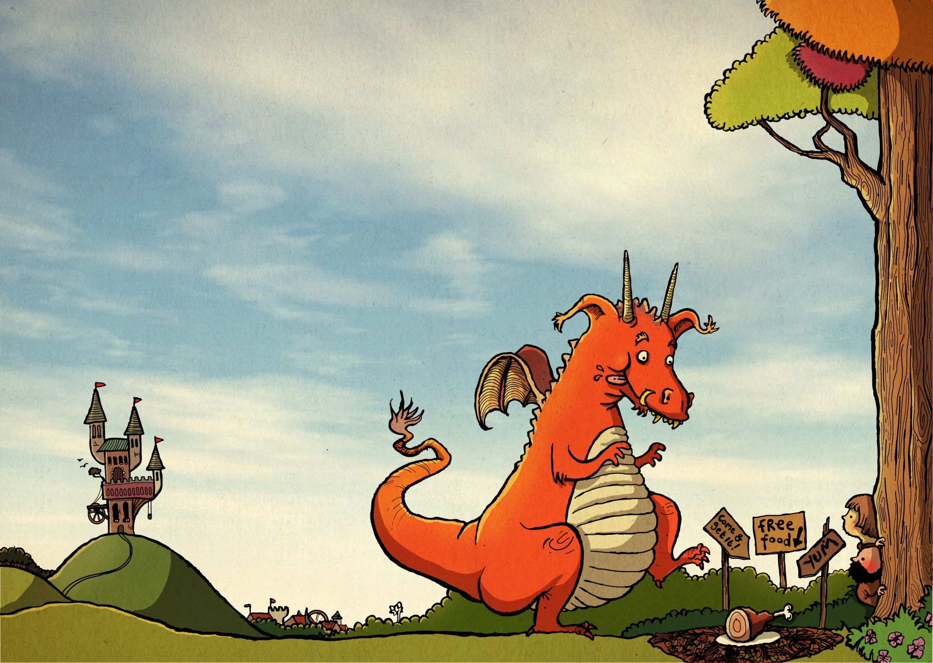
Day 2 – WALT: write a set of instructions
Read the slides on how to trap a dragon.
Think about and design your own trap for a dragon.
Use the same headings as the model text has –
How to trap a dragon
What you need
What you do
A final note of warning
You can draw the trap and label it if you wish – have fun thinking of ideas!

Slide 14
Topic: Vikings
WALT: Locate places with 6 of
the main Viking suffixes from
a given map
KQ: What can we learn about
Viking settlements from a
Study?

Slide 15
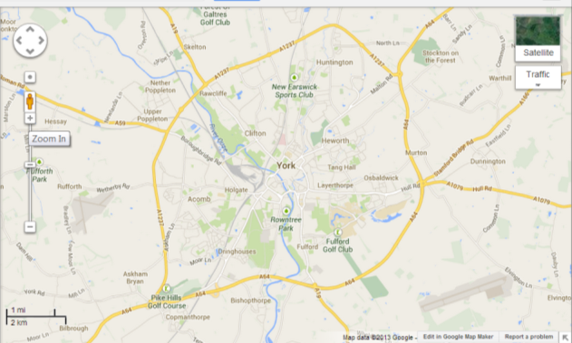
-by | farm, homestead or village
-thorpe | farm
-thwait | farm, clearing, meadow
-toft | house or plot of land
Use these word suffixes in the chart.
Can you find some Viking place names in the map below?
What do these Viking place names tell us about who lived there?
Most Vikings settled after 878 when England was divided by the Danelaw.

Slide 16
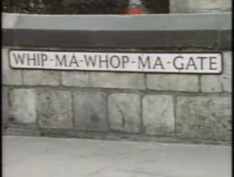
https://www.bbc.co.uk/programmes/p0115k9t
Gate or gaet meant street
There are 155 place names ending in -thorpe in Yorkshire! That’s a lot of Viking settlements!
https://www.bbc.co.uk/programmes/p0115hyw

Slide 17
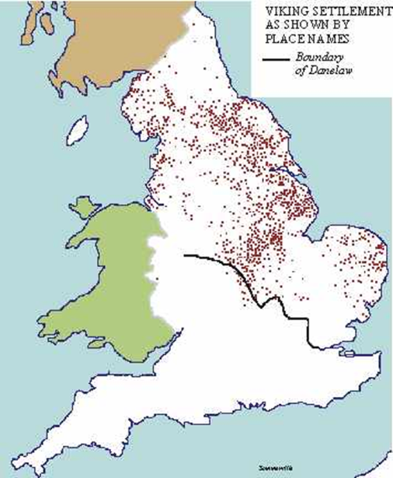
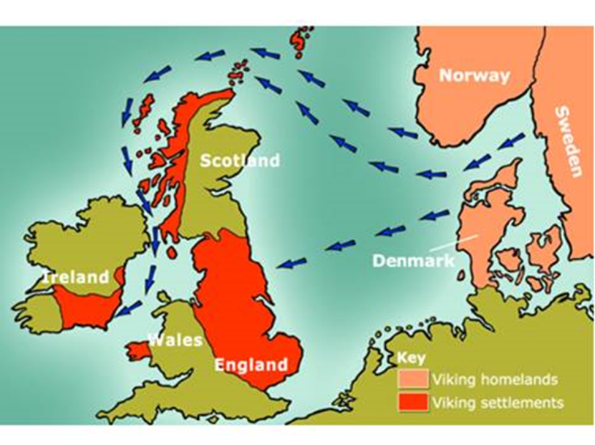
Use the map.
Where did the Vikings settle?
Why do you think the Vikings settled in these parts?

Slide 18
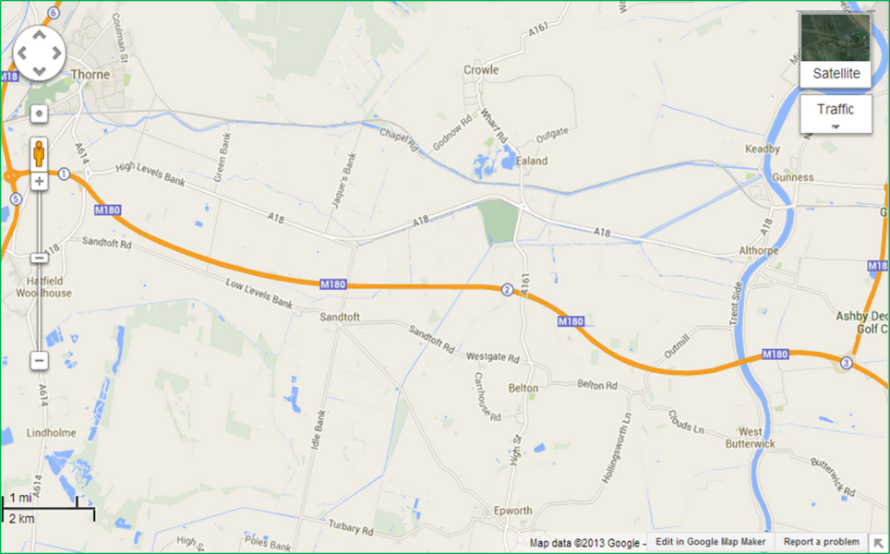
Can you find between 5-8 settlements with Viking place names?

Slide 19
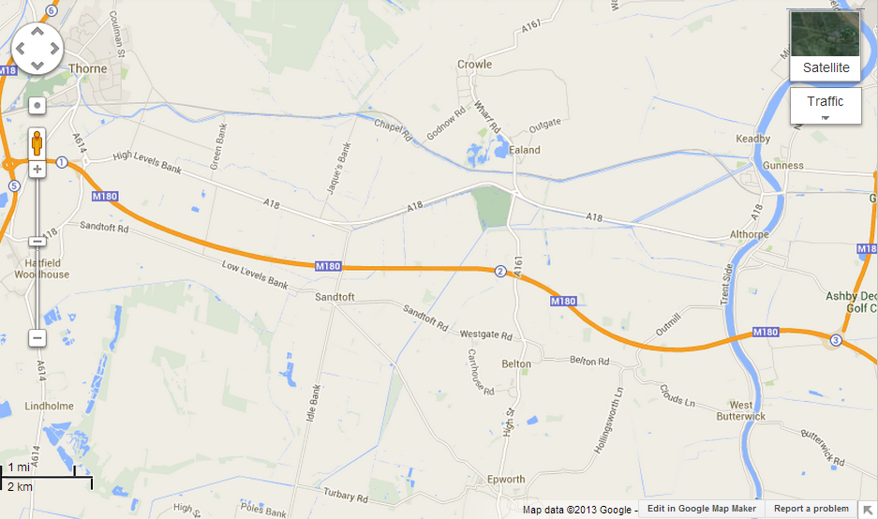
Answers: Did you find them all?

Slide 20
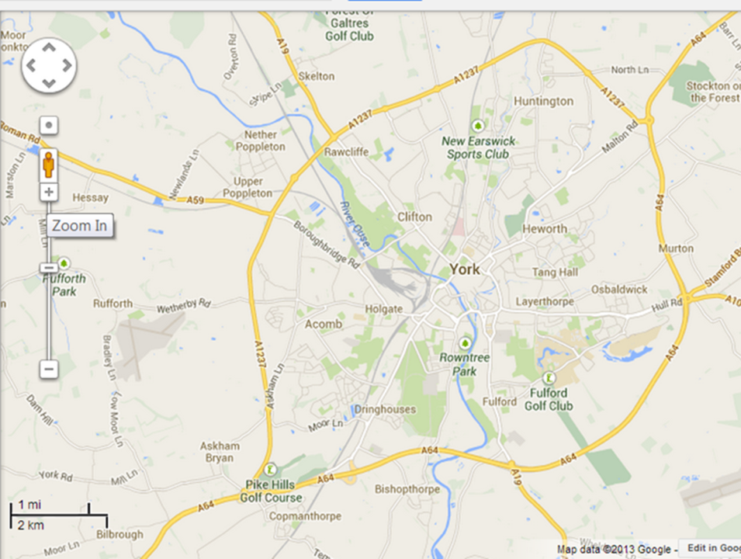
Can you find 5 Viking places in YORK-Jorvik to the Vikings?

Slide 21
Answers
What do you notice about the endings of names?

Slide 22
Use the information you have found out to answer in your books:
Where did the Vikings settle and how do we know?
Most Vikings settled in areas such as ……….
(Where? Link to where they had sailed from)
We know this because…….
(For example We know from the places that ended in ‘by’ that they were farmers.)

