Slide 3
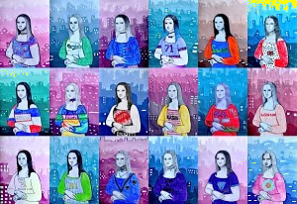
arteascuola.com/2015/05/contemporary-mona-lisa/

Slide 4
Use your printed Mona Lisa in your pack for working at home.

Slide 5
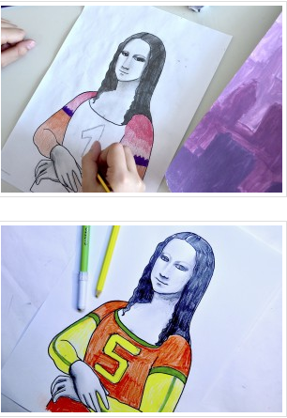
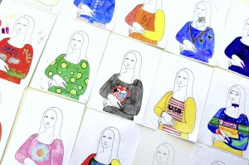
How will you dress your Mona Lisa?
Have fun and be creative!

Slide 6
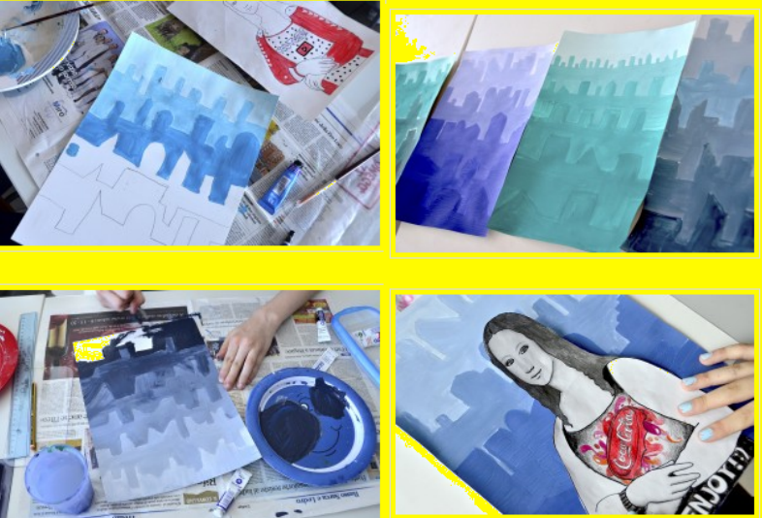

Slide 7
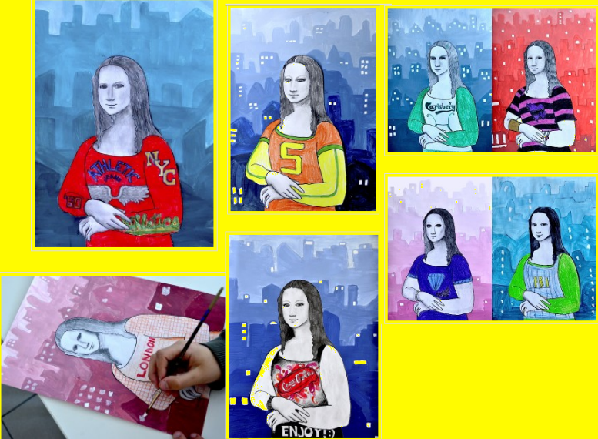

Slide 8
