Slide 1
Year 5 & 6 GPAS
MRS SAUNDERS & MRS BROWNE

Slide 2
GPAS – WHY?
In July 2012, in response to Lord Bew’s independent review of Key Stage 2 assessment, the Government announced a new statutory English grammar, punctuation and spelling test for all children in Year Six. This would be introduced during the 2012-13 academic year and was only signed off on the 20th December 2012. The test includes:
sentence grammar (identification & grammatical accuracy);
punctuation (identification & grammatical accuracy);
vocabulary (grammatical accuracy) and spelling.

Slide 3
GPAS TEST – WHY?
The test puts an additional focus on essential English, including grammar, punctuation and spelling.
Children should be able to recognise and identify these grammatical features, understand the different types of punctuation and understand spelling patterns.
Children should have mastered these skills by the time they leave primary school, so that they can enter secondary school with the basic skills in place.

Slide 4
GPAS - WRITING
These higher expectations of grammar, punctuation and spelling are not only for the GPAS test.
By the end of Year 6 children should be able to use and apply these skills to all their elements of writing.
This higher level of writing should be evident in all of their books across all areas of the curriculum including: English, History, Geography, Science and R.E.
At the end of Year 6, children are assessed on their writing in all of their books.

Slide 5
CURRICULUM – Year 5

Slide 6
Year 5 word
Prior knowledge
Prefix
Suffix
Year 5
Convert nouns and adjectives into verbs using suffixes -ify, -ate, -ise
Using prefixes to alter the meaning of verbs
Beautiful adjective | Formula noun | Critic noun
Beautify verb | Formulate verb | Criticise verb
Class noun | Elastic noun | Terror noun
Classify verb | Elasticate verb | Terrorise adjective
mis- | dis- | de- | re- | over-
misunderstood | disappear | deconstruct | regroup | overload overjoyed
misguided | distrust | decode | redo | overcoat overhang

Slide 7
Gpas question 2017

Slide 8
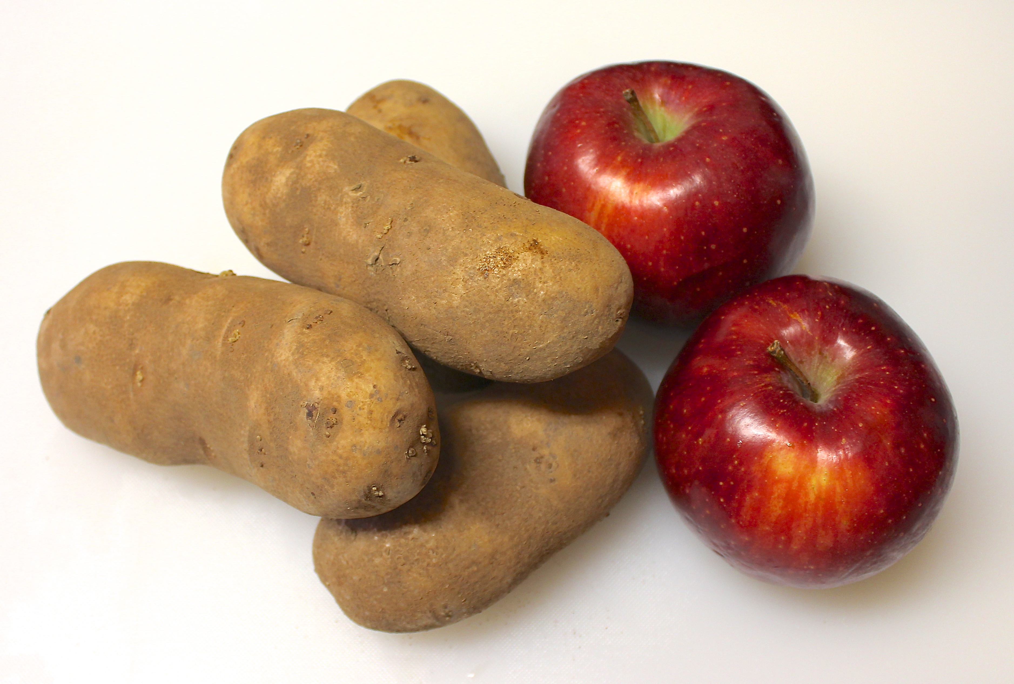
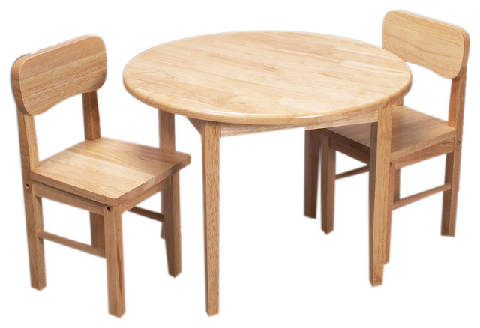
Nouns
Common nouns (naming words)
table
chair
cat
dog
book
pencil
apple
potato

Slide 9
Nouns
Proper nouns (names of people, places, events, days of the week, months of the year)
Simon
Jenny
Monday
Thursday
May
October
Easter
Christmas
Farnborough Primary School
St Martin of Tours Church

Slide 10
Nouns
Collective nouns (groups of things)
Herd of elephants
Pack of wolves
Flock of sheep
School of fish
Pod of dolphins
Parliament of owls
Colony of ants
Bunch of bananas
Fleet of cars
Murder of crows

Slide 11
Nouns
Abstract nouns (feelings or emotions) You can’t see, touch, hear or taste them.
Happiness
Fear
Sadness
Love
Joy
Hate
Anger
Fear
Excitement
Confidence
Enthusiasm

Slide 12
Year 5 sentence
Prior knowledge
Nouns – name or label
Pronouns – used in place of a noun
Relative pronouns – who, which, that, whom, whose
Clause – basis of a sentence
Year 5
Relative clause
The shoes that I bought are so comfy!
Our sofa, which is still extremely comfortable, looks rather old.
The boy, who was crying, had fallen over.

Slide 13
relative clauses
Relative clauses add more information to a sentence to make it more interesting.
The man, who was a marathon runner, completed the race.
The sofa, which was new and made of leather, was extremely comfortable.
Majorca, which is a small island, is part of Europe.
The wind, which was extremely powerful, battered the ships on the coastline.
“Don’t cry,” said the girl, who was being kind to her friend.
The house, which was on the corner, had a beautiful rose garden.
The teacher, who was very helpful, always told me to try my best.

Slide 14
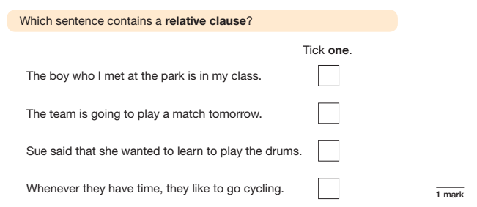
Gpas question 2017

Slide 15
Gpas question 2017

Slide 16
Gpas question 2016

Slide 17
Modal verbs
A modal verb is a special type of verb.
Modal verbs change or affect other verbs in a sentence. They are used to show the level of possibility, indicate ability, show obligation or give permission. Modal verbs behave differently to ‘ordinary’ verbs. They behave as auxiliary verbs and often work in a sentence with another verb.
The most common modal verbs are:
will
would
should
could
may
can
shall
ought to
must
might

Slide 18
Modal verbs
Possibility Modal verbs can be used when we want to show how likely something is to happen. For example:
It might rain tomorrow. "I shall go to the ball!" said Cinderella. We will have fish and chips for tea.
Ability Modal verbs can be used when we want to show a skill or someone's ability to do something. For example:
Jack can sing. We could walk.

Slide 19
Modal verbs
Obligation and advice Modal verbs can be used to state when something is necessary/compulsory, to give an instruction or to give advice. For example:
You must tidy your room. She ought to help with the shopping. James should cook the dinner tonight.
Permission Modal verbs are used to give or ask for permission for an activity. For example:
You may have another biscuit. You can get down from the table now. Could I go to the toilet, please?

Slide 20
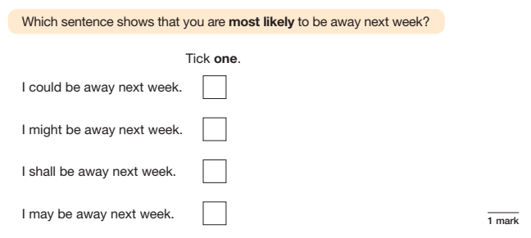
Gpas question 2017

Slide 21
Year 5 sentence
Prior knowledge
Adverbs – describe the verb, adjective, adverb or phrase to show how, where, when, how often
Verbs – engine of the sentence
Year 5
Adverbs to indicate degrees of possibility
certainly - definitely - maybe - possibly clearly - obviously - perhaps - probably
Modal verbs (auxiliary) – helper verbs that support main verb to indicate: level of possibility, level of ability, show obligation and give permission
can - could - may - might - must
shall - should - will - would

Slide 22
Adverbs
Adverbs to indicate degrees of possibility
certainly - definitely - maybe - possibly clearly - obviously - perhaps – probably
He probably won’t choose me.
Perhaps I will complete my homework tonight.
Maybe I can help my teacher hand out the books.
I definitely can’t open this jar.

Slide 23
Year 5 text
Prior knowledge
Paragraph
Year 5
Cohesion (making links) between one sentence and the next
When, then, after that, alternatively
Cohesion between one paragraph and the next
Using adverbials to show shifts in time, place, viewpoint or topic: later on, back at the house, on the other hand

Slide 24
ADVERBIALS
Adverbials of manner – How?
Cautiously, Anna tiptoed along the dark, abandoned corridor.
Reading the instructions carefully, Simon knew what to do next.
Adverbials of place – Where?
In the garden, the dog was chasing the ball.
The book was impossible to reach on top of the shelf.

Slide 25
ADVERBIALS
Adverbials of time – When? How often?
Every evening, I swim 3000 metres in training.
Looking through my window, I saw the sun rise early in the morning.
Adverbials of probability – How certain are we?
Perhaps we should go home as it is late.
He will certainly say yes to this offer.

Slide 26
FRONTED ADVERBIALS
Fronted adverbials are positioned at the beginning of the sentence to make it more interesting.
On the table stood a beautiful vase full of flowers.
Next to the window, the cat snoozed peacefully in the sunshine.
At the end of the lane, David waited for the tractor to pass before continuing to cycle.
Late at night, you could hear the foxes howl in the woodland.
Hesitantly, Evie opened the envelope.

Slide 27
Year 5 punctuation
Prior knowledge
Year 5
( ) Brackets , - dashes or , commas to show parenthesis
To show additional information
Brackets (which always come in pairs) are a form of punctuation.
The lost cat – which had now been missing for three days – looked small, tired and hungry.
The girl, who was extremely short for her age, was not allowed on the rollercoaster.
Rules: (a). or (A.)
To clarify meaning and/or avoid ambiguity
Let’s eat Grandma. vs Let’s eat, Grandma.
Rachel enjoys cooking her family and her dog. vs Rachel enjoys cooking, her family, and her dog

Slide 28
brackets
The information in brackets is not essential to the meaning of the original sentence. The original sentence should make sense on its own without the information in brackets.
Sam (my friend from school) helped me with my homework.
The dog chewed the toys. (His favourite toy is the squirrel).

Slide 29
brackets
Sometimes the information is inserted within the original sentence and is not a complete sentence itself.
Jenny (the girl that lives in the yellow house) invited you to her birthday party next week.
I am going to the park to play with Richard (who goes to school with me).

Slide 30
brackets
Sometimes the information in parentheses is a complete sentence that is separate from the original sentence.
The children won their baseball game. (It was exciting!)
I am going to the park to play with Richard. (Richard went to school with me.)

Slide 31
Gpas question 2017

Slide 32
Gpas question 2017

Slide 33
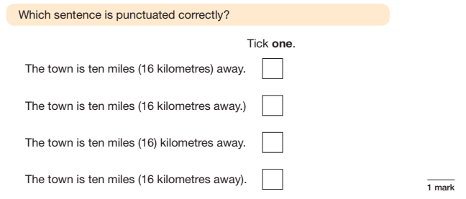
Gpas question 2017

Slide 34
Gpas question 2017

Slide 35
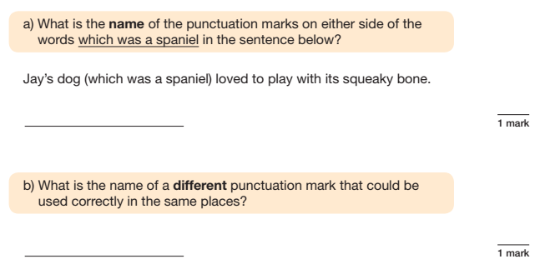
Gpas question 2016

Slide 36
Dashes
The double dash is used in the same way commas and brackets can be used (to contain extra information).
When we get there – if we get there - I’ll have something to say about his awful map.
When we get there (if we get there) I’ll have something to say about his awful map.
When we get there, if we get there, I’ll have something to say about his awful map.

Slide 37
Dashes
The single dash before a final comment or afterthought.
"Yes - I will do it," agreed Lucy.
I just have to make one phone call to the shop – then your surprise will be here.
She got home, put the kettle on and sat down - then she remembered.
I'd like to meet up with you for lunch – next Friday!

Slide 38
Dashes
A dash for suspense.
As the door creaked open, I peered inside and saw – a small flickering flame.
It was only when I squinted that I could see what lay at the bottom of the steps – bones. Lots of bones.

Slide 39
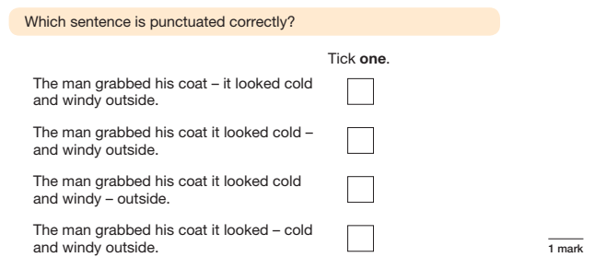
Gpas question 2017

Slide 40
Gpas question 2017

Slide 41
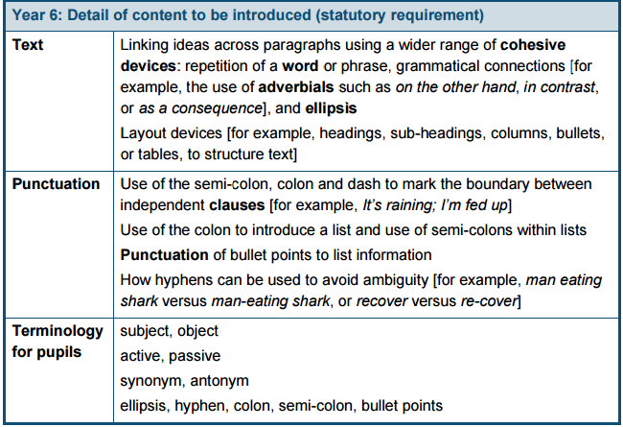
Curriculum – YEAR 6

Slide 42
YEAR 6 - WORD
Prior knowledge
Vocabulary
Year 6
Informal and formal vocabulary
Synonyms (same) and Antonyms (opposite )
Informal | Formal
Rich | Wealthy
Place | Location
Plant eaters | Herbivores
Died out | Extinct
Job | Occupation

Slide 43
WORD
Synonyms – Words that mean the same but are different
Fair: Just, Objective, Impartial, Unbiased
Funny: Humorous, Comical, Hilarious, Hysterical
Happy: Content, Joyful, Mirthful, Upbeat
Hardworking: Diligent, Determined, Industrious, Enterprising
Honest: Honourable, Fair, Sincere, Trustworthy
Intelligent: Smart, Bright, Brilliant, Sharp
Kind: Thoughtful, Considerate, Amiable, Gracious
Lazy: Idle, Lethargic
Mean: Unfriendly, Unpleasant, Bad-tempered, Difficult
Rich: Affluent, Wealthy, Well-off, Well-to-do
Strong: Stable, Secure, Solid, Tough
Unhappy: Sad, Depressed, Melancholy, Miserable
Lucky: Auspicious, Fortunate
Positive: Optimistic, Cheerful,

Slide 44
Gpas question 2017

Slide 45
WORD
Antonyms – Words that are the opposite meaning of a word
Achieve – Fail
Idle – Active
Afraid – Confident
Ancient – Modern
Arrive – Depart
Arrogant – Humble
Ascend – Descend
Attack – Defend
Blunt – Sharp
Brave – Cowardly
Cautious – Careless
Complex – Simple

Slide 46
Gpas question 2017

Slide 47
Year 6 - sentence
Year 6
Subjunctive form. The subjunctive is a verb form or mood used to express things that could or should happen. It is used to express wishes, hopes, commands, demands or suggestions.
Formal
Special mood of the verb
Wishes, conditions and non-factual expressions
Not common
Write using the starter of If I were ________________,
Finish sentence with I would ___________

Slide 48
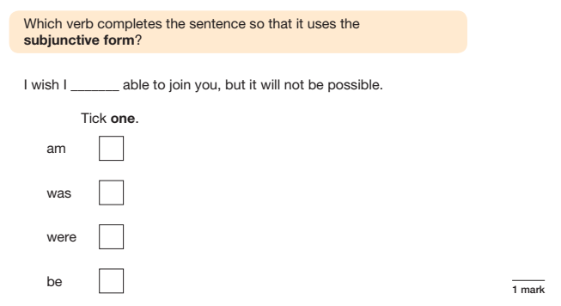
Gpas question 2016

Slide 49
Year 6 - sentence passive voice
Year 6
Active voice – subject performs the action
Sally opened the windows.
We heated the test tube.
The teacher marked all of the books.
Passive voice – subject has action done to it
The windows were opened by Sally.
The test tube was heated.
All the books were marked by the teacher.

Slide 50
Gpas question 2017

Slide 51
Gpas question 2016

Slide 52
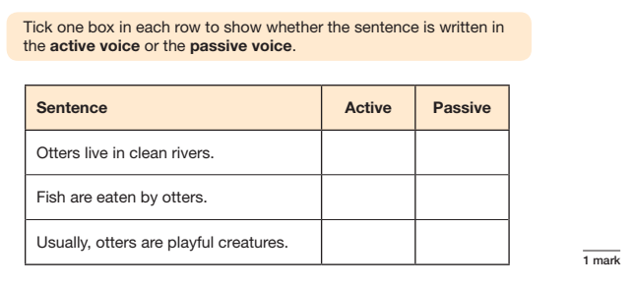
Gpas question 2016

Slide 53
YEAR 6 - TEXT
Cohesive devices
conjunctions
Words and phrases
can act like
signposts to help
readers see
significant links in
the text.
adverbials
These show links
between ideas
within a sentence,
e.g. when,
because, until,
although.
Words and phrases
that show links
between one
sentence and the
next, e.g.
However,
Consequently,
On the other hand,
In contrast…
repetition
Repeated words
or phrases
punctuation
Some punctuation marks
(: ; -) can show links
between clauses whilst
… shows something is missing.
pronouns
To avoid awkward repetition of nouns and noun phrases

Slide 54
Year 6 punctuation
: Colons – used to introduce closely related information where one clause introduces the next clause or phrase.
The weather was deteriorating rapidly: she would not go out today.
: Colons – to introduce a list
; Semi colon – separate off closely related items within a sentence
It was the best of days; it was the worst of days.
; Semi colon – within lists

Slide 55
COLOns
A colon is often used to introduce a list.
For example:
You will need to bring three things to the party: some food, something to drink and a small gift for the host.
When you go shopping, buy me: some bananas, eggs, a bottle of milk and some margarine.

Slide 56
colons
A colon can also be used to introduce an explanation, definition or quote:
I’ll tell you what I’m going to do: I’m going to train harder.
Elephant: a large grey mammal.
In Scene 5, Romeo states:
“Juliet I love you.”

Slide 57
colons
The colon can be used to isolate a point for emphasis:
There’s only one word I can use to describe that: fabulous.
There’s only one thing I had left: hope.
I only wanted one thing: understanding.

Slide 58
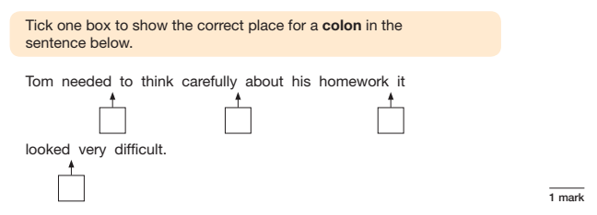
Gpas question 2017

Slide 59
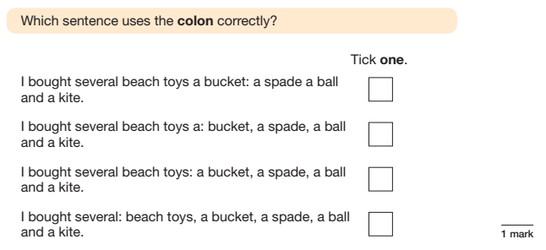
Gpas question 2016

Slide 60
Semi-colons
The semi-colon is often used to join together two connected clauses.
For example:
Mary drives a Mercedes; Jo drives a Volvo.
Mrs Saunders teaches French; Mr Atkinson teaches PE.
I like jam on toast; my brother prefers peanut butter on toast.
Adam’s birthday is in September; Matthew’s is in December.

Slide 61
Semi-colons
A semi-colon can sometimes be used to replace a full stop. It links two complete sentences and turns them into one.
Elephants live in hot countries; they cool off by bathing.
Teachers have lots of work; they are always marking books.
She was very tired; she had worked late into the night.
The invitations had all been sent out; two hundred guests were expected.

Slide 62
Semi-colons
The semi-colon is also used to separate items in a list, when the items are long phrases.
I have been to Newcastle, Carlisle, and York in the North; Bristol, Exeter, and Portsmouth in the South; and Cromer, Norwich, and Lincoln in the East.
When I went shopping, I bought bread, milk, butter, and cheese from the corner shop; lamb and beef from the market and onions from your uncle's stall.

Slide 63
GPAS question 2017

Slide 64
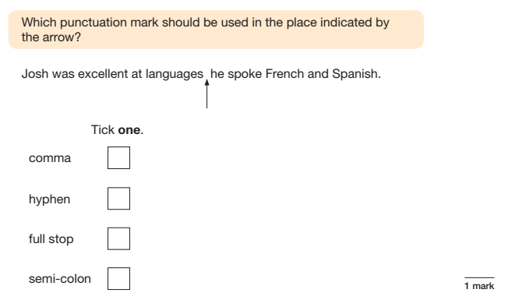
Gpas question 2017

Slide 65
Year 6 punctuation
Dashes – separate (longer than a hyphen)
And the winner is – Angela!
The lost cat – which had now been missing for three days – looked small, tired and hungry.
Hyphens – link
Brother-in-law
Recovering from an illness, re-covering a chair
Man eating shark, man-eating shark (to avoid ambiguity).
Bullet points - to list

Slide 66
USEFUL WEBSITES, GAMES AND ACTIVITIES
www.woodlands-junior.kent.sch.uk/interactive/literacy2.htm
www.bbc.co.uk/bitesize/ks2/english/spelling_grammar/
www.topmarks.co.uk
http://www.compare4kids.co.uk/literacy.php
http://www.crickweb.co.uk/ks2literacy.html
http://www.iboard.co.uk/iwb/Punctuate-Me-Super-Heroes-Complex-Speech-2485

Slide 67
USEFUL WEBSITES AND PAST PAPERS
http://www.satspapers.org.uk/
http://www.satstestsonline.co.uk/sto_past_papers.aspx
http://www.theschoolrun.com

Slide 68
Any questions?
To help:
Copy of the presentation on the website
Glossary on the website
Range of study guides e.g. CGP and Collins (age related)

