Slide 1
Phonics Recap

Slide 2
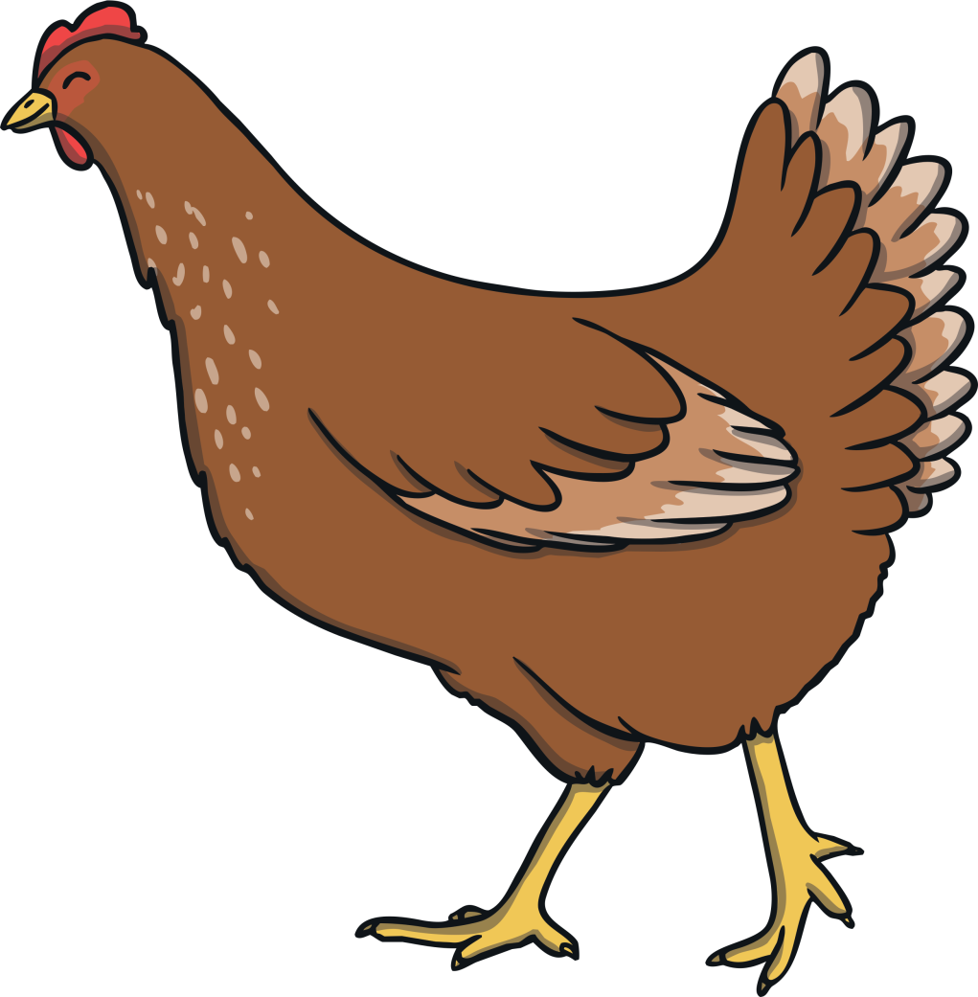
ch

Slide 3
sh

Slide 4
th

Slide 5
ng

Slide 6
ai

Slide 7
ee

Slide 8
igh

Slide 9
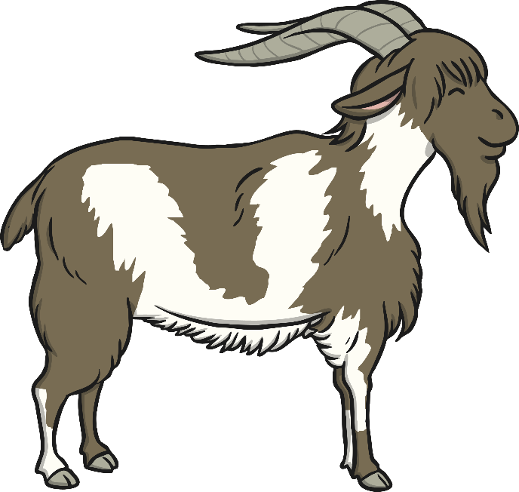
oa

Slide 10
oo

Slide 11
oo

Slide 12
ar

Slide 13
or

Slide 14
ur

Slide 15
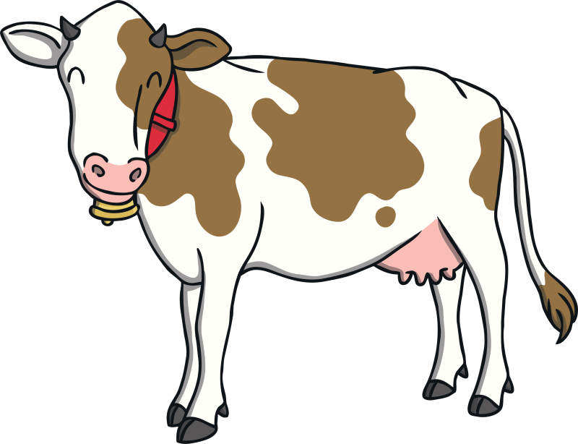
ow

Slide 16
oi

Slide 17
ear

Slide 18
er

Slide 19
air

Slide 20
the

Slide 21
to

Slide 22
I

Slide 23
no

Slide 24
go

Slide 25
into

Slide 26
he

Slide 27
she

Slide 28
we

Slide 29
me

Slide 30
be

Slide 31
was

Slide 32
you

Slide 33
they

Slide 34
all

Slide 35
are

Slide 36
my

Slide 37
her

Slide 39
roof
roof

Slide 40
hoof
hoof

Slide 41
zoom
zoom

Slide 42
pool
pool

Slide 43
food
food

Slide 44
tool
tool

Slide 45
zoo
zoo

Slide 46
boot
boot

Slide 47
moon
moon
?
Next

Slide 49
hood
hood

Slide 50
look
look

Slide 51
cook
cook

Slide 52
wood
wood

Slide 53
hook
hook

Slide 54
shook
shook

Slide 55
woof
woof

Slide 56
book
book
?
Next

Slide 57
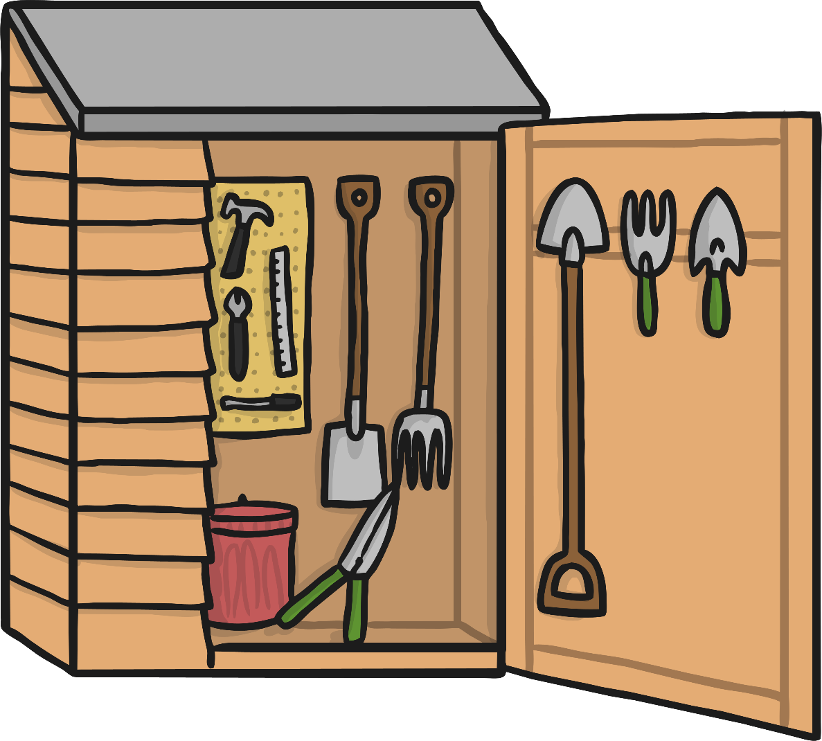
I can see tools in the shed

Slide 58
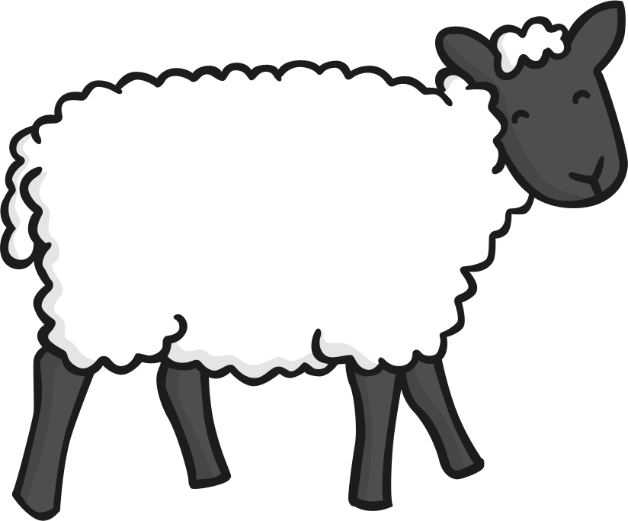

Slide 59
Well Done!

