Slide 1
Phonics Recap

Slide 2
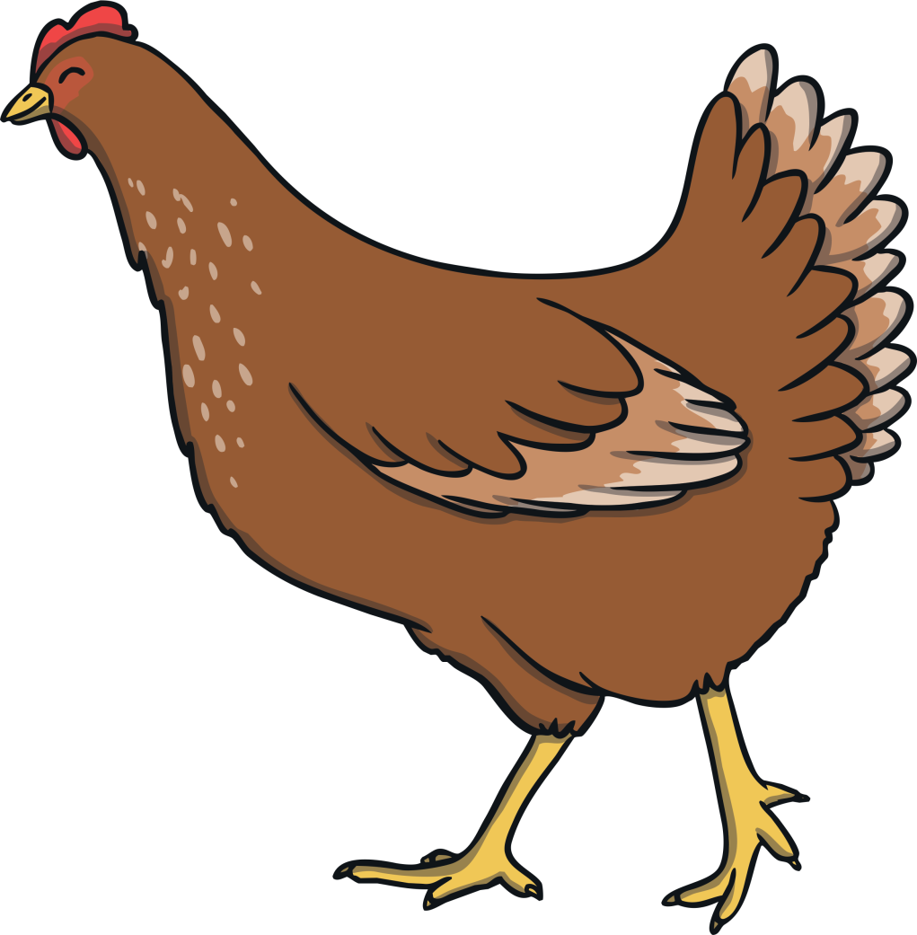
ch

Slide 3
sh

Slide 4
th

Slide 5
ng

Slide 6
ai

Slide 7
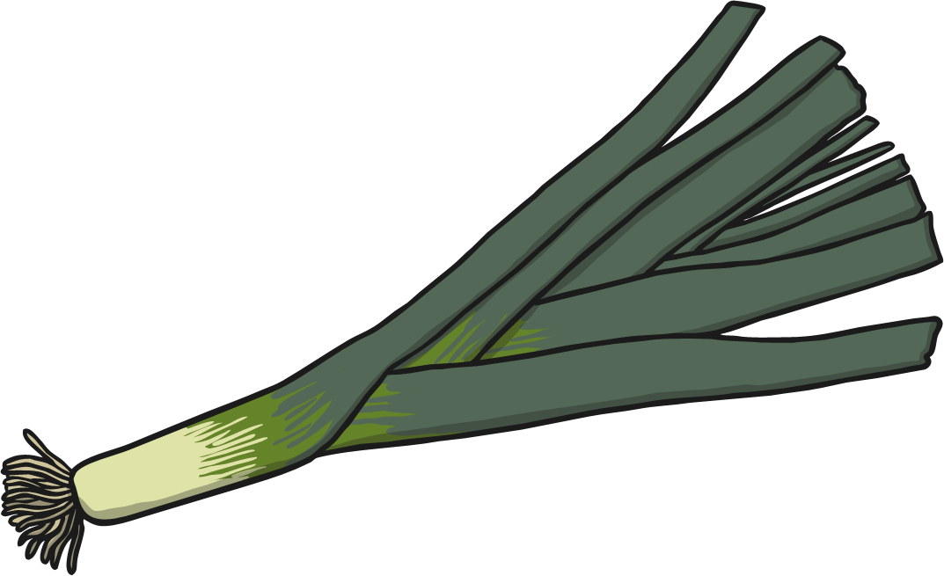
ee

Slide 8
igh

Slide 9
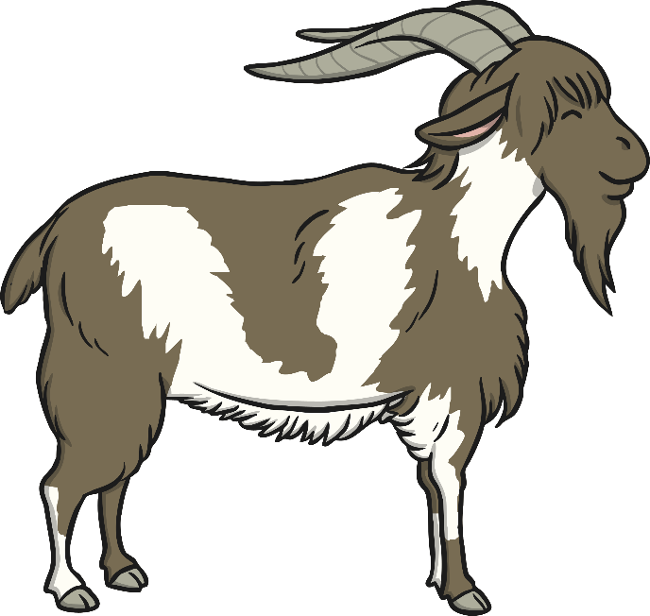
oa

Slide 10
oo

Slide 11
oo

Slide 12
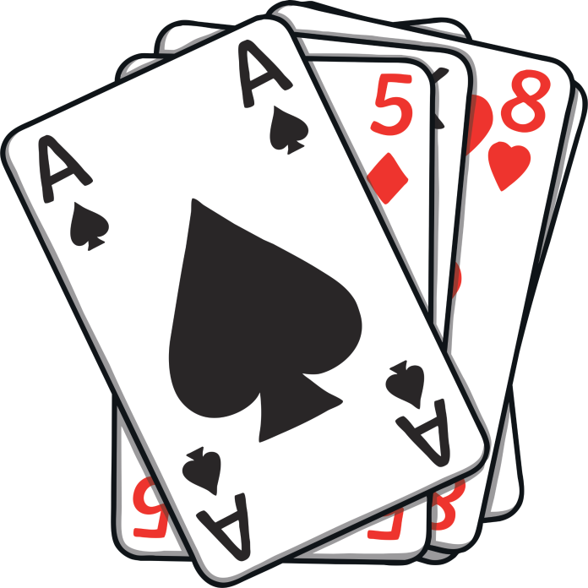
ar

Slide 13
or

Slide 14
ur

Slide 15
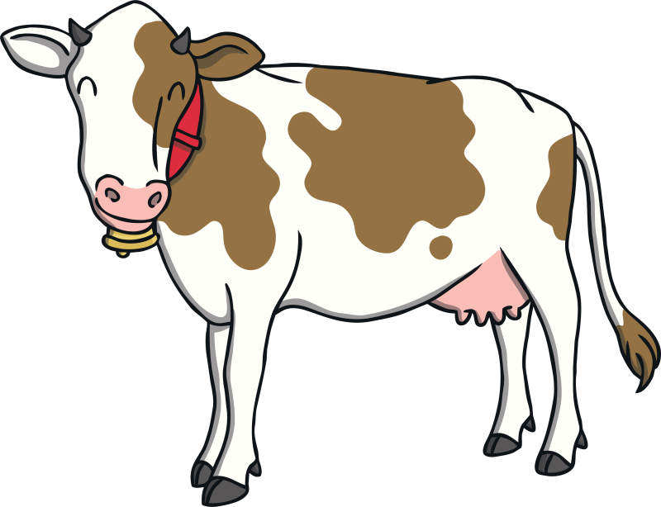
ow

Slide 16
oi

Slide 17
ear

Slide 18
er

Slide 19
air

Slide 20
the

Slide 21
to

Slide 22
I

Slide 23
no

Slide 24
go

Slide 25
into

Slide 26
he

Slide 27
she

Slide 28
we

Slide 29
me

Slide 30
be

Slide 31
was

Slide 32
you

Slide 33
they

Slide 34
all

Slide 35
are

Slide 36
my

Slide 37
her

Slide 39
aim
aim

Slide 40
pain
pain

Slide 41
sail
sail

Slide 42
wait
wait

Slide 43
rain
rain

Slide 44
nail
nail

Slide 45
waiting
waiting

Slide 46
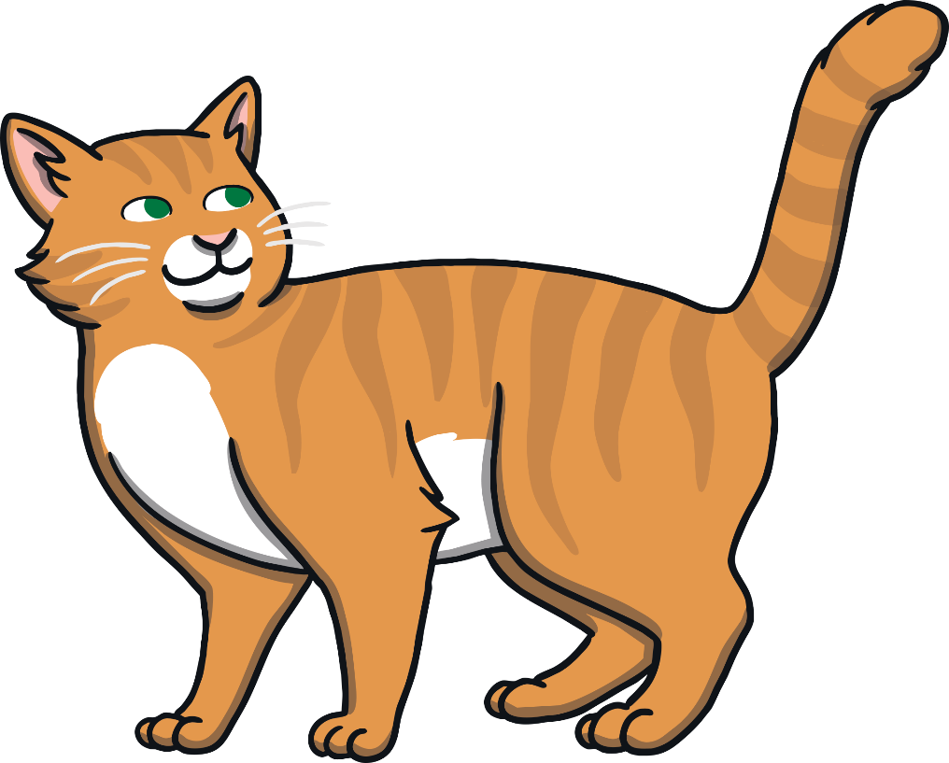
tail
tail
?

Slide 48
see
see

Slide 49
feel
feel

Slide 50
queen
queen

Slide 51
week
week

Slide 52
seed
seed

Slide 53
teeth
teeth

Slide 54
free
free

Slide 55
feet
feet

Slide 56
weep
weep

Slide 57
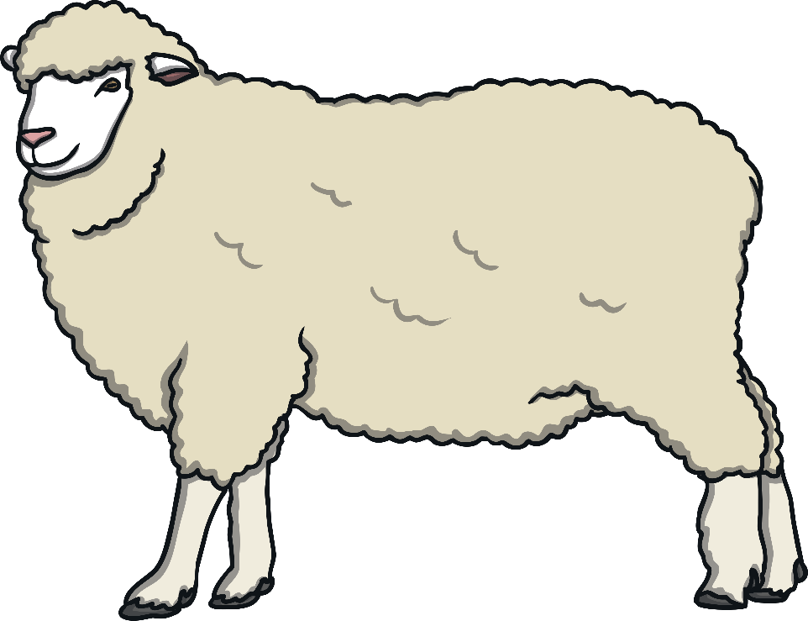
sheep
sheep
?
Next

Slide 58
I can see sixteen trees.

Slide 59
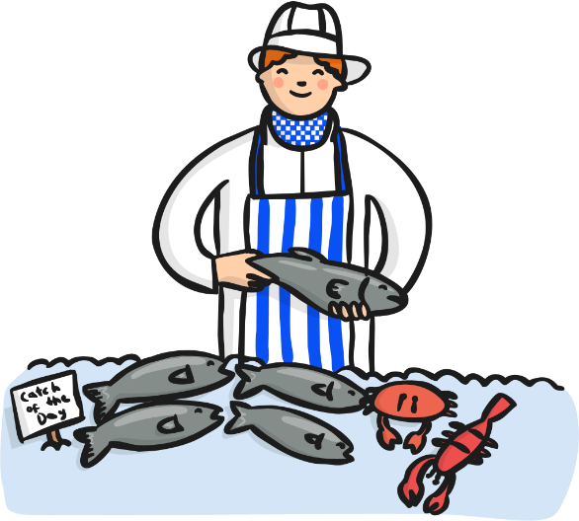
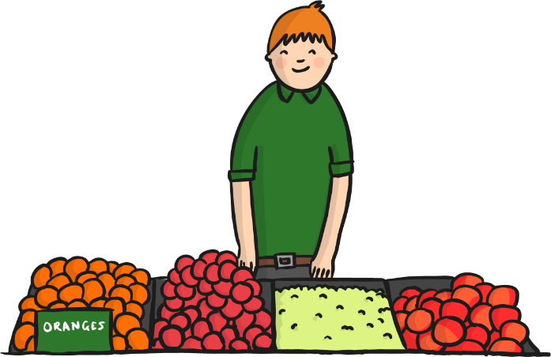
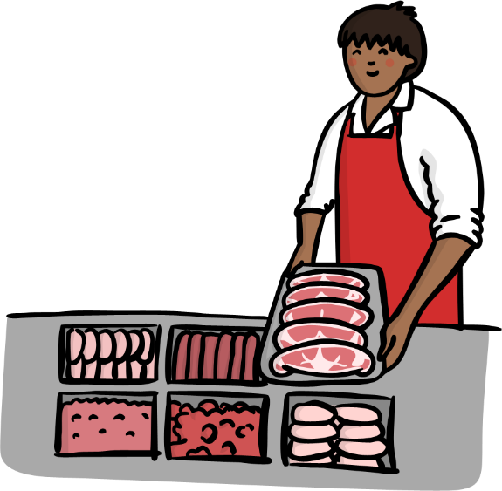

Slide 60
no

Slide 61
Well Done!

