Slide 1
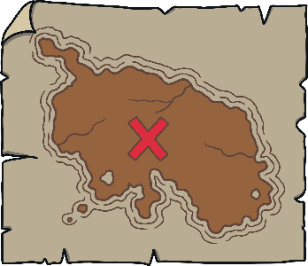
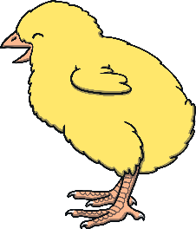
Revisit and Review
Let’s practise Sam’s Sounds and Tricky Words!
w
v
j
y
qu
zz
z
ch
x
me
be
she
we
he

Slide 2
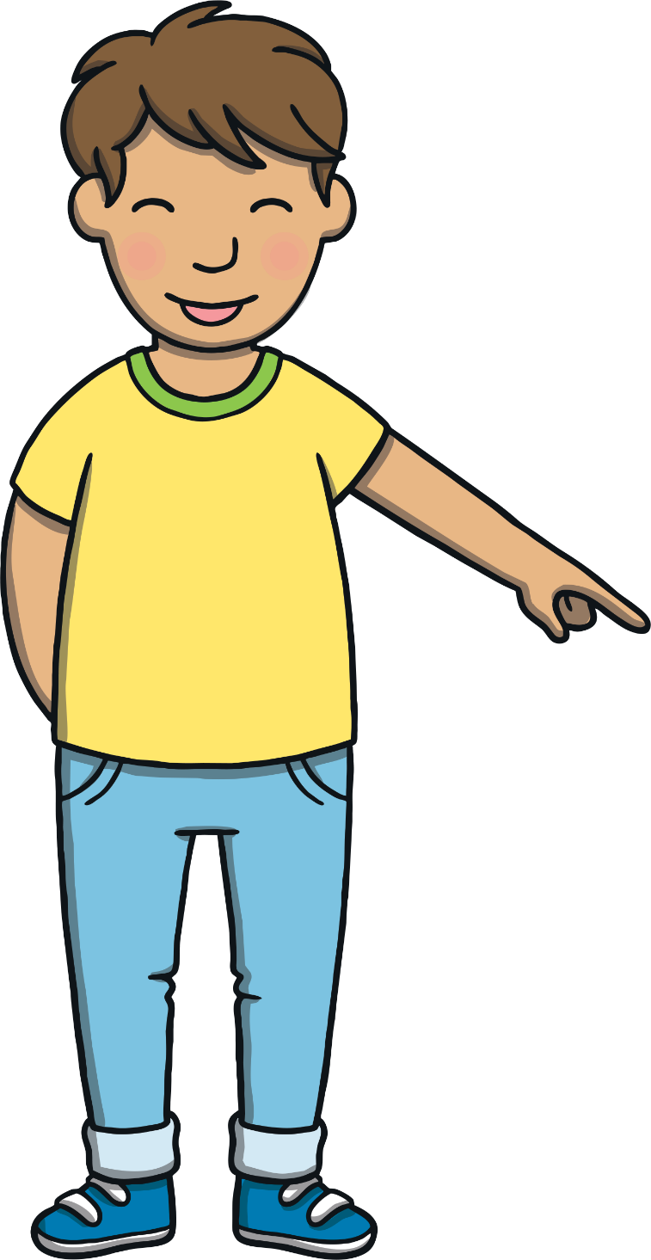
Today, we are learning…
thng

Slide 3
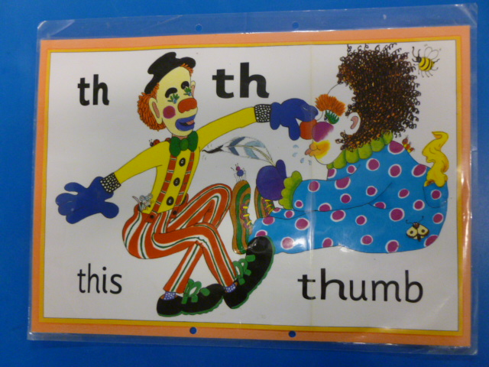
Jolly Phonics Song and action
Website link for all the songs – a-z order
https://vimeo.com/106231366
Action

Slide 4
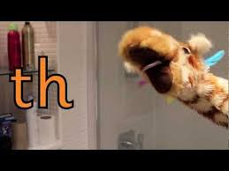
Let’s watch Geraldine the Giraffe tell us all about the sound th
Copy and paste the link below
https://www.youtube.com/watch?v=6U354eD-hgQ&list=PLbLK9vA5SHxMngmNql2aUhhXRDlUD97za&index=2&t=0s

Slide 5
Can you think of anything that begins with the sound th?

Slide 6
Torchlight Words
Practise
Kit and Sam have found some words on the tents in the campsite with their torches. Can you help to read them?

Slide 7
Practise
b
a
th
Check

Slide 8
Practise
th
i
n
Check

Slide 9
Practise
th
i
ck
Check

Slide 10
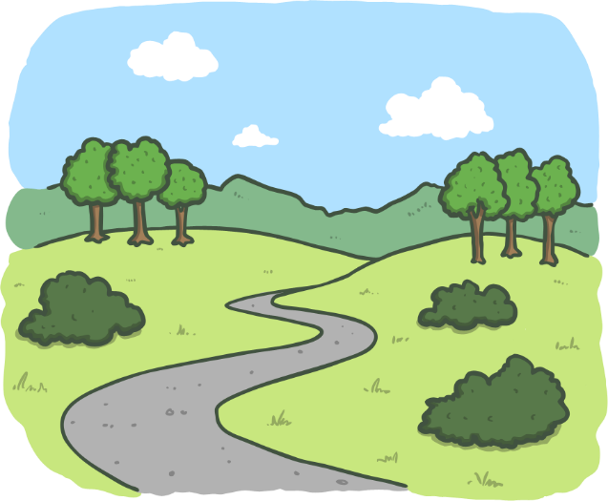
Practise
p
a
th
Check

Slide 11
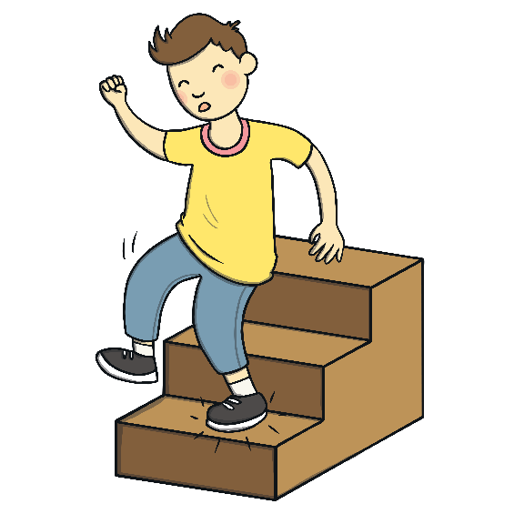
Practise
th
u
d
Check

Slide 12
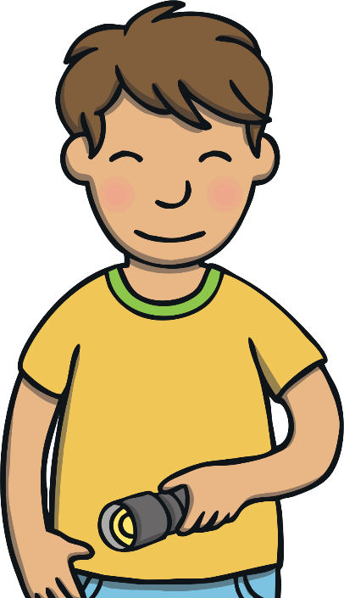
Sentence Time
Apply
What happened when Kit and Mum followed the path? Read the sentence to find out!
X
Click ‘Sound Buttons On/Off’ to select whether you want to show sound buttons under the caption.
Click me for Kit’s teaching tips!

Slide 13
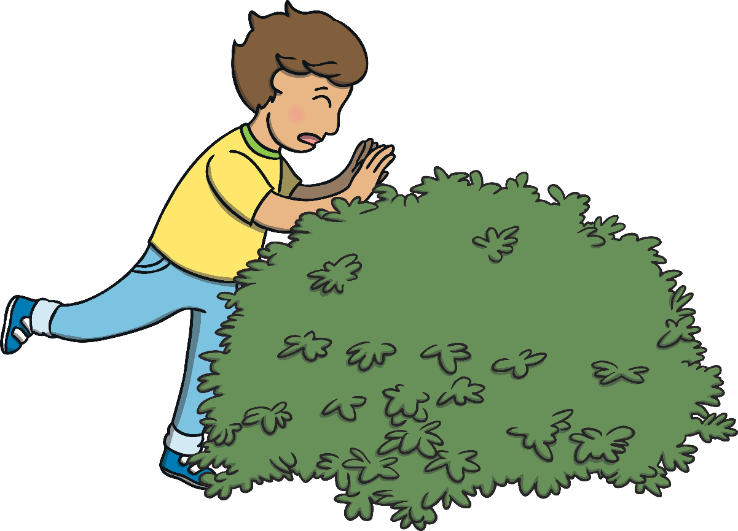
Apply
Kit fell in a thick bush.
Sound Buttons On/Off
Show

Slide 14
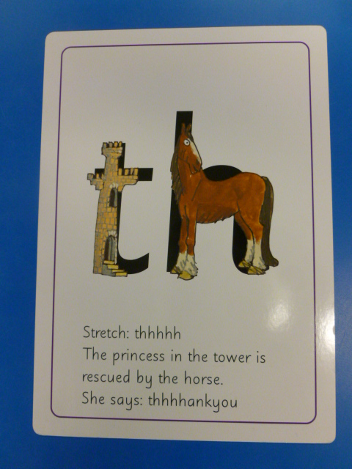
Can you try to write the sound a?

Slide 15
Today, we have learnt…
th

