Slide 1
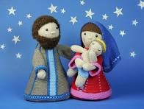
Welcome to Reception w/c 30th November
We have now completed teaching all of the 26 letters and sounds in the alphabet. This week will be spent consolidating this knowledge and assessing what the children now know on an individual basis. This information will be used to inform our phonics teaching going forward. We will also be reviewing reading and writing as well as maths.
We continue to learn the Tricky Words – these are words that can’t be sounded out. A list of these, in the order they are taught, is available on the website.
In Maths the focus will continue to be learning about one more.
We are also practising our Reception Christmas Nativity – please encourage your child to practise their words at home with you by saying them confidently in a loud voice. Thank you for all the costumes, the children are going to look amazing.
Books will be sent home again this week to share with your child – either a picture book or a reading book ( if your child is already on Bug Club books on-line ), together with a library book .
These should be returned to school on Friday.
Homework / Reading comments should be e-mailed by Monday please.
Many thanks,
Mrs Holmes

