Slide 1
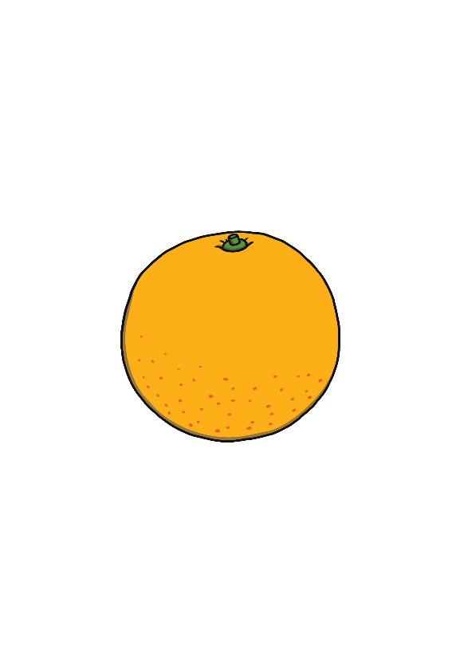
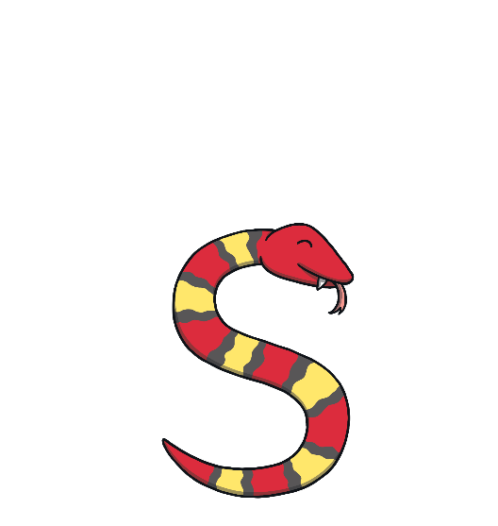
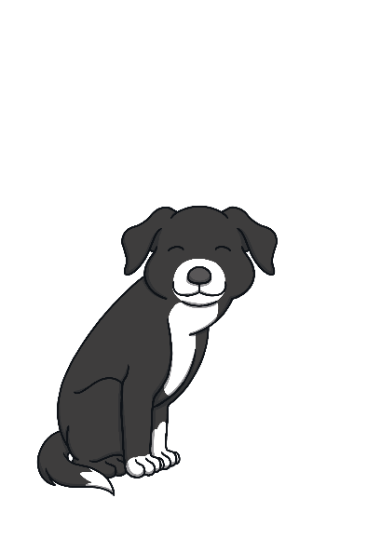
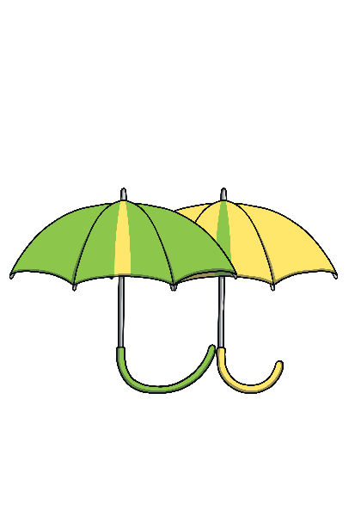
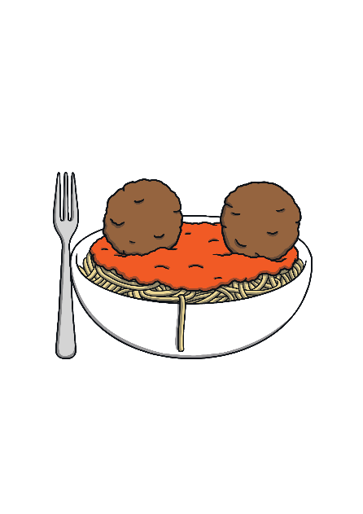
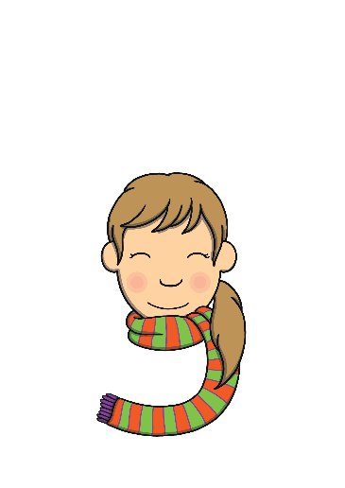
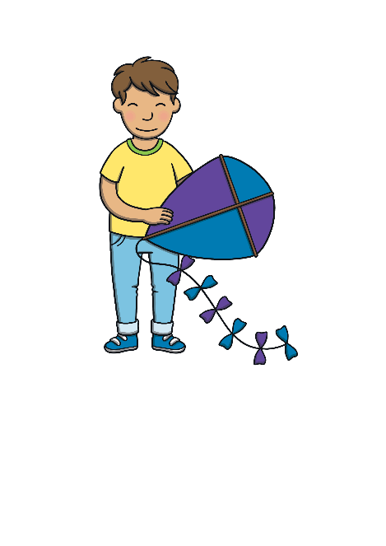
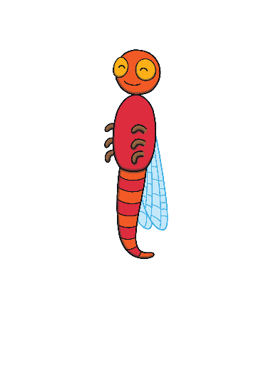
Revisit and Review
Let’s practise Sam’s Sounds and Tricky Words!
g
p
c
u
a
o
s
e
t
n
m
r
i
k
d
h
go
no
to
the
I

Slide 2
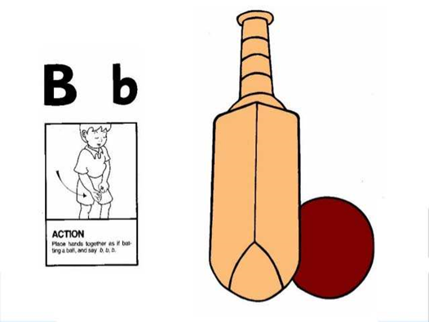
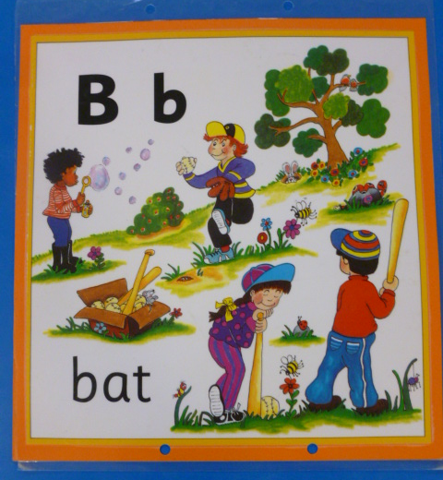
Jolly Phonics Song and action
Website link for all the songs – a-z order
https://vimeo.com/106231366
Action

Slide 3
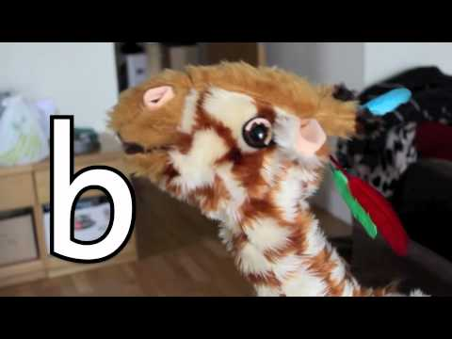
Let’s watch Geraldine the Giraffe tell us all about the sound b
Copy and paste the link below
https://www.youtube.com/watch?v=HIKQVqtMZco

Slide 4
Can you think of anything that begins with the sound b?

Slide 5
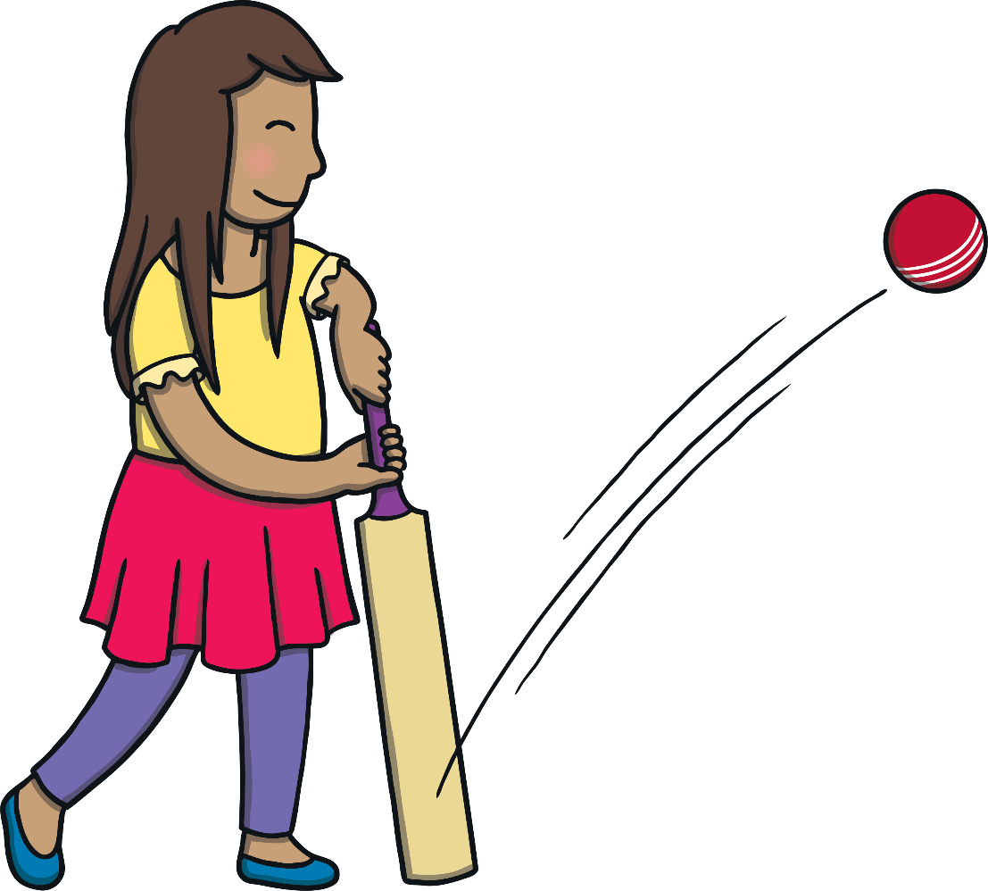
Window Smash!
Practise
Oh no, Sam’s ball has smashed the kitchen window! What word is hidden behind the broken panes?

Slide 6
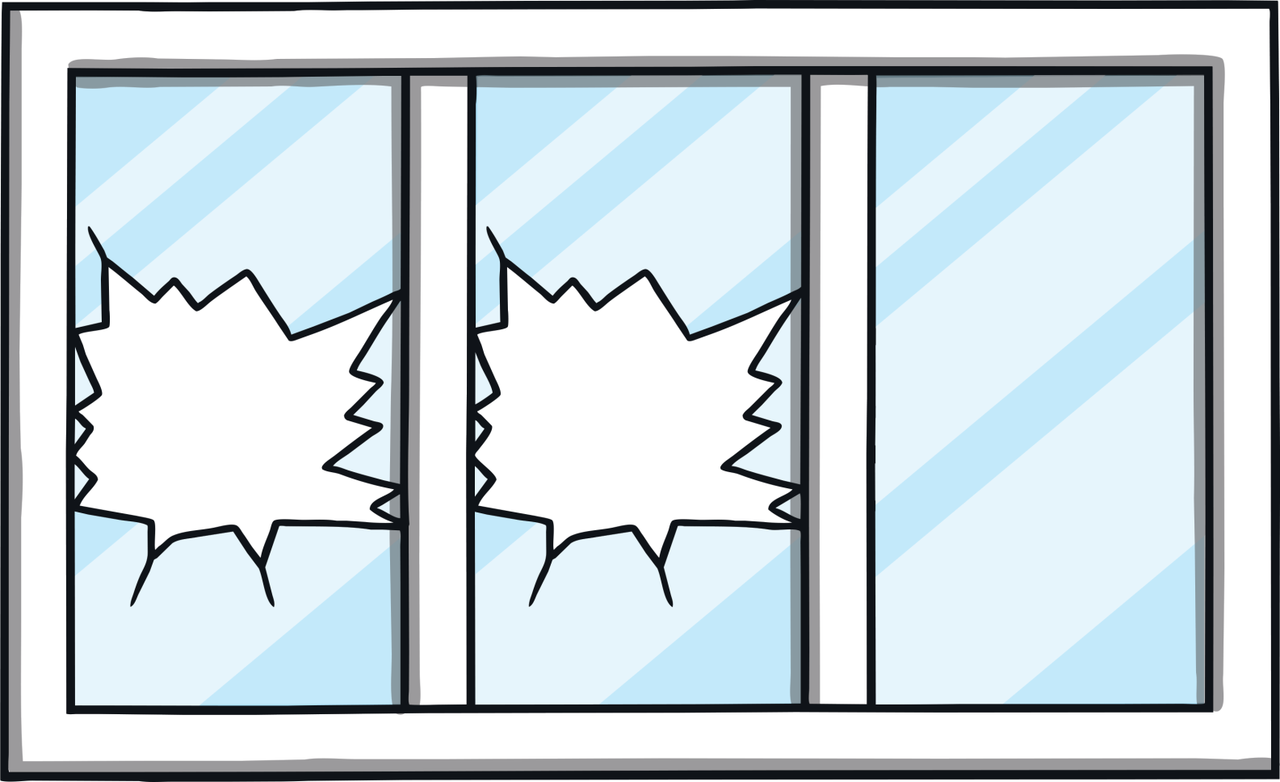
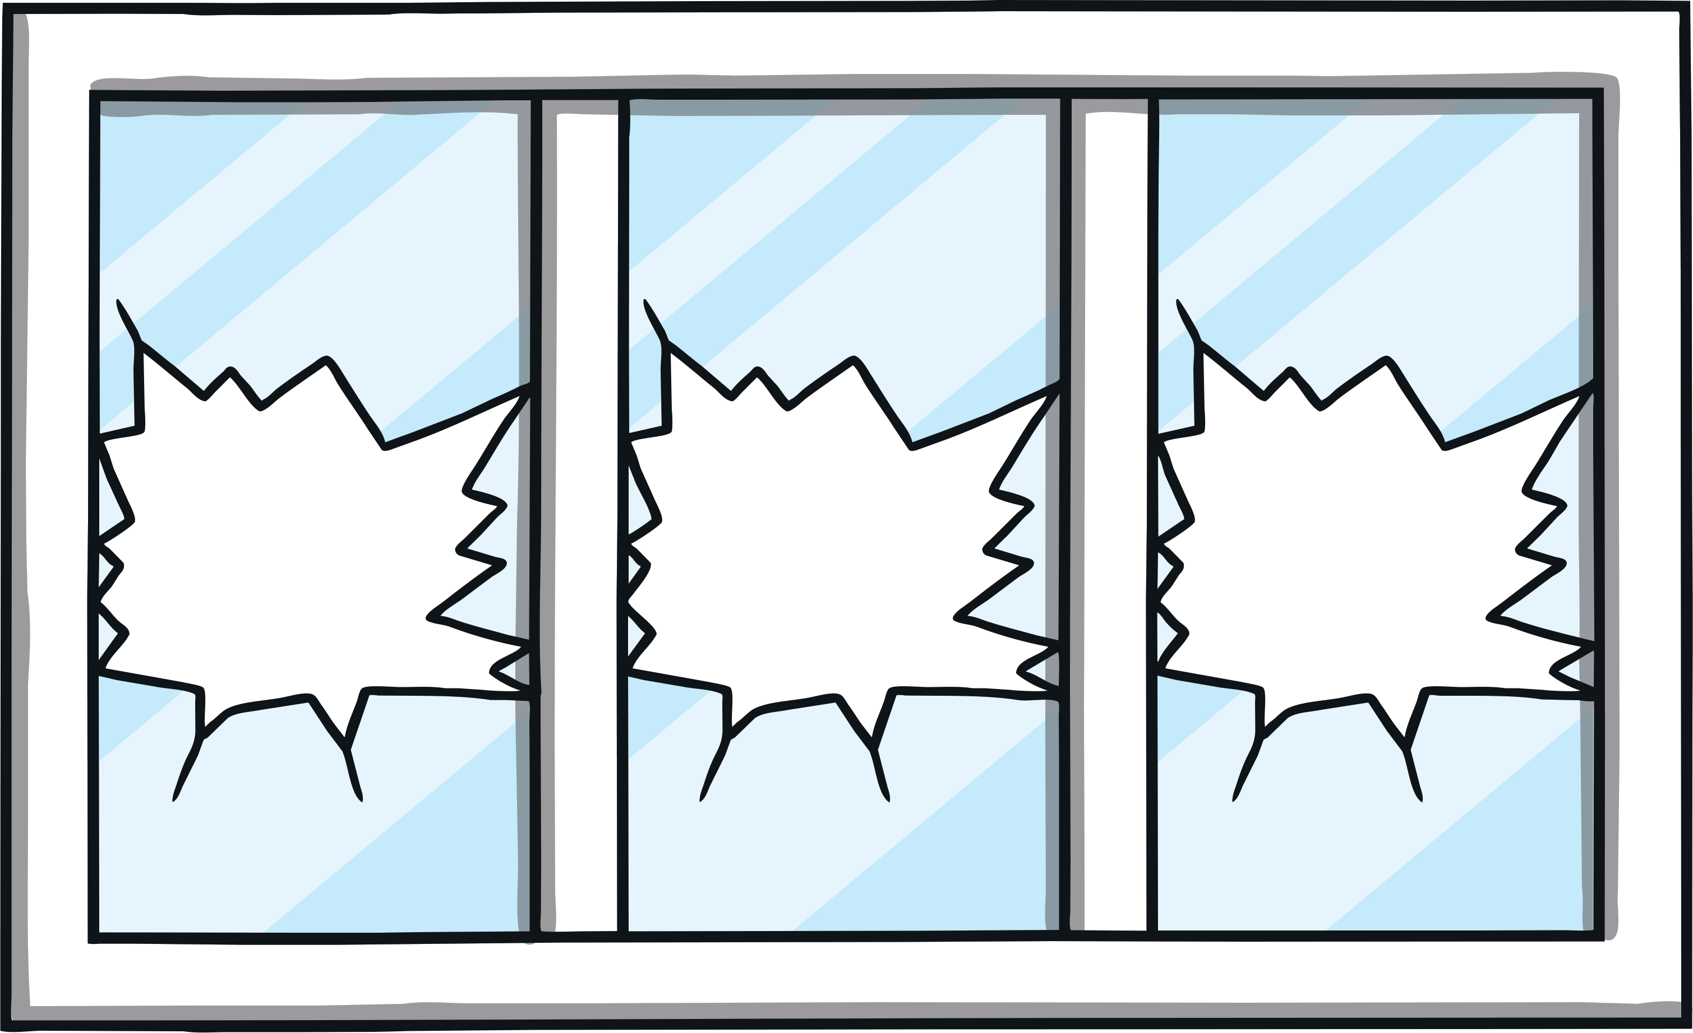
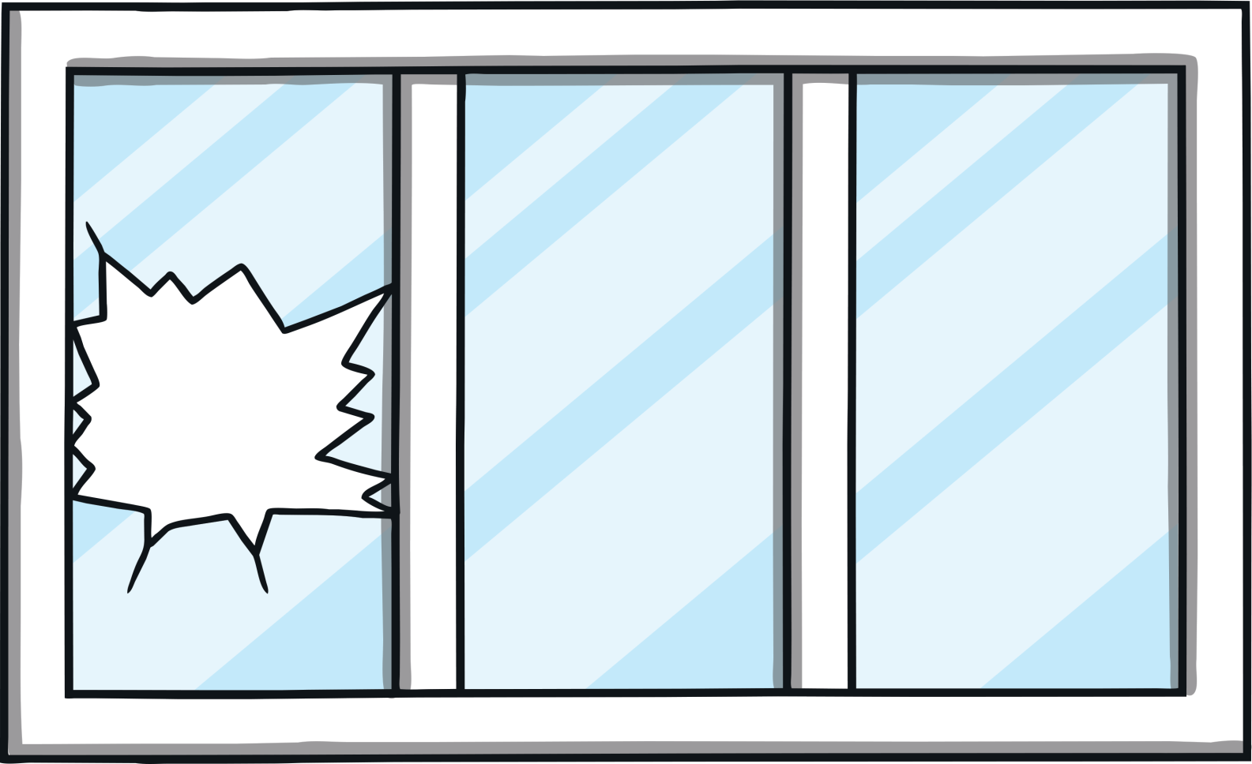
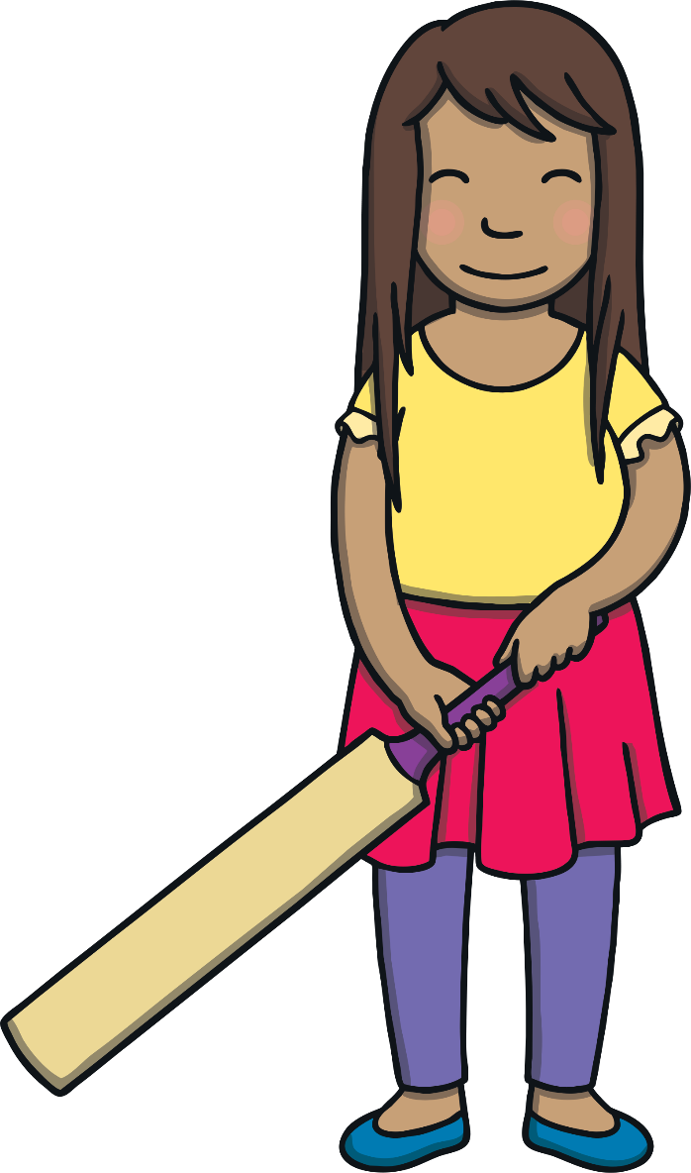
Practise
b
a
t

Slide 7
Practise

Slide 8
Practise
b
e
d

Slide 9
Practise

Slide 10
Practise
b
u
g

Slide 11
Practise

Slide 12
Practise
b
u
n

Slide 13
Practise

Slide 14
Practise
b
u
s

Slide 15
Practise

Slide 16
Practise
b
a
g

Slide 17
Practise

Slide 18
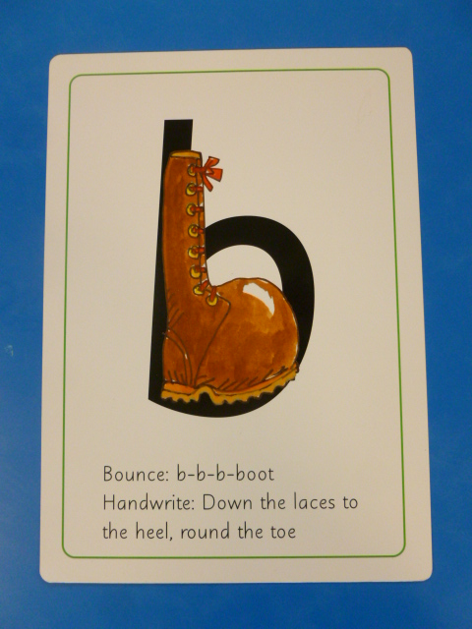
Can you try to write the sound b?

Slide 19
Today, we have learnt…
b

