Slide 1
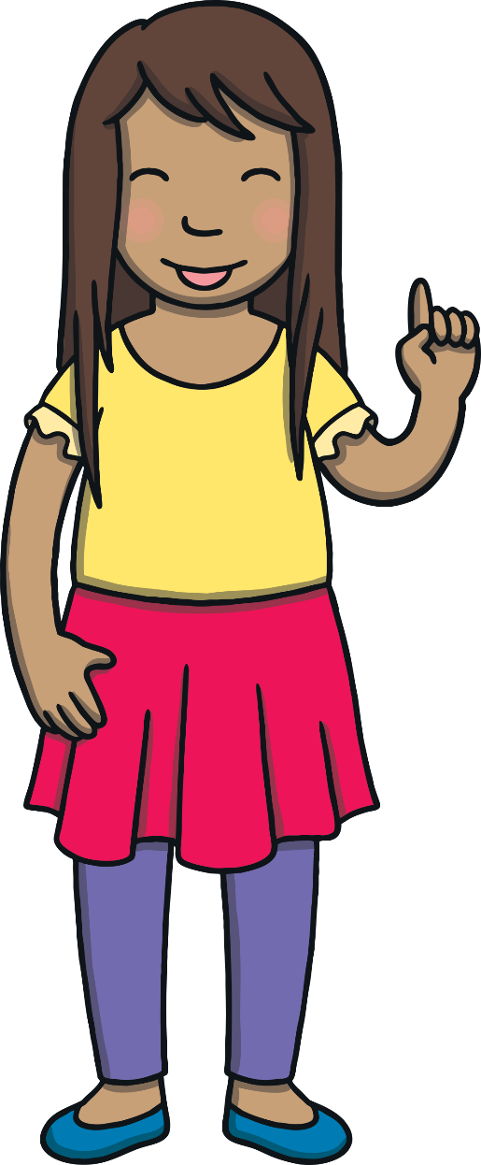
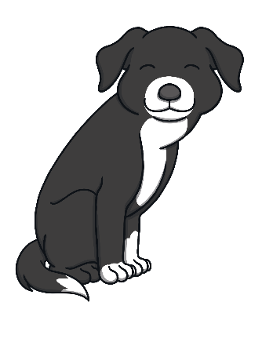
Revisit and Review
Let’s practise Sam’s Sounds!
s
a
p
n
t
i

Slide 2
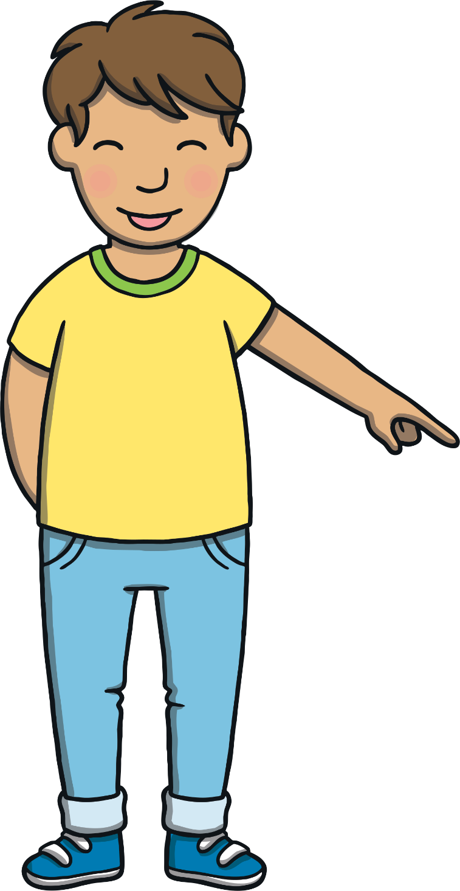
Today, we are learning…
m

Slide 3
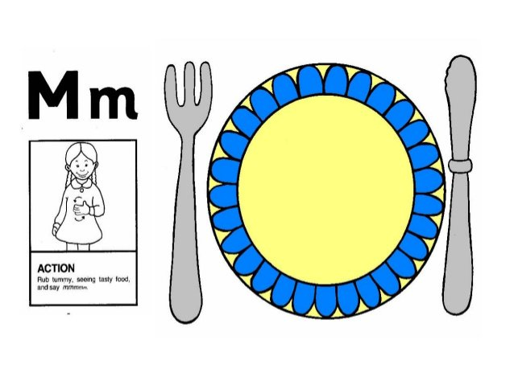
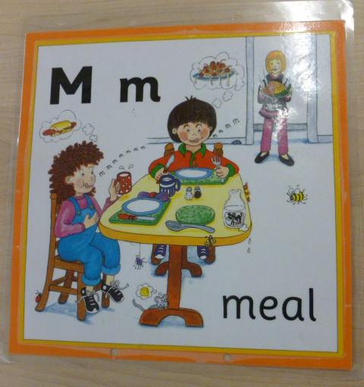
Jolly Phonics Song and action
Website link for all the songs – a-z order
https://vimeo.com/106231366
Action

Slide 4
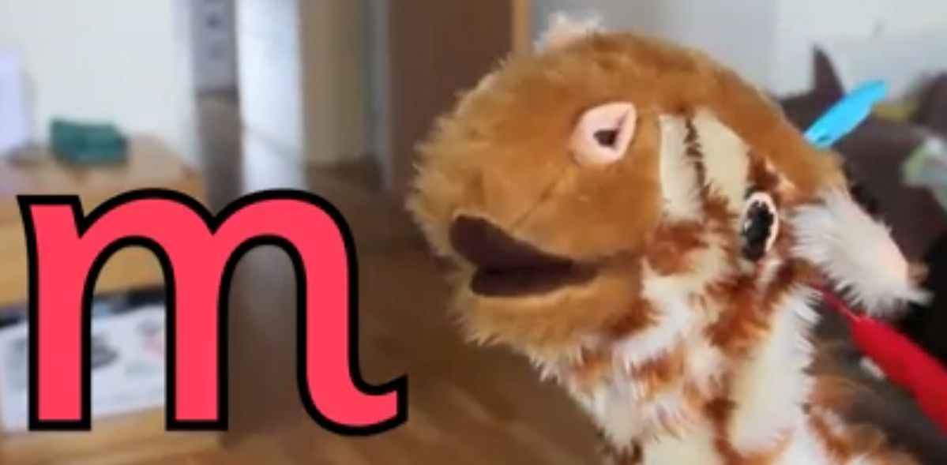
Let’s watch Geraldine the Giraffe tell us all about the sound m
Copy and paste the link below
https://www.youtube.com/watch?v=Xh6Ux5D2D84

Slide 5
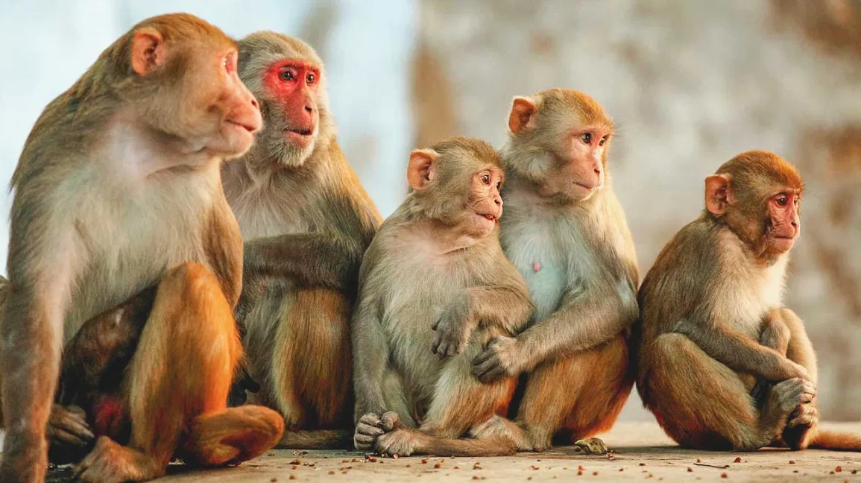
Can you think of anything that begins with the sound m?

Slide 6
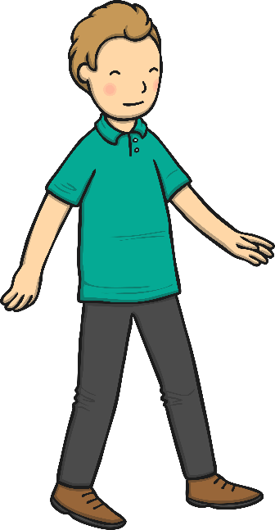
m
a
n

Slide 7
m
u
g

Slide 8
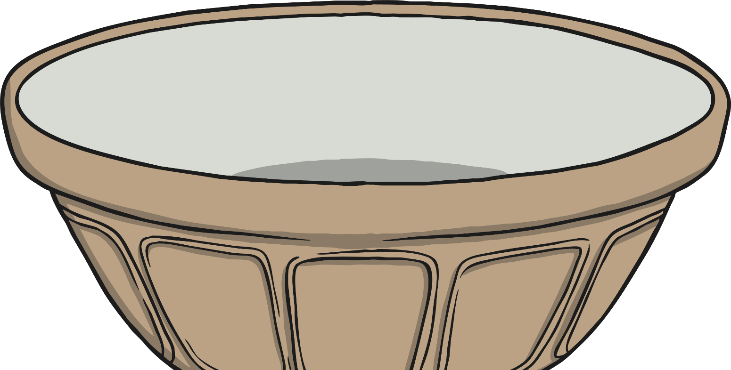
Recipe Picture Match
Apply
Click on Miss Wells to hear her read out the recipe. What needs to go into the bowl? Click the correct picture to drop the ingredient into the bowl.
X
Oral segmenting will make phonetic approximations to the correct spelling of the word.
Click me for Kit’s teaching tips!

Slide 9
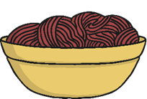
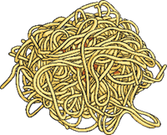
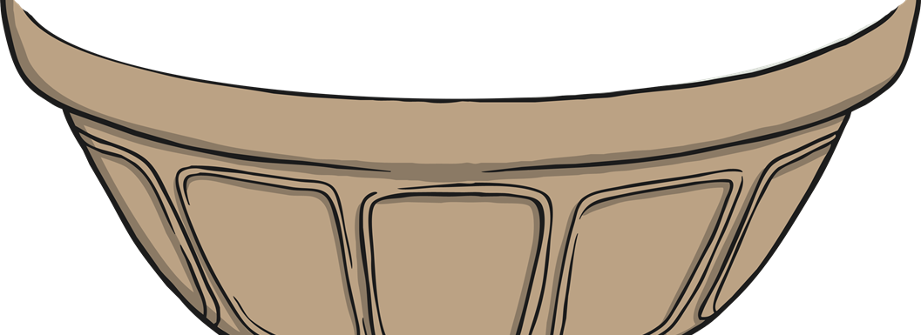
Apply

Slide 10
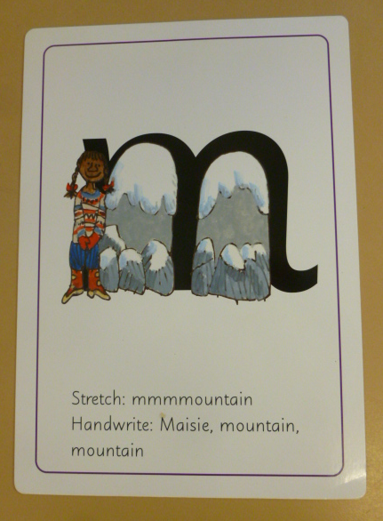
Can you try to write the sound m?

Slide 11
Today, we have learnt…
m

