Slide 1
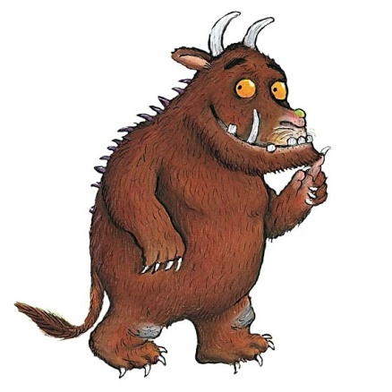
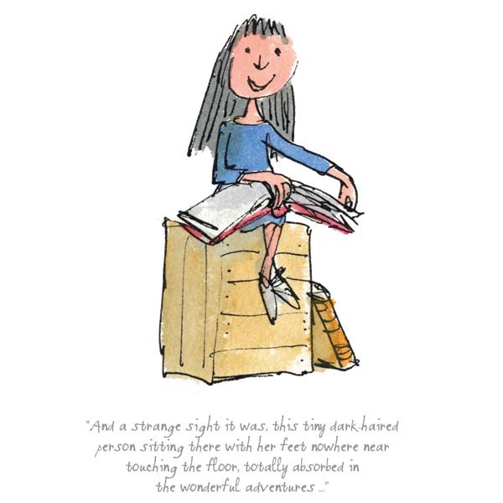

Slide 2
Welcome to Year 2:
Unicorns Class
Mrs Matthews
Mrs Gohil
Mrs Hirst

Slide 3
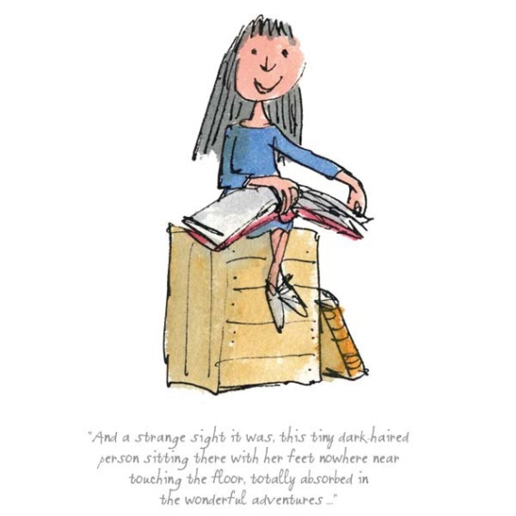
Uniform Standards
Children should wear smart school uniform or their P.E. kits on P.E. days.
We have P.E. on a Monday and a Thursday, so children should come to school in their P.E. kit on these days.
We try to encourage children to take responsibility for their belongings and it is much easier when everything is named.
Long hair must be tied up and any bows/hairbands etc should be in school colours

Slide 4
Year 2 Homework
Homework is designed to support and consolidate the learning in class with a focus on basic skills. Tasks may sometimes be repetitive or timed and this is to increase pace and embed learning.
We will be setting homework online , this will start from next week and more details about this will be sent out separately.
We will continue to use the homework grid system that the children are used to for their Topic Homework.
Bug Club will also continue.
20 minutes for a task, reasonably independently.

Slide 5
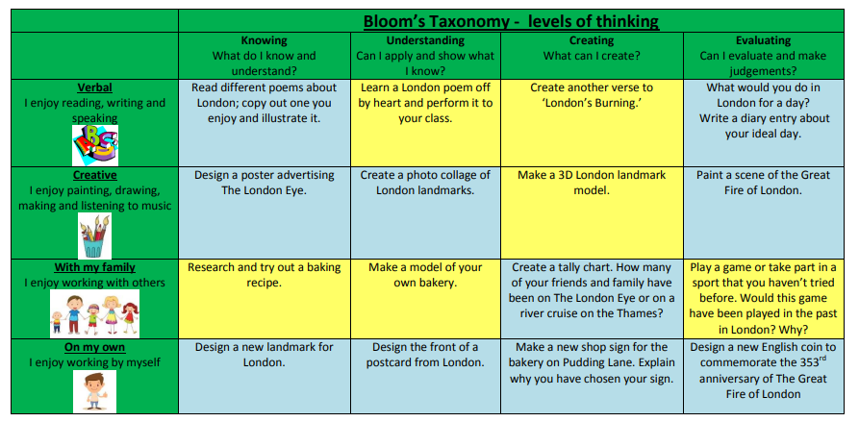
Year 2 Homework

Slide 6
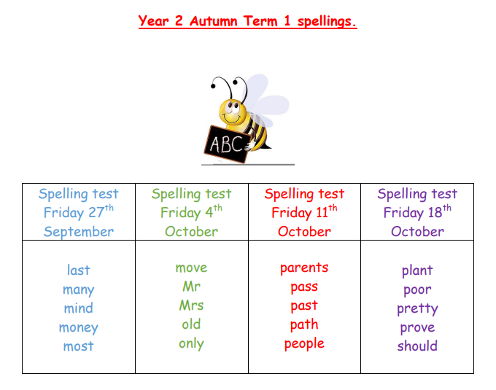
Spelling Test lists will be posted on Monday ready for our test on a Friday.
.

Slide 7
The Curriculum for the Year
Autumn Term: Lively London
We look at London today and famous landmarks. We look at London today before then moving onto focusing on September 1666, and The Great Fire of London.
Spring Term: Oh, The Places We’ll Go!
The children will learn about different countries as they travel around the world and discover many wonderful and exciting places. In particular the islands of Madagascar and Greenland. As they visit the various countries, they will link the countries with their continents.
Summer Term: Food, Glorious Food!
The children will learn about the importance of clear instructions, and will research different recipes from around the world as well as cooking and tasting a variety of dishes.

Slide 8
Houses and House Points
The Houses and House Point system is continued from last year
Each child is slotted into a house and they remain in the same house during their life at Farnborough.
The houses are named after famous Olympians, they are called Farah, Simmonds, Redgrave and Ennis-Hill.
The children are awarded house points by the teachers
for their behaviour, attitude to learning and school as
well as their work. We celebrate their achievements
every week in our Friday assembly.

Slide 9
Thank you!
I am looking forward to a fantastic year with your children!
Thank you for listening.

