Slide 1
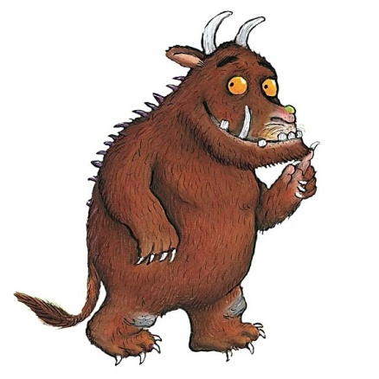

Slide 2
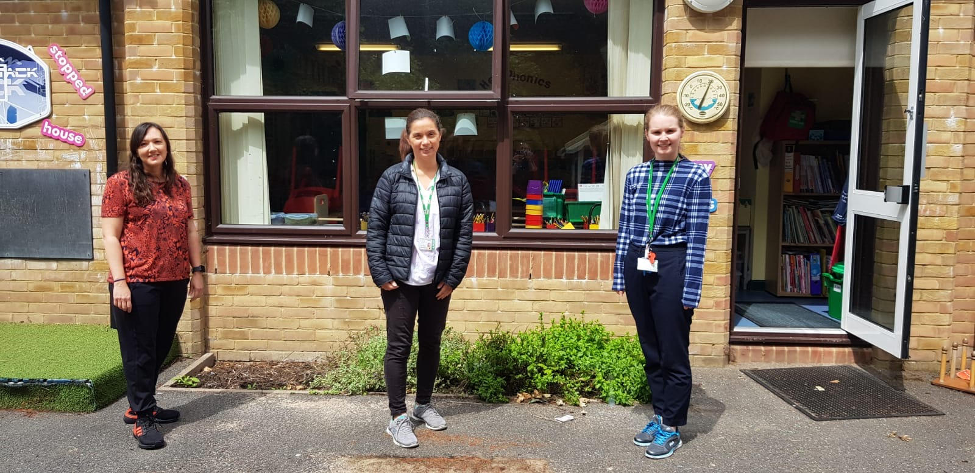
The Year 1 Team
Mrs Murray– Class Teacher
Mrs Welensky - TA
Miss Mcdonnell - TA

Slide 3
Timings of the day
Year One begin their school day
at 8:40am.
The children are collected at the school
gate.

Slide 4
Timings of the day
Year 1 finish school at 3.00pm. Children
will be taken to the school gate by their
teachers.
Please wait for your child outside the school gates.
Mrs Murray will call out your child’s name when she sees you.
Your child is not to leave the class line before his/her name is called out.

Slide 5
Uniform Standards
ALL items of clothing must be clearly named, coats, jumpers, cardigans, hats and gloves included.
Red P.E. kit, green P.E. kit, plimsolls, spare socks!
Please ensure children's hair is tied back, please only small bows in school colours.
Name, name, name everything!
Water bottles will be sent home daily to be cleaned and refilled.

Slide 6
The Curriculum Overview for the Year
English, Maths, Geography, History, Art, D.T, P.E, ICT, R.E, Science, Music and PSHE.
Topics we will cover this year
Our superheroes
Here we are
Adventures in space

Slide 7
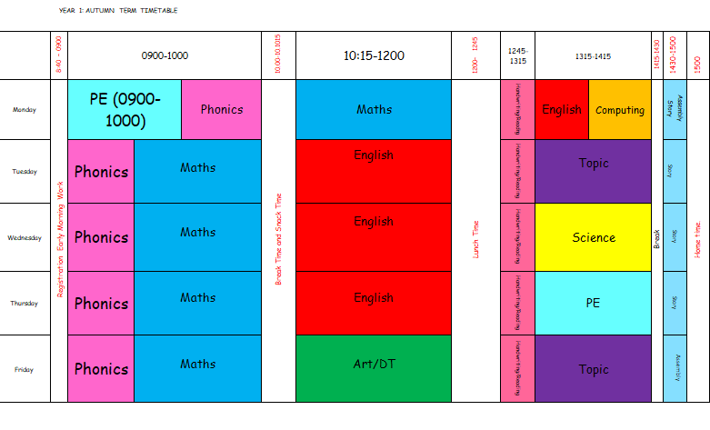
The Autumn Weekly Timetable

Slide 8
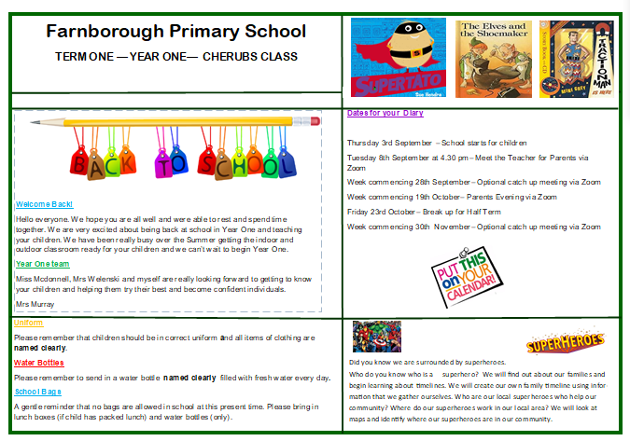
The Curriculum Overview for Autumn

Slide 9
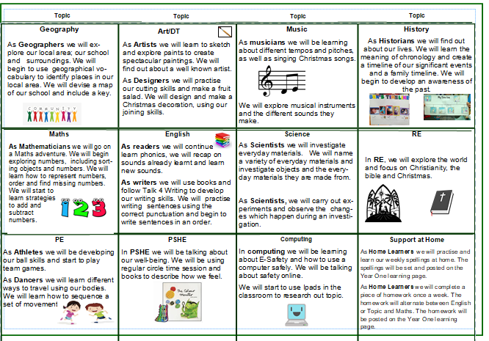
The Curriculum Overview for Autumn

Slide 10
Books We Will Use in Year 1

Slide 11
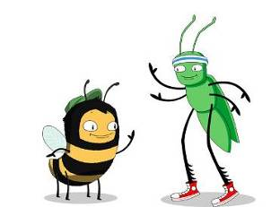
The Curriculum Overview for the Term in more detail
Our school reading programme that joins books with eBooks

Slide 12
The Curriculum Overview for the Term in more detail
An example of a child’s homepage
Your child will see eBooks on their homepage .
The bug club pass word will change to Year1

Slide 13
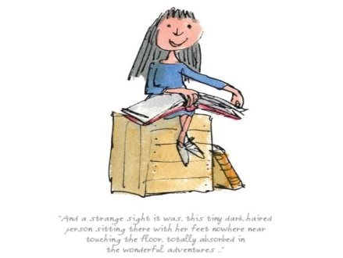
Weekly Homework – English/Topic
Homework activities are intended to be as open ended as possible, allowing the children to reflect on their learning in class in a creative way and for the children to make their own decisions on how to collect, record and present their home learning.
We know that all pupils have different learning styles - some are visual learners, others work well with words and writing, many learn best from practical hands on activities e.g. through making things, art or music.
We know that children’s learning is maximised when they engage in activities using their individual learning styles.

Slide 14
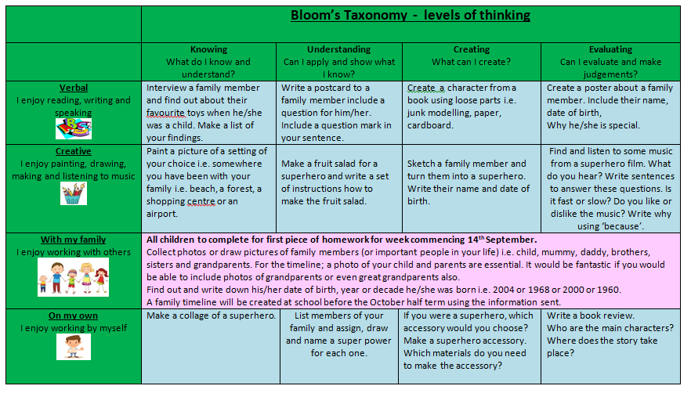
Homework Grid

Slide 15
Weekly Homework – Maths and Phonics
Homework is designed to support and consolidate the learning in class with a focus on basic skills. Some tasks may be repetitive, this is to develop pace and fluency.
Presentation of homework should mirror the expectations of presentation for class work

Slide 16
Weekly Homework
One piece of English/Topic or Maths homework is to be
completed and sent via email to
yearonelearning@farnborough.sch.uk by Monday each week.
English/Topic or Maths homework will
alternate each week.
Phonics homework to be completed once a week.
Spellings will be set each week.
Spellings and homework will appear on the Year One learning
page.

Slide 17
Year 1 Phonics Screening
What is the Phonics Screening Check?
Children in Year 1 throughout the country will all be taking part in a phonics screening check during the same week in June.
The phonics screening check is designed to confirm whether individual children have learnt sufficient phonic decoding and blending skills to an appropriate standard.
What Happens During the Test?
The test contains 40 words. Each child will sit one to one and read each word aloud to a teacher.
The list of words the children read is a combination of 20 real words and 20 pseudo words (nonsense words).

Slide 18
Year 1 Phonics Screening
Nonsense words and why they are used
The nonsense words will be shown to your child with a picture of an alien. Nonsense words are included because they will be new to all pupils; they do not favour children with a good vocabulary knowledge or visual memory of words.

Slide 19
How can I help my child at home?
How Can I Help My Child At Home?
Read as much as possible to and with your child.
Encourage and praise
If your child is struggling to decode a word, help them by encouraging them to say each sound in the word from left to right.
Blend the sounds by pointing to each letter, e.g. /c/ in cat, or the letter group, e.g. /ng in sing. Next move your finger under the whole word as you say it.
Discuss the meaning of words if your child does not
know what they have read.

Slide 20
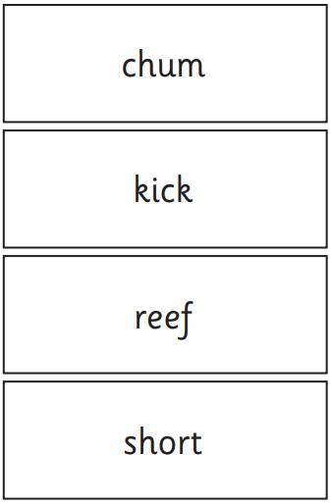
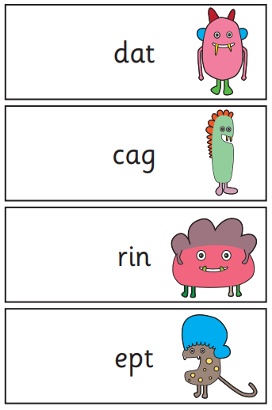
Examples of words in the Year 1 Phonics Screening

Slide 21
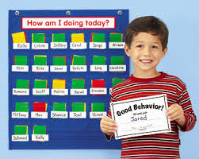
School Behaviour Policy

Slide 22
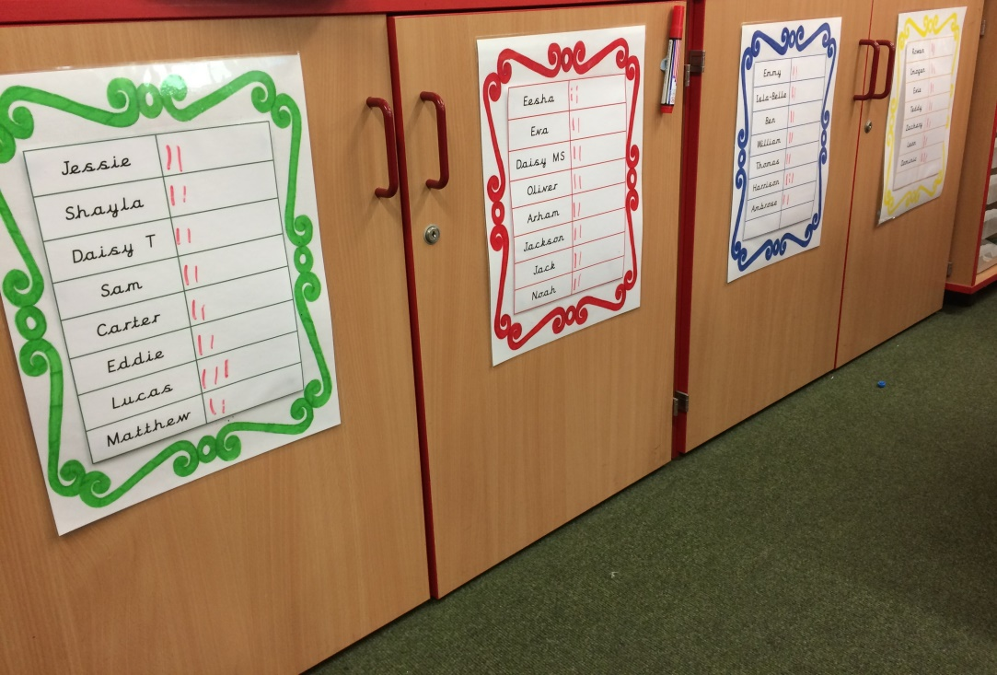
Houses and House Points
Throughout the school children are rewarded for their good behaviour and hard work through house points.

