Slide 1


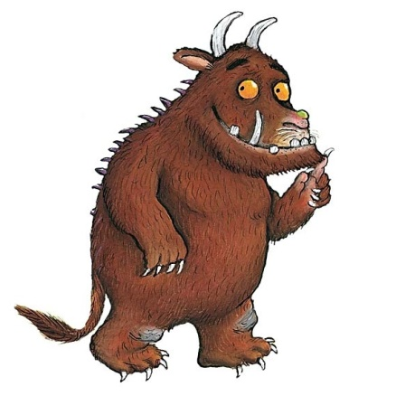
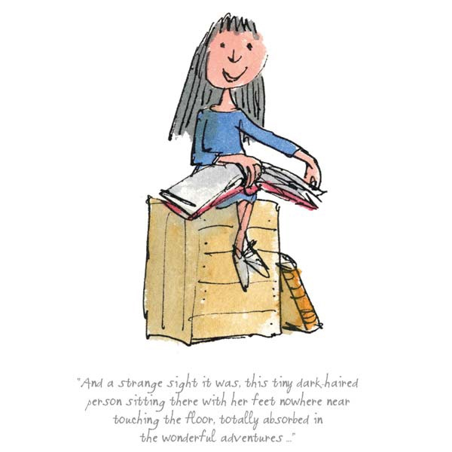

Slide 2
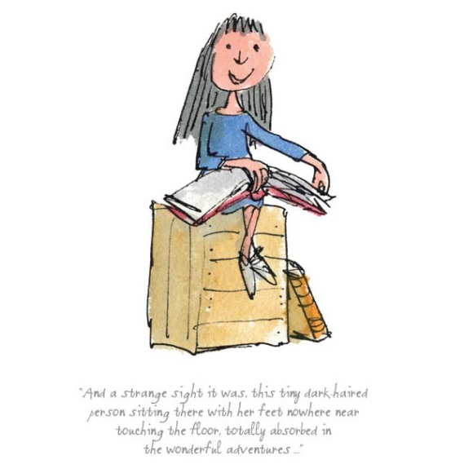
The Year 5 Team
The Year 5 team includes:
Miss Morrison
Mrs Cheeseman
Mrs Brett

Slide 3

Timings of the day
Gates open at 8.55
Register at 9.05
Lunch is at 12.45 until 13.30
School ends at 15.15

Slide 4
Uniform Standards
Please ensure children come to school in:
Correct school uniform including appropriate shoes. P.E kit to be worn to school on the day your child’s class does P.E.
For health and safety reasons children with pierced ears may wear studs, which will need to be taken out or taped up for PE.
Watches may be worn, but no other jewellery. However if jewellery is worn for religious reasons then a written note to Miss James is needed.

Slide 5


The Curriculum for this term
Children will be learning about the Victorian era through the topic of Bah Humbug.
In English our fiction work will be based around a number of different texts which will include Cogheart by Peter Bunzl and film clips which will engage the children’s imaginations.
Our non fiction work will link to our topic, it will be research based, with them finding out about every aspect of that time period through questions that
they have generated.

Slide 6

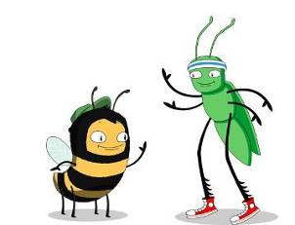
Our school online reading programme.

Slide 7
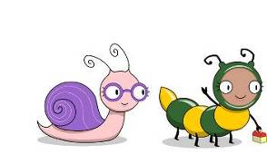
What is Bug Club?
A reading programme that the whole school will be using to help teach reading.
Reception and KS1 have been using this scheme for two years and it has been very well received.

Slide 8
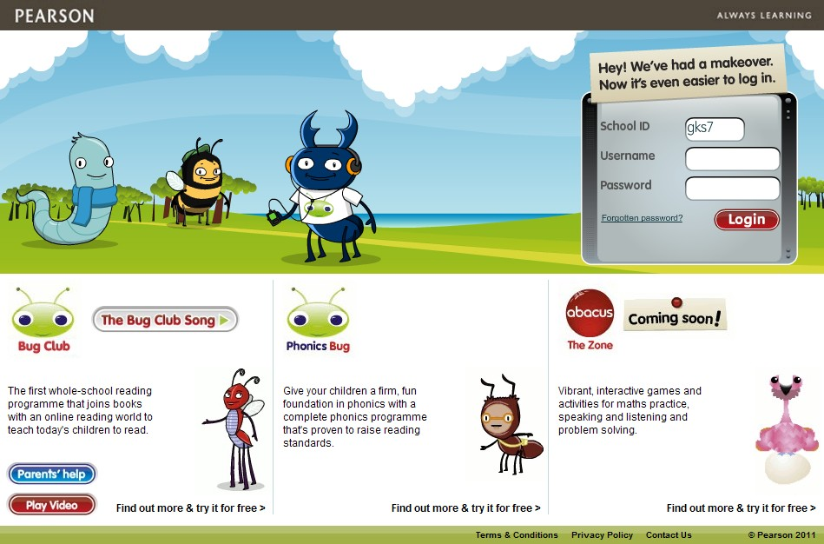
Using the eBooks
We are providing each child with their own login details to a website where they can read eBooks.
www.activelearnprimary.co.uk

Slide 9
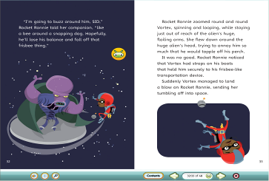
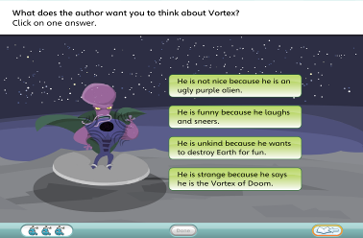
Reading an eBook
You can click on the book cover to see how many quiz questions there are.
When reading the book your child needs to click on all the bug icons to open the quiz questions.
Your child does not need to finish all quiz questions in one sitting. They can come back to a book later.

Slide 10
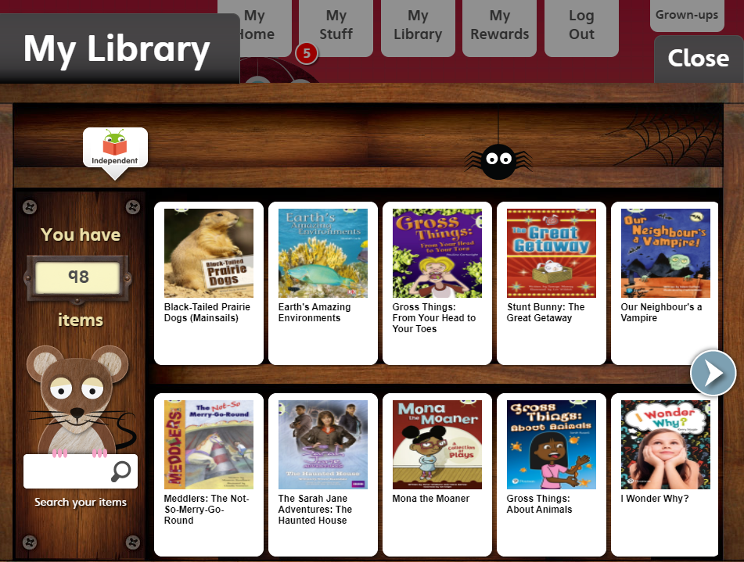
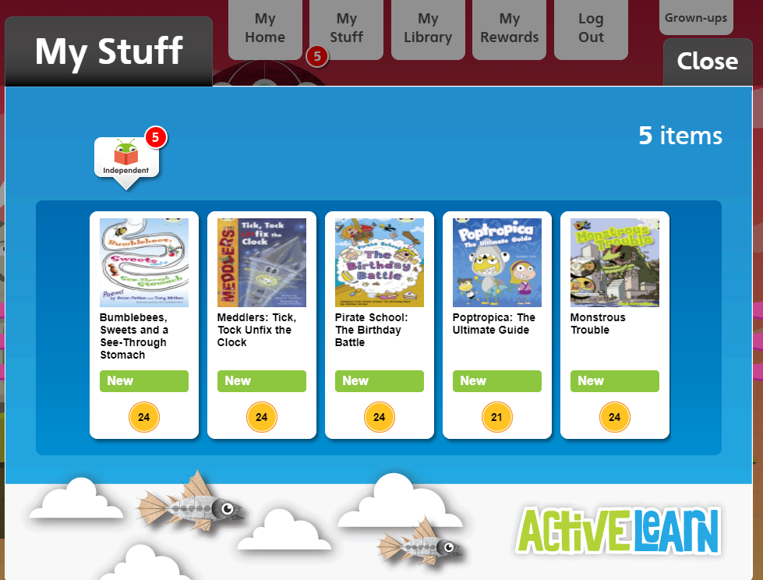
Books I Have Read
When your child has finished a book, it will move to ‘My Library’.
If your child has not completed all quiz questions in a book, then it remains in the ‘My Stuff’ area and it will not move to ‘My Library’.
Until the book moves to ‘My Library’ class teachers cannot tell that it has been fully completed.

Slide 11
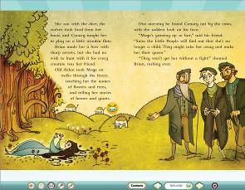
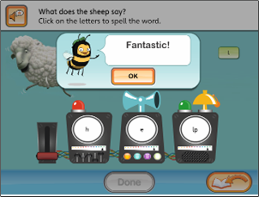
Getting the most out of the eBooks
Children can read at their own pace.
Encourage your child to attempt all of the quizzes.
Teachers can track your child’s progress and help them with types of quiz questions they struggle with.

Slide 12
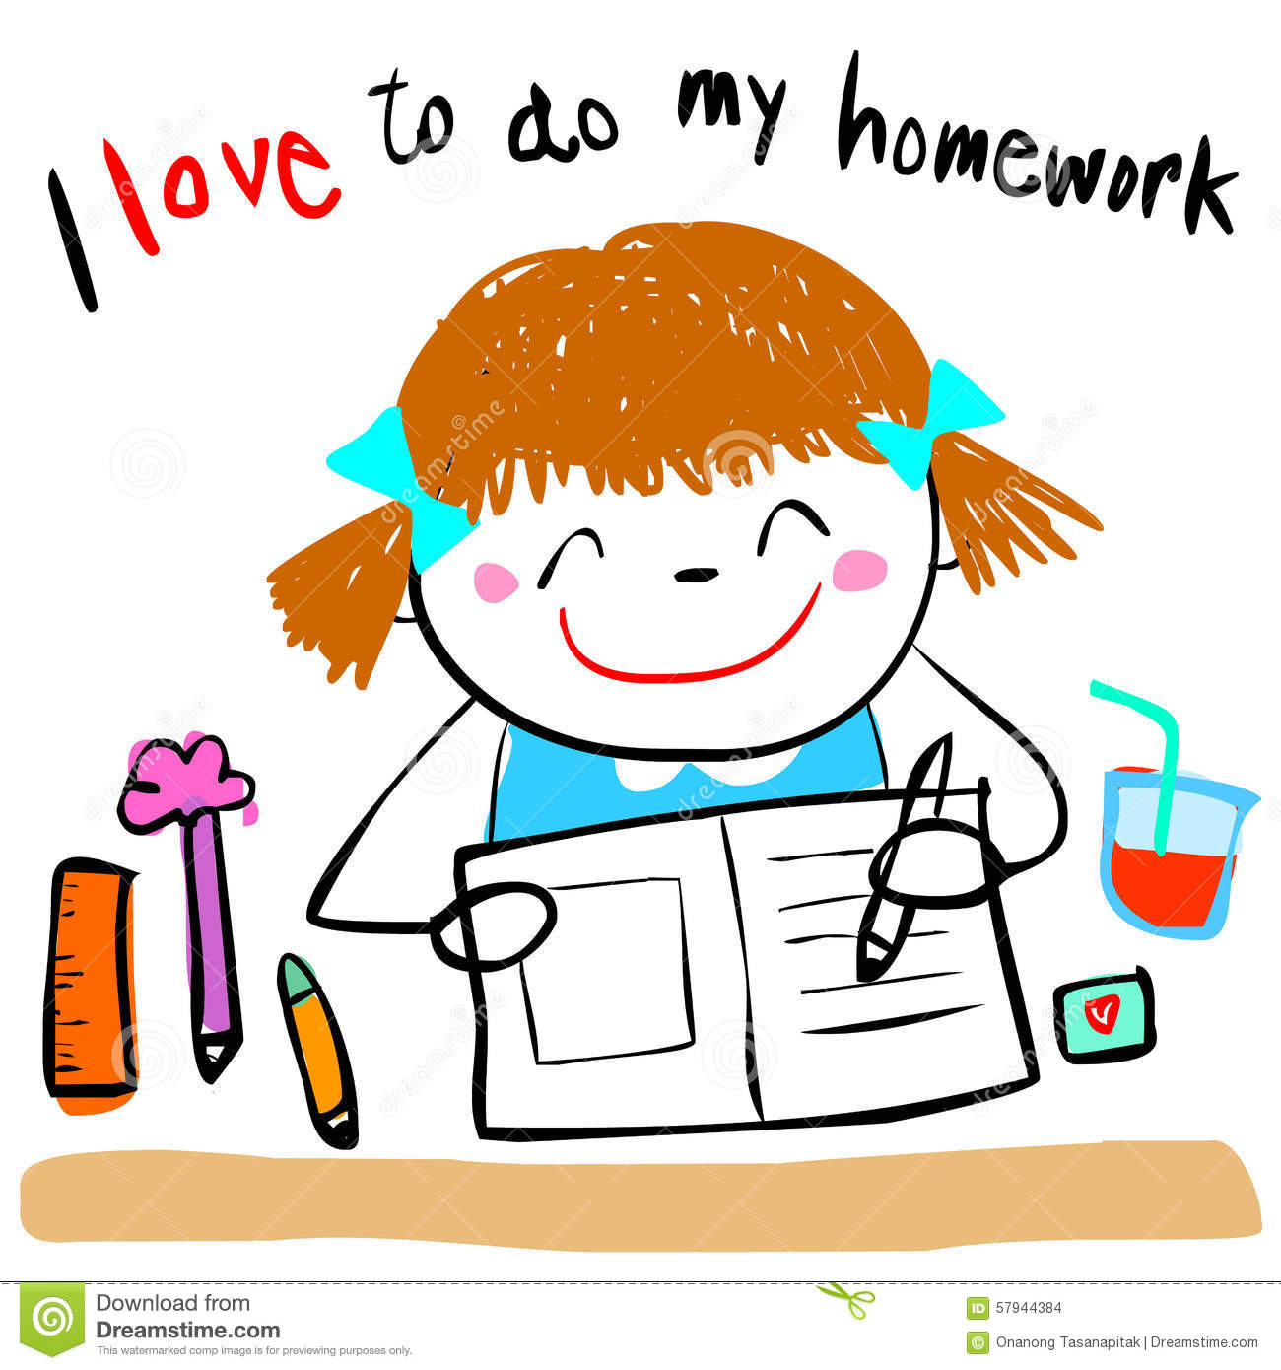

Homework for this term
Children will receive homework once a week on through Google classroom details explaining this will be sent out in a separate letter.
Maths will be MyMaths as before.
English, Topic or Science will be selected from the grid.
Children will be tested on their spellings on a Friday.
A comprehension task will be set every two weeks.

Slide 13
The Curriculum Overview for the Term in more detail
In Maths children will be focusing on:
Place value
Addition and subtraction
Multiplication and division
Fractions etc
In all of these areas there will be a strong focus on reasoning and problem solving.

Slide 14

The Curriculum Overview for the Term in more detail

Slide 15
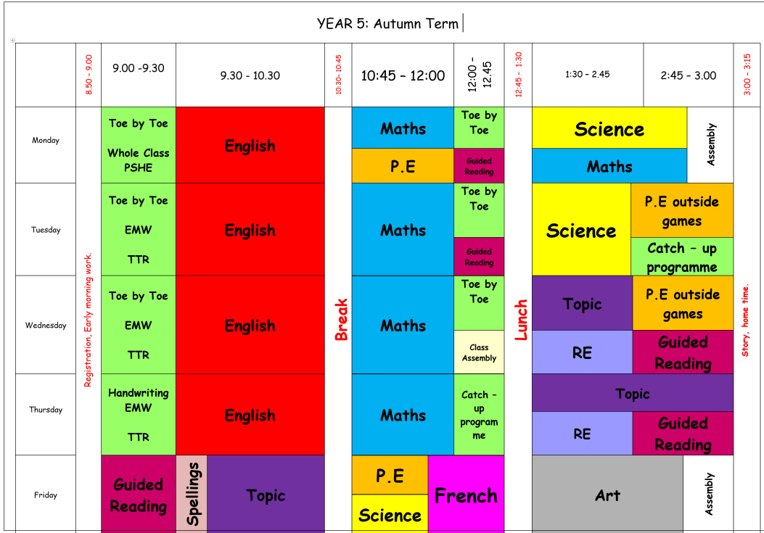
The Weekly Timetable

Slide 16
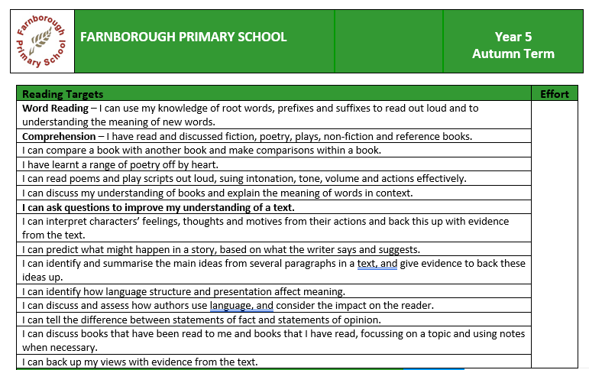
Target Sheets and Information Packs

Slide 17

Houses and House Points
The Houses and House Points system continues from last year. All children are placed in houses and if they have siblings they will be placed in the same houses. The houses are Redgrave, Farah, Ennis-Hill and Simmonds.

