Slide 1
Good morning Unicorns!
Here’s your work for today: Wednesday 8th July

Slide 2
I’m looking forward to seeing lots of you at our Bingo Zoom session at 9.15 this morning. Make sure you have your grid and a pencil ready.
Who will be the winner this week?

Slide 3
Let’s start the day by being…

Slide 4
Challenge 1:
Maths Answers from Monday:
Find 10 more of the following numbers:
22 33 76 86 45 55 84 94 88 98 32 42
Find 10 less of the following numbers:
73 63 55 45 90 80 71 61 83 73 77 67

Slide 5
Challenge 2:
Maths Answers from Tuesday
Find 10 or 100 more of the following numbers:
36 46 or 136 66 76 or 166 125 135 or 225 476 486 or 576 567 577 or 667 632 642 or 732
Find 10 or 100 less of the following numbers:
456 446 or 356 199 189 or 99 153 143 or 53 154 144 or 54 246 236 or 46 192 182 or 92

Slide 6
Challenge 3: Answers:
315
335
684
694
882
902
981
991

Slide 7
Maths

Slide 8
Maths
200
600

Slide 9
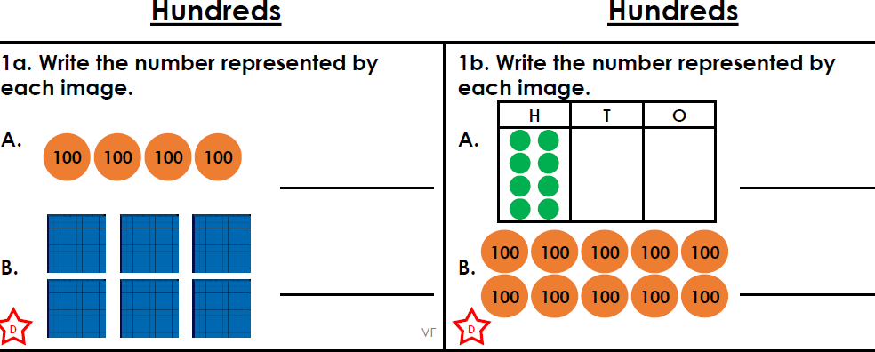
Challenge 1:

Slide 10
Challenge 2:

Slide 11
Challenge 3:
Can you solve my clues?
I am thinking of a number that is 100 more than 56. What is my number?
I am thinking of a number that is 100 less than 678. What is my number?
I am thinking of a number that is 100 more than 876. What is my number?
I am thinking of a number that is 100 less than 1200. What is my number?

Slide 12
You can write your answers in your exercise books.
You can write your answers in your exercise books.
If you would like to try Gruffalo work, complete Challenge 1.
If you would like to try Horrid Henry work, complete Challenge 2.
If you would like to try James and the Giant Peach work, complete Challenge 3.

Slide 13
Yesterday was the beginning of a new week for Race around the World.
Last week we reached Greece. You can see the previous week’s total by clicking on this link:
http://farnboroughprimary.co.uk/active-challenge/

Slide 14
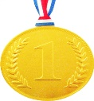
Farnborough’s Race across the World Results up to Monday 29th June
Class | Number of kilometres covered | *Which country did your class reach? From Farnborough School to …..
Pixies | 2637 km | Turkey
Elves | 2135 km | Romania
Unicorns | 2412 km | Greece
Phoenix | 1587km | Tunisia
Pegasus | 5104 km | Canada
Giants | 2771 km | Turkey
Griffins | 2800km | Turkey
Centaurs | 3633 km | Egypt
Dragons | 1750 km | Tunisia

Slide 15
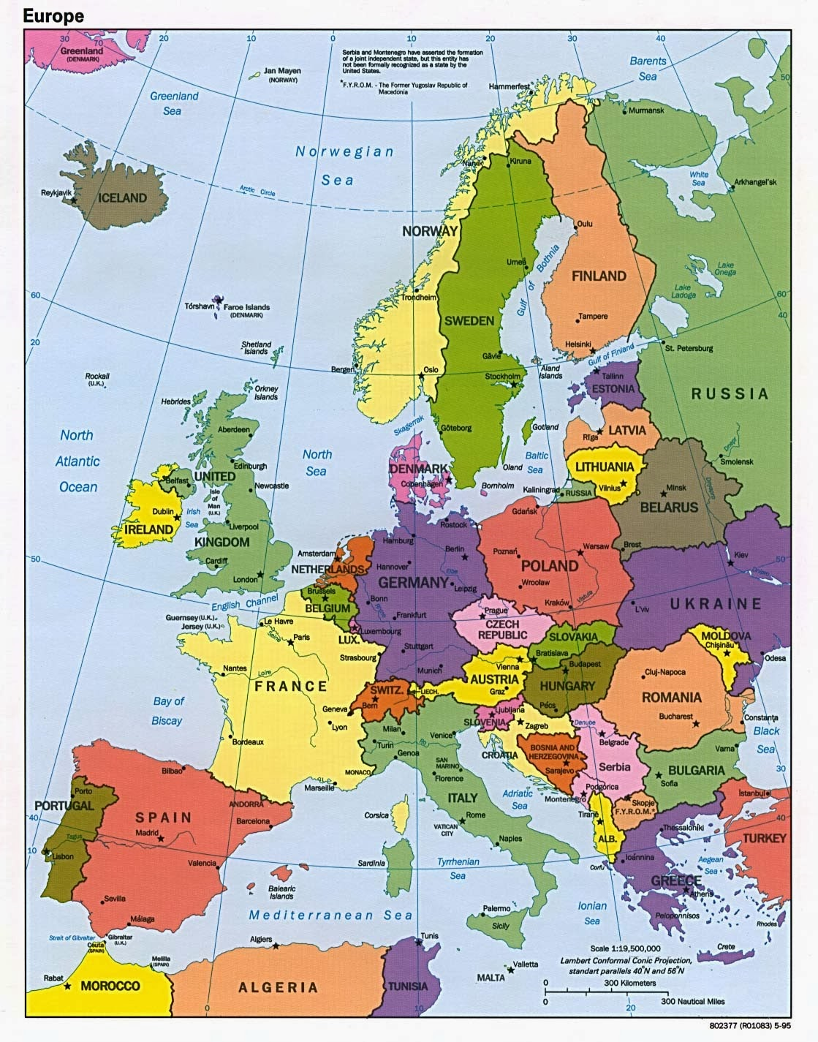
Which country did your class reach?
Map of Europe
Which country did your class reach?

Slide 16
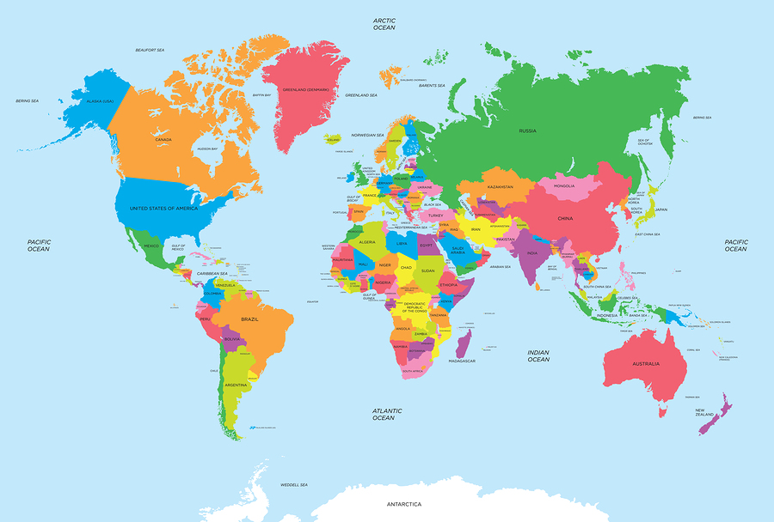
Map of the World
Which country did your class reach?

Slide 17
Follow this link and find Greece on Google Earth:
Google Earth
Login to:
https://www.oddizzi.com/schools/login/
Username: Unicorns
Password: Unicorns
Go to: Explore The World Places Europe Greece
Read through the facts and then look at the Greece Photo Gallery.
What do you think the attractions are for the many foreign visitors that holiday there each year? Does Greece look similar to where you live or is it very different? How is it different?

Slide 18
Outdoor Activity
Every day I am going to give you an activity that can be carried out either outdoors, (if the sun is shining) or indoors (if we’re not as lucky as the weather!).
Today it’s another Science investigation! Make sure you ask an adult to help you with this.

Slide 21
Reading online
Please log on to Bug Club and read for at least 15 minutes
Make sure you answer your bug questions!

Slide 22
Enjoy, Unicorns!

