Slide 1
Good morning Unicorns!
Here’s your work for today: Tuesday 7th July

Slide 2
Let’s start the day by being…

Slide 3
English
This week we are going to look at the story of ‘Pirates Love Underpants’

Slide 4
English
Click on the link below to watch the story:
https://youtu.be/Vd8_Y1bEzA8

Slide 5
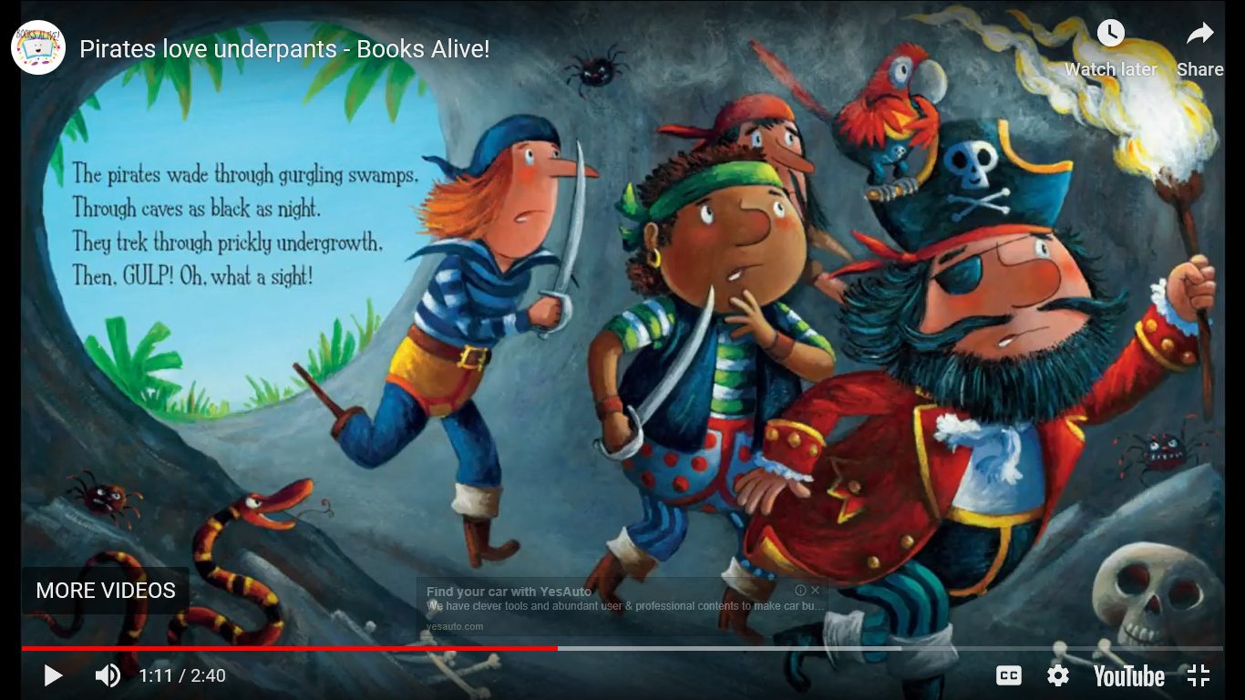
Read this page and look at the descriptive language used to describe the cave.

Slide 6
We are going to write our own description of where the pirates might have visited on their journey. For example: an ocean, a beach, a swamp.
This is mine:
The pirates ploughed through the ankle deep mud, rushing to get the stolen treasure. The cave was as dark as the midnight sky with only a tiny bit of light gleaming through to help show them the way. The bats flapped their wings loudly.
Choose a landscape that the pirates visited and write a description about what it was like there. What did they see? Hear? Smell? Touch? Taste?

Slide 7
Remember to Battle today!
The Battles will commence from 8.30am to 2pm today. You can battle for half an hour - more or less. It is up to you!
https://ttrockstars.com/

Slide 8
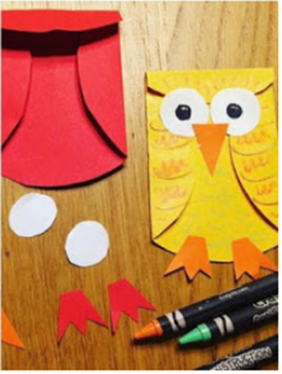
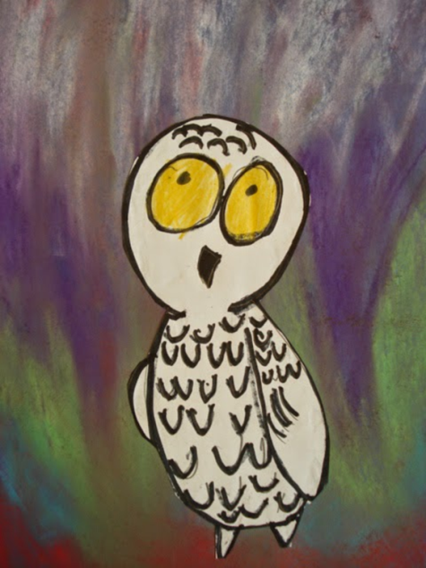
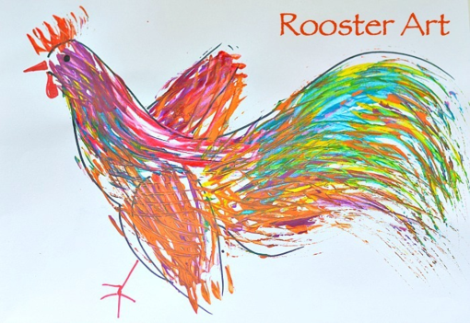
Carnival of the Animals An Art festival
For the next few weeks we are going to run a series of art lessons based around animals.
So whether you are working at home or in school you can create some great pictures. We would like to fill the Farnborough Art Gallery with your work to create a “Carnival of the Animals.”
If you are home learning, you can scan your work and send it in to your teacher.
Good luck, have fun and we want you to be creative, so if you have your own ideas we would love to see your artwork!

Slide 9
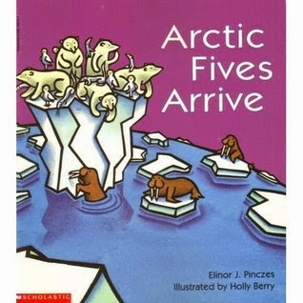
Snowy Owls and Northern Lights

Slide 10
Listen to this lovely picture book, Arctic Fives Arrive on https://www.youtube.com/watch?v=j1vlNrn8IpE&t=375s
The book is very cute and basically tells the story of a group of Arctic animals gathering together on an iceberg to view the northern lights.
First, five snowy owls perch upon an iceberg. They are followed by five polar bears. Next, five ermine show up, and then five walrus, five Arctic hares and five musk oxen join the crowd. All the animals settle in for a view of the Northern Lights.
In the next slides you will find some pages from the book, which will give you an idea of the story and some ideas for your art today.

Slide 11
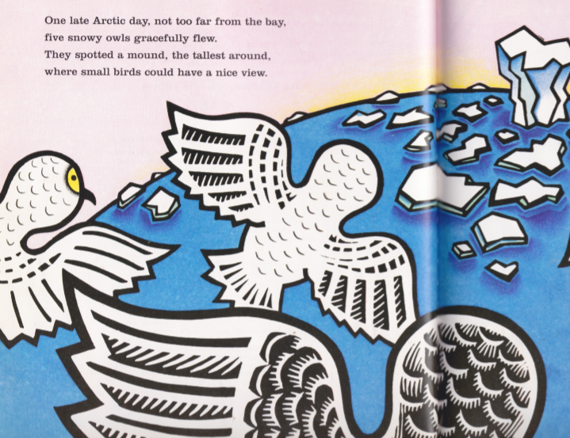
The owls gather together to watch the Northern lights…but are soon joined by other Arctic animals.

Slide 12
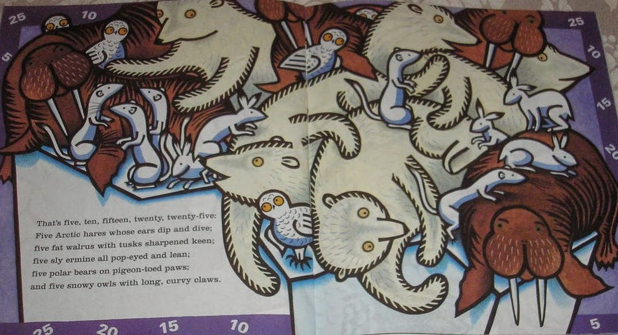
The iceberg gets very crowded very quickly, look at how the illustrator draws the apprehensive expression on the snowy owl's faces……..can we try to draw them?

Slide 13
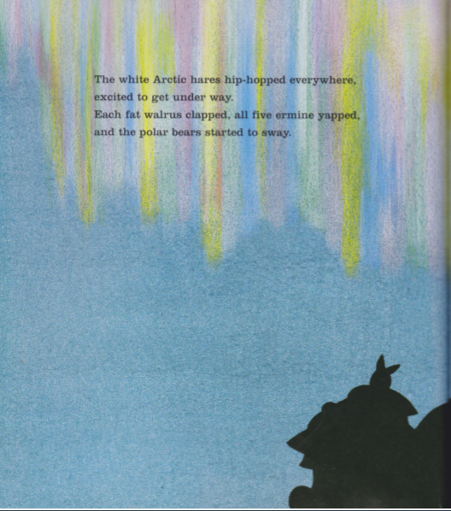
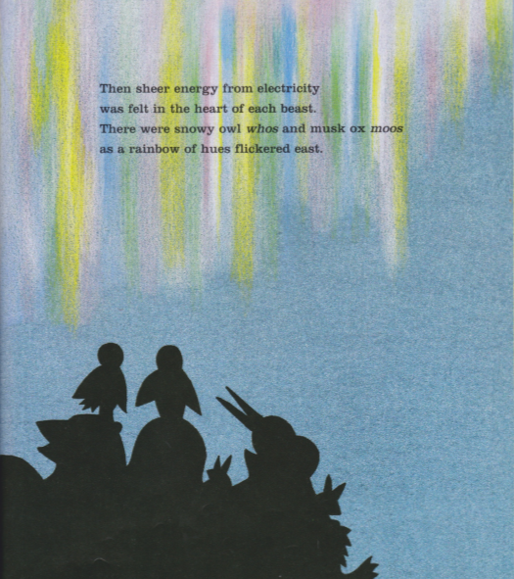
Look at how the illustrator has drawn the colourful Northern lights…..you could get the same effect using chalk/pastels/paints or pencils.

Slide 14
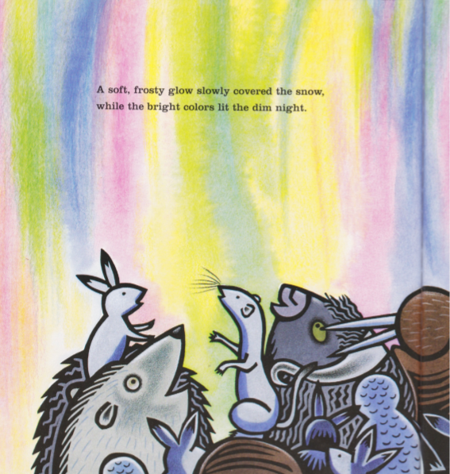
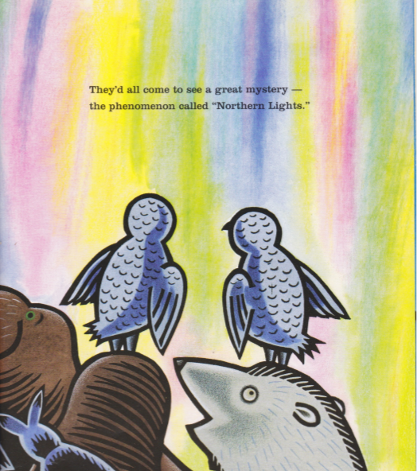

Slide 15
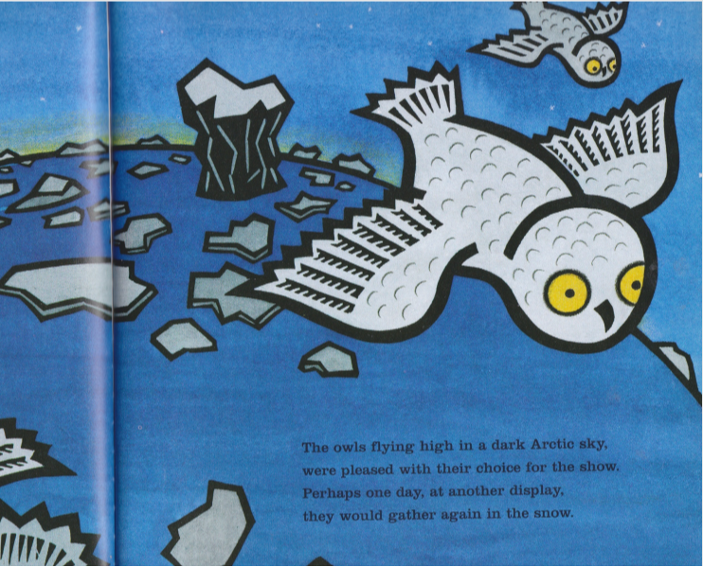
The spectacular show is over and the animals leave …………..

Slide 16
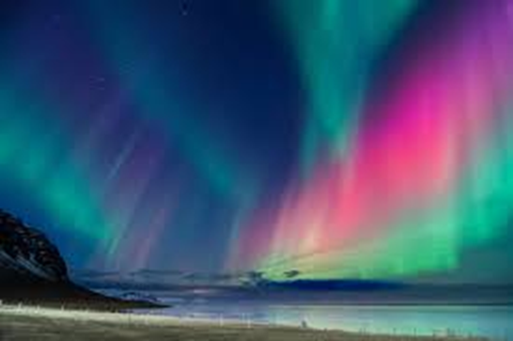
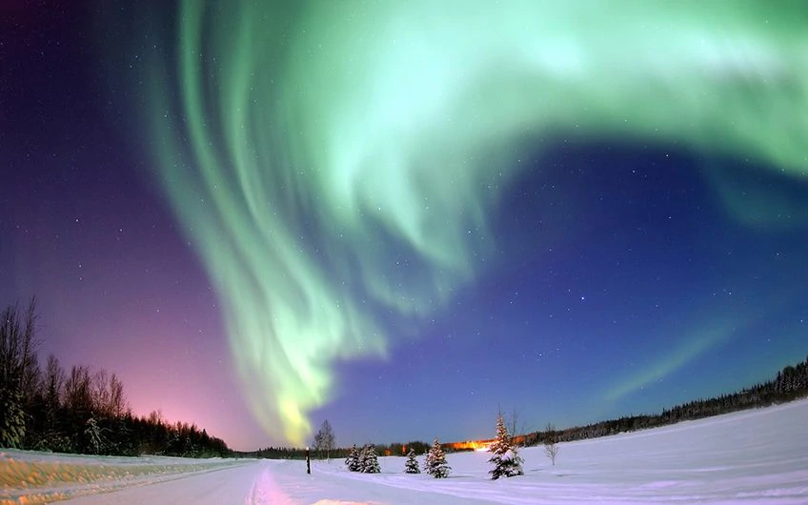
You’ve probably heard about the northern lights. You may have even been lucky enough to see them. The northern lights — also called aurora borealis (say "ah-ROAR-ah bore-ee-AH-lis") — are coloured lights that appear in the northern sky, kind of like nature's fireworks!

Slide 17
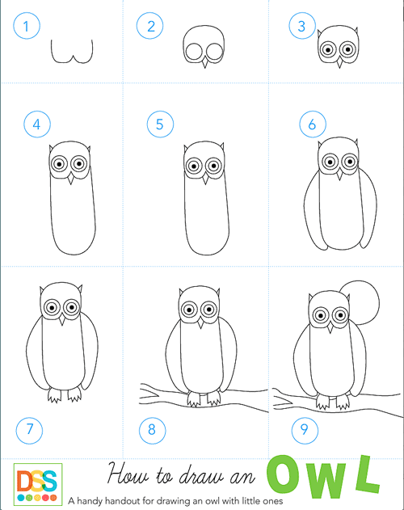
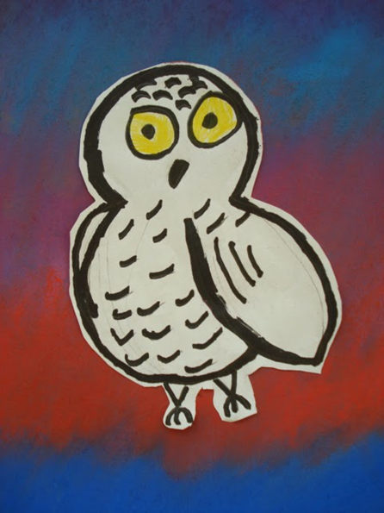
Tip: The bodies of our snowy owls are a bit shorter and rounder!

Slide 18
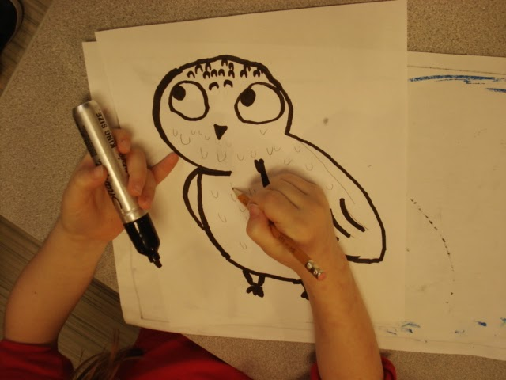
Remember big eyes!
Draw the snowy owl in pencil first.
When you are happy with your shape outline it using black marker pens/ Sharpies.
You want the same bold, black outlines that are in the book.

Slide 19
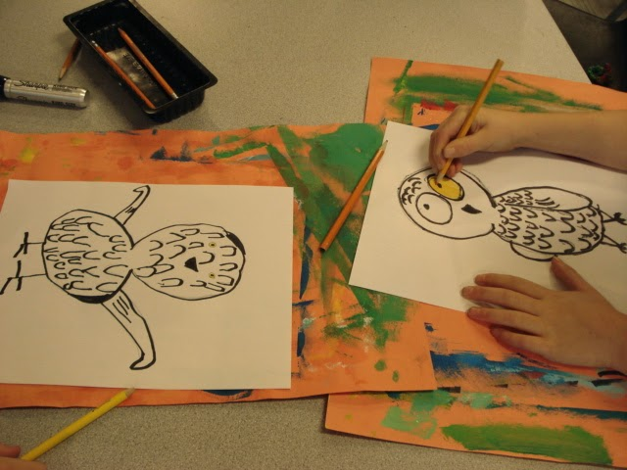
Then colour the eyes yellow and cut the owls out carefully.

Slide 20
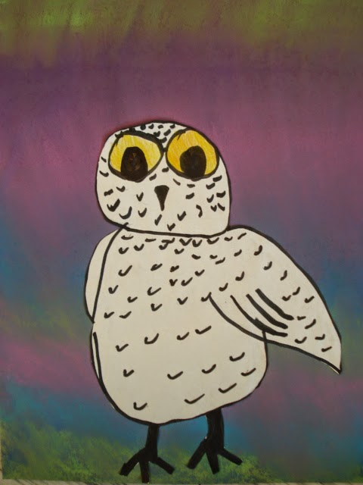
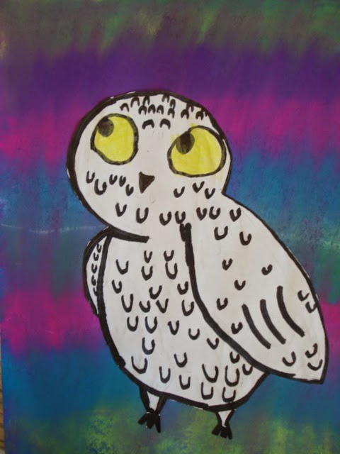
Take another piece of paper and create Northern Lights by blending chalks/ pastels/paints.
Then with clean, dry hands, carefully glue the owls on top.
Top Tip: PVA glue is better for sticking on a chalk /pastels surface.

Slide 21
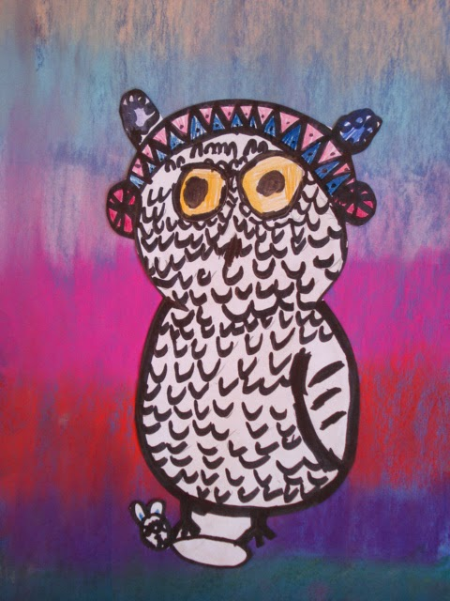
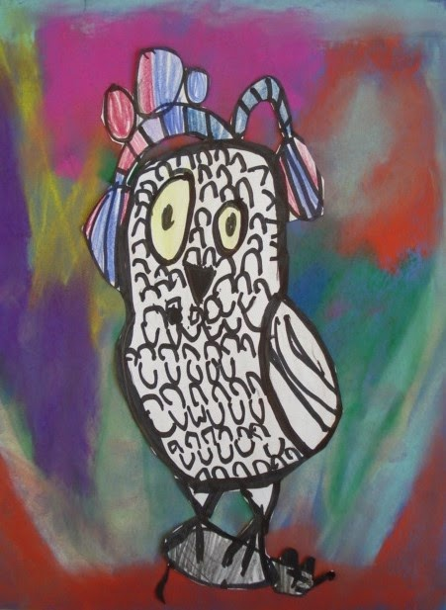
Add your own details!
These owls are wearing earmuffs and have captured a mouse!

Slide 22
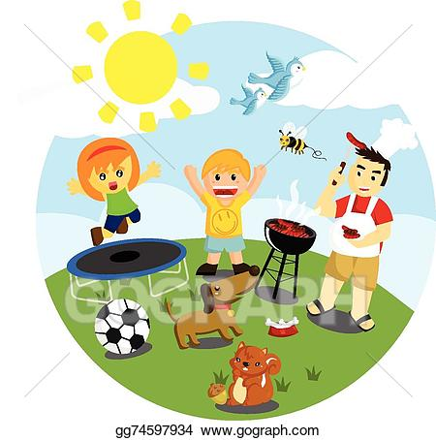
Outdoor Activity
Every day I am going to give you an activity that can be carried out either outdoors, (if the sun is shining) or indoors (if we’re not as lucky as the weather!).

Slide 23
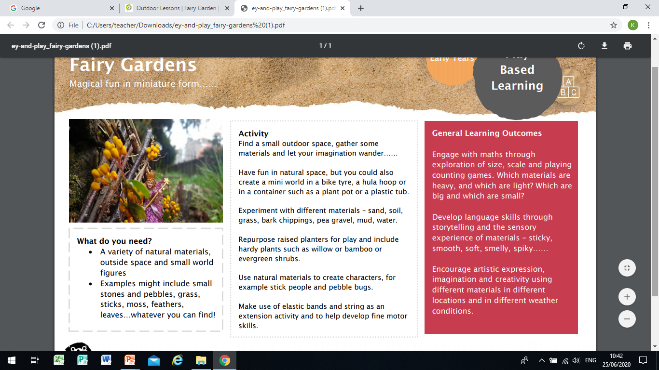

Slide 24
Reading online
Please log on to Bug Club and read for at least 15 minutes
Make sure you answer your bug questions!

Slide 25
Remember to send in your totals for the Race across the World.
Which country will we reach this week?

Slide 26
Maths Bingo
We will have another zoom session tomorrow where you will be taking part in Maths Bingo.
In preparation for this I would like you to draw a grid like you would if you were playing noughts and crosses:
Then choose nine numbers between 1 and 20 to put in the grid.
Tomorrow I will be giving you different number sentences. If your answer is a number in your grid, then you cross out the number.
The first person to cross out all nine of the numbers wins the game!

Slide 27
Enjoy, Unicorns!

