Slide 1
I’m looking forward to seeing lots of you at our Zoom sessions this week.
Watch the animation on the next slide to remind yourself of how to keep safe online.

Slide 2
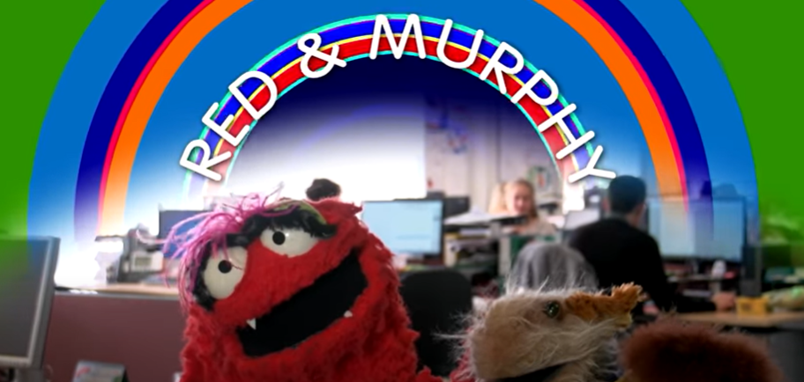
https://www.youtube.com/watch?v=FNQmo0LF6YY

