Slide 2
Good morning Unicorns!
Here’s your work for today: Monday 6th July

Slide 3
I’m looking forward to seeing lots of you at our Storytime Zoom session at 9.15 this morning.
Watch the animation on the next slide to remind yourself of how to keep safe online.

Slide 4
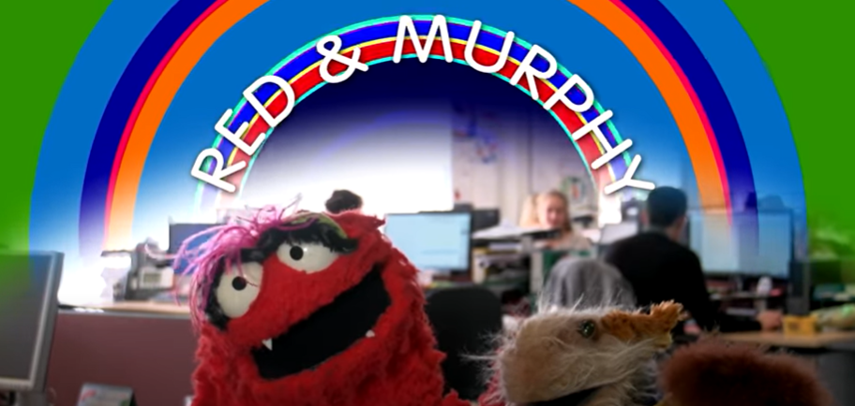
https://www.youtube.com/watch?v=FNQmo0LF6YY

Slide 5
Let’s start the day by being…

Slide 6
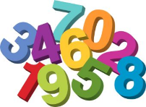
Maths
Can you identify the numbers under the splats?

Slide 7
How did you get on? Practise counting
in tens from any number e.g. 45
1 | 2 | 3 | 4 | 5 | 6 | 7 | 8 | 9 | 10
11 | 12 | 13 | 14 | 15 | 16 | 17 | 18 | 19 | 20
21 | 22 | 23 | 24 | 25 | 26 | 27 | 28 | 29 | 30
31 | 32 | 33 | 34 | 35 | 36 | 37 | 38 | 39 | 40
41 | 42 | 43 | 44 | 45 | 46 | 47 | 48 | 49 | 50
51 | 52 | 53 | 54 | 55 | 56 | 57 | 58 | 59 | 60
61 | 62 | 63 | 64 | 65 | 66 | 67 | 68 | 69 | 70
71 | 72 | 73 | 74 | 75 | 76 | 77 | 78 | 79 | 80
81 | 82 | 83 | 84 | 85 | 86 | 87 | 88 | 89 | 90
91 | 92 | 93 | 94 | 95 | 96 | 97 | 98 | 99 | 100

Slide 8
Challenge 1:
Find 10 more of the following numbers:
23 76 45 84 88 32
Find 10 less of the following numbers:
73 55 90 71 83 77

Slide 9
Challenge 2:
Find 10 or 100 more of the following numbers:
36 66 125 476 567 632
Find 10 or 100 less of the following numbers:
456 199 153 154 246 192

Slide 10
Challenge 3:

Slide 11
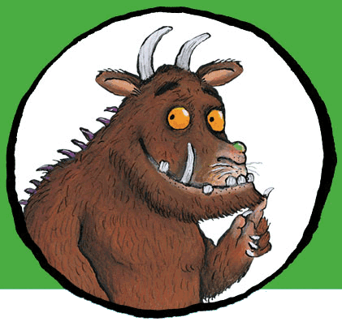
You can write yYou cYou can write your answers in your exercise books.
an write your answers in your exercise books.
our answers in your exercise books.
You can write your answers in your exercise books.
If you would like to try Gruffalo work, complete Challenge 1.
If you would like to try Horrid Henry work, complete Challenge 2.
If you would like to try James and the Giant Peach work, complete Challenge 3.

Slide 12
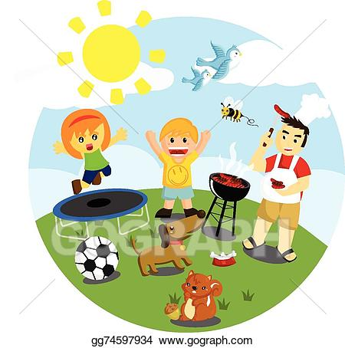
Outdoor Activity
Every day I am going to give you an activity that can be carried out either outdoors, (if the sun is shining) or indoors (if we’re not as lucky as the weather!).

Slide 13
Create your own treasure map. You might want to ask an adult to help you tea stain it.
Use your imagination and think about what your map might include.
You can base it around the story, ‘Pirates love underpants’ or think of another idea. This might include: food, sports, colours.
For example: Milky Way Mountains, Scrumptious Snickers Bar Island.

Slide 14
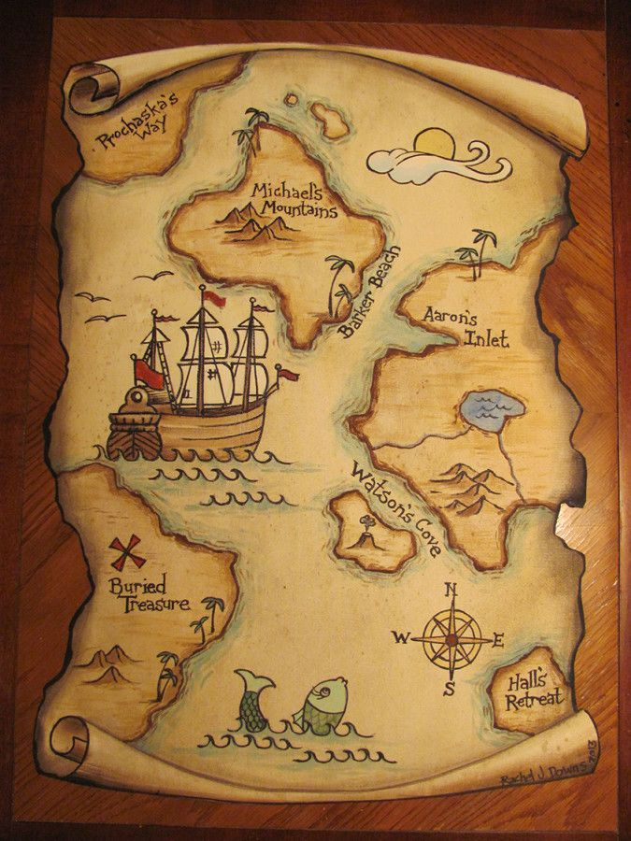
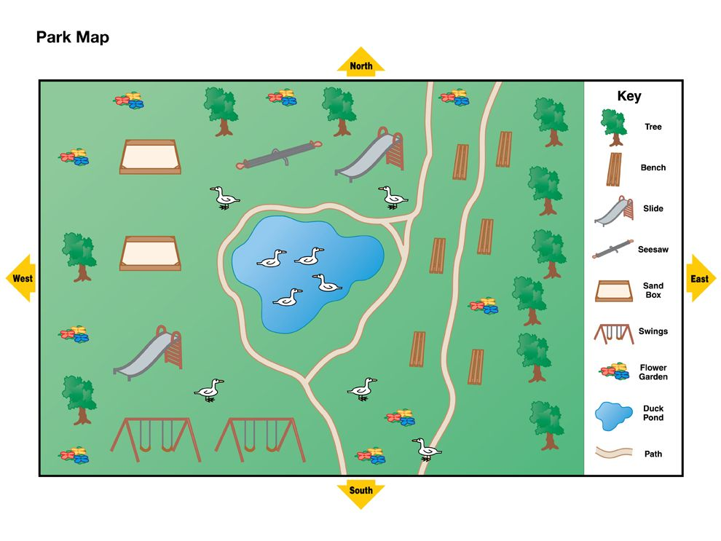
What will your treasure
map include?
A ship
An island
A compass
Mountains
Treasure
Create a key and label your
map.

Slide 15
Design new pirate themed underpants for the pirates!

Slide 16
Things to think about when designing:
What will the pattern be?
What colour will they be?
How will you make them?
You can draw, paint or use craft materials to
make your new pirate underpants!

Slide 17
Reading online
Please log on to Bug Club and read for at least 15 minutes
Make sure you answer your bug questions!

Slide 18
Enjoy, Unicorns!

