Slide 1
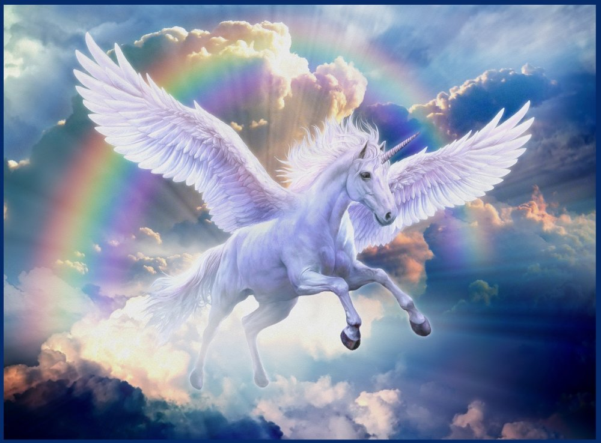
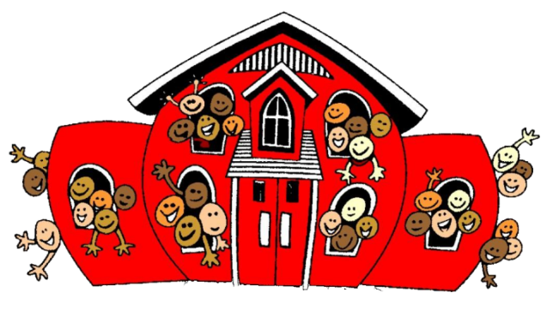
Welcome to Pegasus class!

Slide 2
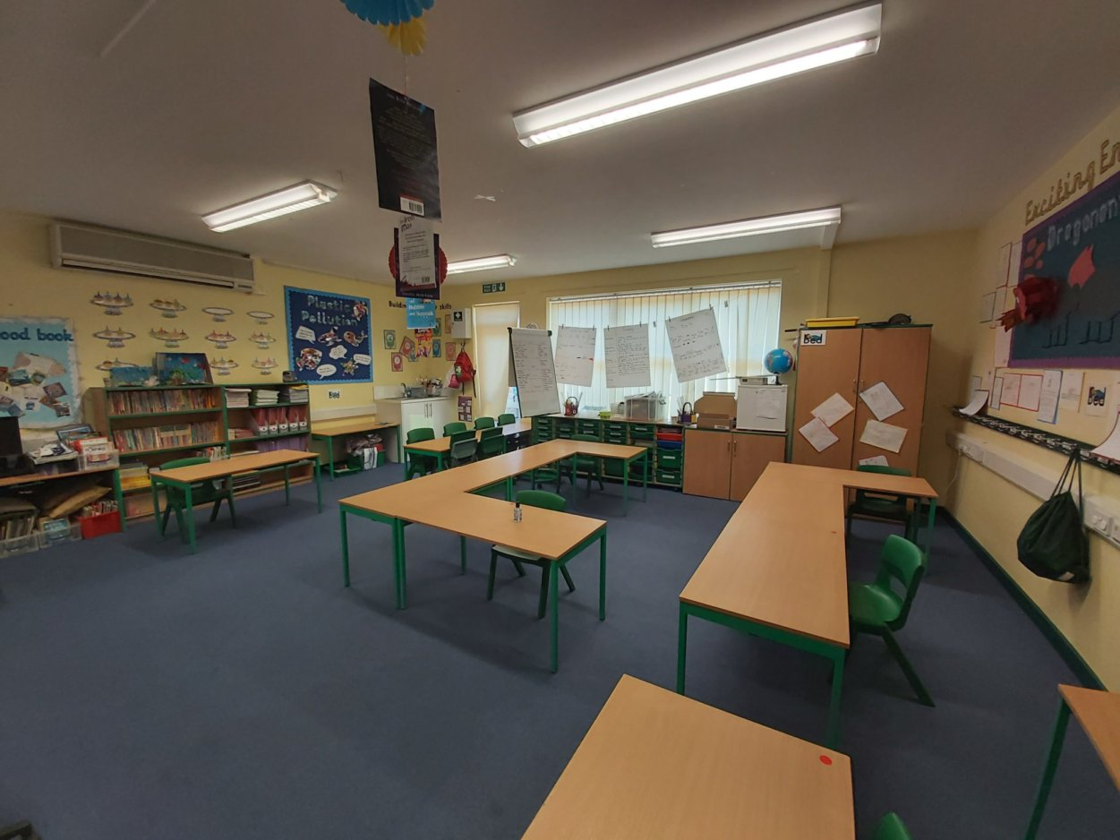
Our Classroom:
We are going to be called Pegasus Class. Here is a picture of our classroom ☺

Slide 3
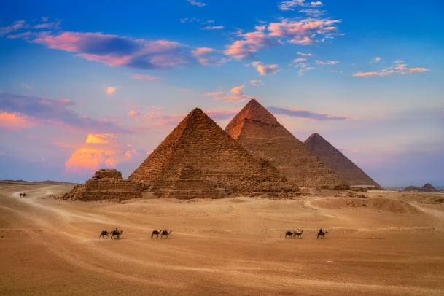
Our Learning:
Our first topic next year is a history topic all about Ancient Egypt.
Click here to find out more about Ancient Egypt.
Click here for activities you can complete about Ancient Egypt.
Click here for a list of books you might like to read about Ancient Egypt.

Slide 4
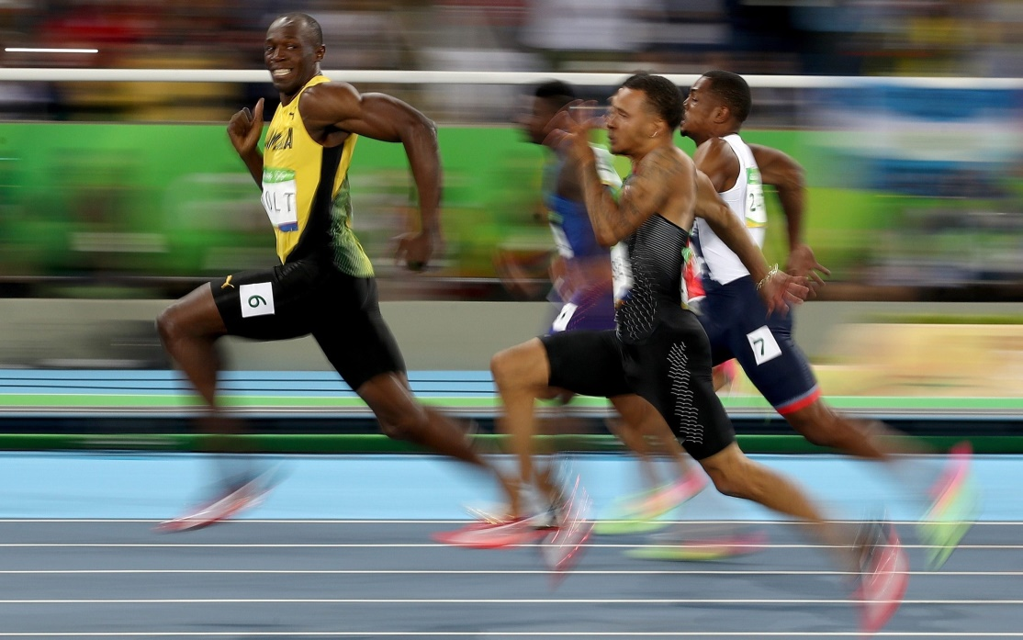
Our Learning:
In Science, we will be looking at Animals including humans, focusing on the Human Body.
Using the science investigations we carry out, we will be trying to answer the question:
How can Usain Bolt move so quickly?

Slide 5
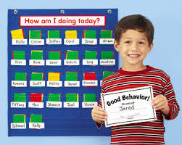
Class Values
Our core values are:
Respect for others and tolerance
Trust, honesty and truth
Equality
Commitment
Friendship and kindness
Confidence and courage

Slide 6
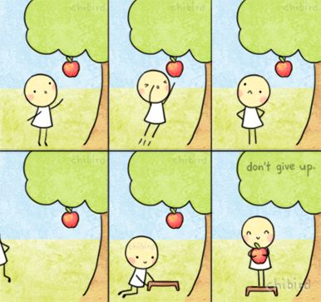
Mrs Roberts
My three main focuses in Year 3 are for us to work hard, follow our class values and have fun! ☺
I want everyone in my class to try their best and never give up with their learning.

Slide 7
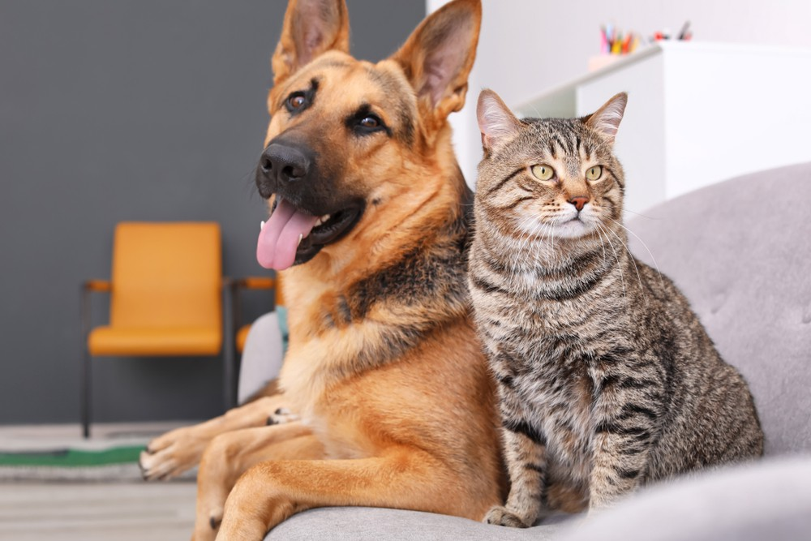
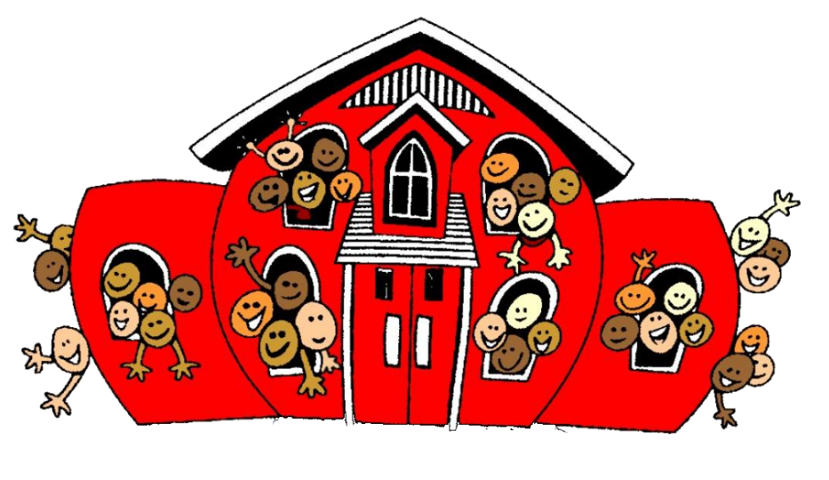
Things I have learnt about you.
We love exercise and sport, especially bike rides.
We enjoy playing games like Pokémon.
We are animal lovers.
We love reading lots of different books.
We love to act, dance and sing.
We are amazing artists.
We have travelled to lots of places.

