Slide 1
English – Day 4
Read through the extract on the next 3 slides which will help you to answer the questions in today’s lesson.

Slide 2
Extract 4
In this extract, which is much further on in the book, Edmund has been captured by a witch and a dwarf and is being made to walk through a forest. As they walk, the snow covering all of Narnia begins to melt because Aslan, representing the force of good, is returning.
Every moment the patches of green grew bigger and the patches of snow grew smaller. Every moment more and more of the trees shook off their robes of snow. Soon, wherever you looked, instead of white shapes you saw the dark green of firs or the black prickly branches of bare oaks and beeches and elms. Then the mist turned from white to gold and presently cleared away altogether. Shafts of delicious sunlight struck down on to the forest floor and overhead you could see a blue sky between the tree tops. Soon there were more wonderful things happening.

Slide 3
Extract 4 continued
Coming suddenly round a corner into a glade of silver birch trees, Edmund saw the ground covered in all directions with little yellow flowers. The noise of water grew louder. Presently they actually crossed a stream. Beyond it they found snowdrops growing. Only five minutes later Edmund noticed a dozen crocuses growing round the foot of an old tree - gold and purple and white. Then came a sound even more delicious than the sound of the water. Close beside the path they were following, a bird suddenly chirped from the branch of a tree. It was answered by the chuckle of another bird a little further off.
And then, as if that had been a signal, there was chattering and chirruping in every direction, and then a moment of full song, and within five minutes the whole wood was ringing with birds' music, and wherever Edmund's eyes turned he saw birds alighting on branches, or sailing overhead or chasing one another or having their little quarrels or tidying up their feathers with their beaks. There was no trace of the fog now. The sky became bluer and bluer, and now there were white clouds hurrying across it from time to time. In the wide glades there were primroses.

Slide 4
Extract 4 continued
A light breeze sprang up which scattered drops of moisture from the swaying branches and carried cool, delicious scents against the faces of the travellers. The trees began to come fully alive. The larches and birches were covered with green, the laburnums with gold. Soon the beech trees had put forth their delicate, transparent leaves. As the travellers walked under them the light also became green. A bee buzzed across their path. "This is no thaw," said the dwarf, suddenly stopping. "This is Spring.

Slide 5
Questions and activities from day 4
From the first slide, list as many adjectives as you can. Underline ones that you think are particularly effective.
On the first slide it says that the trees ‘shook off their robes of snow’. Describe some other ways that the snow could melt from things. Could the white blanket disappear? The icing sugar be eaten?
Why do you think the sunlight felt so ‘delicious’ after it had been winter in Narnia for so many years?

Slide 6
Day 4 continued
4) From slide 2 find the verbs that the author uses to explain the noises the robin makes.
5) Find a picture of crocuses and primroses. Choose some words to describe them.
6) Can you find out what larches, birches and laburnums are?
7) Do you think C.S. Lewis has described the winter thawing effectively? Give reasons for your answer using evidence from the text.

Slide 7
Thursday 9th July 2020

Slide 9
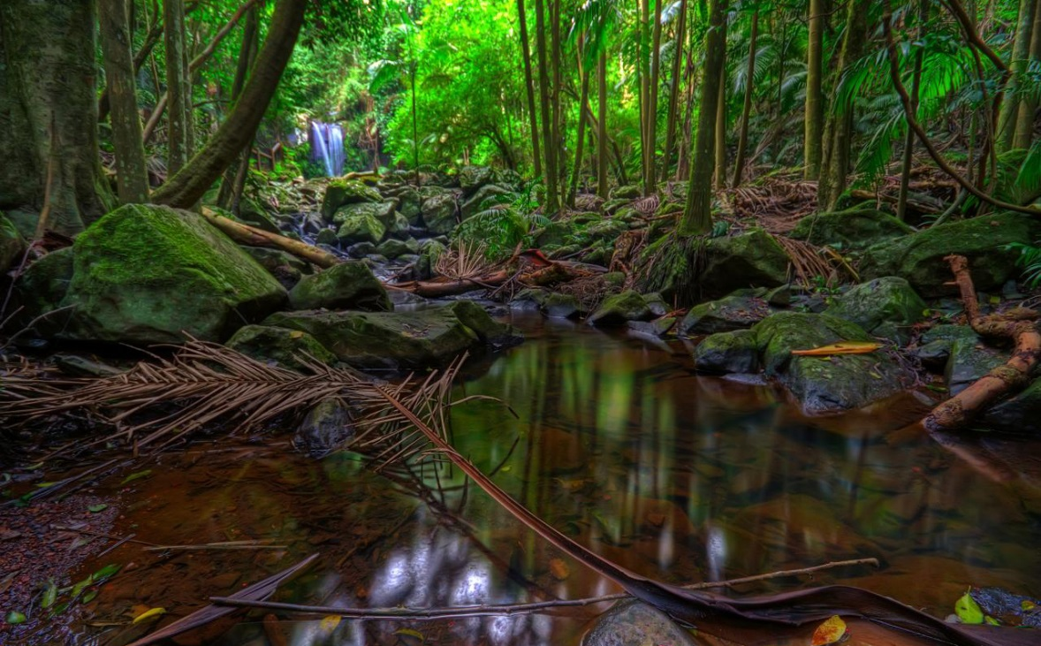
Rainforest
Photo courtesy of tauntingpanda (@flickr.com) - granted under creative commons licence

Slide 10
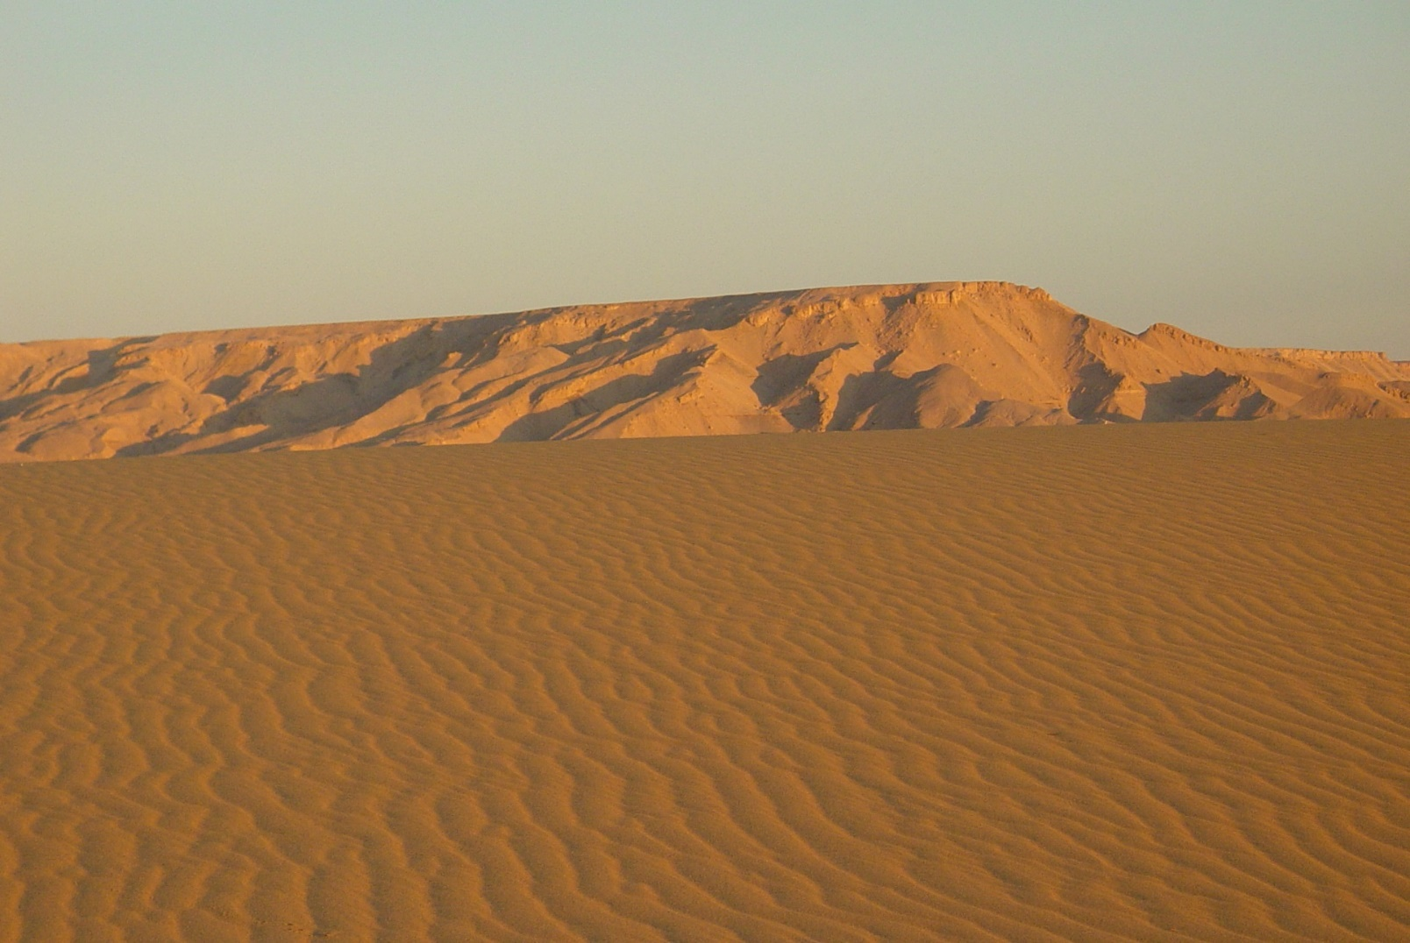
Desert
Photo courtesy of Jungle_Boy (@flickr.com) - granted under creative commons licence

Slide 11
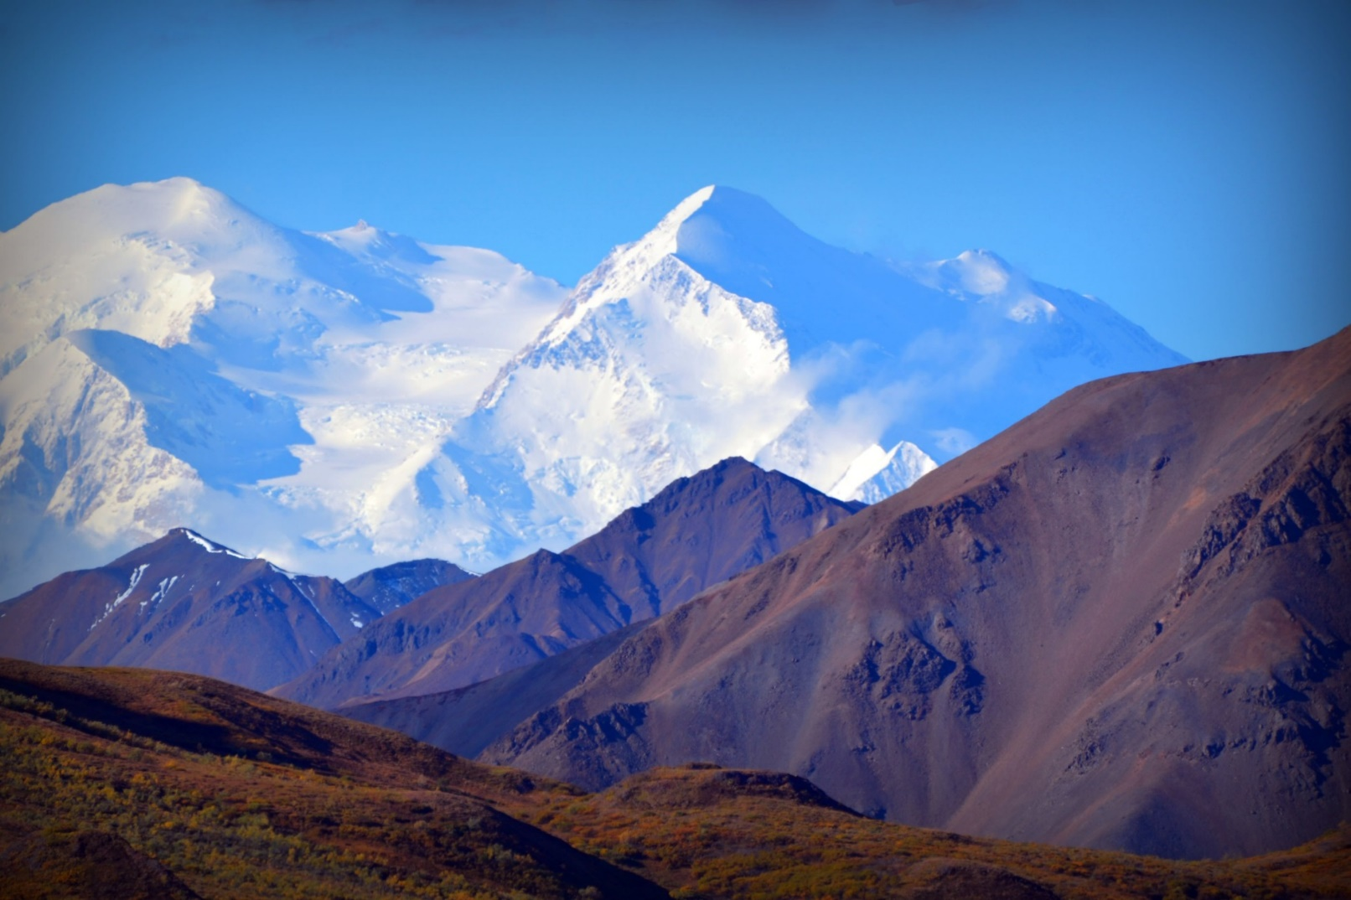
Mountains
Photo courtesy of blmiers2 (@flickr.com) - granted under creative commons licence

Slide 12
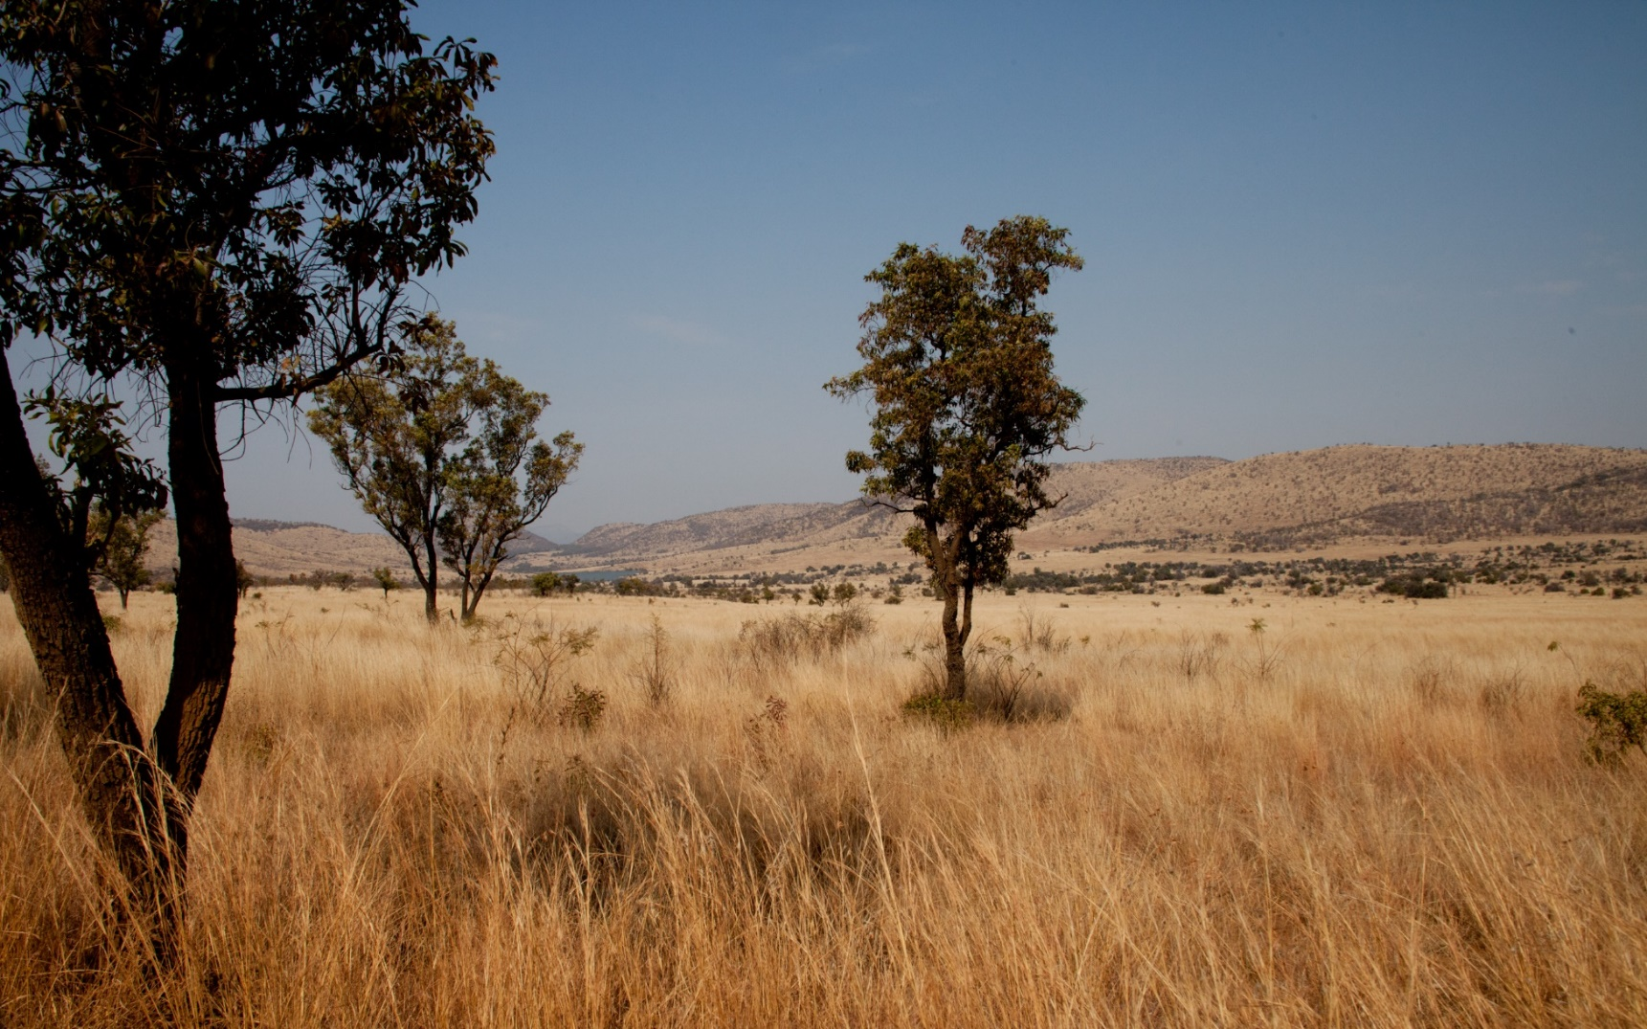
African Plains
Photo courtesy of blmiers2 (@flickr.com) - granted under creative commons licence

Slide 13
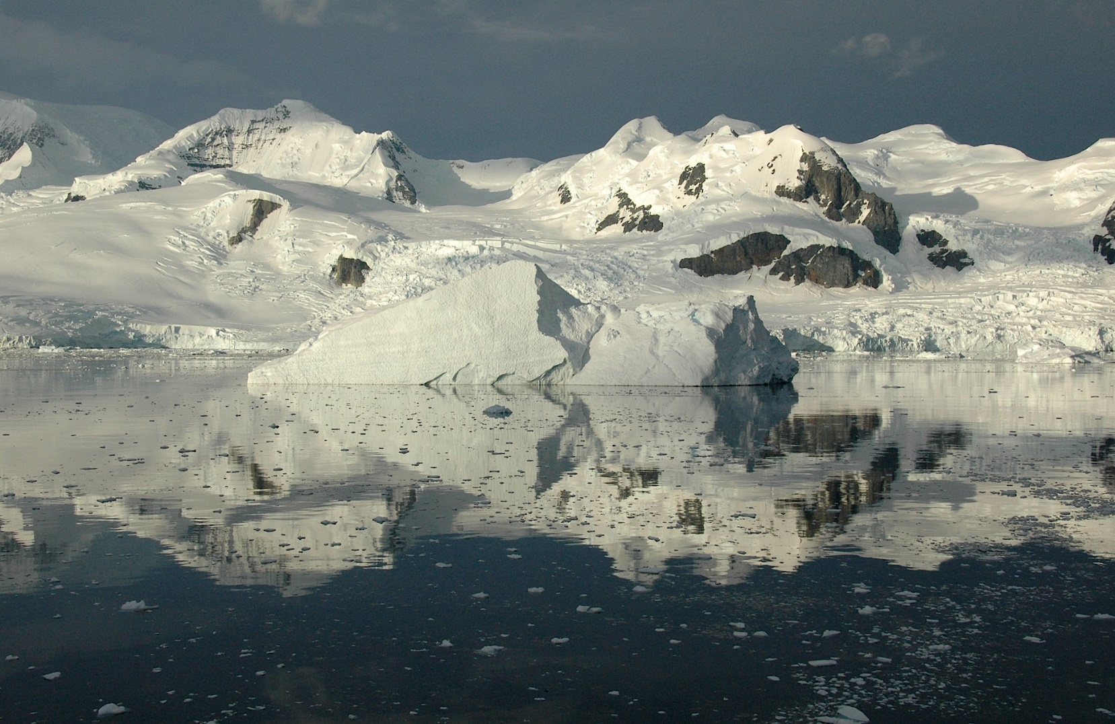
Arctic
Photo courtesy of Rita Willaert (@flickr.com) - granted under creative commons licence

Slide 14
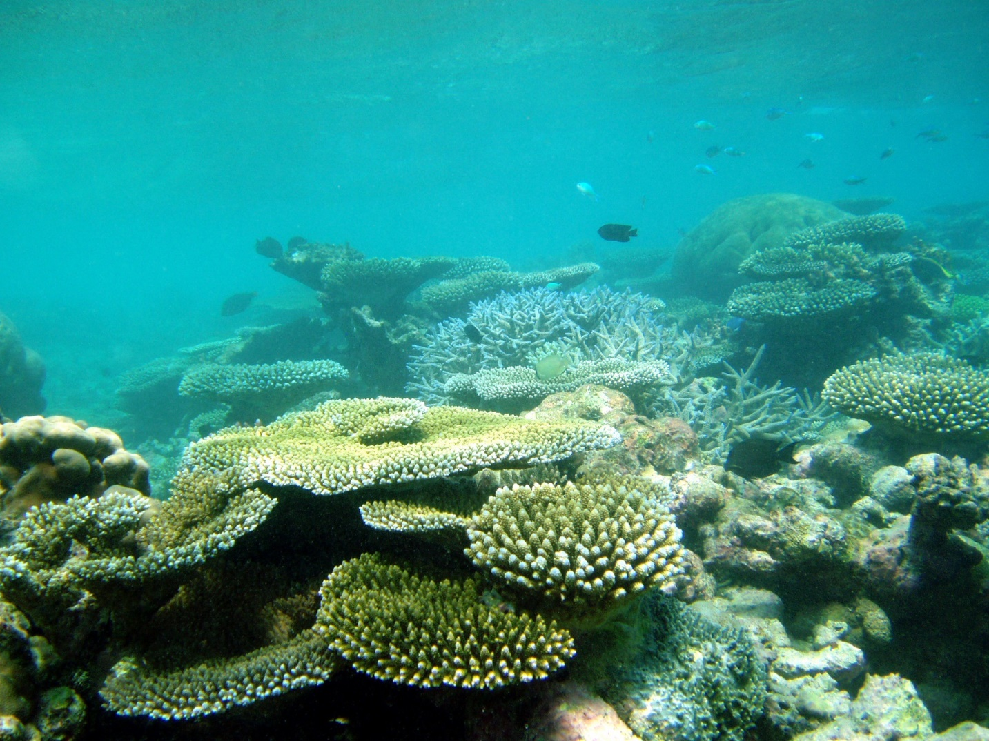
Corals
Photo courtesy of ccharmon (@flickr.com) - granted under creative commons licence

Slide 15
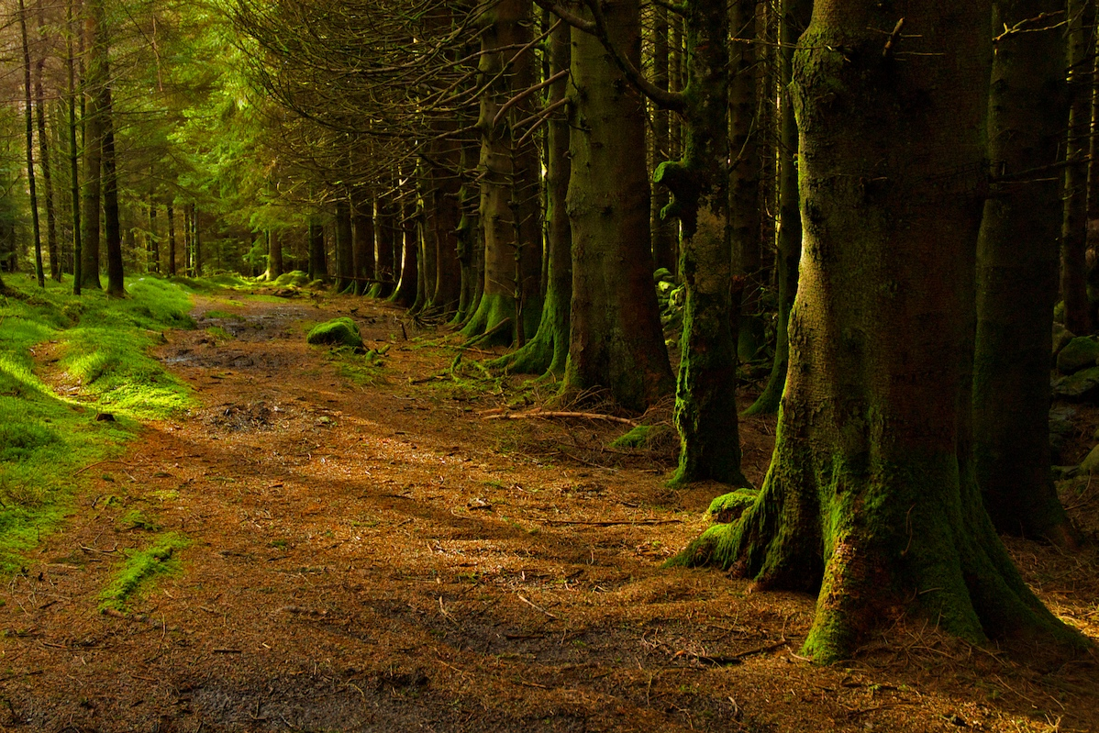
Woodland
Photo courtesy of erwlas (@flickr.com) - granted under creative commons licence

Slide 16
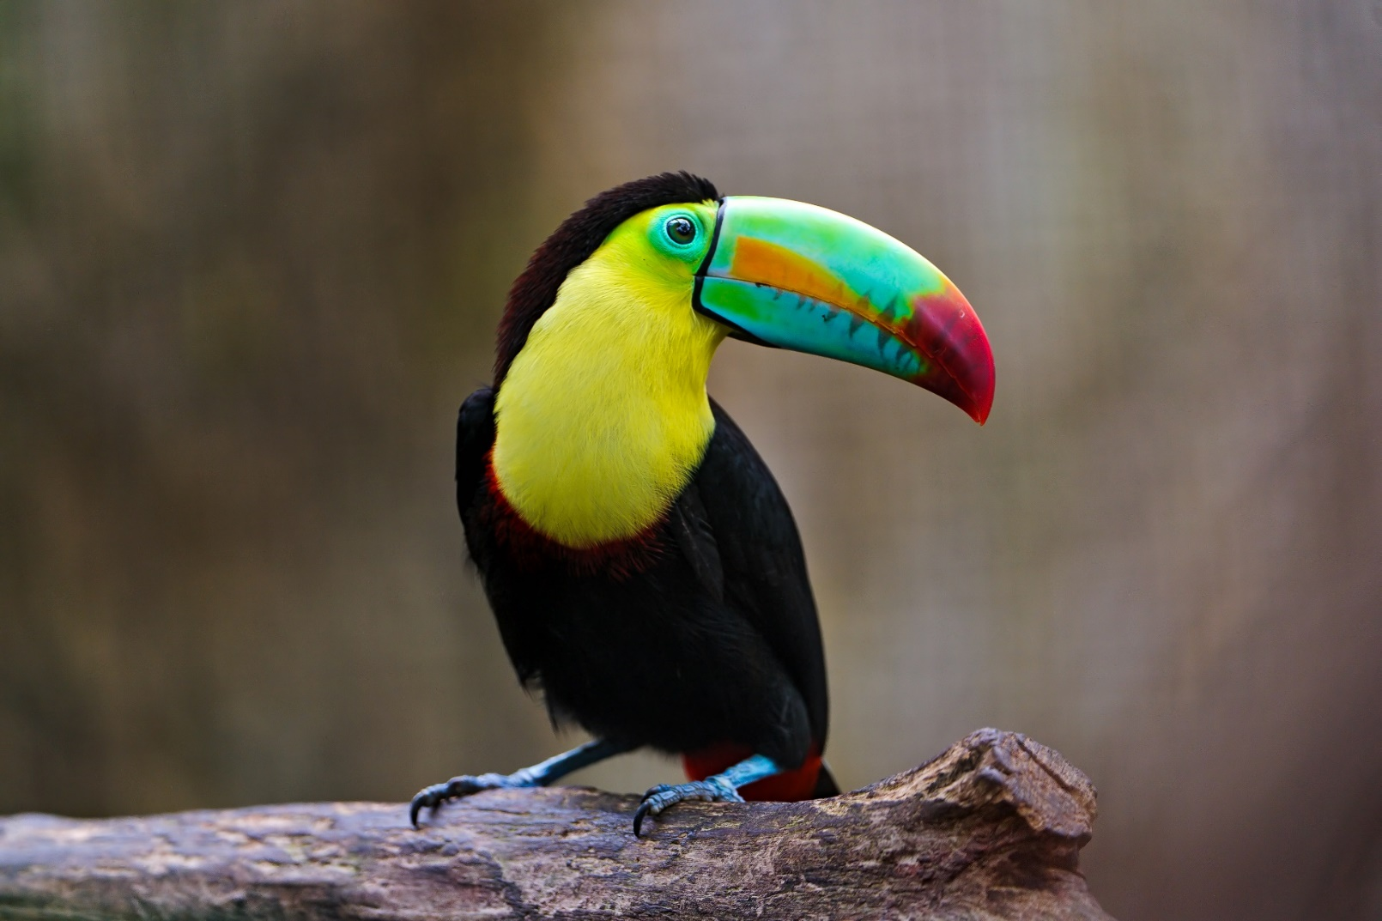
Toucan
Photo courtesy of ecollc (@flickr.com) - granted under creative commons licence

Slide 17
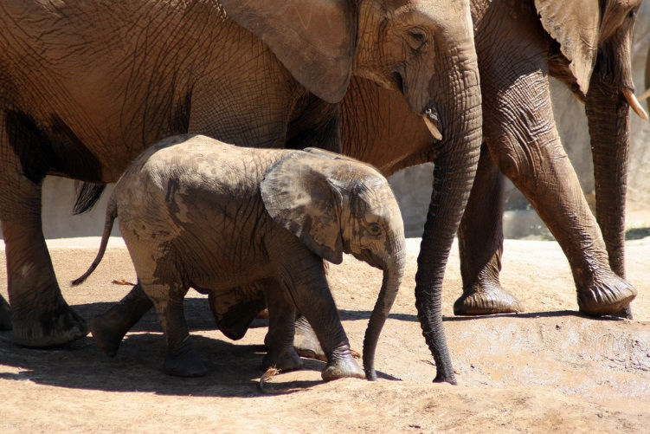
Elephants
Photo courtesy of ecollc (@flickr.com) - granted under creative commons licence

Slide 18
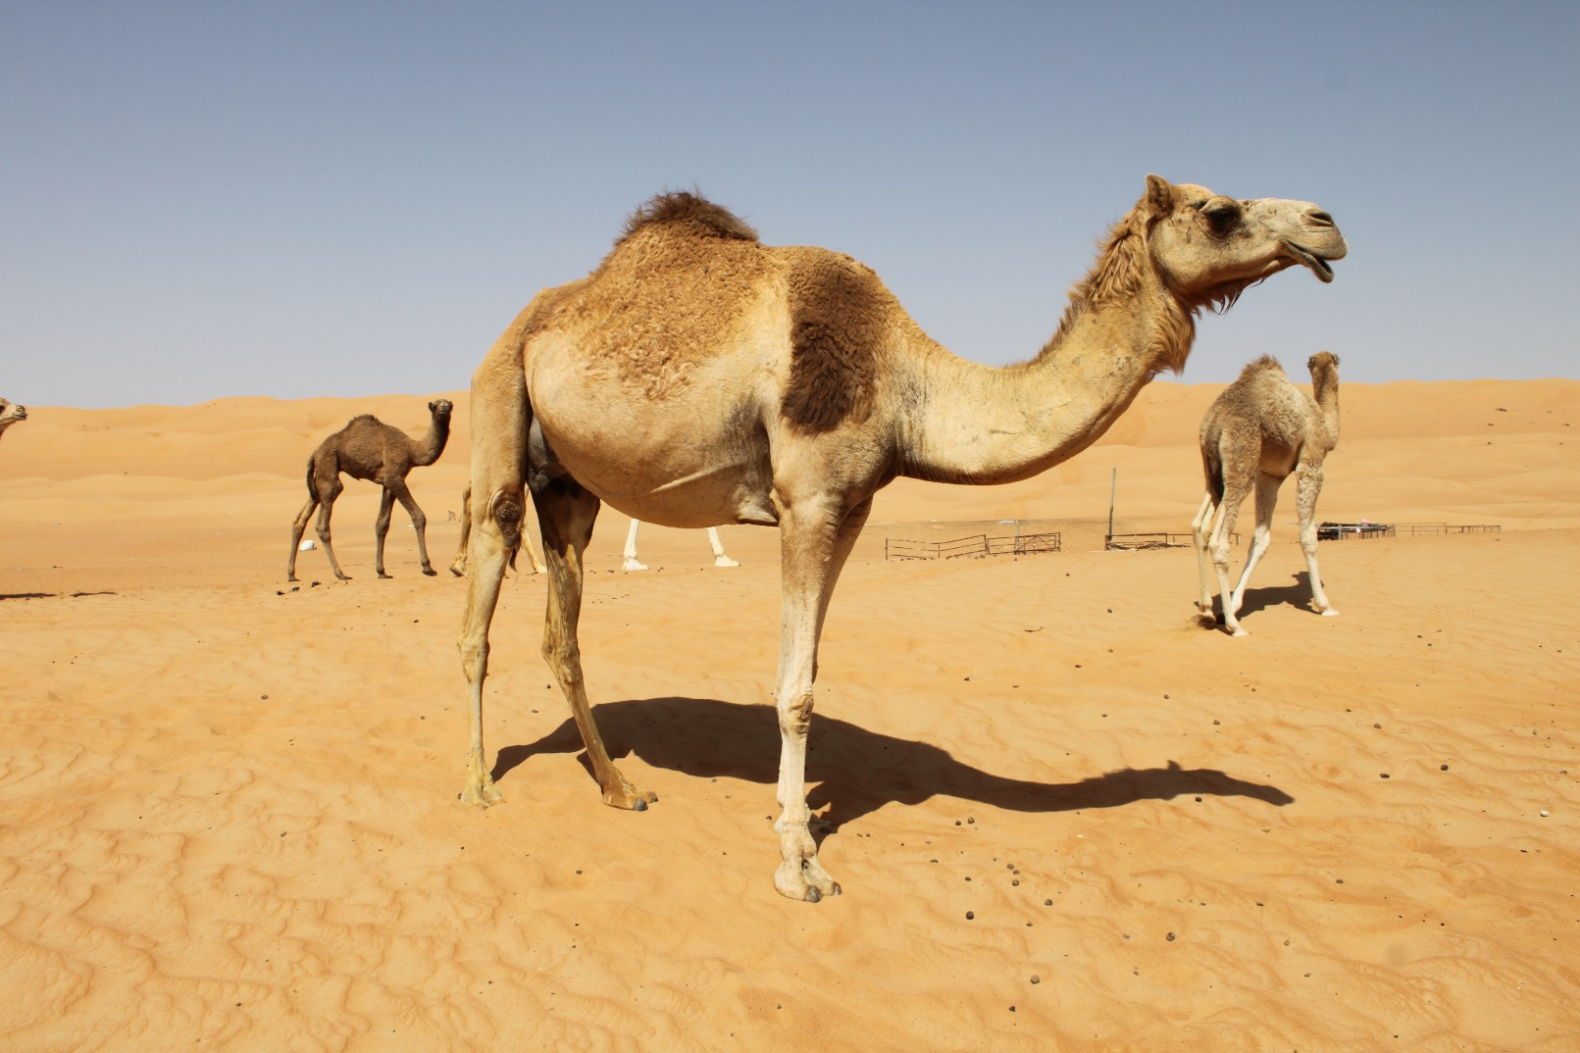
Camel
Photo courtesy of Liam (@flickr.com) - granted under creative commons licence

Slide 19
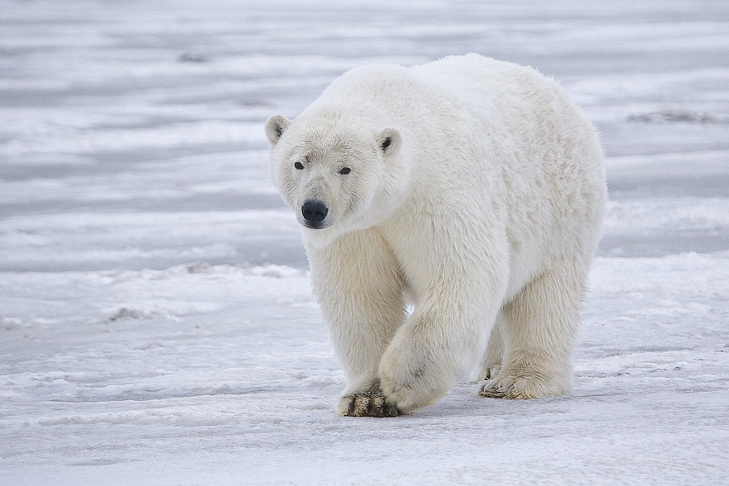
Polar Bear
Photo courtesy of frubyblossom (@flickr.com) - granted under creative commons licence

Slide 20
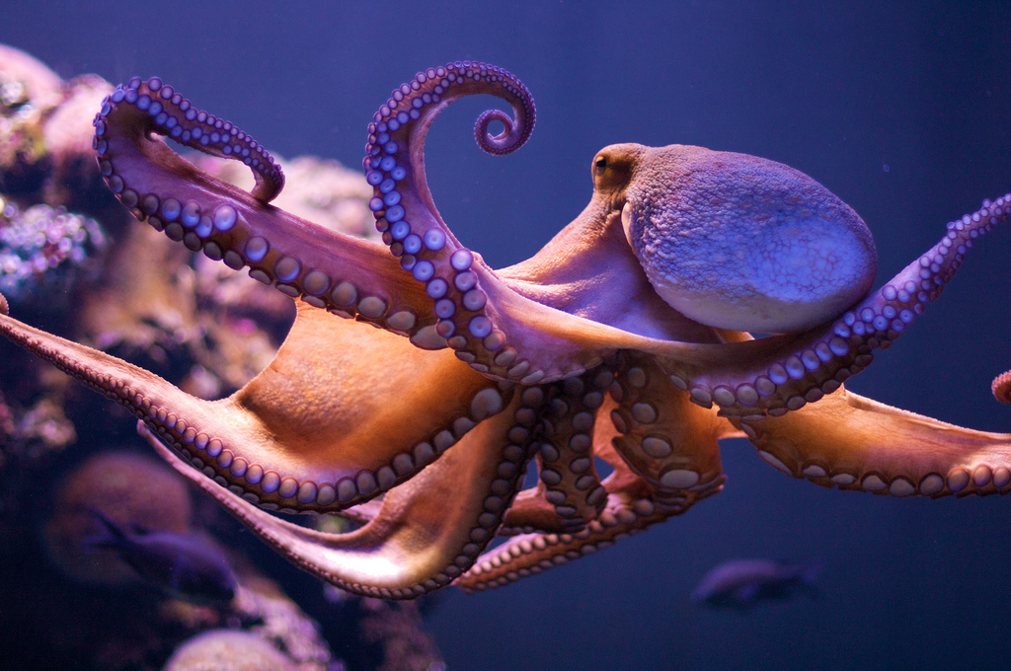
Octopus
Photo courtesy of Morten Brekkevold (@flickr.com) - granted under creative commons licence

Slide 21
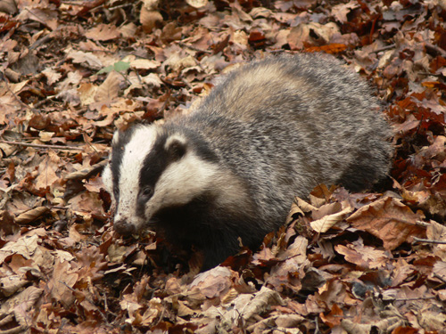
Badger
Photo courtesy of Fryerman (@flickr.com) - granted under creative commons licence

Slide 22
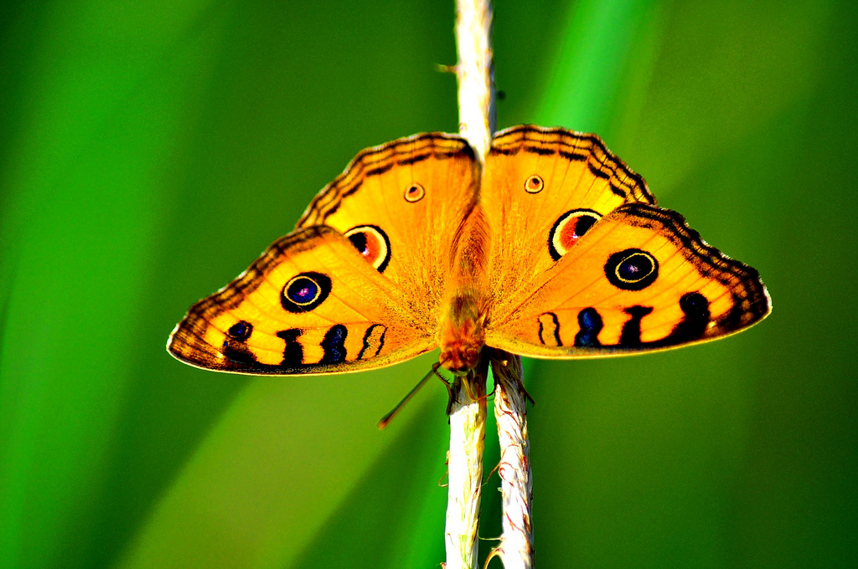
Butterfly
Photo courtesy of whologwhy (@flickr.com) - granted under creative commons licence

Slide 23
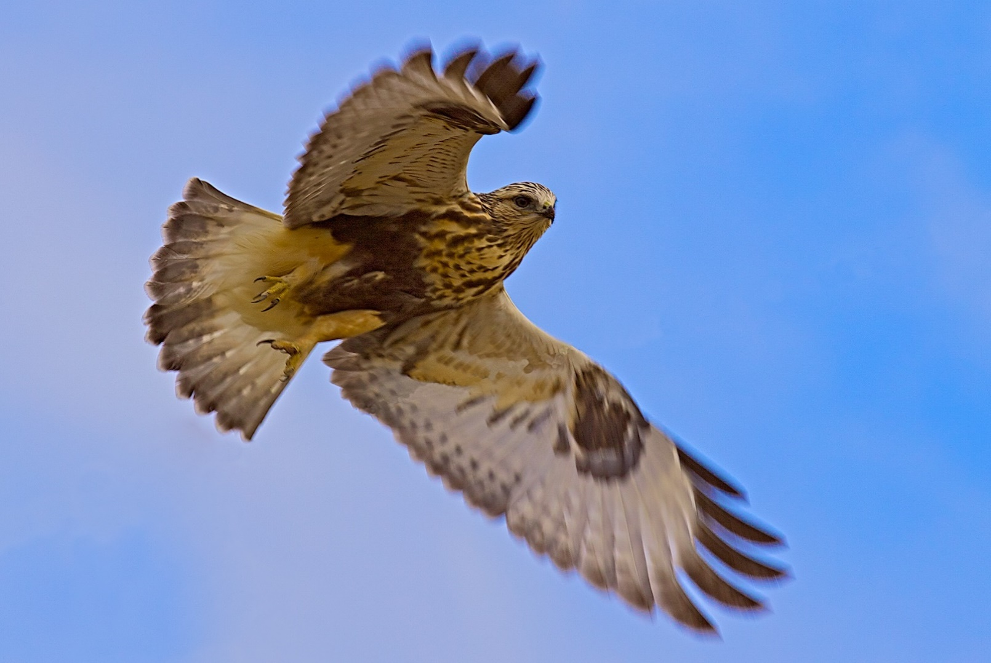
Hawk
Photo courtesy of fyngyrz (@flickr.com) - granted under creative commons licence

Slide 24
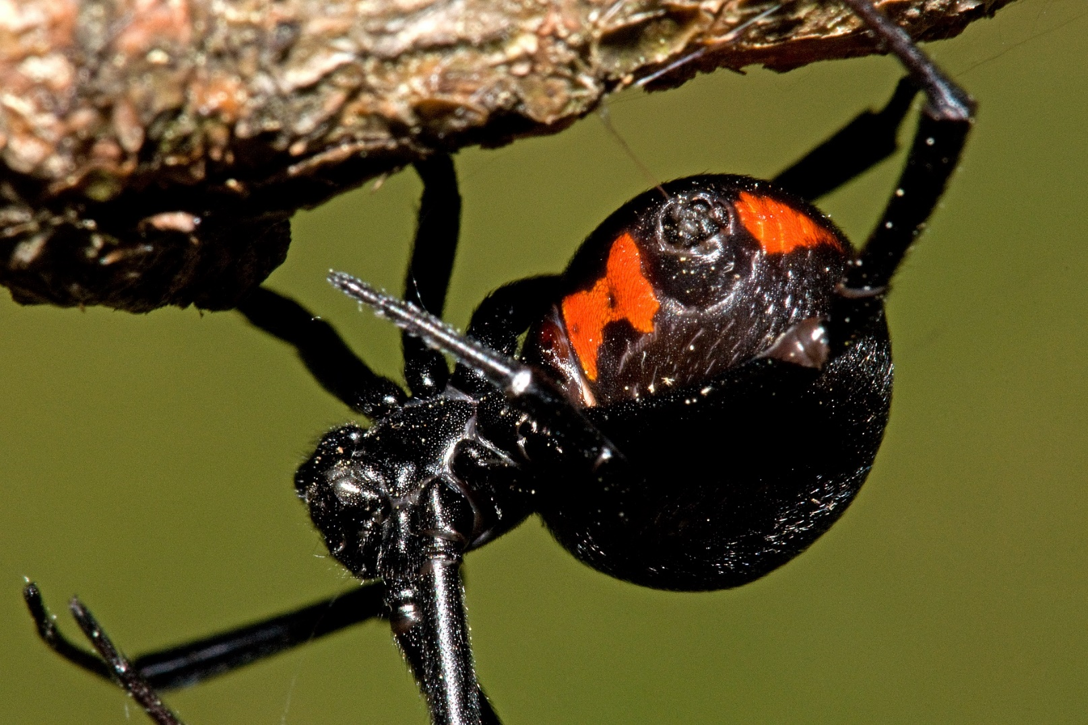
Spider
Photo courtesy of e_monk (@flickr.com) - granted under creative commons licence

Slide 25
Task
Take inspiration from the images you have just looked at and use your worksheets to create your own creature! Remember that it can be as crazy as you want!
Top Tip:
Think about the features it has to help it survive in the habitat it lives in.

Slide 26
