Slide 1
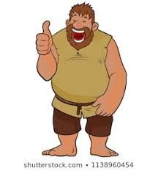
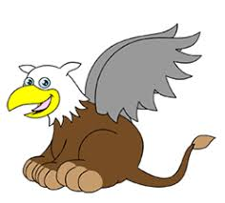
Goodbye Giants and Griffins!
Dear Year 4 Children,
As this strange school year closes, we wanted to congratulate you on your hard work and effort that you have made in your home learning. We know that it has been difficult at times, but you have persevered and have been determined to continue learning. We know that you have been supported and encouraged by the adults around you, so you must thank them for helping you so much in the past few months.
All your determined efforts will make it easier for you to continue with your learning as you enter Year 5. This is a very grown up thing you have learnt to do, so well done. We are very proud of you!

Slide 2
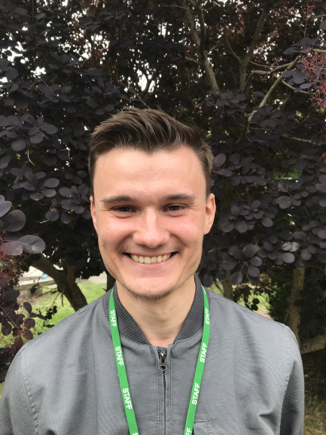
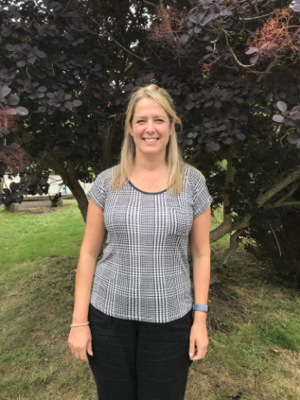
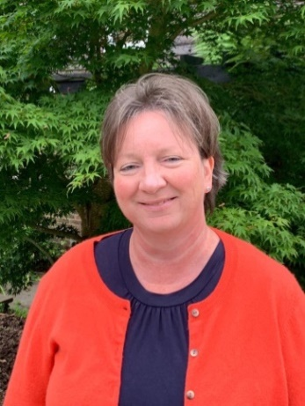
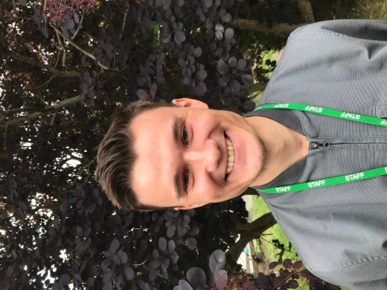
Of course, we are very sad that we didn’t get the opportunity to have the full year with you. We miss being together, sharing in your news and laughs, watching you learn new things and shine.
It has been lovely getting to know you, and we shall miss you. We know that you shall really enjoy Year 5 with Miss Morrison and Mrs Cheeseman. We still of course want to hear your news and funny stories when we see you in the playground.
Thank you also for your kind words and gifts, it was very generous of you and must have been tricky to organise! Thank you, we do appreciate it.
Take care and enjoy your summer break; you deserve it!
Mrs Browne, Miss Pattison & Mr Vallois

