Slide 1
Remember to Battle today!
The Battles will commence from 8.30am to 2pm today. You can battle for half an hour - more or less. It is up to you!
https://ttrockstars.com/

Slide 3
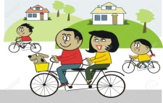
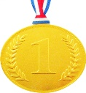
Farnborough’s Race across the World Results up to Monday 29th June
Class | Number of kilometres covered | *Which country did your class reach? From Farnborough School to …..
Pixies | 2637 km | Turkey
Elves | 2135 km | Romania
Unicorns | 2412 km | Greece
Phoenix | 1587km | Tunisia
Pegasus | 5104 km | Canada
Giants | 2771 km | Turkey
Griffins | 2800km | Turkey
Centaurs | 3633 km | Egypt
Dragons | 1750 km | Tunisia

Slide 4
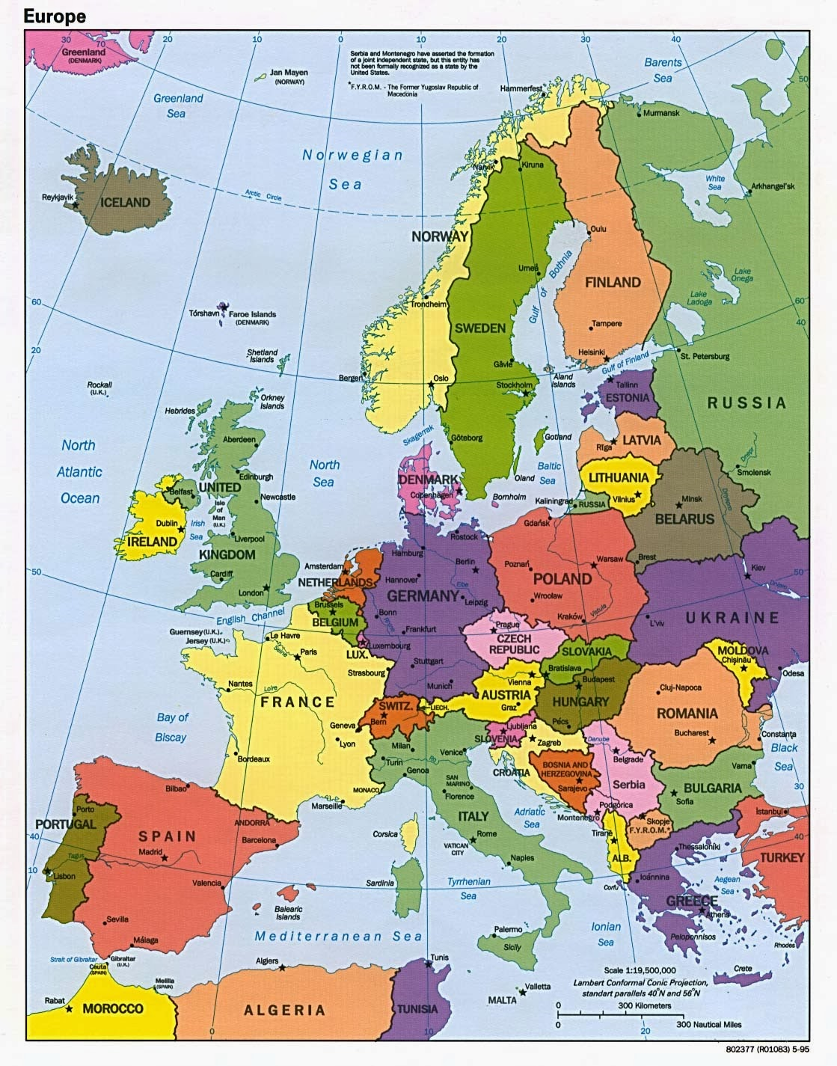
Which country did your class reach?
Map of Europe
Which country did your class reach?

Slide 5
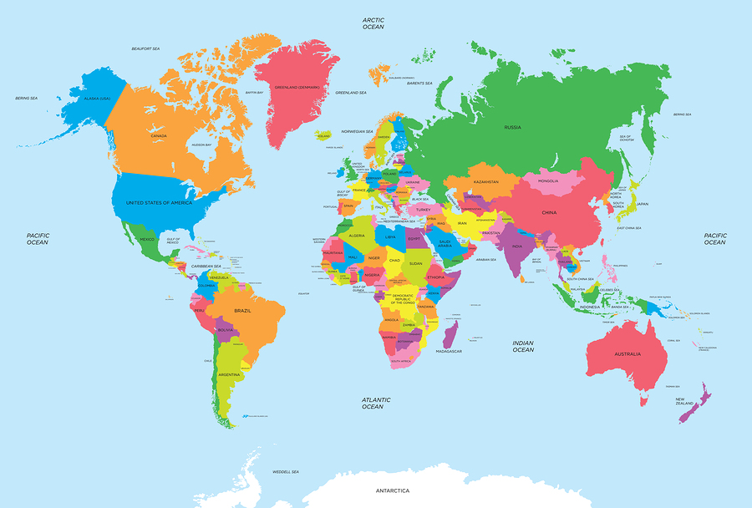
of the World
Map of the World
Which country did your class reach?

Slide 6
Day 2
English

Slide 7
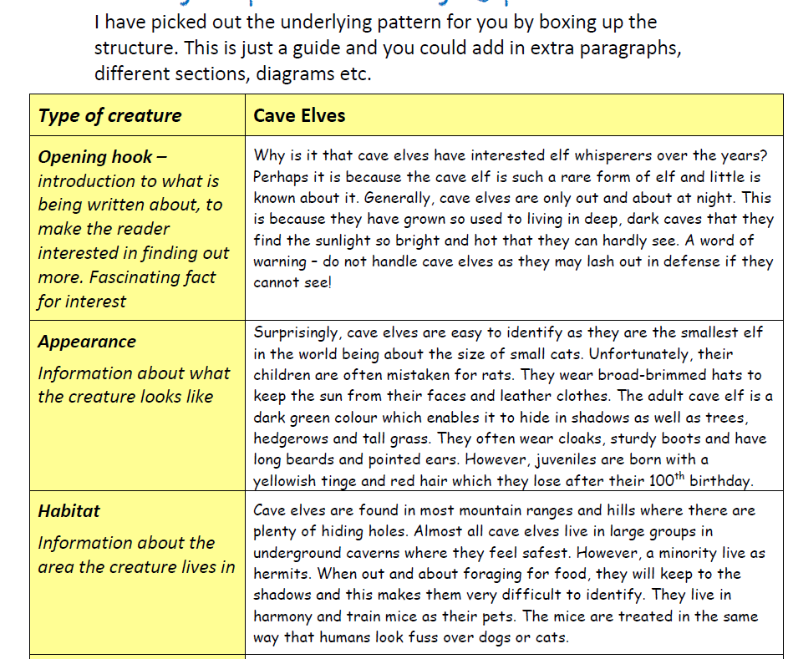

Slide 8
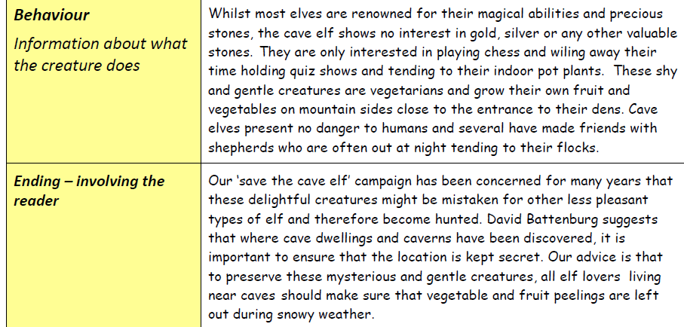

Slide 9
Start planning some ideas using the questions above. You may want to include your
own headings too.

Slide 10
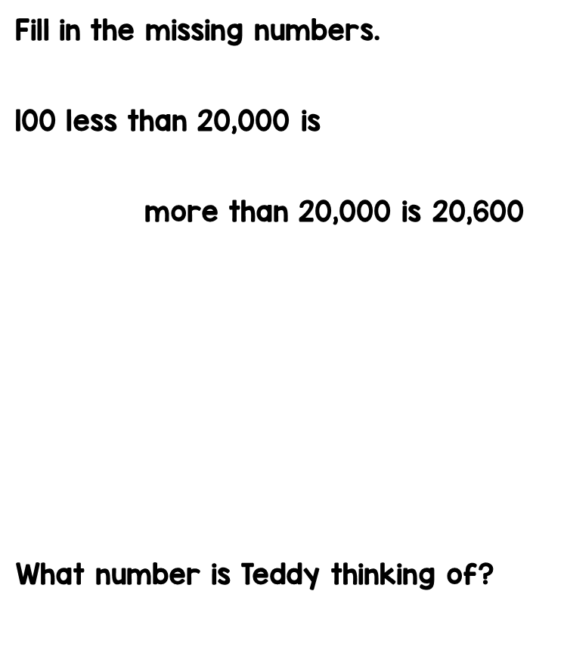
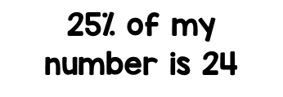
Answers from Maths day 1

Slide 11
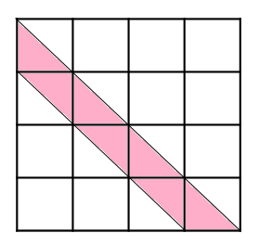

Slide 12
Day 2

Slide 13
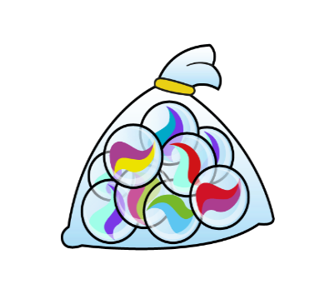
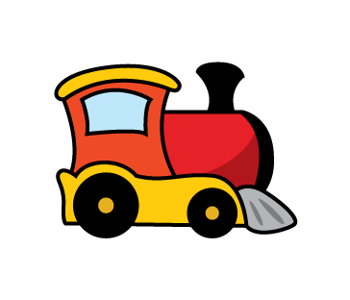
Have a go at these problems

Slide 14
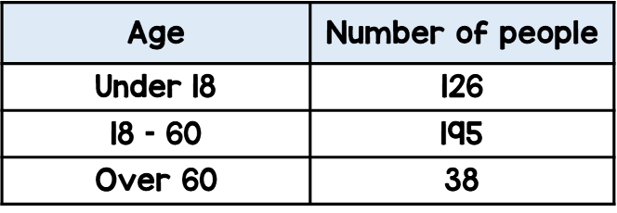
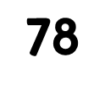
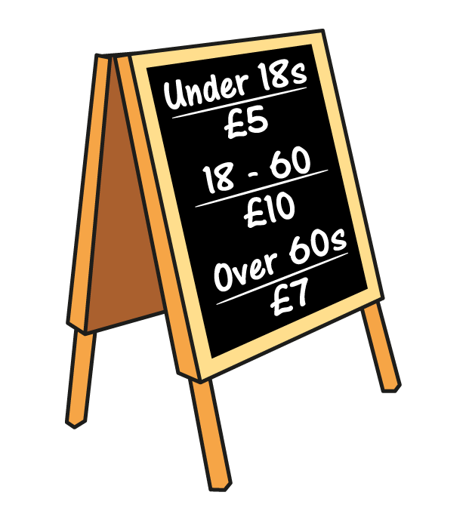
$$+$$
$$+$$
$$+$$
$$=$$
$$+$$
$$+$$
$$+$$
$$=$$
$$×$$
10
$$=$$
42
$$÷$$
10
$$=$$
42

Slide 15
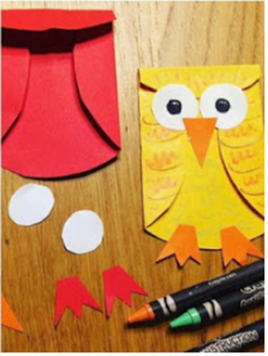
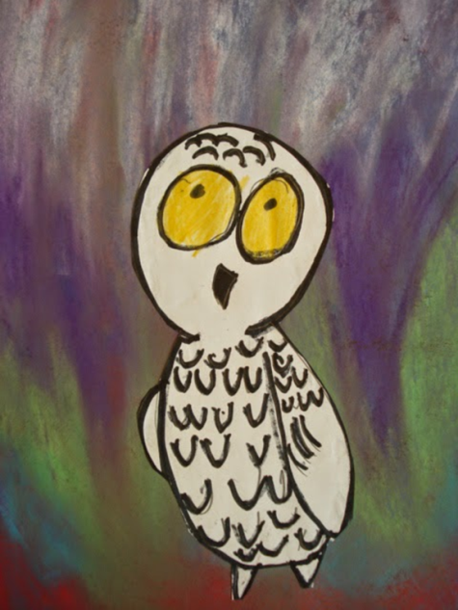
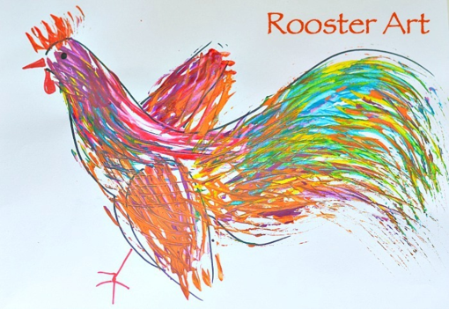
Carnival of the Animals An Art festival
For the next few weeks we are going to run a series of art lessons based around animals.
So whether you are working at home or in school you can create some great pictures. We would like to fill the Farnborough Art Gallery with your work to create a “Carnival of the Animals.”
If you are home learning, you can scan your work and send it in to your teacher.
Good luck, have fun and we want you to be creative, so if you have your own ideas we would love to see your artwork!

Slide 17
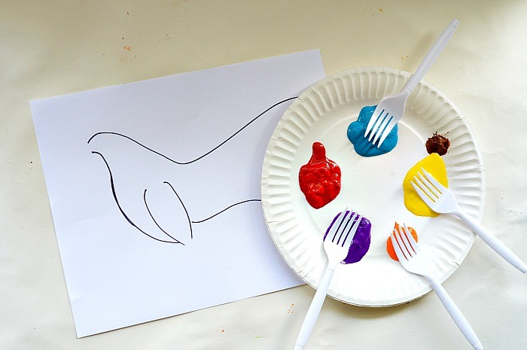
Materials you will need:
Paper plate
Plastic Forks
Washable Kids Paint or Acrylic Paint
If you need help drawing a rooster see:
https://artprojectsforkids.org/how-to-draw-a-rooster-2/

Slide 18
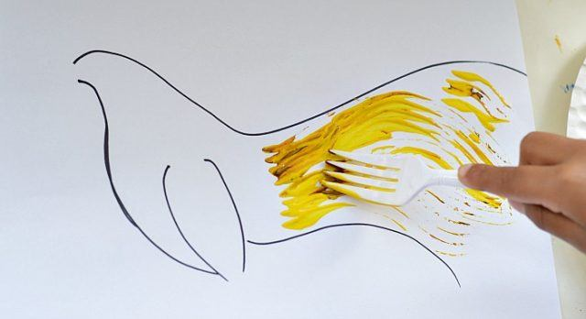
Try using watered down washable paint rather than thick paint out of the bottle. Washable acrylic paint is a great alternative too. Or you could draw lots of lines or strokes using gel pens /paint and brushes /chalk /charcoal or pastels.
Draw a basic outline for a bird, then use the forks to follow the curves and get the rooster coloured in. This entire art activity can be done simply with plastic forks and paint.

Slide 19
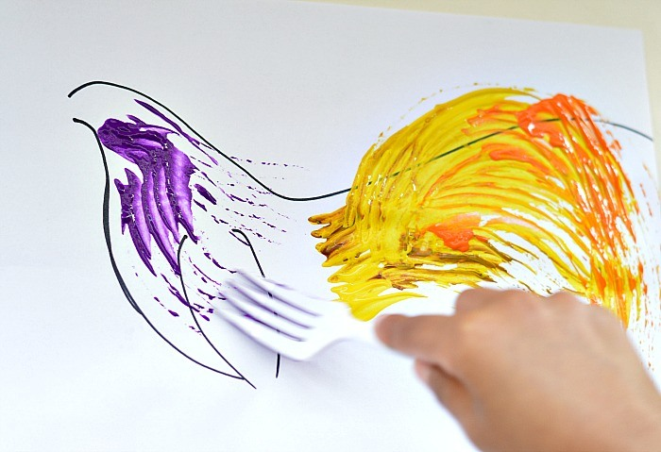
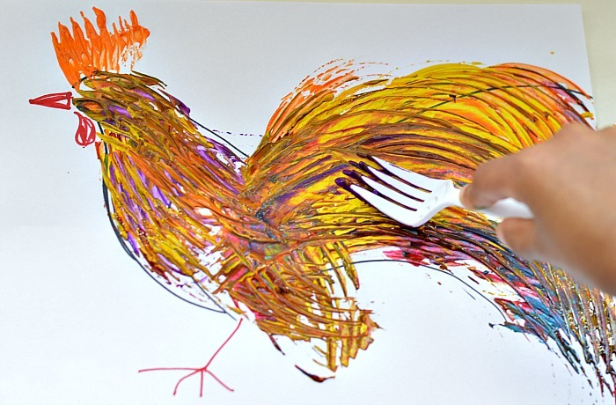
Try around 5 colours and do not stick to the natural colours of the bird.
There is no need to keep the fork painting inside the shape.
The art looks better when it is not too perfect! It looks even better when the fork marks look distinct!

Slide 20
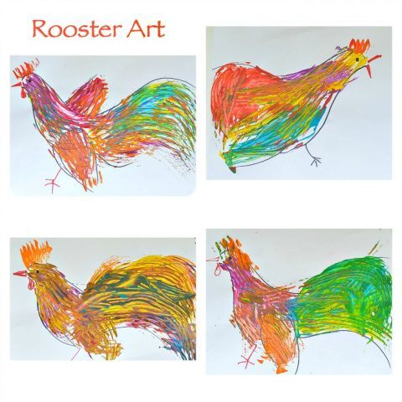
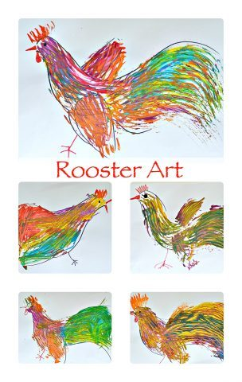
Finish off with by drawing a beak and an eye.

Slide 21
Active Learning

Slide 22
Science
You are going to see what happens when you add vegetable oil, fizzing tablets and food colouring together in a bottle. Follow the link below for the instructions.
https://sciencebob.com/wp-content/uploads/2015/04/Blobs-In-A-Bottle.pdf

