Slide 1
!

Slide 2
Day 1
English
Activity 1: Read the information about cave elves and/or listen to the information.
https://soundcloud.com/talkforwriting/whisperer/s-im7KkHzc880

Slide 4
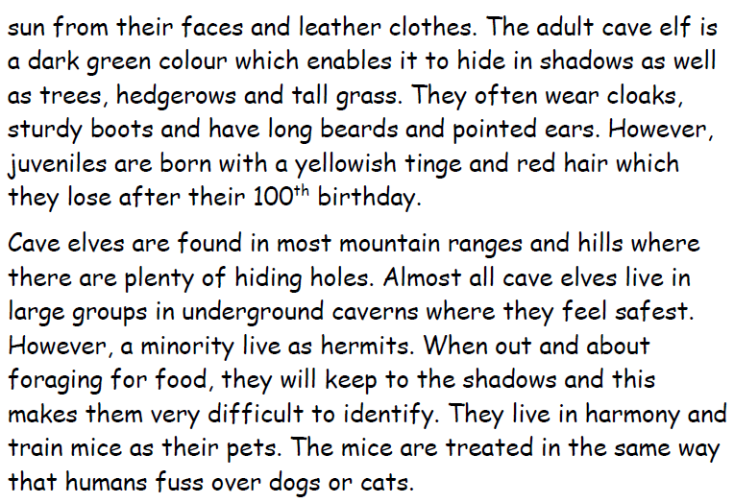

Slide 5
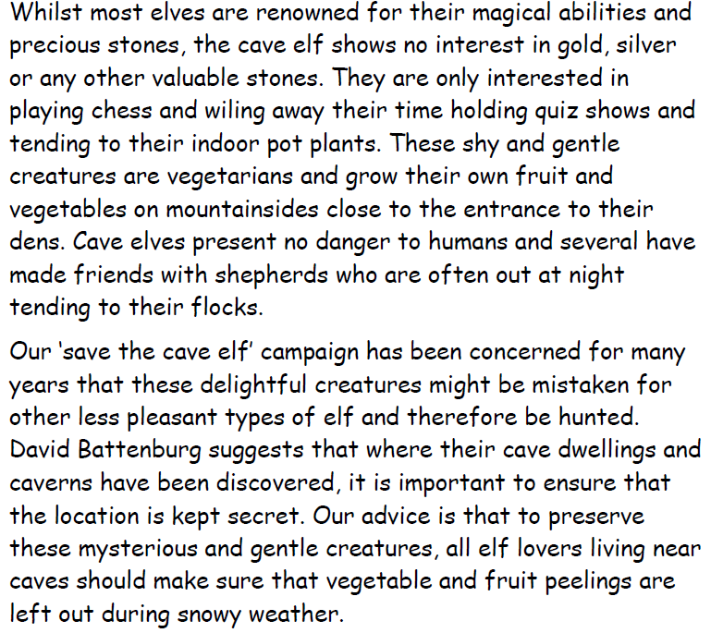

Slide 6
Activity 2:
Draw a cave elf and label them using the information from the text.

Slide 7
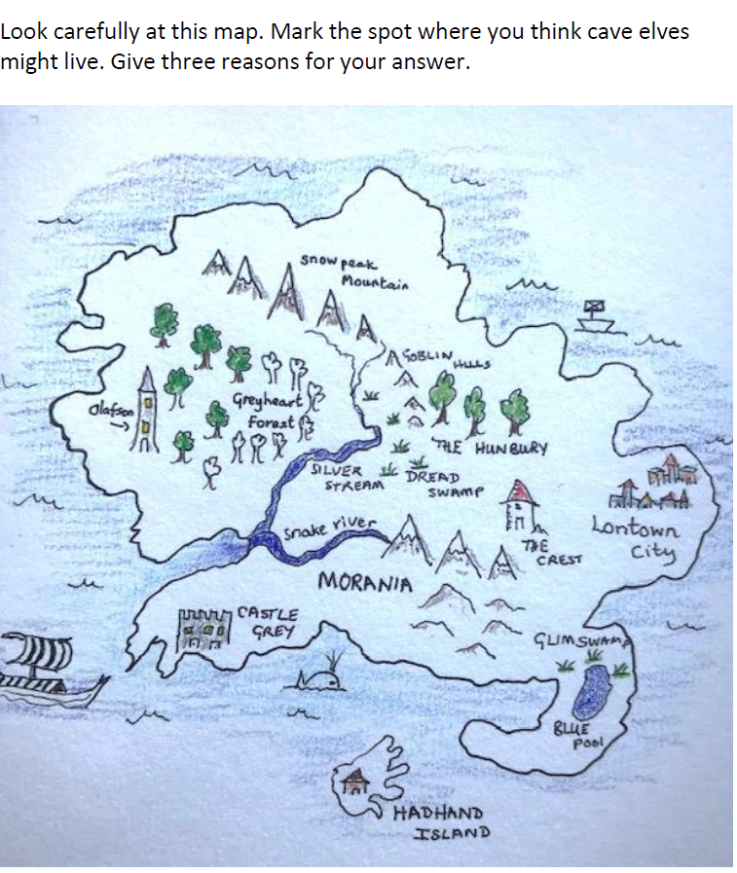
Activity 3:

Slide 8
Activity 4:

Slide 9
Day 1

Slide 10
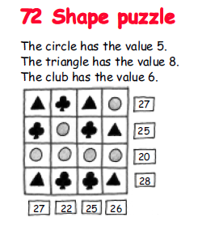

Slide 11
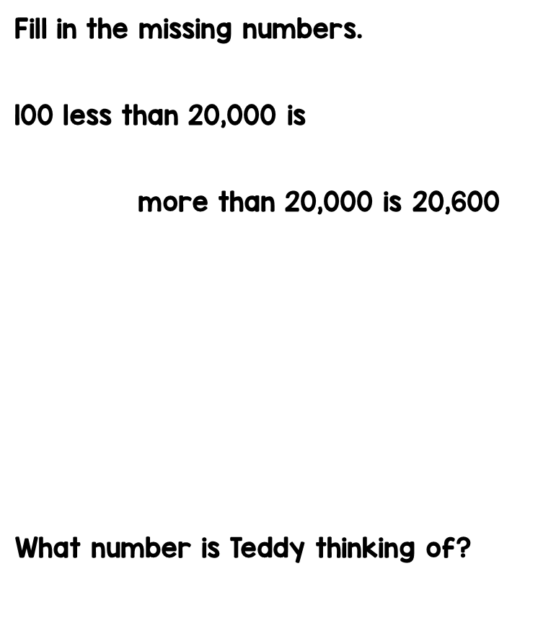
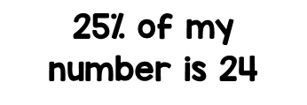
Have a go at these problems.

Slide 13
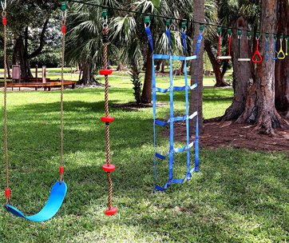
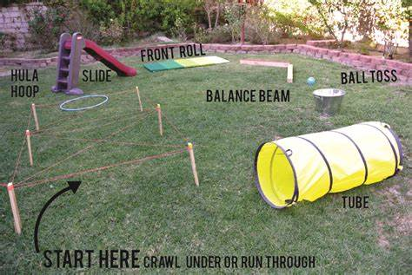
Outdoor learning
Make a simple obstacle course, using things from around the house or from the garden. Talk about what would be safe to use and what might not be safe to use. Are there rules to your obstacle course? Can you think of instructions on how to complete your obstacle course?

Slide 14
Active Learning!

Slide 15
Quick read
Guided reading- read the information and have a go at answering the questions on the next page.

