Slide 1
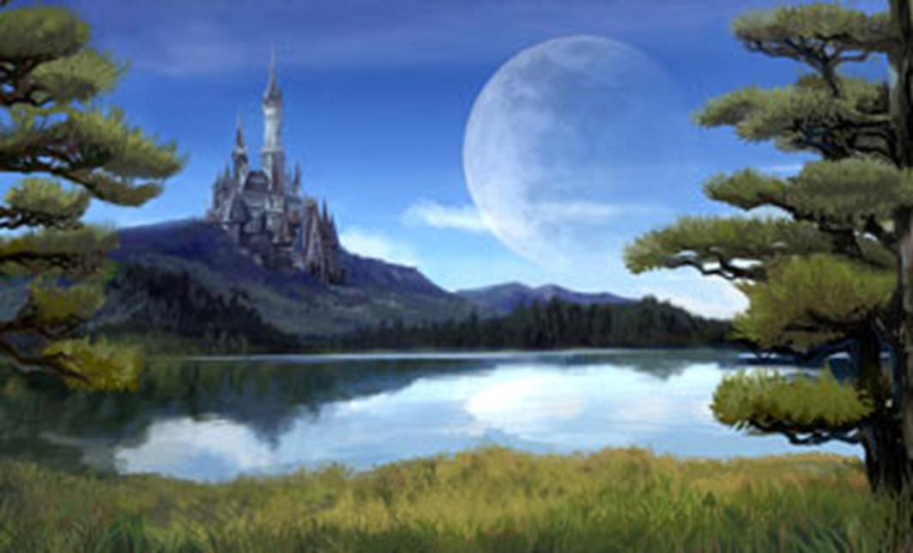
Day 3
English

Slide 2
Write your report about your chosen elf or sprite for the ‘Ultimate guide’.

Slide 4
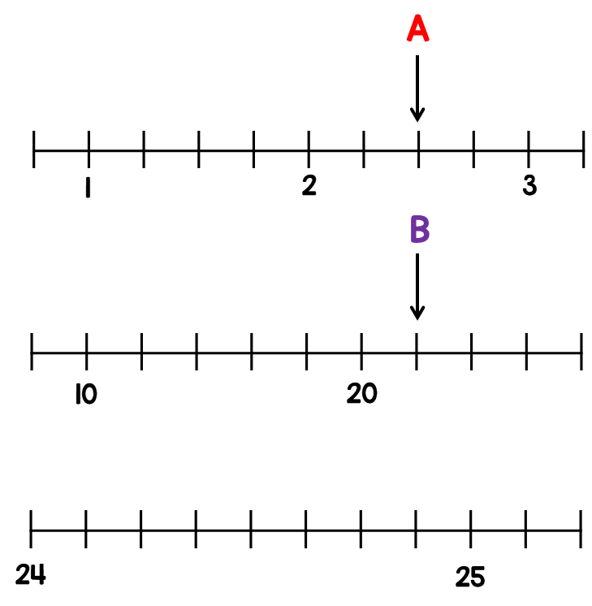
Maths answers from Tuesday.

Slide 5
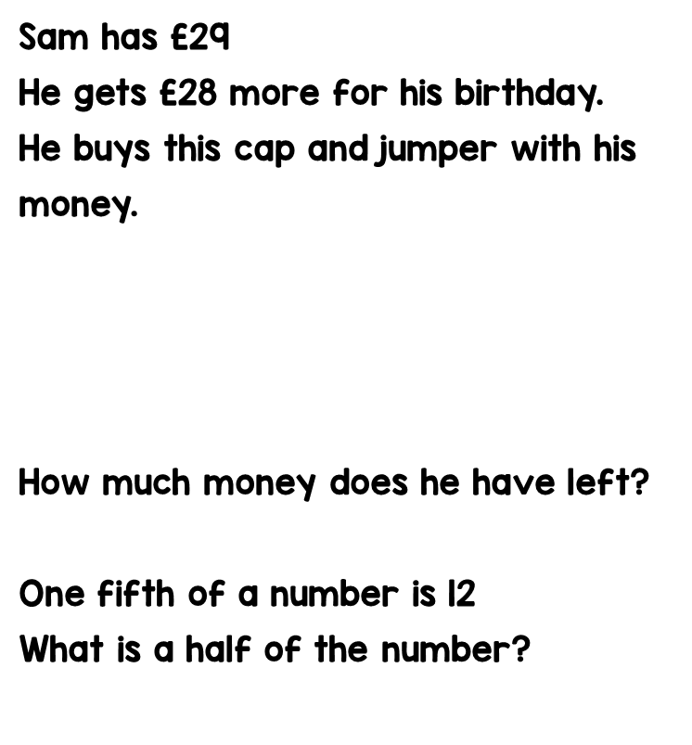
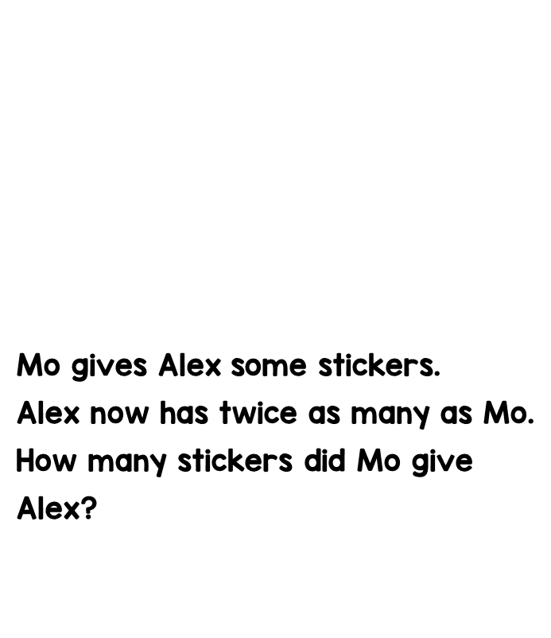

Slide 6
Day 3

Slide 7
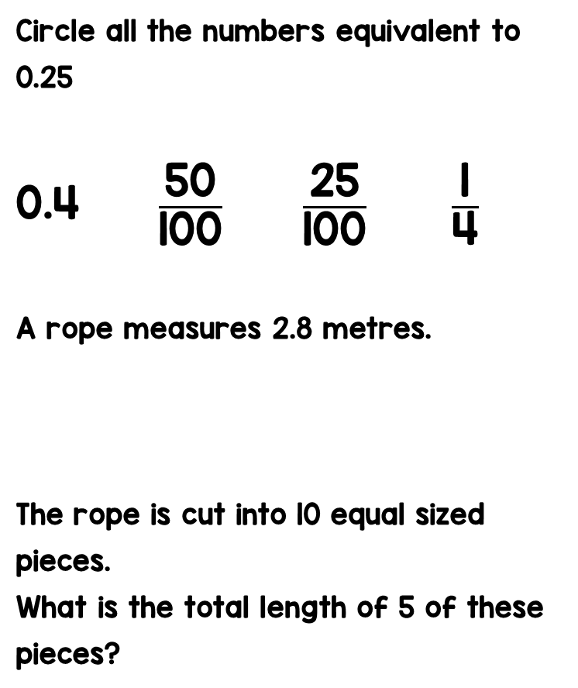
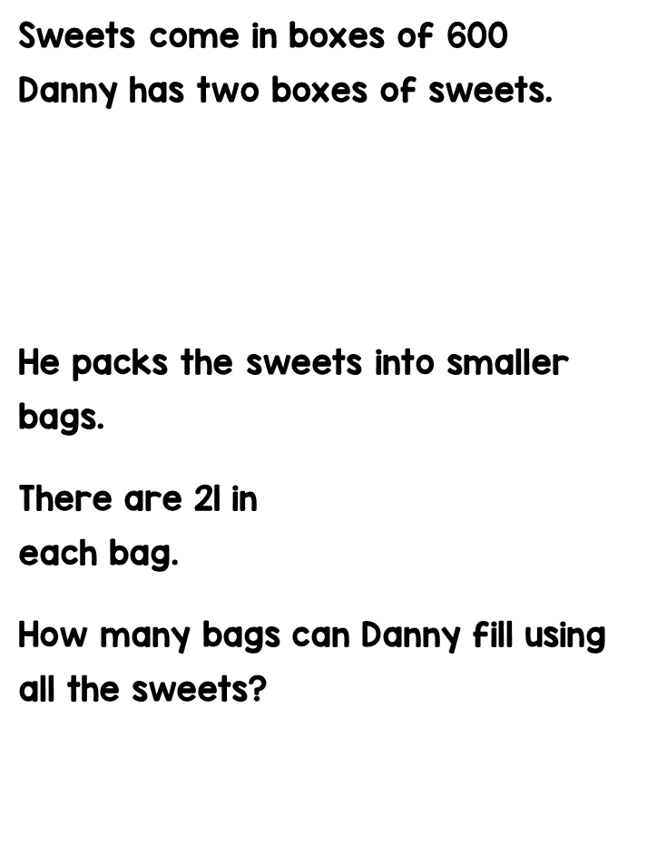

Slide 9
New beginnings
Moving to the next year group can cause a mix of emotions. You may feel excited, nervous or apprehensive.
Make a list of things you feel you have achieved this academic year; e.g. learning a particular method in maths, precise art work or a new sports skill.

Slide 10
New beginnings
Now make a list of things you would like to achieve in the next academic year; e.g. it could be trying a new sport or a new responsibility like house captain.

Slide 12
Active Learning

Slide 13
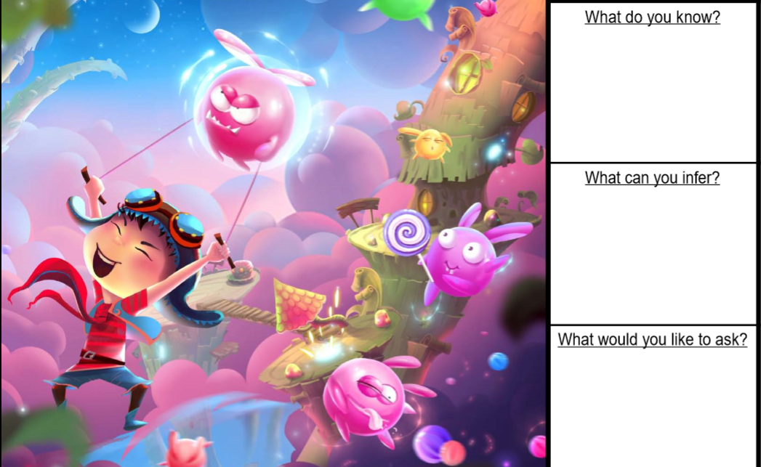
Quick read!

Slide 14
Science
You are going to create a colour symphony.
Follow the link below for the instructions.
https://sciencebob.com/wp-content/uploads/2015/02/A_color_symphony1.pdf

