Slide 1

!
Dear Centaurs,
How are you all? I can not quite believe we are nearly at the end of our journey together. I would just like to say you have been an amazing class! I will miss you next year but I know Mr Atkinson will enjoy being your teacher as I have.
On Friday our Zoom lesson may be longer than 15 minutes as we need to say our goodbyes.
Have a great week! Enjoy your ‘Meet the Teacher’ – Mr Atkinson
See you on Friday,
Miss Morrison

Slide 2
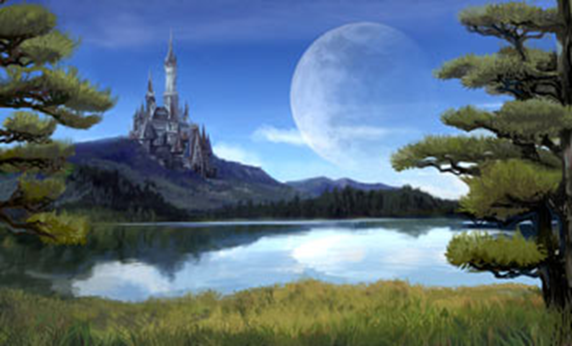
Day 1
English

Slide 3

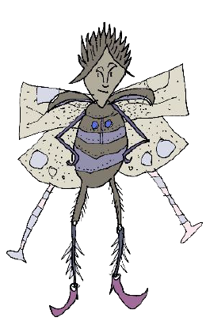
Draw and label your chosen species of
elf or sprite.

Slide 4
Here is an entry from the ‘Ultimate Guide about forest sprites’. Notice what the different paragraphs are about, taking ideas that you might employ in your writing. Also, magpie any useful vocabulary that you can use in your writing.

Slide 5
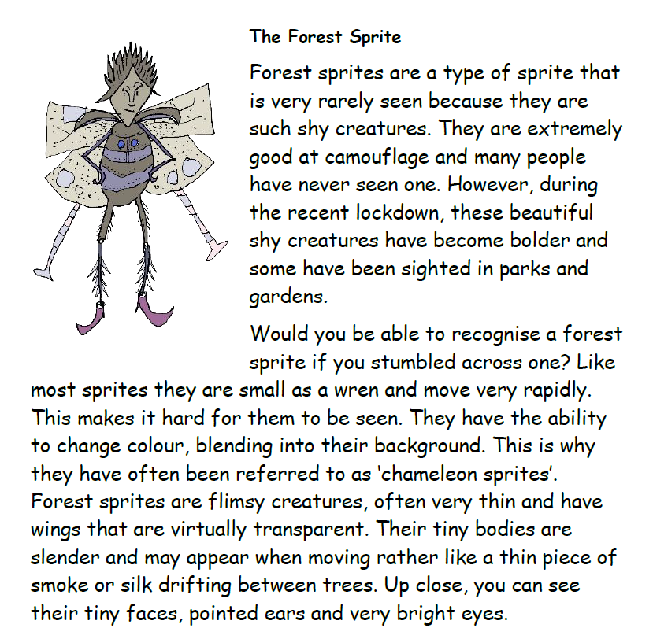

Slide 6
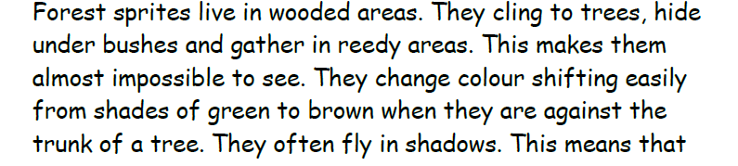
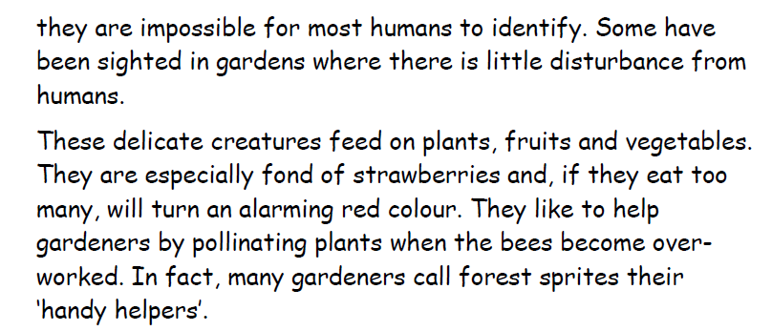

Slide 7
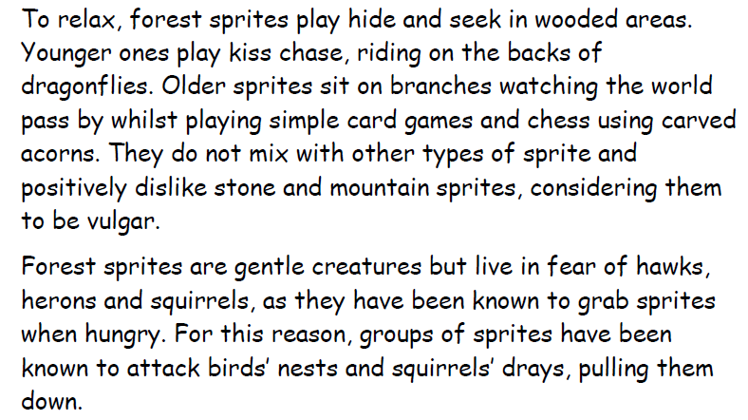

Slide 8
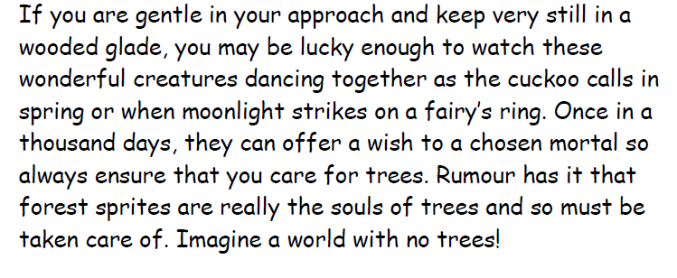

Slide 9


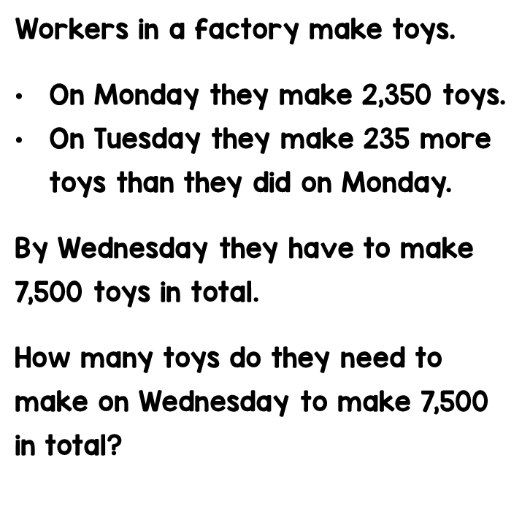

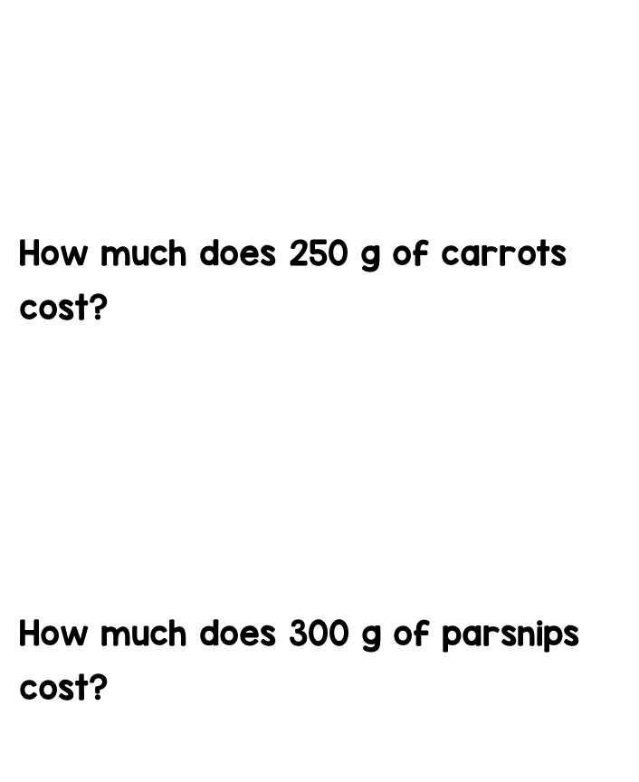






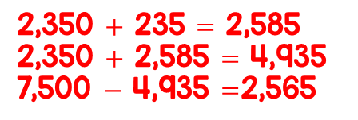



Maths answers from last Wednesday

Slide 10
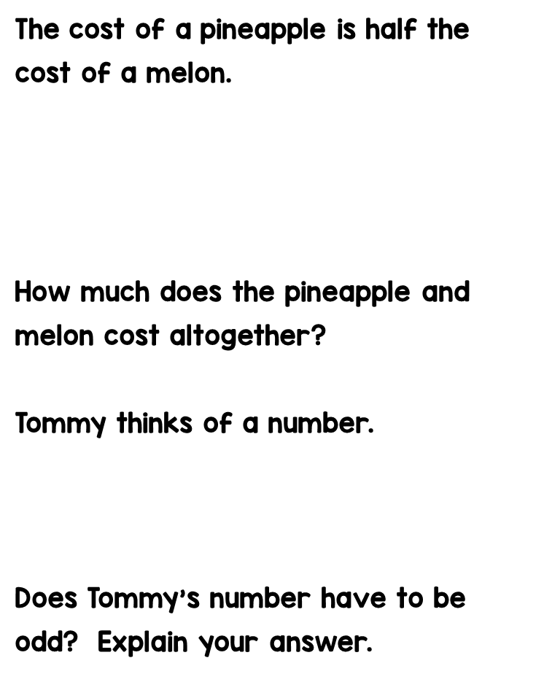

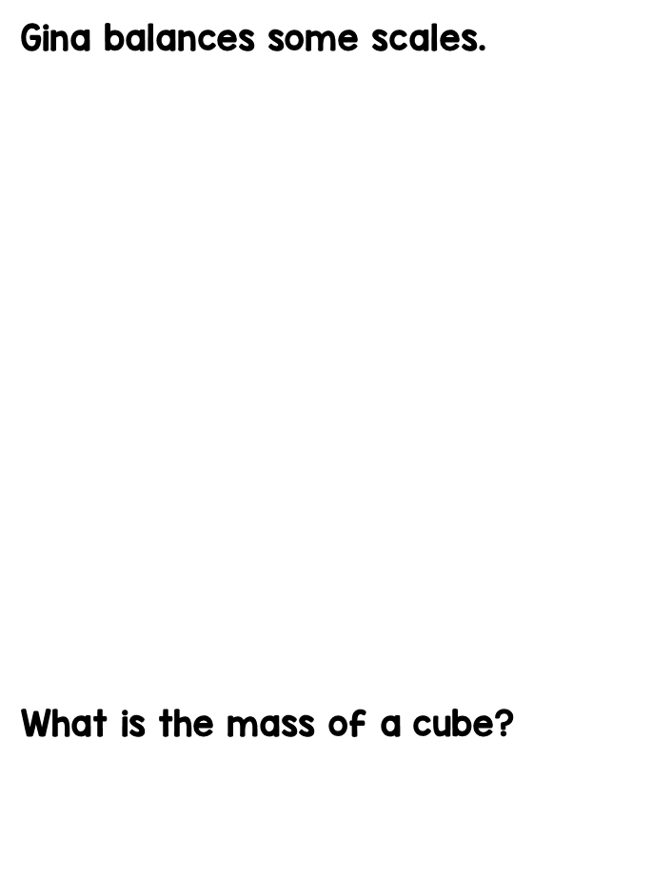






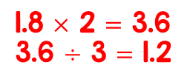










£3.50 each

Slide 11

Day 1

Slide 12
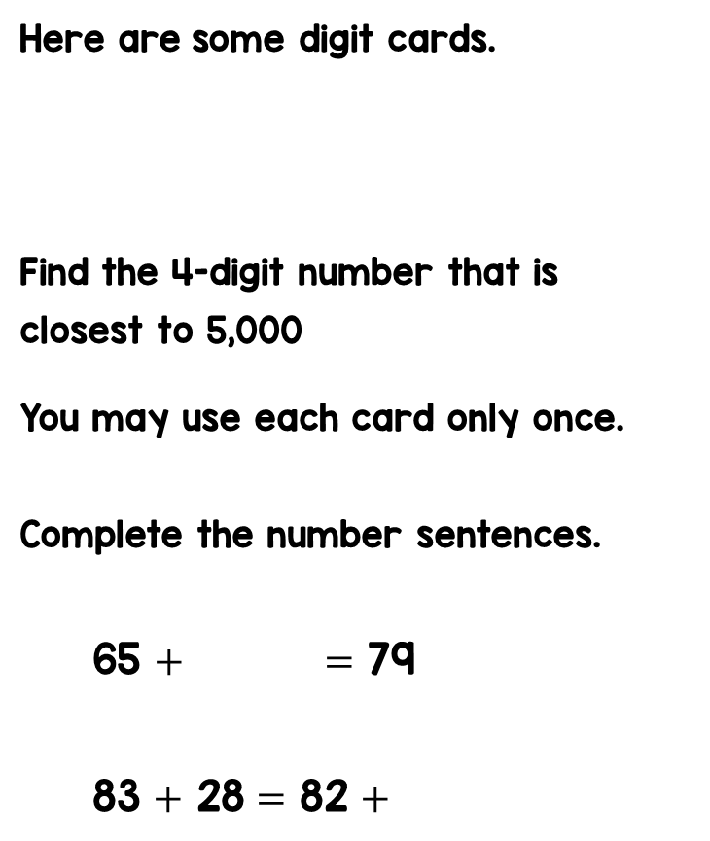
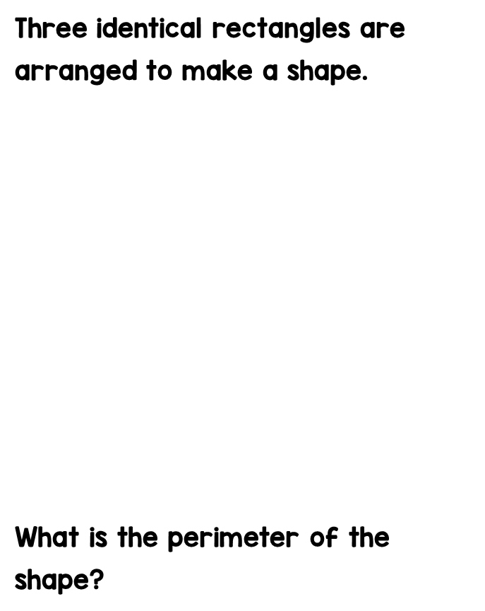

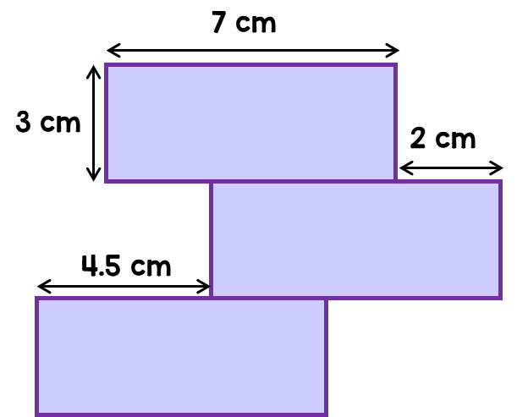


Slide 13
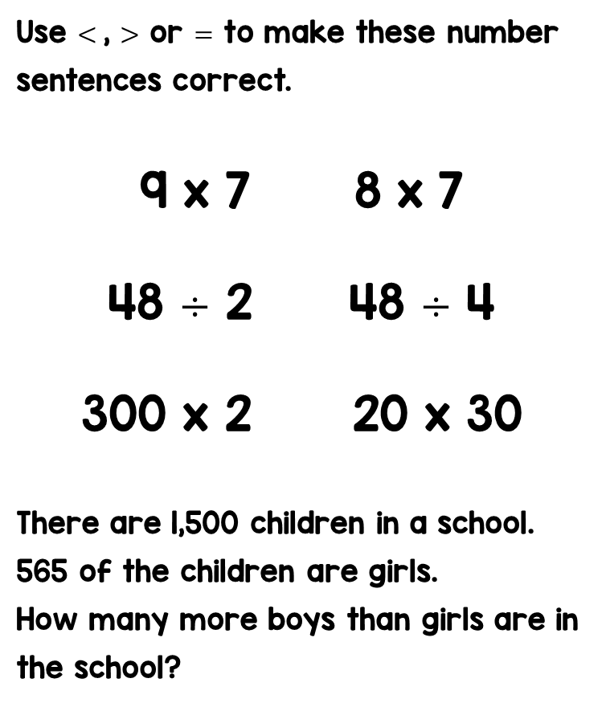

Mr Patel writes a number on the board.
Leon finds $\frac{\text{1}}{\text{2}}$ of the number.
Sophie finds $\frac{\text{1}}{\text{3}}$ of the number.
Leon’s number is 7 more than Sophie’s.
What is the number Mr Patel started with? This bar model may help you.

Slide 14
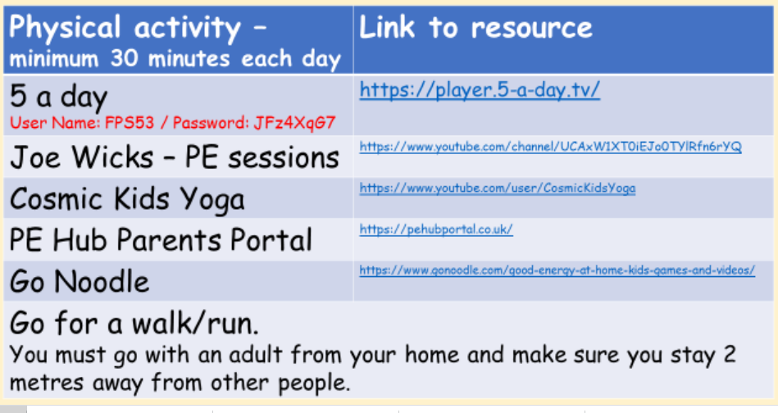
Active Learning!

Slide 15
Have a go at this Mathematical scavenger hunt. You can complete this indoors or outdoors.

Slide 16
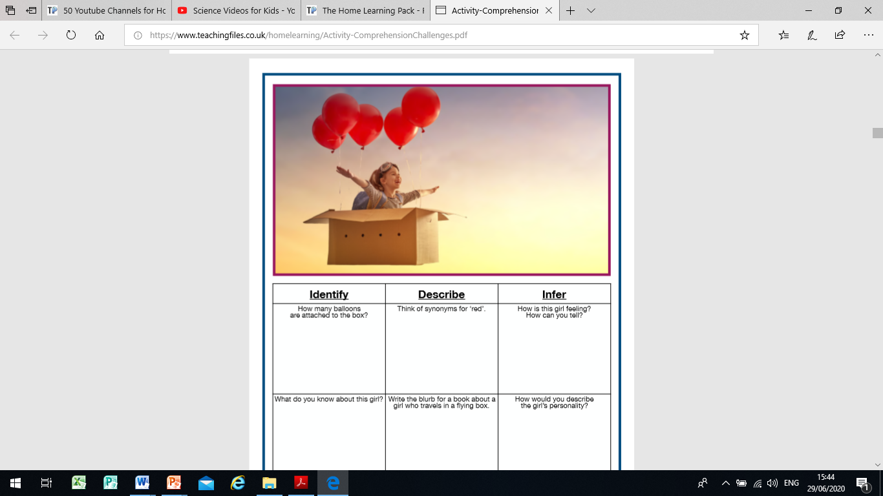
Quick read!

