Slide 1
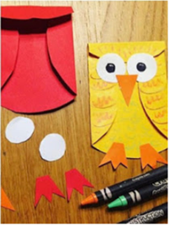
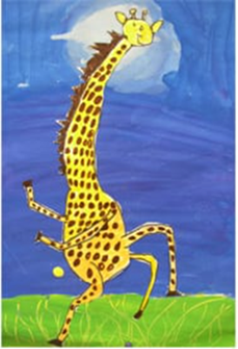
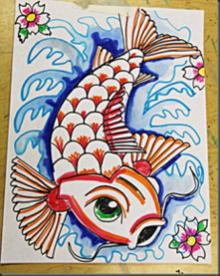
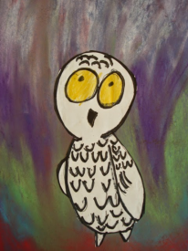
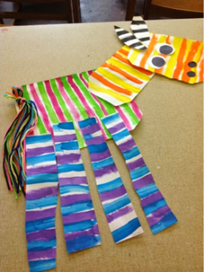
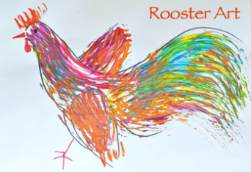
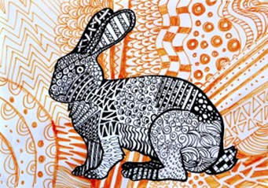
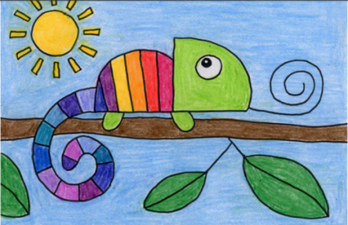
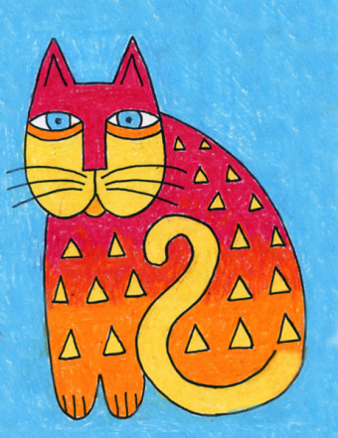
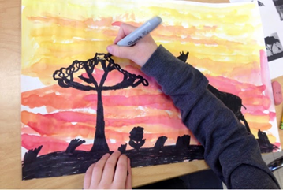
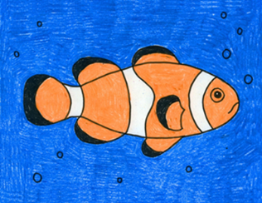
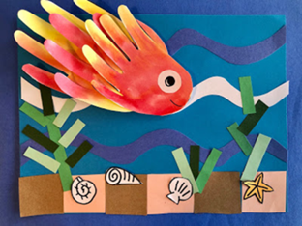
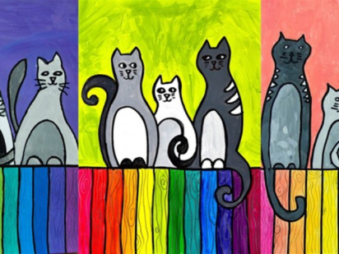
Carnival of the Animals - An Art festival
Hello
Over the last 6 weeks you been creating some great art on the theme of “Carnival of the Animals.”
We hope you have enjoyed the lessons and we have really enjoyed looking at your work. It’s been lovely to hear that family members have also joined in!
This week I am giving you a choice from my favourite websites….
There are so many nice ideas on these websites I found it difficult to choose, so take a look and decide yourself!
Enjoy ,relax, be creative this week and
over the summer.
We would love to see your artwork in September!
Take care
Miss Pattison
Thank you for sending in your fabulous artwork! Remember it’s not too late to send your art to your home learning page. We put up everything that is sent in on the website.

Slide 2
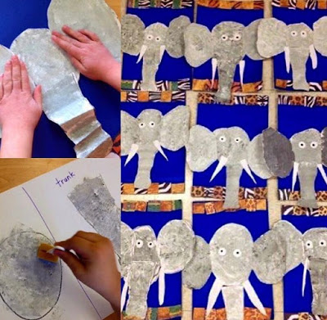
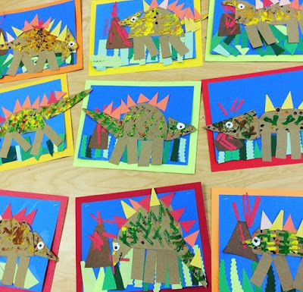
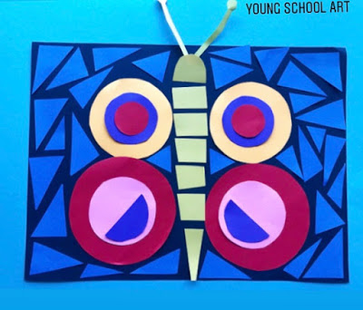
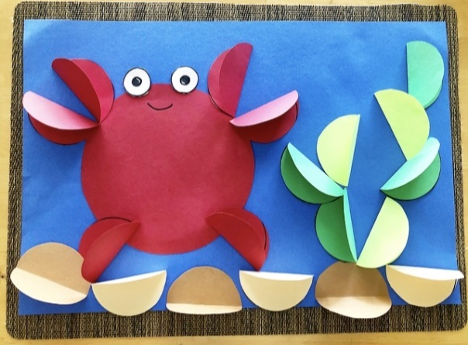
Young artists will enjoy this website
https://youngschoolart.blogspot.com/
https://youngschoolart.blogspot.com/2020/05/online-art-lessons-week-7.html
https://youngschoolart.blogspot.com/2020/06/
https://youngschoolart.blogspot.com/2020/05/online-art-lessons-week-10.html
https://youngschoolart.blogspot.com/2020/05/online-art-lessons-week-9.html

Slide 3
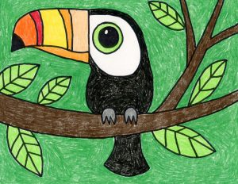
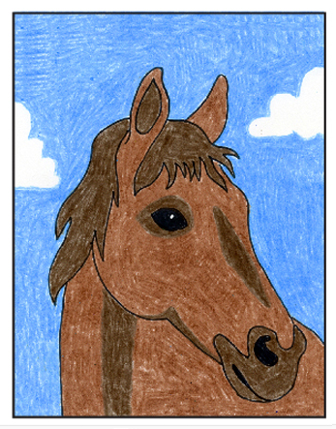
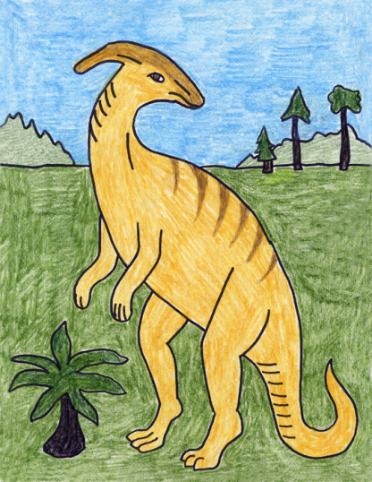
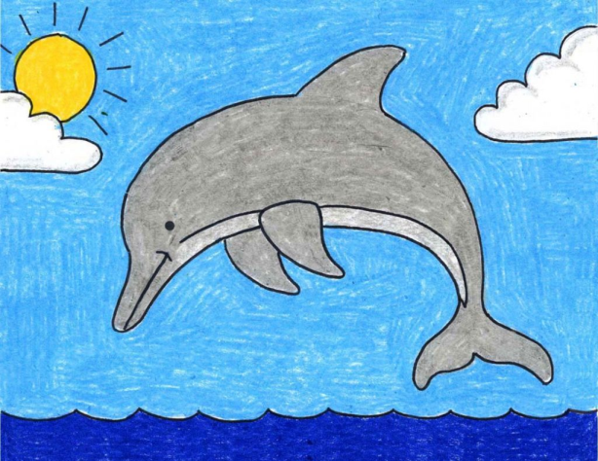
https://artprojectsforkids.org/
Know what you want to draw? This website gives you easy step by step instructions for virtually every animal. A few suggestions.....
https://artprojectsforkids.org/how-to-draw-a-toucan/
https://artprojectsforkids.org/draw-grumpy-cat/
https://artprojectsforkids.org/how-to-draw-a-horse-head/
https://artprojectsforkids.org/how-to-draw-a-dolphin/
https://artprojectsforkids.org/how-to-draw-a-parasaur-dinosaur/

Slide 4
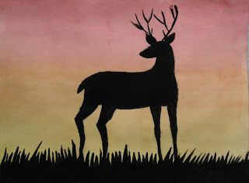
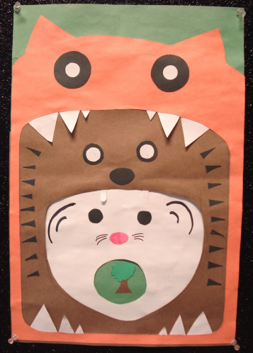
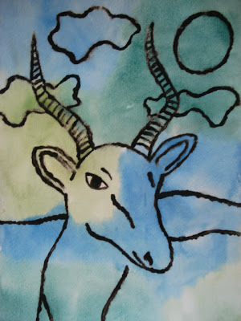
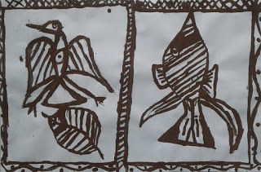
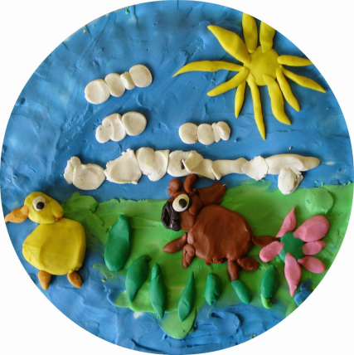
For more arty animal ideas check out this website:
https://afaithfulattempt.blogspot.com/
https://afaithfulattempt.blogspot.com/2019/05/antler-animals-in-silhouette.html
https://afaithfulattempt.blogspot.com/search?q=food+chain+collage+
https://afaithfulattempt.blogspot.com/2011/05/glue-resist-african-animals-watercolour.html
https://afaithfulattempt.blogspot.com/2015/05/plasticine-pictures.html
https://afaithfulattempt.blogspot.com/2019/11/korhogo-cloth-paintings.html

