Slide 1
Subject / Lesson | Time
Maths | 1 hour
English – Leavers Comments | 1 hour
Physical Activity | 30 minutes
Geography | 1 hour

Slide 2
Maths Task | Time
Maths Playground – Fractions Games https://www.mathplayground.com/index_fractions.html | 15 minutes
BBC Bitesize – Perimeter and Area – Zoom | 40 minutes

Slide 3
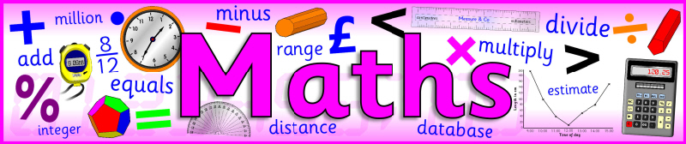
We will be looking at perimeter and area again.
The work will be from the BBC Bitesize page but I will first go through it on Zoom first.
BBC Bitesize Link
https://www.bbc.co.uk/bitesize/articles/znt3hcw

Slide 4

At the end of Year 6, you all write comments about each other which I then collate and put in a document for you to have. I think this is the nicest thing you receive. It shows some of the lovely things the people you have learnt and played with with over the years think about you.
We will discuss ideas on Zoom. The meeting ID and password will have been emailed to your parents’ email.
I will put some examples on the next slide.

Slide 5
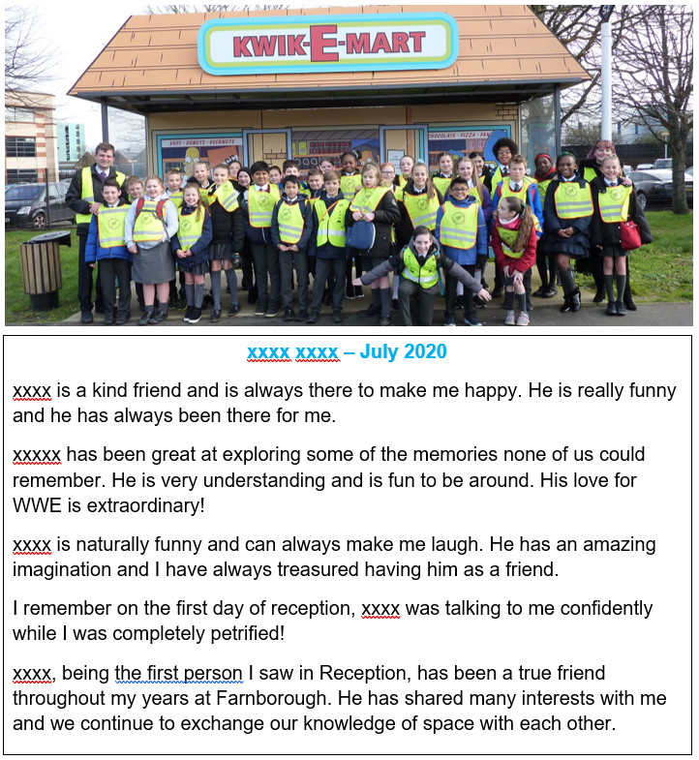
The more effort that is put in, the better the results.
It is not always easy to think up things on the spot, so we will take as much time as we need. I have definitely got today and tomorrow for working on this but we can have all week or longer if needed.
Once you have written a comment can you send it to me. You can send them one at a time. It takes time to put it together so send as soon as you can.
If you can send your comments electronically it does save me some time but don’t worry if it is as a photo.

Slide 6
If we have finished our comments for the Leavers documents, we will have a look at poetry.
Here is a link to 2 of my favourite poems:
http://farnboroughprimary.co.uk/wp-content/uploads/2020/06/Poems-Kraken-Jaberwocky.docx
BBC Bitesize – Analysing and Performing Poems
https://www.bbc.co.uk/bitesize/articles/zdw83j6

Slide 7
Physical activity – minimum 30 minutes each day | Link to resource
5 a day User Name: FPS53 / Password: JFz4XqG7 | https://player.5-a-day.tv/
Joe Wicks – PE sessions | https://www.youtube.com/channel/UCAxW1XT0iEJo0TYlRfn6rYQ
Cosmic Kids Yoga | https://www.youtube.com/user/CosmicKidsYoga
PE Hub Parents Portal | https://pehubportal.co.uk/
Go Noodle | https://www.gonoodle.com/good-energy-at-home-kids-games-and-videos/
Go for a walk/run. You must go with an adult from your home and make sure you stay 2 metres away from other people.

Slide 8

Global Knowledge
On the next slide, I have included instructions on how to access the resources and a sheet describing the tasks.

Slide 9

Login at: https://www.oddizzi.com/schools/login/
Username: Dragons
Password: Dragons
Select ‘Global Knowledge’
Complete as many tasks as you can from the sheet below:
http://farnboroughprimary.co.uk/wp-content/uploads/2020/06/World-Knowledge.pdf

