Slide 1
Welcome back Elves!
.
See you at 11 for Bingo!

Slide 2
Maths Bingo
In preparation for Maths Bingo, I would like you to draw a grid like the one below.
Then choose six numbers between 0 and 15 to put in the grid.
I will be calling out numbers. If your answer is a number in your grid, then you cross out the number.
The first person to cross out all six of the numbers wins the game! Call out House when you have all six numbers.

Slide 3
It’s Wednesday!
Wednesday 24th June 2020
Here’s your work for today…
.

Slide 4
Farnborough Dance Routine
Mrs Humphries has created our very own Farnborough Dance Routine!
It has five parts and every day this week we are going to start the day by being active and joining in.
Click on the link below:
http://farnboroughprimary.co.uk/farnborough-dance

Slide 5
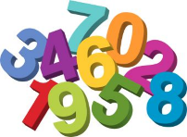
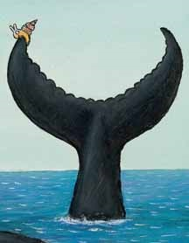
Maths
‘Please can you help us?’ squealed the Snail and the Whale.

Slide 6
.
Can you make your own puzzle for someone in your family? To start the
puzzle, draw 16 squares on an a4 piece of paper. Ask a grown up to do this.

Slide 7
. .
You can write your answers in your exercise books.
If you would like to try Gruffalo work, complete question 1
If you would like to try Horrid Henry work complete question 2
If you would like to try James and the Giant Peach work, complete question 3

Slide 8
Today we are going to find out some facts about
whales.

Slide 9
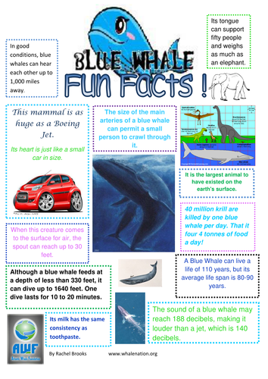
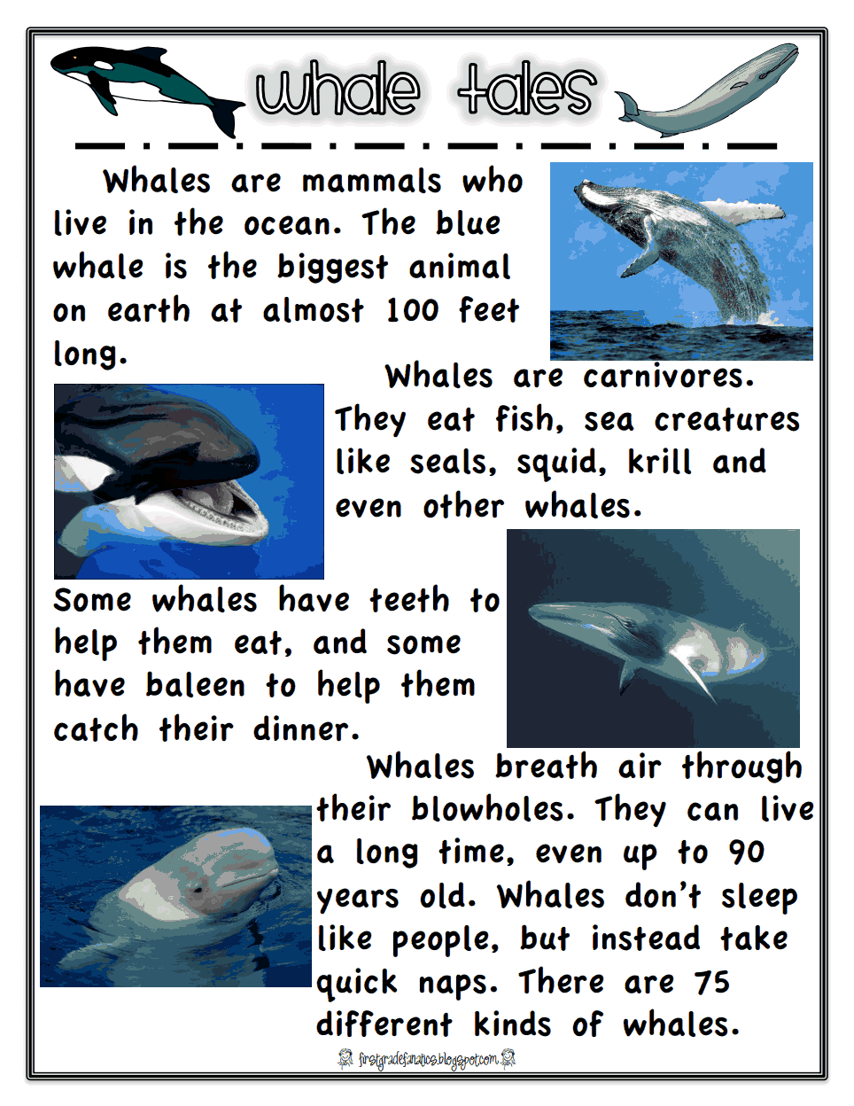
Follow these links to find out about whales. Create a whale fact sheet!
Facts about Whales for Kids - Whale Facts and Information
https://www.whale-world.com/facts-about-whales-for-kids
Whale Facts for Kids
https://www.scienceforkidsclub.com/whale-facts.html

Slide 10
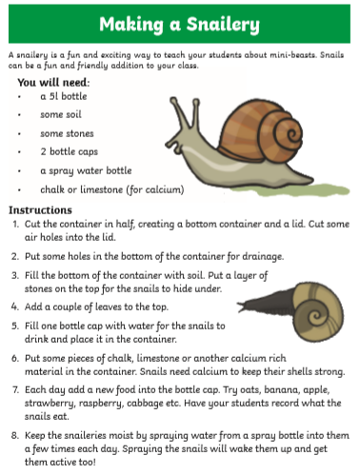

Slide 11
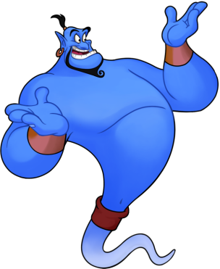
Reading online
I’m so impressed with your reading Elves.
You should be very proud of yourselves!
Please log on to Bug Club
Read for at least 15 minutes.
Please read the key words inside the front cover first.
When you find the bug questions, click and complete them.
Please note down the books you’ve read in your reading
record book.
Your personal login details are on the inside of your reading record book.

Slide 12
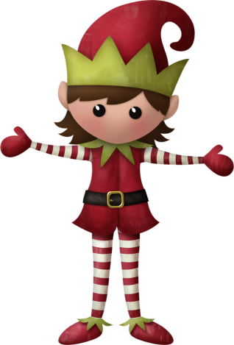
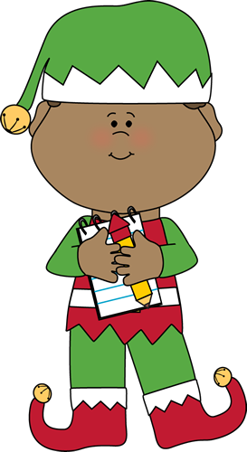
Well done for
your super work today!
Let me know how you are getting on!
admin@farnborough.bromley. sch.uk

