Slide 1
Good morning Unicorns!
Here’s your work for today: Wednesday 1st July

Slide 2
I’m looking forward to seeing lots of you at our Bingo Zoom session at 9.15 this morning. Make sure you have your grid and a pencil ready.
Who will be the winner this week?

Slide 3
Let’s start the day by being…

Slide 4
Maths answers from Monday:
Challenge 1:
3 circles for car
1 circle for other
Challenge 2:
4 cm longer
Challenge 3:
54 kg
( circle = 9, square = 27)

Slide 5
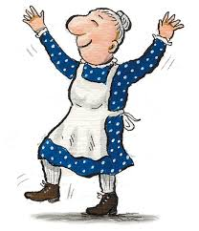
Maths
The little old lady isn’t very good at solving problems and she needs your help please, Unicorns!
Can you help her to solve the problems on the next slides?

Slide 6
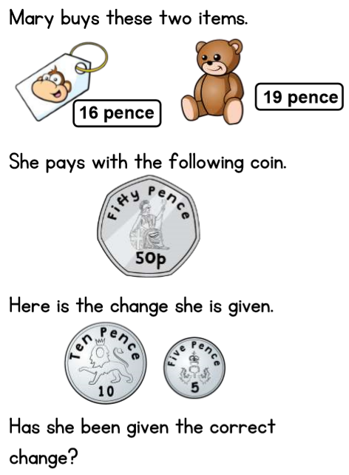
Challenge 1:

Slide 7
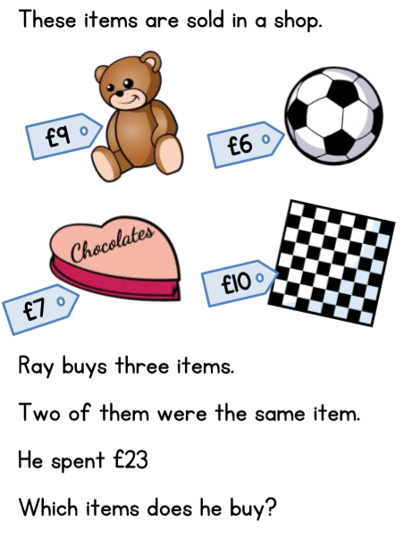
Challenge 2:

Slide 8
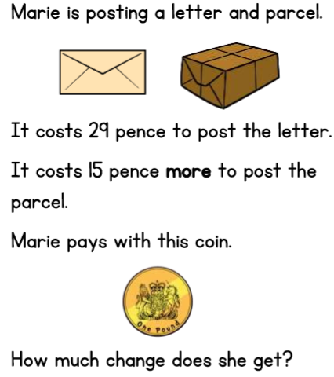
Challenge 3:

Slide 9
You can write your answers in your exercise books.
If you would like to try Gruffalo work, complete Challenge 1.
If you would like to try Horrid Henry work, complete Challenge 2.
If you would like to try James and the Giant Peach work, complete Challenge 3.

Slide 10
Yesterday was the beginning of a new week for Race around the World.
Last week we reached Romania. You can see the previous week’s total by clicking on this link:
http://farnboroughprimary.co.uk/active-challenge/

Slide 11
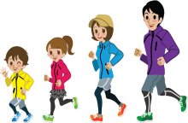
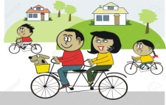
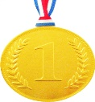
Farnborough’s Race across the World Results up to Monday 22nd June
Class | Number of kilometres covered | *Which country did your class reach? From Farnborough School to …..
Pixies | 2383 km | Greece
Elves | 1797 km | Algeria
Unicorns | 2015 km | Romania
Phoenix | 1521km | Algeria
Pegasus | 4879 km | Ivory Coast
Giants | 2351 km | Greece
Griffins | 2551km | Greece
Centaurs | 3007 km | Turkey
Dragons | 1662 km | Algeria

Slide 12
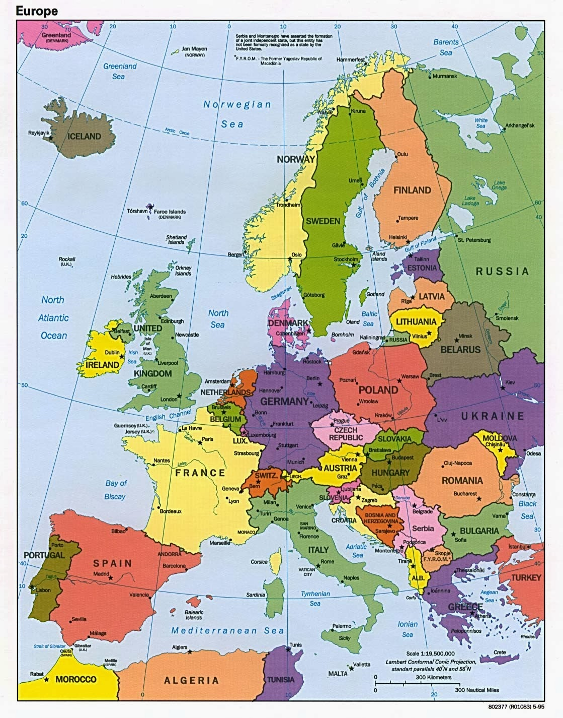
Which country did your class reach?
Map of Europe
Which country did your class reach?

Slide 13
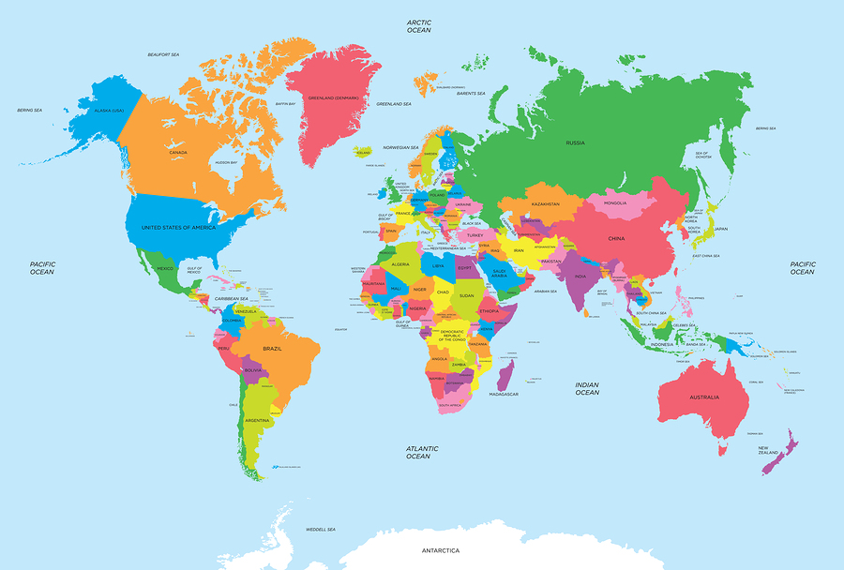
of the World
Map of the World
Which country did your class reach?

Slide 14
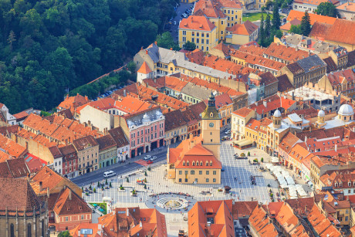
Follow this link and find Romania on Google Earth:
Google Earth
Brasov, a mountain town in Romania, was rumoured to be where the Pied Piper of Hamelin took the children when they left Germany. Watch this link to hear the story:
https://www.youtube.com/watch?v=70alIgk1-70
Old town of Brasov, Transylvania, Romania

Slide 15
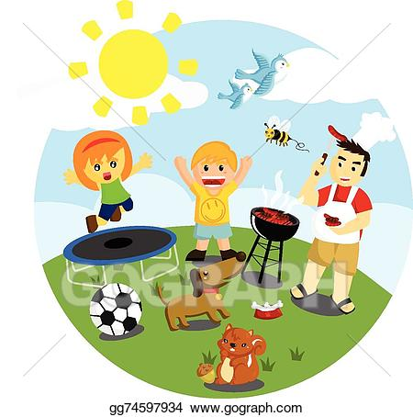
Outdoor Activity
Every day I am going to give you an activity that can be carried out either outdoors, (if the sun is shining) or indoors (if we’re not as lucky as the weather!).

Slide 16
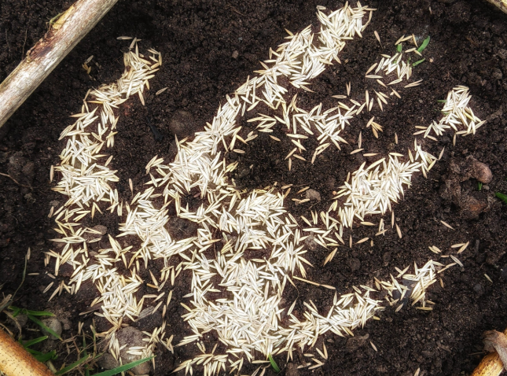
Outdoor Home Learning
A Green High Five
Get playful with quick growing seeds like grass or cress sowing them in a handprint or other simple quirky shapes.
Open the link to investigate this further…
https://www.ltl.org.uk/resources/greenhigh-five/

Slide 17
Reading online
Please log on to Bug Club and read for at least 15 minutes
Make sure you answer your bug questions!

Slide 18
Enjoy, Unicorns!

