Slide 1
Welcome back Elves!
.
Let’s get busy Elves.

Slide 2
It’s Wednesday!
Wednesday 17th June 2020
Here’s your work for today…
.

Slide 3
Farnborough Dance Routine
Mrs Humphries has created our very own Farnborough Dance Routine!
It has five parts and every day this week we are going to start the day by being active and joining in.
Click on the link below:
http://farnboroughprimary.co.uk/farnborough-dance

Slide 4
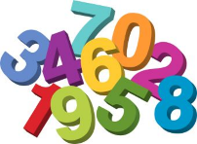
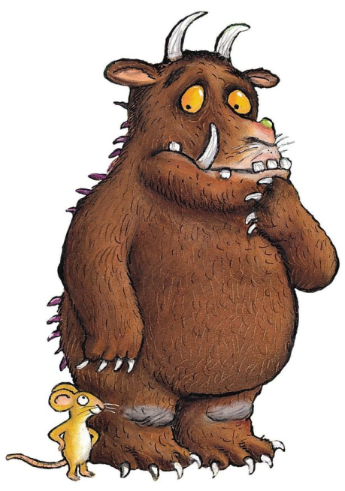
Maths
The Gruffalo wants to see if you can help him with this investigation…..

Slide 5
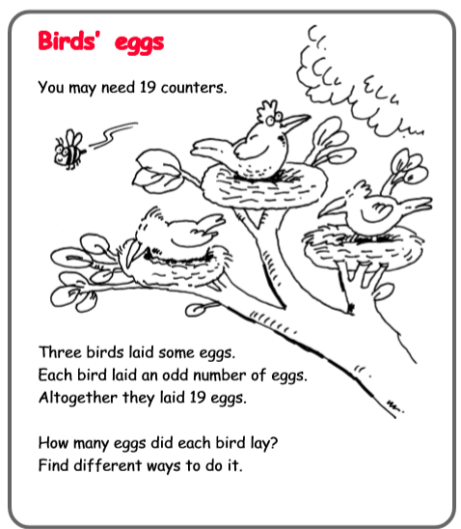
2.
1.
2.
3. Write down as many odd numbers as you can. What is the highest number you can go to? What is the pattern of odd numbers?

Slide 6
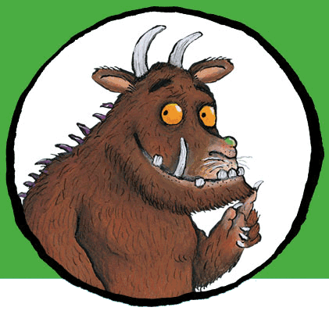
. .
You can write your answers in your exercise books.
If you would like to try Gruffalo work, complete question 1
If you would like to try Horrid Henry work complete question 2
If you would like to try James and the Giant Peach work, complete question 3

Slide 7
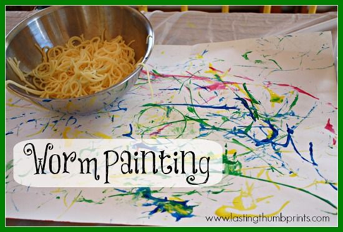
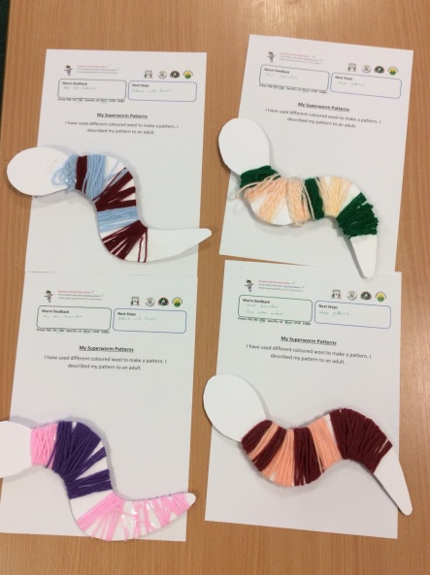
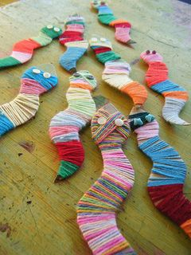
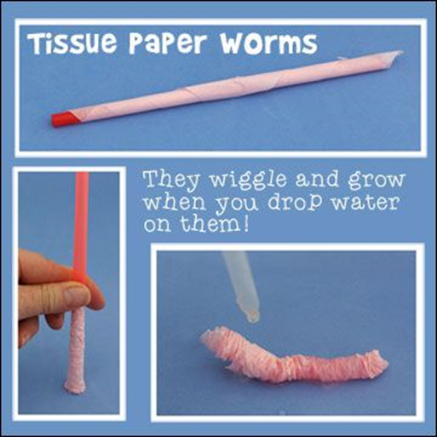
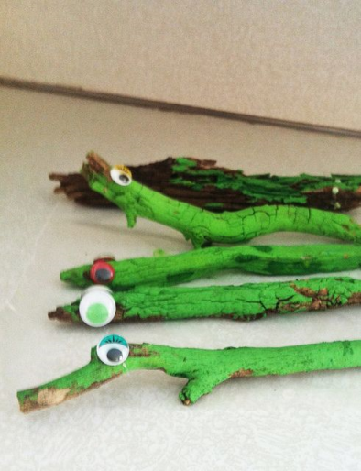
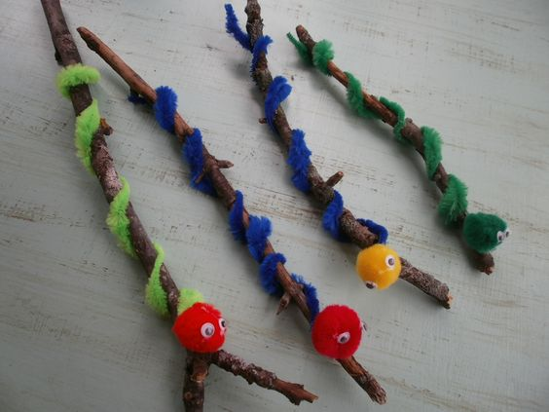
Create some Worm Art and Craft!

Slide 8
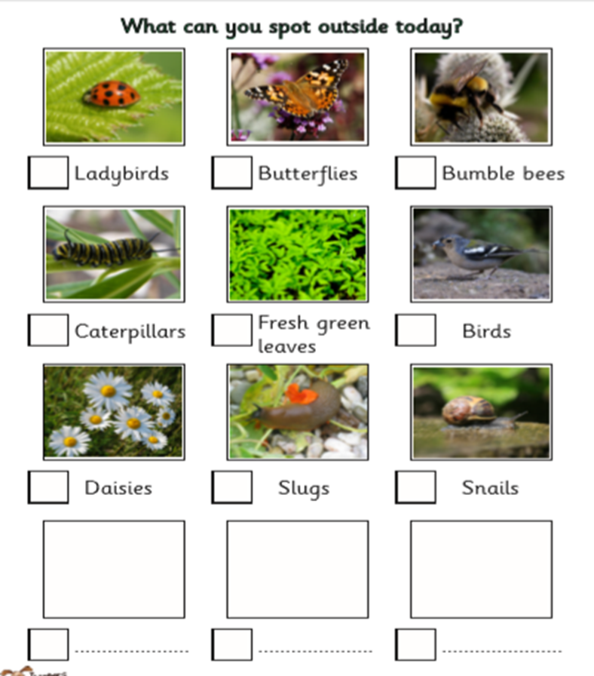

Slide 9
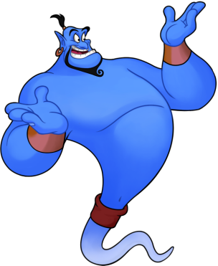
Reading online
I’m so impressed with your reading Elves.
You should be very proud of yourselves!
Please log on to Bug Club
Read for at least 15 minutes.
Please read the key words inside the front cover first.
When you find the bug questions, click and complete them.
Please note down the books you’ve read in your reading
record book.
Your personal login details are on the inside of your reading record book.

Slide 10
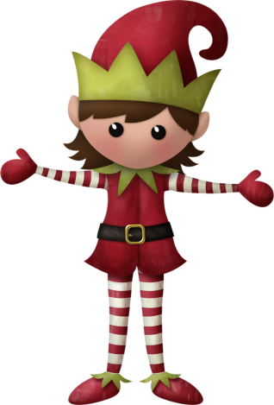
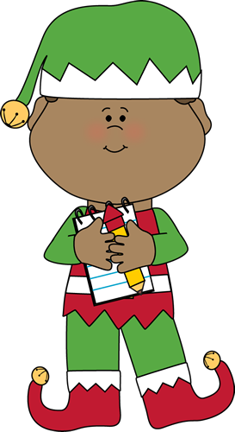
Well done for
your super work today!
Let me know how you are getting on!
admin@farnborough.bromley. sch.uk

