Slide 1
Good morning Unicorns!
Here’s your work for today: Wednesday 10th June

Slide 2
Farnborough Dance Routine
Mrs Humphries has created our very own Farnborough Dance Routine!
It has five parts and every day this week we are going to start the day by being active and joining in.
Click on the link below:
http://farnboroughprimary.co.uk/farnborough-dance

Slide 3
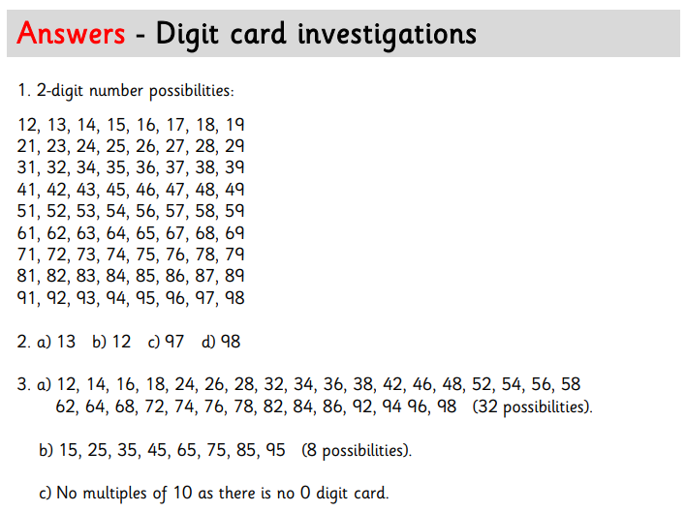
Maths answers from Monday:

Slide 4
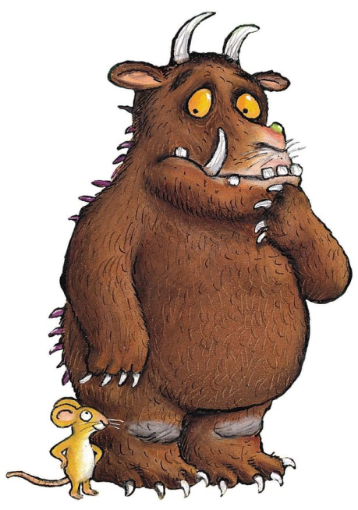
Maths
The Gruffalo isn’t as amazing at Maths as all of you in Unicorns Class!
He needs your help to carry out another investigation…

Slide 5
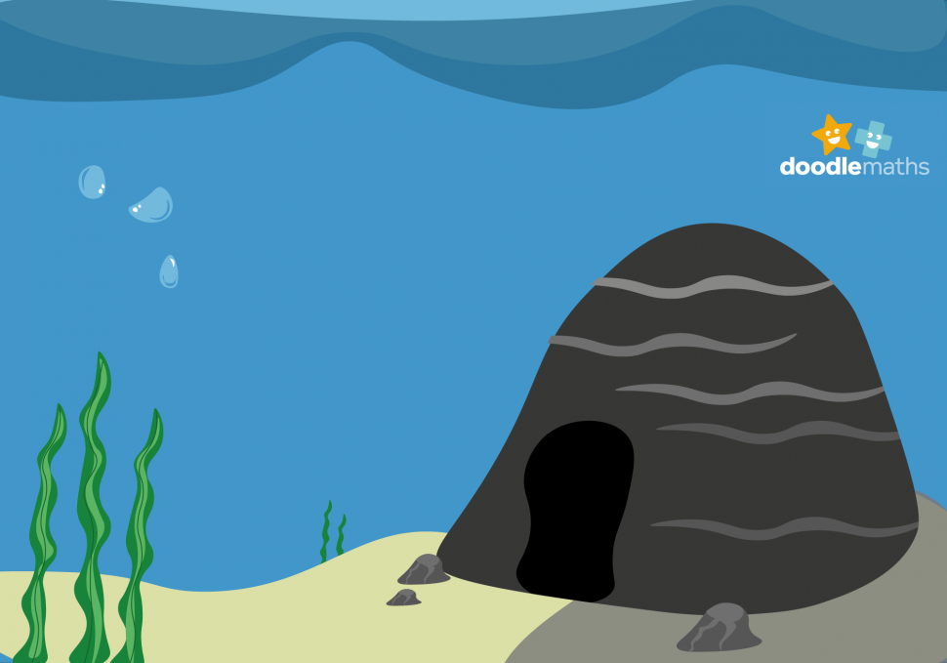

Slide 6
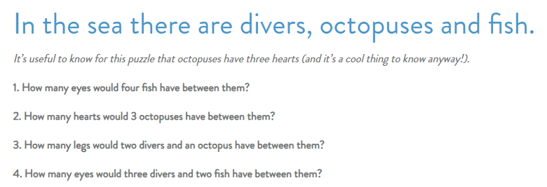
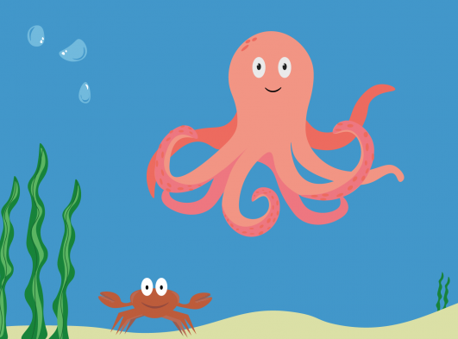

Slide 7
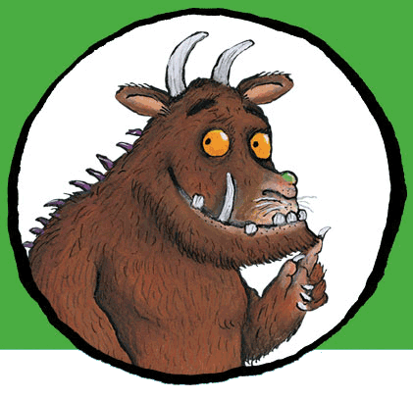
You can write your answers in your exercise books.
If you would like to try Gruffalo work, complete questions 1, and 2.
If you would like to try Horrid Henry work, complete questions 1, 2 and 3.
If you would like to try James and the Giant Peach work, complete questions 1, 2, 3 and 4.

Slide 8
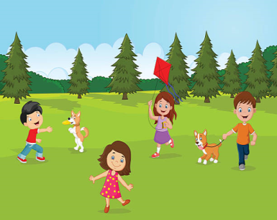
We are doing really well in our race around the world- keep being active, Unicorns!
To help us to be even better, today I would like you to create a warm up routine for your family before setting off on your exercise.
Design a poster to show the warm up routine. Have a look at the next slide to give you some ideas.

Slide 9
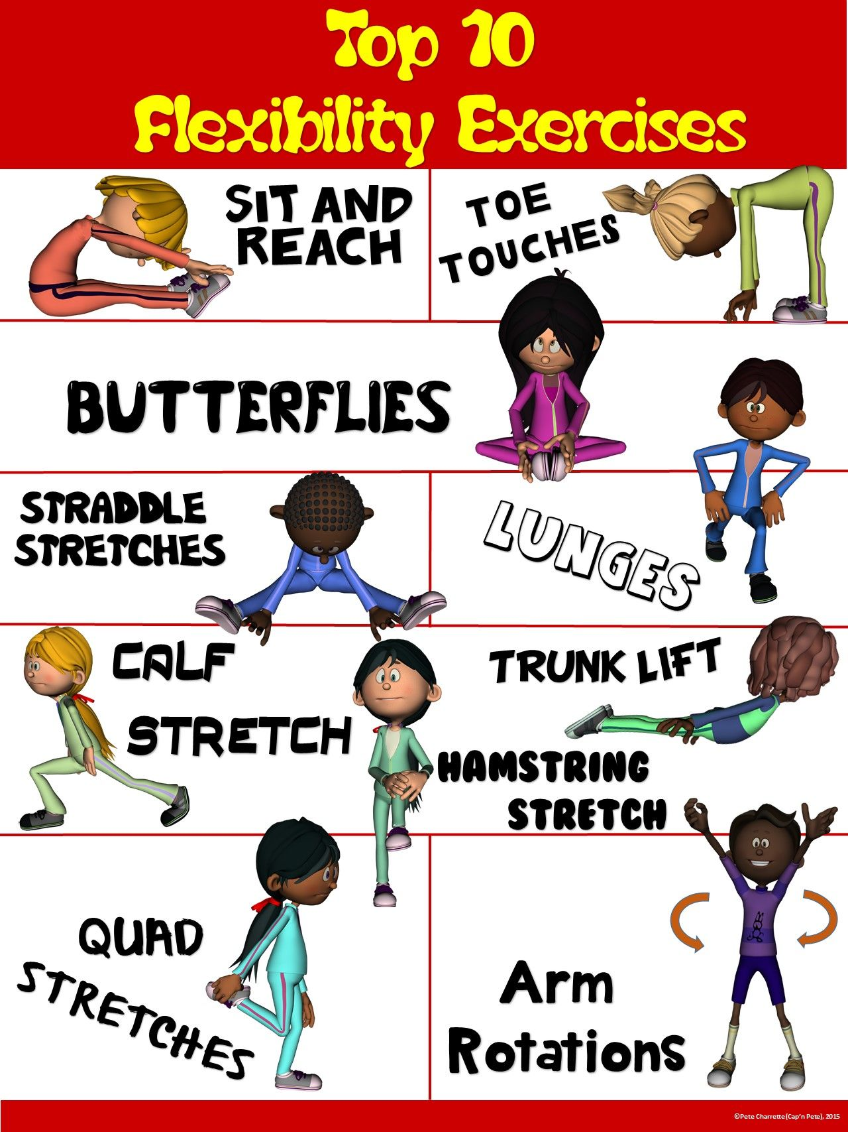
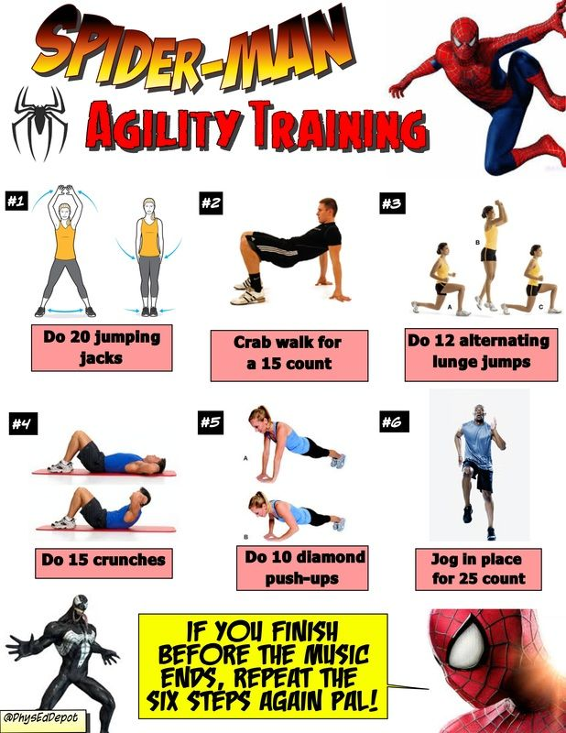
Some ideas for your poster …..

Slide 10
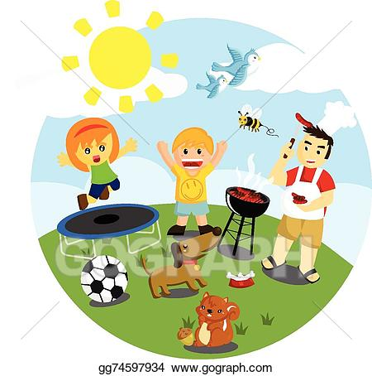
Outdoor Activity
Every day I am going to give you an activity that can be carried out either outdoors, (if the sun is shining) or indoors (if we’re not as lucky as the weather!).

Slide 11
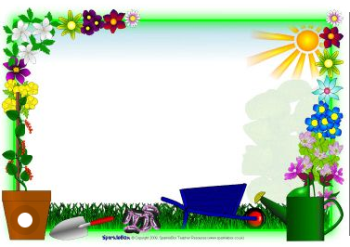
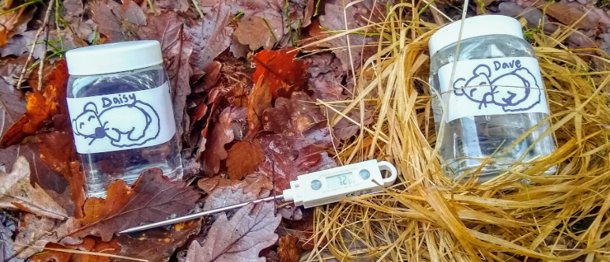
Outdoor Home Learning
Insulation Investigation
Find a space outdoors/indoors where you can create a nest to keep a ‘dormouse’ warm. Choose materials that you think will be good insulators. Make your ‘dormouse’ a jar of warm water. Check the temperature over time.
Open the link to investigate this further…
https://www.ltl.org.uk/resources/hibernation-an-insulation-investigation/

Slide 12
Reading online
Please log on to Bug Club and read for at least 15 minutes
Make sure you answer your bug questions!

Slide 13
Enjoy, Unicorns!

