Slide 1
Welcome back Elves!
.
Let’s get busy Elves.

Slide 2
Green group
Monday’s
Maths Answers
5p and 1p.
2p, 2p, 2p
2p,2p,1p,1p
2p,1p,1p,1p,1p
1p,1p,1p,1p,1p,1p
2. 5p,2p
5p, 1p,1p
2p,2p,2p,1p
2p,2p,1p,1p,1p
2p,1p,1p,1p,1p,1p
1p,1p,1p,1p,1p,1p,1p

Slide 3
It’s Tuesday!
Tuesday 9th June 2020
Here’s your work for today…
.

Slide 4
Farnborough Dance Routine
Mrs Humphries has created our very own Farnborough Dance Routine!
It has five parts and every day this week we are going to start the day by being active and joining in.
Click on the link below:
http://farnboroughprimary.co.uk/farnborough-dance

Slide 5
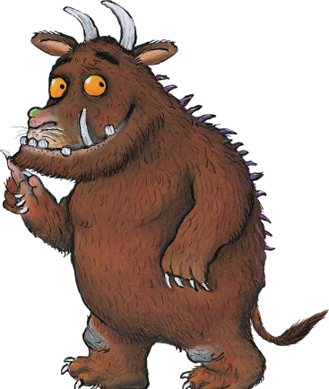
English
Let’s read The Gruffalo by Julia Donaldson
..\Y1 return\Week 1\Animals - The Gruffalo Story.pptx

Slide 6
English
We are learning to describe a character

Slide 7
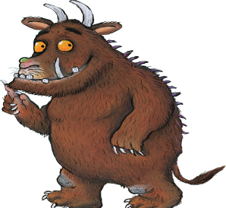
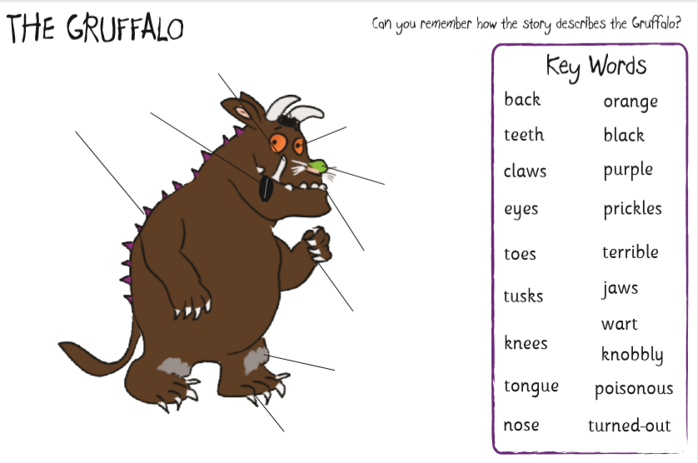
English

Slide 8
English
Challenge: Use your adjectives (describing words) and put them into
sentences.
Remember to include capital letters and full stops to write in full sentences.

Slide 9
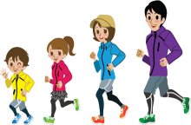
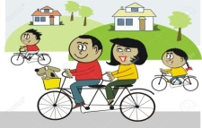
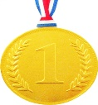
Farnborough’s Race across the World Results up to Monday 1st June
Class | Number of kilometres covered | *Which country did your class reach? From Farnborough School to …..
Pixies | 1162 km | Austria
Elves | 598 km | Germany
Unicorns | 624 km | Germany
Phoenix | 805 km | Switzerland
Pegasus | 2654 km | Ukraine
Giants | 881 km | Germany
Griffins | 1337 km | Sweden
Centaurs | 941 km | Germany
Dragons | 1110 km | Czech Republic

Slide 10
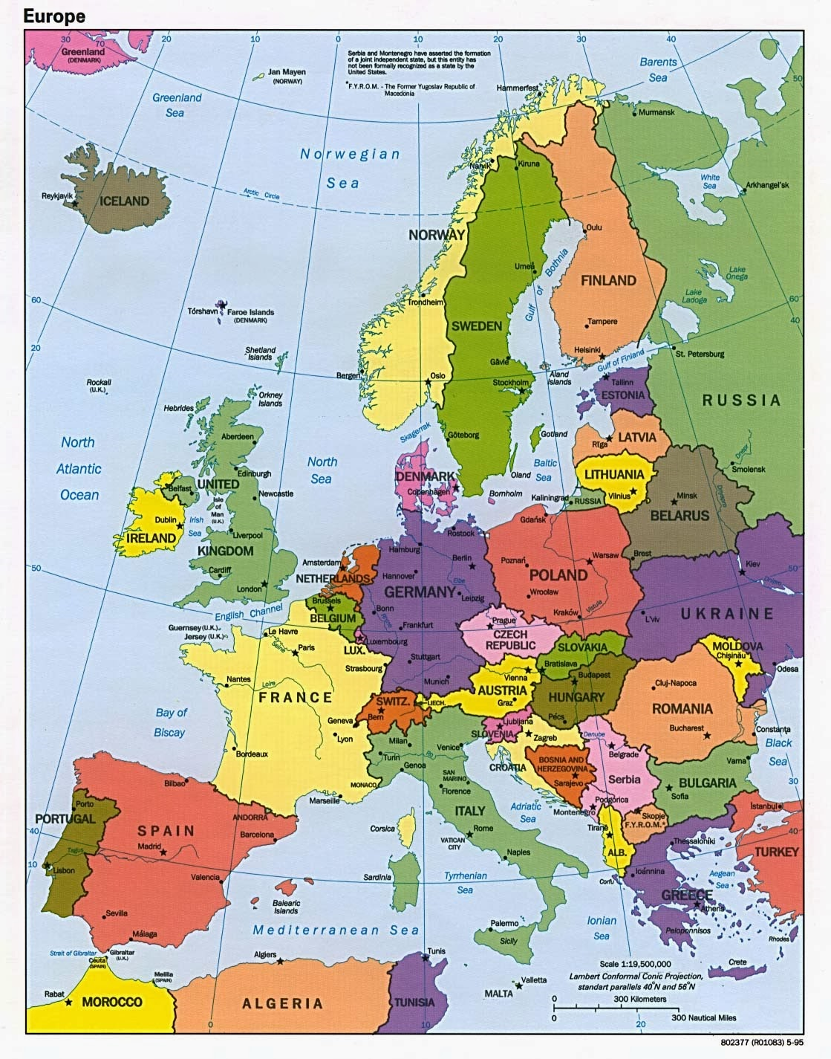
Which country did your class reach?
Which country did your class reach?

Slide 11
Congratulations, We reached Germany in our Race across the
World.
Can you find Germany on google earth?
Google Earth
The following link takes you to the oddizzi website.
Oddizzi.com
Login details are
Username: Elves1
Password: Elves1
Go to explore the world/places/europe/germany.
Write out some interesting facts about Germany in your books.
Where is Germany?
What is their favourite food?
Can you say hello in German?

Slide 12
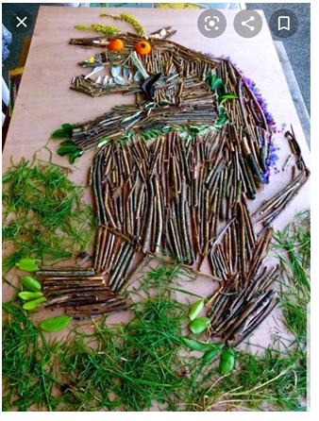
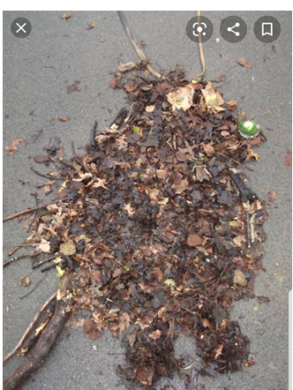
Today I would like you to collect some items either when you are outside on your daily exercise or in your garden. Collect items that you might see if you went for a walk in the woods such as leaves, twigs, feathers…
You are going to use these to create a Gruffalo picture/collage.

Slide 13
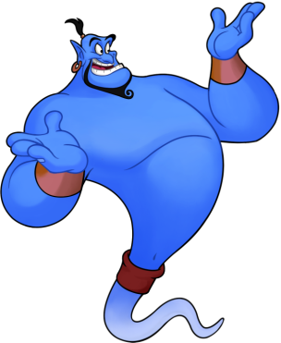
Reading online
I’m so impressed with your reading Elves.
You should be very proud of yourselves!
Please log on to Bug Club
Read for at least 15 minutes.
Please read the key words inside the front cover first.
When you find the bug questions, click and complete them.
Please note down the books you’ve read in your reading
record book.
Your personal login details are on the inside of your reading record book.

Slide 14
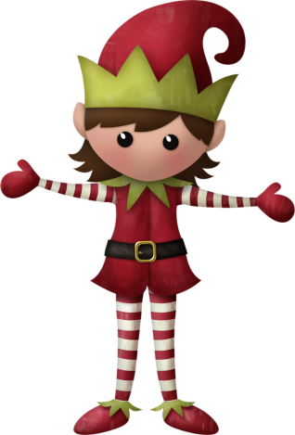
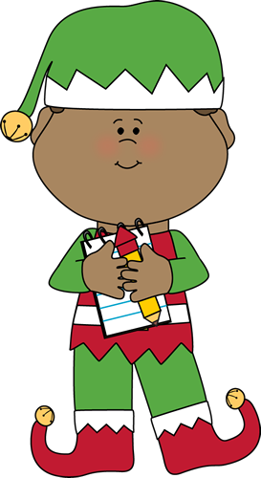
Well done for
your super work today!
Let me know how you are getting on!
admin@farnborough.bromley. sch.uk

