Slide 1
Good morning Unicorns!
Here’s your work for today: Tuesday 23rd June

Slide 2
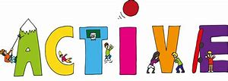
Let’s start the day by being…

Slide 3
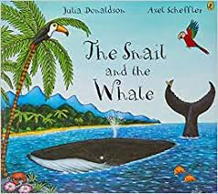
English
Our next book that we are going to be carrying out activities based upon is ‘The Snail and the Whale’
First watch this animation:
https://www.bbc.co.uk/iplayer/episode/m000cslw/the-snail-and-the-whale

Slide 4
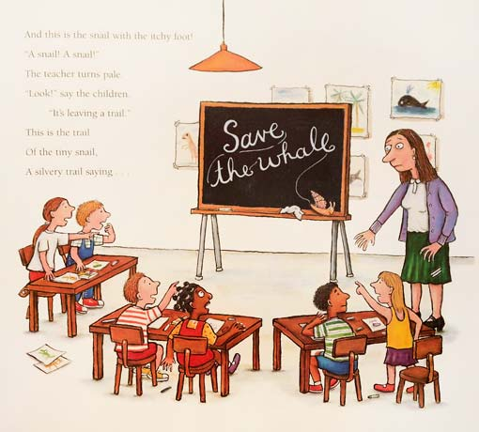
The snail goes into a school and writes a message on the whiteboard.
This was his rescue idea.
Today you are going to think of all the things that could have gone wrong with this plan

Slide 5
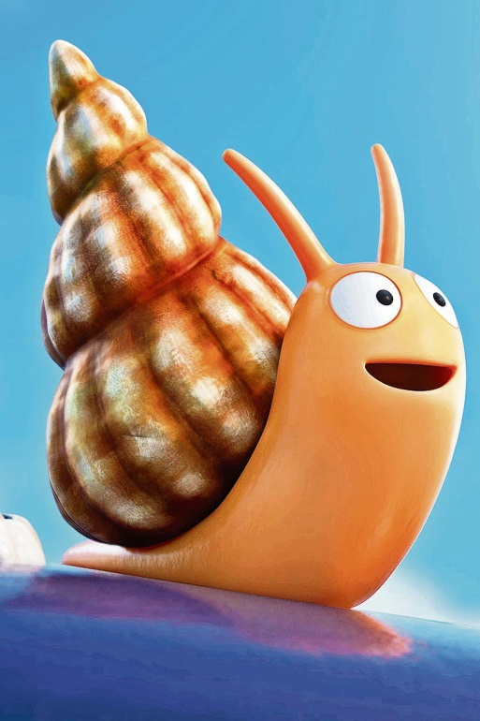
You could think about:
His speed.
How strong he is.
His handwriting.
I might start my writing in this way:
Although the snail was very clever ( and kind) to think of a plan to help rescue the whale, there were a few things that could have meant that this plan was not very successful…

Slide 6
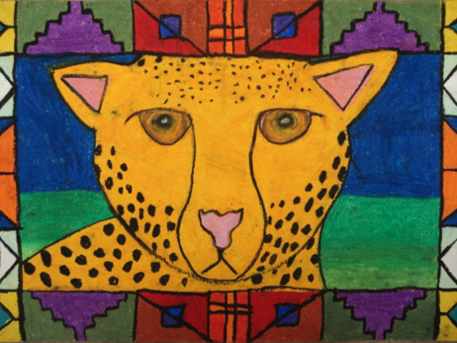
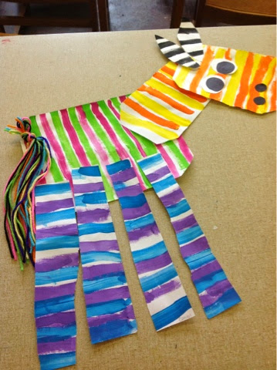
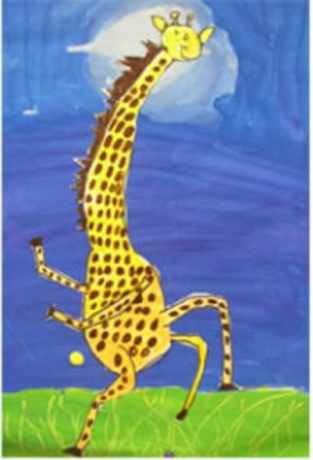
Carnival of the Animals An Art festival
For the next few weeks we are going to run a series of art lessons based around animals.
So whether you are working at home or in school you can create some great pictures. We would like to fill the Farnborough Art Gallery with your work to create a “Carnival of the Animals.”
If you are home learning, you can scan your work and send it in to your teacher.
Good luck, have fun and we want you to be creative, so if you have your own ideas we would love to see your artwork!

Slide 7
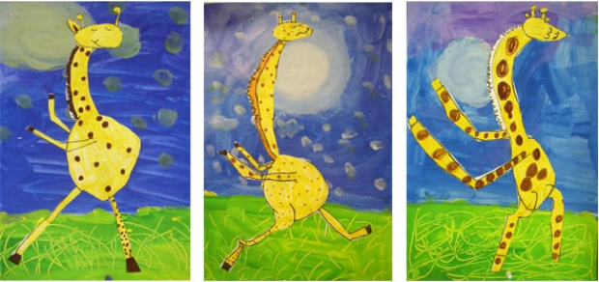
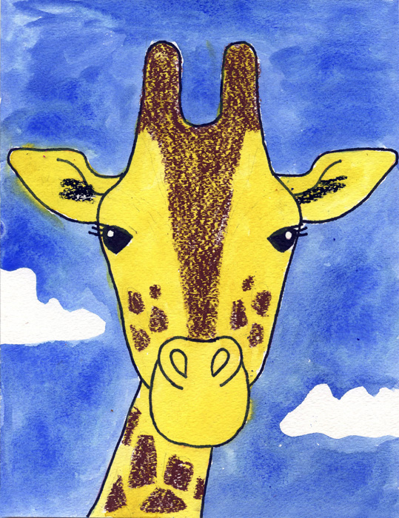
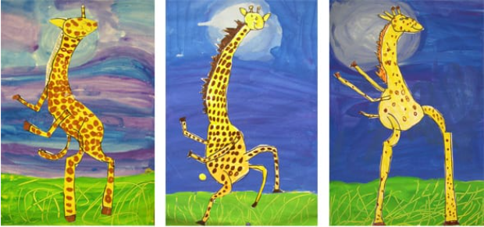
Giraffes
You can try just the face or get your giraffe dancing!

Slide 8
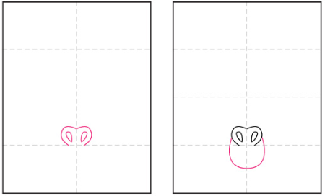
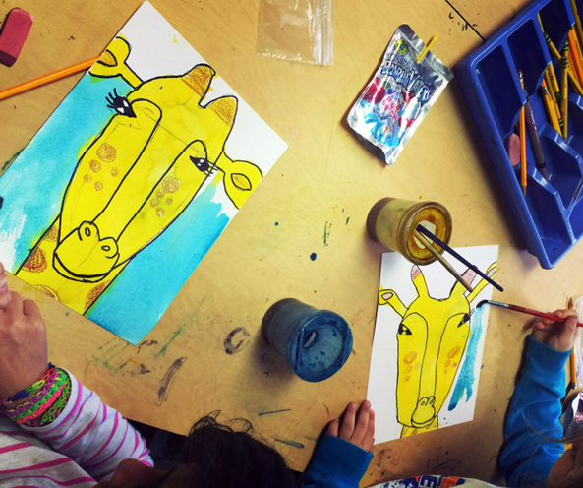
1. Fold the paper so have 8 folds. Start the nose.
2. Draw the mouth.

Slide 9
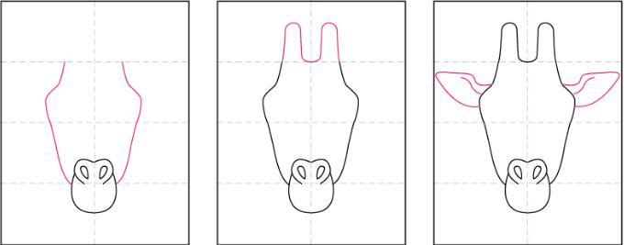
3. Draw the sides of the face.
4. Add the 2 horns.
5. Draw 2 ears.

Slide 10
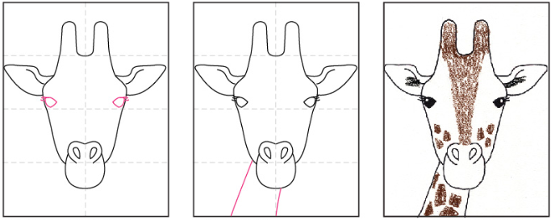
6. Add the eyes and eyelashes.
7. Add the neck.
8.Colour in pastels, paint, felt pens or pencils. Giraffes are tall so you could just have the sky in the background or the tree canopy. It’s your choice!

Slide 11
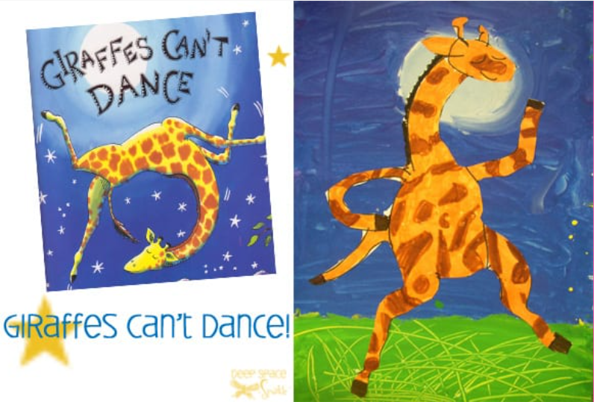
You might enjoy this:
https://www.youtube.com/watch?v=vZjsLK5vwNU

Slide 12
You want your giraffe to dance? Or sway, gyrate or hip-hop………………..

Slide 13
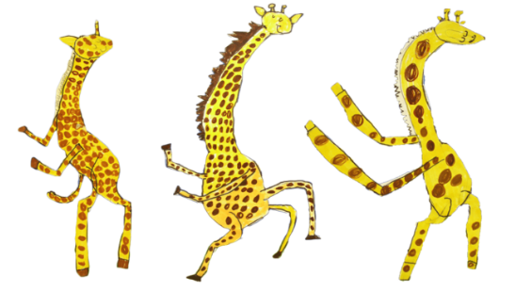
Skinny rectangles for legs!
Big circle for the belly!
Colour your giraffes using yellow or orange pens or pencils. Then add spots and markings using a brown or black felt pen.
You could try cutting out and sticking it on your background, it’s up to you!

Slide 14
If you are painting the moonlit sky……
Use a plastic cup to trace a big circle for the moon.
Mix blue and purple paint directly onto the paper, and use big sweeping brush strokes to paint the sky.
Start from the bottom (about a third of the way up) and paint towards the moon, being careful not to paint inside the circle shape.

Slide 15
If you are painting the moonlit sky……
Next, paint the white moon, painting in a circular motion, starting in the centre and moving outwards until you touch the blue paint.
Go into the blue sky a bit, so the white and blue paints mix.
Finally, paint the grass yellow, wait a minute, then paint over the yellow with green paint. Using the ends of the brushes, scratch grass like strokes into the paint. Once dry stick the giraffes onto your background and enjoy the lovely art!
Remember to send your pictures in! We want a disco of giraffes in the Farnborough Art gallery!

Slide 16
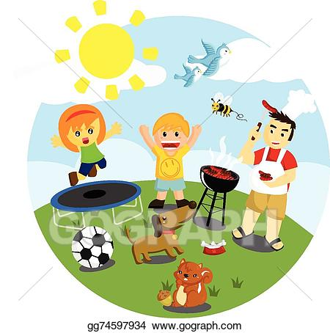
Outdoor Activity
Every day I am going to give you an activity that can be carried out either outdoors, (if the sun is shining) or indoors (if we’re not as lucky as the weather!).

Slide 17
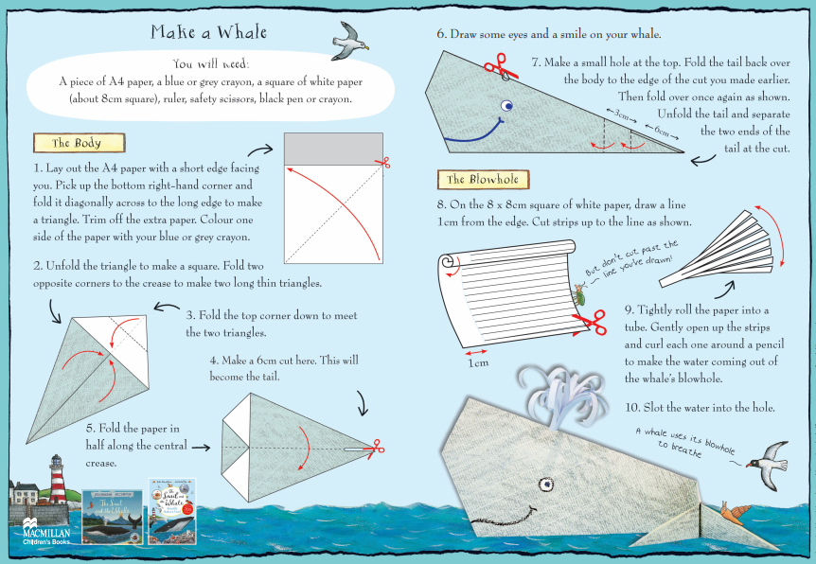

Slide 18
Reading online
Please log on to Bug Club and read for at least 15 minutes
Make sure you answer your bug questions!

Slide 19
Remember to send in your totals for the Race across the World.
Which country will we reach this week?

Slide 20
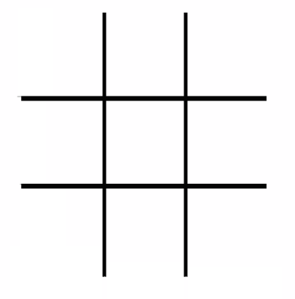
Maths Bingo
We will have another zoom session tomorrow where you will be taking part in Maths Bingo.
In preparation for this I would like you to draw a grid like you would if you were playing noughts and crosses:
Then choose nine numbers between 1 and 20 to put in the grid.
Tomorrow I will be giving you different number sentences. If your answer is a number in your grid, then you cross out the number.
The first person to cross out all nine of the numbers wins the game!

Slide 21
Enjoy, Unicorns!

