Slide 1
Good morning Unicorns!
Here’s your work for today: Tuesday 16th June

Slide 2
Farnborough Dance Routine
Mrs Humphries has created our very own Farnborough Dance Routine!
Today I would like you to try the whole dance in one go-enjoy!
Click on the link below:
http://farnboroughprimary.co.uk/farnborough-dance

Slide 3
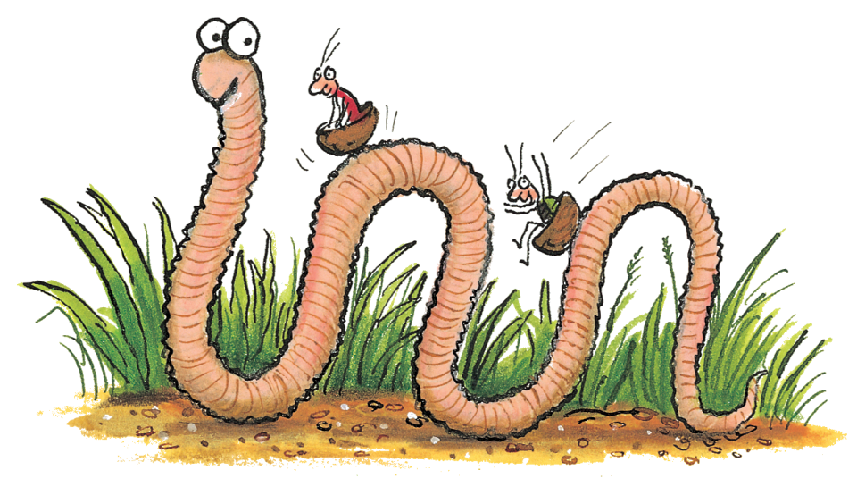
English
Today we are going to look at the story of ‘Superworm’ in more detail.
First, remind yourself of what happened…

Slide 5
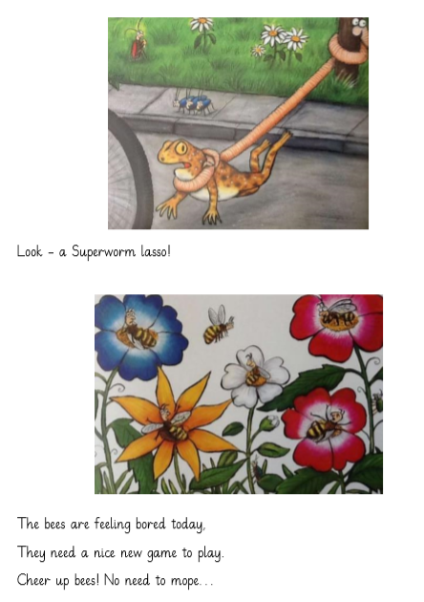
•

Slide 6
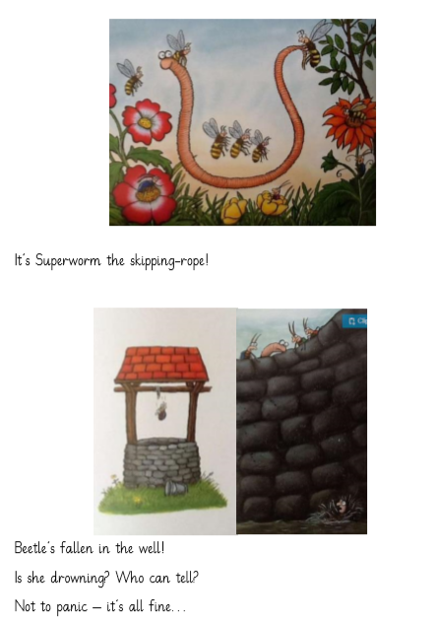
•

Slide 7
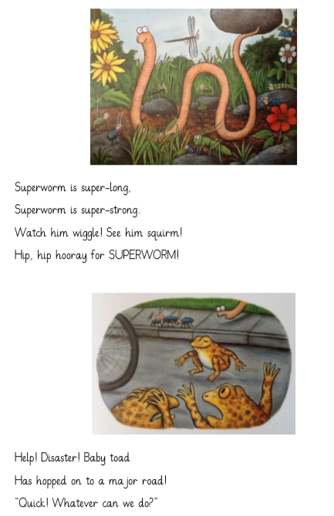
•

Slide 8
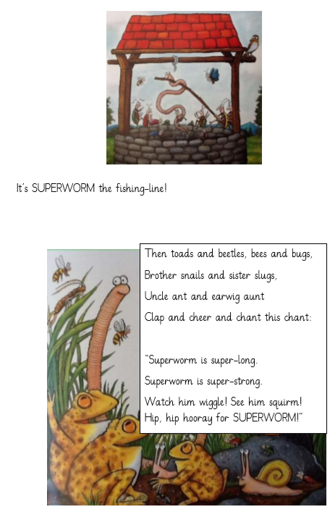
•

Slide 9
•

Slide 10
•

Slide 11
•

Slide 12
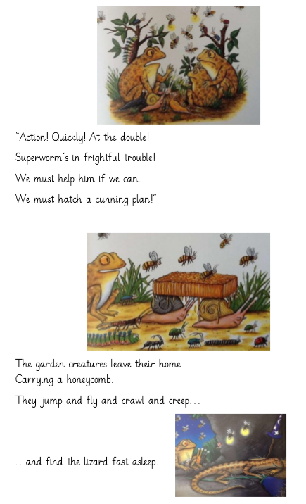
•

Slide 13
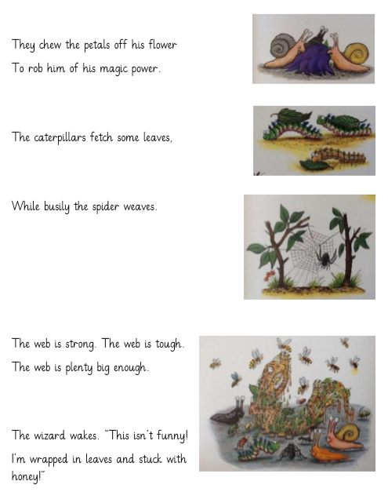
•

Slide 14
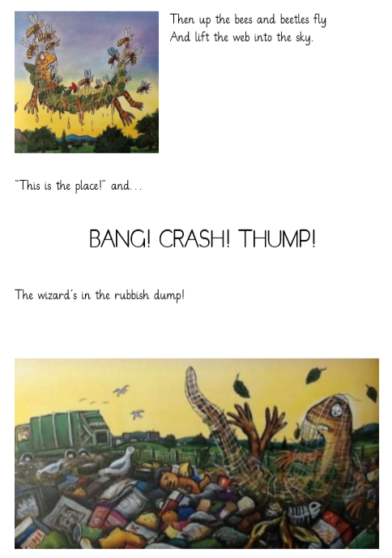
•

Slide 15
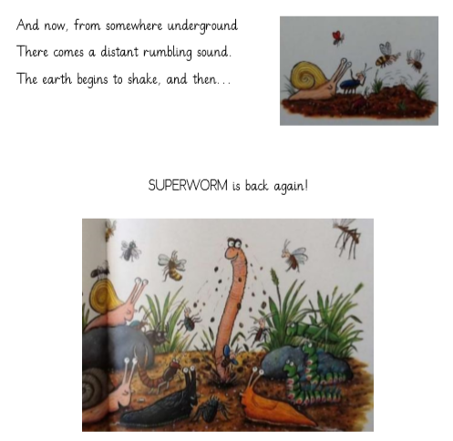

Slide 16
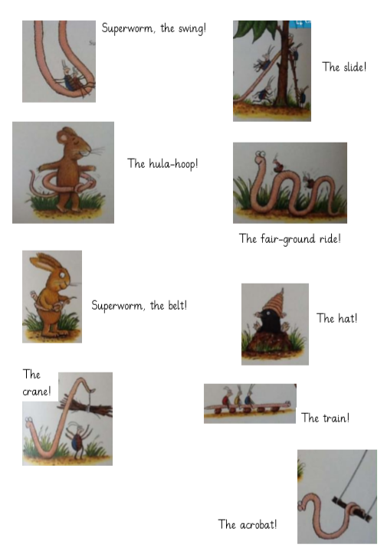
•

Slide 17
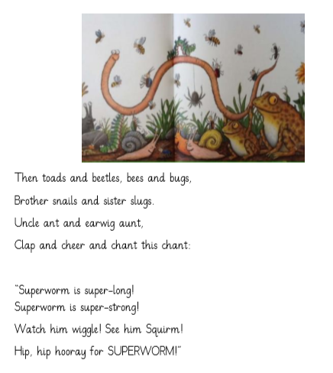
•

Slide 18
•
Now that you know the story so well, you are going to read through some sentences and decide whether they are true or false…

Slide 19
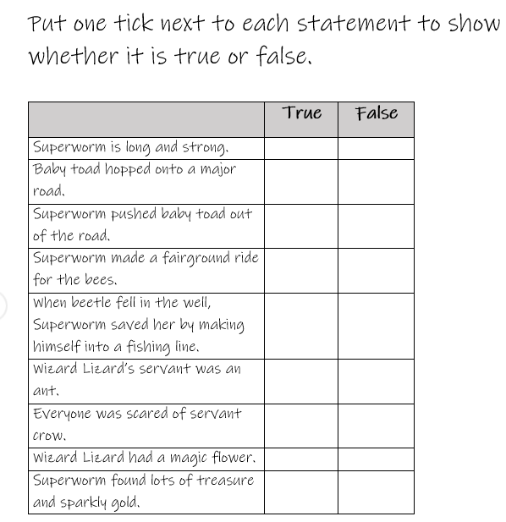
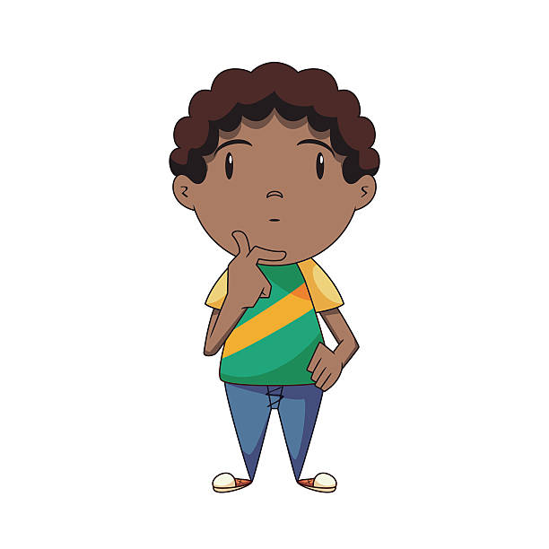
Did these things happen in the story or not?

Slide 20
Now I would like you to make up at least two sentences of your own about ‘Superworm’.
You can decide whether they are going to be true or false.
My sentence is…
The bees and beetles dropped Wizard Lizard onto the park.
Is that true or false?

Slide 21
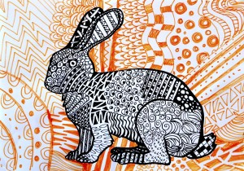
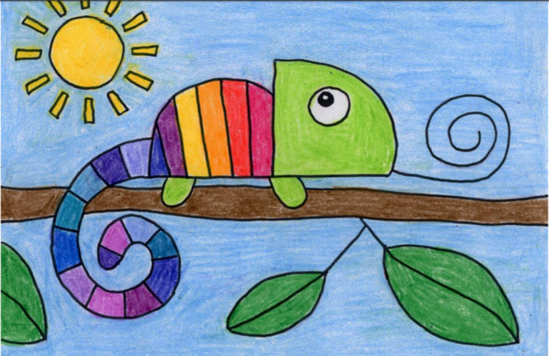
Carnival of the Animals An Art festival
For the next few weeks we are going to run a series of art lessons based around animals.
So whether you are working at home or in school you can create some great pictures. We would like to fill the Farnborough Art Gallery with your work to create a “Carnival of the Animals.”
If you are home learning, you can scan your work and send it in to your teacher.
Good luck, have fun and we want you to be creative, so if you have your own ideas we would love to see your artwork!

Slide 22
Try drawing this rainbow chameleon!

Slide 23
Follow these simple steps to draw your chameleon

Slide 24
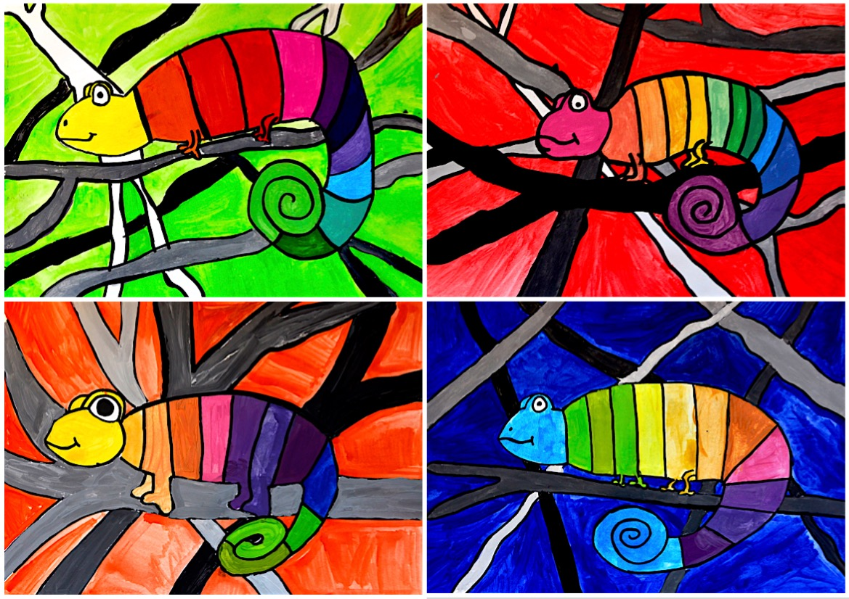
You can use the background in the example or try your own ideas. It’s up to you!
Use pencils, paints or felt pens to colour your fabulous picture!

Slide 25
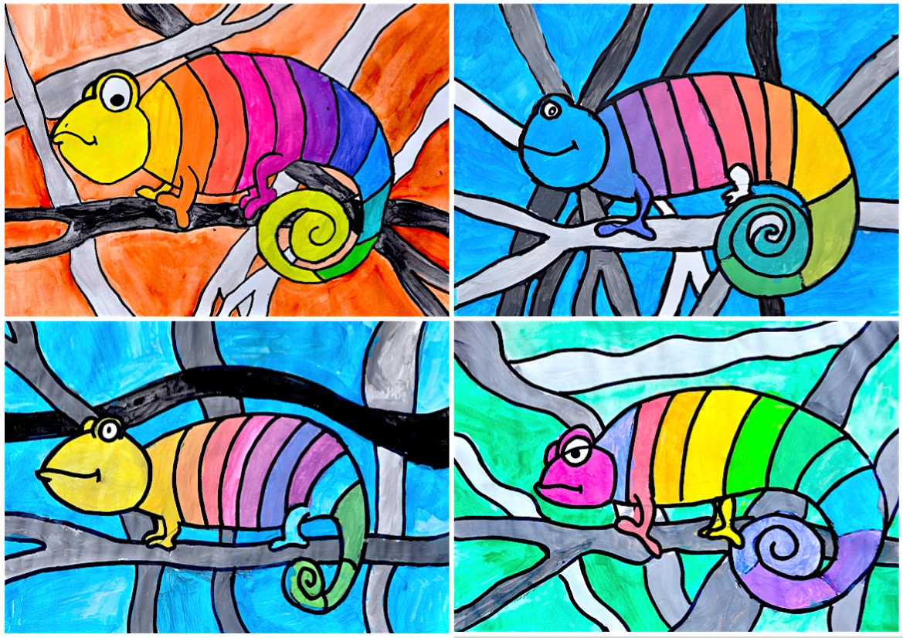

Slide 26
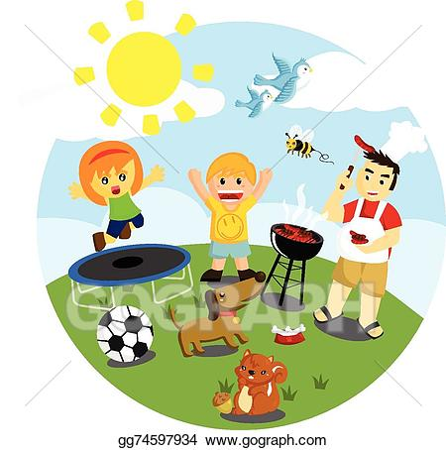
Outdoor Activity
Every day I am going to give you an activity that can be carried out either outdoors, (if the sun is shining) or indoors (if we’re not as lucky as the weather!).

Slide 27
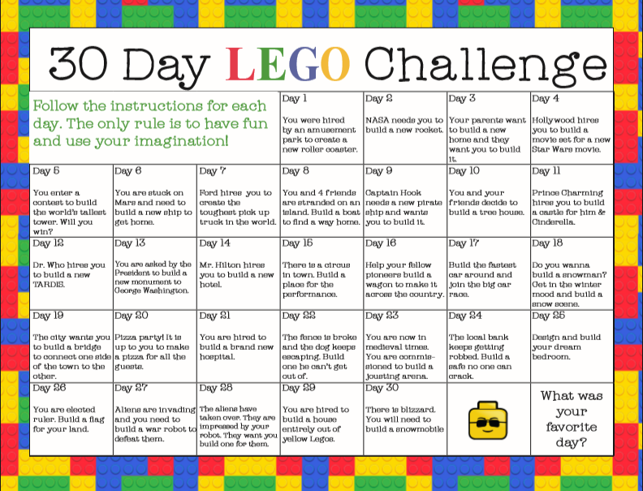
Select one of these activities to complete. If you do not have Lego at home, complete the challenge with other materials you find around your house or outside. Happy Building!

Slide 28
Reading online
Please log on to Bug Club and read for at least 15 minutes
Make sure you answer your bug questions!

Slide 29
Remember to send in your totals for the Race across the World.
Which country will we reach this week?

Slide 30
Maths Bingo
We will have another zoom session tomorrow where you will be taking part in Maths Bingo.
In preparation for this I would like you to draw a grid like you would if you were playing noughts and crosses:
Then choose nine numbers between 1 and 20 to put in the grid.
Tomorrow I will be giving you different number sentences. If your answer is a number in your grid, then you cross out the number.
The first person to cross out all nine of the numbers wins the game!

Slide 31
Enjoy, Unicorns!

