Slide 1
Welcome back Elves!
.
Let’s get busy Elves.

Slide 2
Green group
Wednesday’s
Maths Answers
1.
0 + 9 + 3
0 + 8 + 4
0 + 7 + 5
1 + 9 + 2
1 + 8 + 3
1 + 7 + 4
1 + 6 + 5
2 + 7 + 3
2 + 4 + 6
3 + 5 + 4

Slide 3
It’s Thursday!
Thursday 2nd July 2020
Here’s your work for today…
.

Slide 4
Farnborough Dance Routine
Mrs Humphries has created our very own Farnborough Dance Routine!
It has five parts and every day this week we are going to start the day by being active and joining in.
Click on the link below:
http://farnboroughprimary.co.uk/farnborough-dance

Slide 5
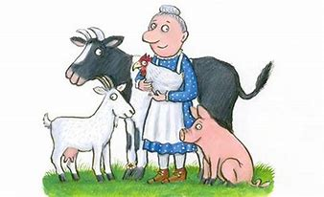
English
Let’s listen to the Squash and a Squeeze.
You Tube A Squash and a Squeeze
https://www.youtube.com/watch?v=iIjAC_rw5M

Slide 6
English
We are learning to use nouns.

Slide 7
English
What is a noun?
A noun is a thing, object or a person.
It is something you can touch.
Follow this link to find out about nouns:
What are nouns? - BBC Bitesize
https://www.bbc.co.uk/bitesize/topics/zrqqtfr/articles/zpd8ng8

Slide 8
English
Go on a noun hunt. Explore your house or outside and find nouns that you can squash
or squeeze. Write a list of these in your books. Write in full sentences.
I can squeeze a bottle of ketchup, my cuddly toy ……..
I can squash a ripe banana, a bunch of leaves, …….

Slide 9
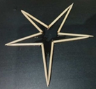
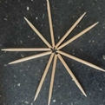
Transforming Star!
You will need:
5 cocktail sticks
Straw
Water

Slide 10
Break your cocktail sticks in half without snapping them in two.
Arrange your cocktail sticks into a 10 point star with the centres touching.
Submerge your straw in water, then place your thumb on the end to lift up some water. Carefully put a few drops of water into the centre of the cocktail sticks.
Watch as your star begins to move!

Slide 11
What’s the Science behind it? Cocktail sticks are made of dry wood. When dry wood absorbs water, the bent wood fibres expand and unbend. As the cocktail sticks straighten out, they push against one another opening up the inside of the star.

Slide 12
Can you invent a game to play
around the house?
Write out the rules (this is called an algorithm). Think about do the rules explain everything?
Play the game with your family.
An algorithm can be rules as well as a sequence of instructions. The rules need to be precise and specific.

Slide 13
Reading online
I’m so impressed with your reading Elves.
You should be very proud of yourselves!
Please log on to Bug Club
Read for at least 15 minutes.
Please read the key words inside the front cover first.
When you find the bug questions, click and complete them.
Please note down the books you’ve read in your reading
record book.
Your personal login details are on the inside of your reading record book.

Slide 14
Zoom on Friday
It’s French Day tomorrow.
Either find something in your house that has a link with France, if not, find something which has a link with another country.
For example, food – ‘The French eat croissants for breakfast’. Other examples are another type of food, flag, post card or a french word.
We are going to go on a Word Scavenger Hunt. So be
ready to search for things around your house!
I look forward to seeing you tomorrow!

Slide 15
Have a lovely weekend and enjoy French Day! Don’t forget to send me photos of your work or activities! Thank you.

