Slide 1
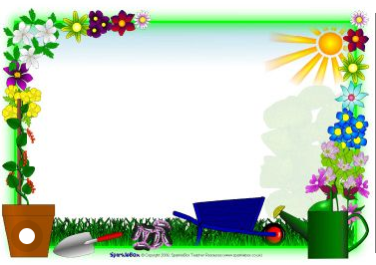
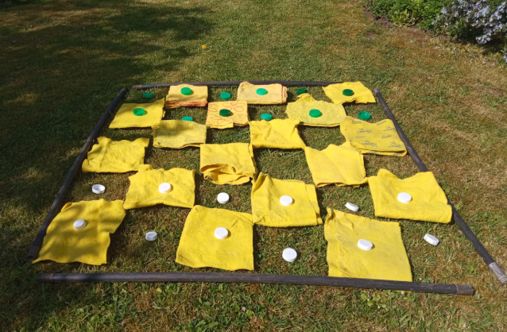
Outdoor Home Learning
Played all the board games in your house already?
Then it’s time to invent a new one. This could be desk-based or if you have the space take it outside and go large-scale with family member counters, real ladders and …real snakes!
Open the link to investigate this further…
https://www.ltl.org.uk/resources/boredom-busting-board-games/

Slide 2
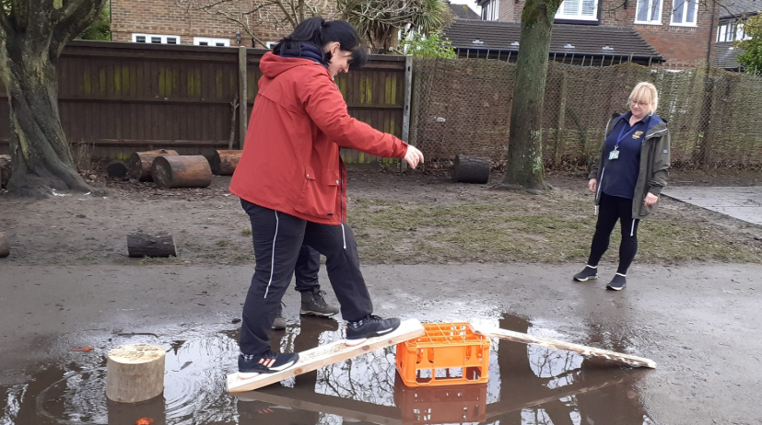
Outdoor Home Learning
Bridging the Gap
Can you build a bridge that will hold your weight and enable you to cross a puddle, a raging tarpaulin river, or a bubbling lava blanket? Alternatively go small-scale and create micro bridge to hold a 500g bag of sugar or similar.
Open the link to investigate this further…
https://www.ltl.org.uk/resources/bridging-the-gap/

Slide 3
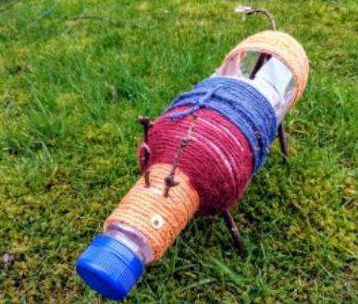
Outdoor Home Learning
Plastic Planters
Give the plastic recycling a new lease of life and design your own planter. You could even use it to grow one of your cuttings in!
https://www.ltl.org.uk/resources/recycl ed-planters/
Open the link to investigate this further…

