Slide 1
Welcome back Elves! We hope you enjoyed Vocabulary Day. Congratulations to Charlie W, Ellie, Erika and Guy for their Achievement Awards! I am looking forward to seeing lots of your amazing work this week! If you haven’t already done so, send in your best pieces from last week. Email yearonelearning@farnborough.bromley.sch.uk

Slide 2
I’m looking forward to seeing lots of you at our Storytime Zoom session at 11.00 this morning.
Watch the animation on the next slide to remind yourself of how to keep safe online.

Slide 3
https://www.youtube.com/watch?v=M-njh8mFvVk

Slide 4
Spellings
This weeks spellings are posted on the
Year 1 Learning page to learn.
Your grown up can carry out the spelling test on Friday!
Happy Spelling

Slide 5
It’s Monday!
Monday 29th June 2020
Here’s your work for today…
.

Slide 6
Farnborough Dance Routine
Mrs Humphries has created our very own Farnborough Dance Routine!
It has five parts and every day this week we are going to start the day by being active and joining in.
Click on the link below:
http://farnboroughprimary.co.uk/farnborough-dance

Slide 7
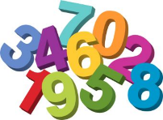
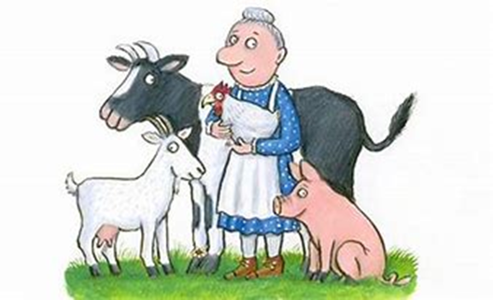
Maths
The Little Old Lady from a Squash and a Squeeze need your help with this
Maths investigation……

Slide 8
Maths
Top tip:
Colour in the
Squares the indicated colour before working out
the questions.
Cut out squares with the indicated colour to work out the question.
1.
2.
3

Slide 9
. .
You can write your answers in your exercise books.
If you would like to try Gruffalo work, complete question 1
If you would like to try Horrid Henry work complete question 2
If you would like to try James and the Giant Peach work, complete all questions

Slide 10
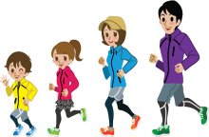
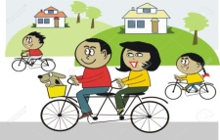
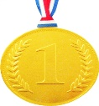
Farnborough’s Race across the World Results up to Monday 22nd June
Class | Number of kilometres covered | *Which country did your class reach? From Farnborough School to …..
Pixies | 2383 km | Greece
Elves | 1797 km | Algeria
Unicorns | 2015 km | Romania
Phoenix | 1521km | Algeria
Pegasus | 4879 km | Ivory Coast
Giants | 2351 km | Greece
Griffins | 2551km | Greece
Centaurs | 3007 km | Turkey
Dragons | 1662 km | Algeria

Slide 11
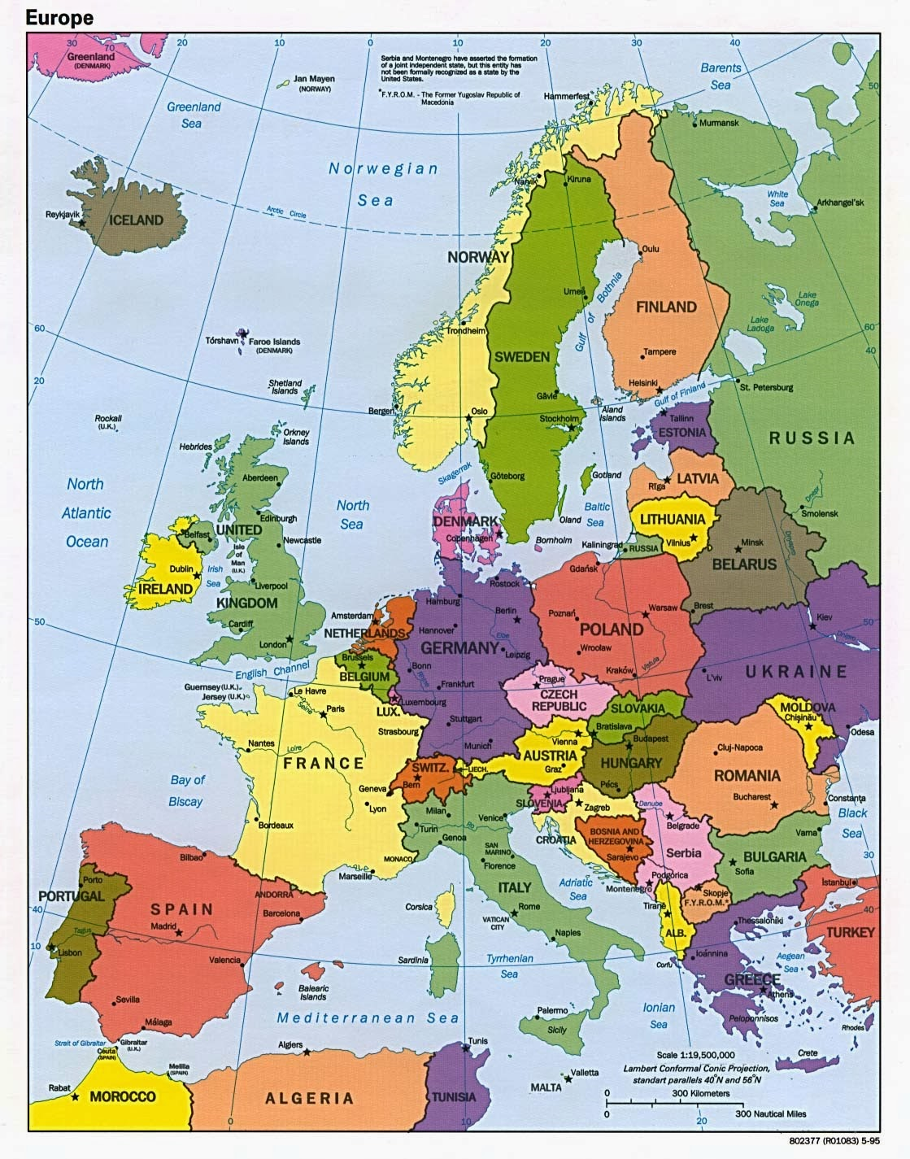
Which country did your class reach?
Map of Europe
Which country did your class reach?

Slide 12
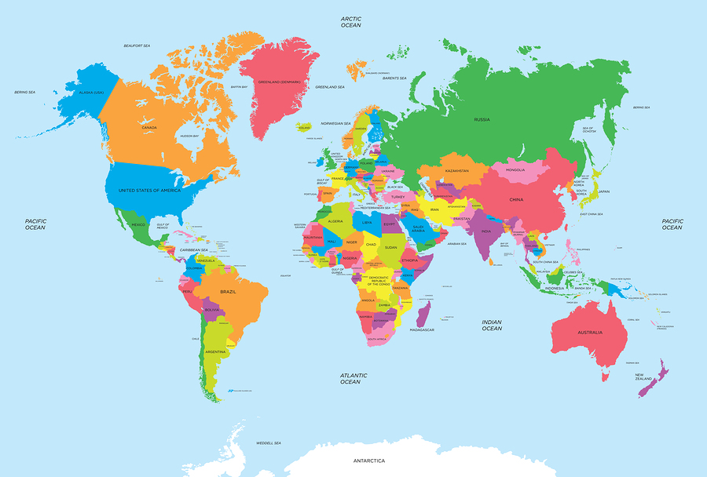
of the World
Map of the World
Which country did your class reach?

Slide 13
Congratulations we have reached
Algeria.
Go on to google maps and find Algeria. What do you see? Which continent is Algeria in?
Google Earth
https://www.google.co.uk/intl/en_uk/earth/
Can you find out which desert is partly in Algeria?
Follow this link to find out more interesting facts about Algeria.
Interesting facts about Algeria | Just Fun Facts
http://justfunfacts.com/interesting-facts-about-algeria/

Slide 14
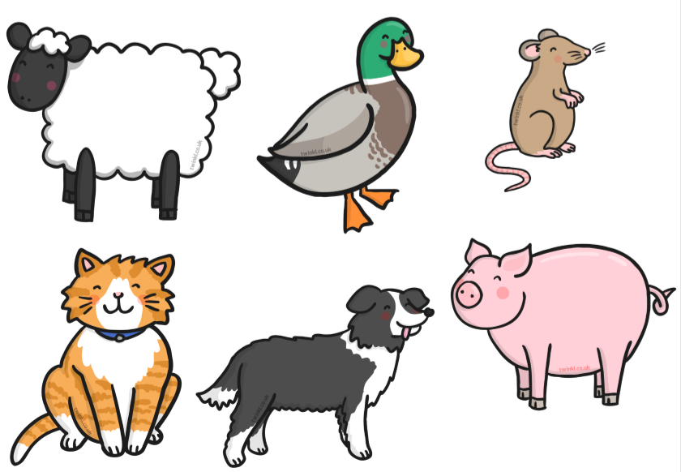
Create puppets for the Squash and Squeeze.
Can you make a puppet from scratch for the character that is missing.

Slide 15
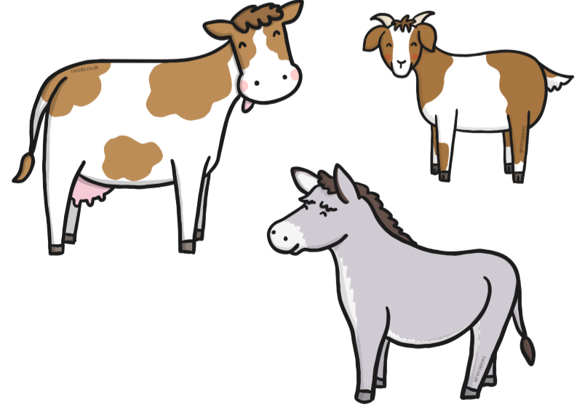

Slide 16
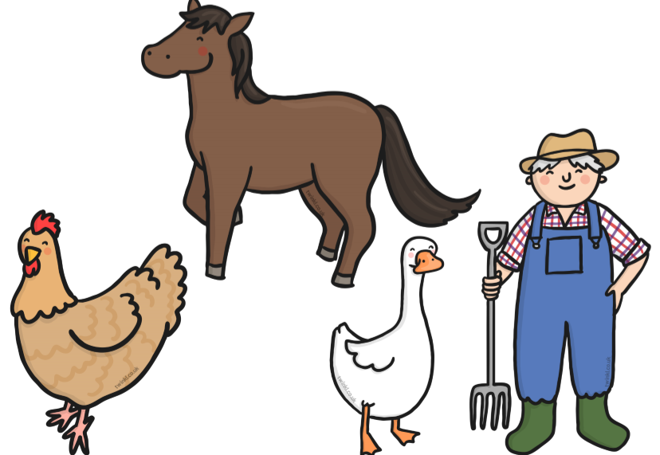

Slide 17
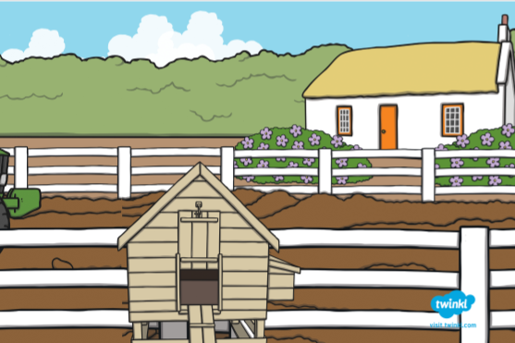
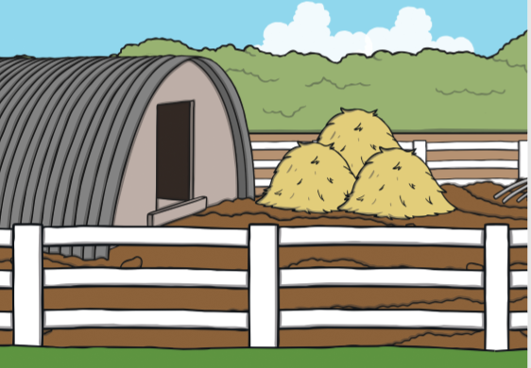
Create a background for your puppets. Use materials you have at home, outside or inside.
Choose a background or you can use something like this…..

Slide 18
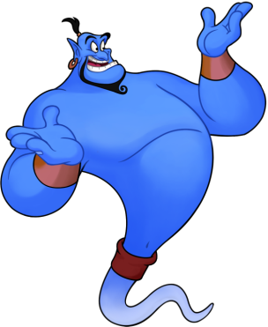
Reading online
I’m so impressed with your reading Elves.
You should be very proud of yourselves!
Please log on to Bug Club
Read for at least 15 minutes.
Please read the key words inside the front cover first.
When you find the bug questions, click and complete them.
Please note down the books you’ve read in your reading
record book.
Your personal login details are on the inside of your reading record book.

Slide 19
Are you ready to Battle?
Back by popular demand – The Battles will begin 8.30am to 2pm on Tuesday 16th June and every Tuesday until the end of term. Therefore, practise your tables to build up your timetable strength and become the Times Tables Legends you are!
https://ttrockstars.com/
This battle is for the whole school. This is an optional activity and Year One children are just beginning to learn about multiplication and division. If your child is beginning to practise, they may like to give it a go. Good luck!

Slide 20
PSHE
Talking to the people in our household is always a good thing to do and helps us to understand some of the new things that are happening in our lives at the moment.

Slide 21
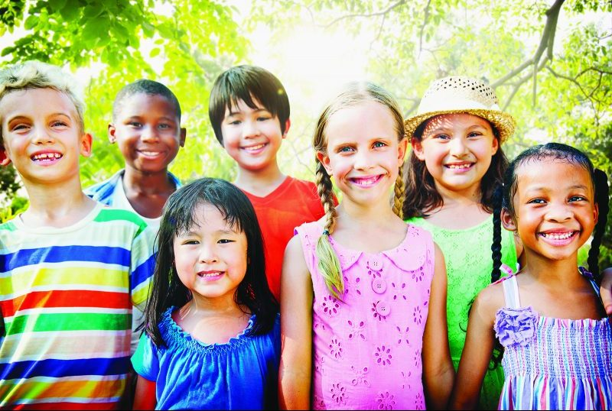
Who are you?

Slide 22
What is it like to be YOU in the World?

Slide 23
Create a list with your name, your favourite game, favourite music and favourite toy.
You could add your best thing about weekends, your future ambition and a dream for our future world.
Record your ideas with drawings, sound, photography or video. There are many things that make you different to other people.

Slide 24
There are also many things that make you the same. Some differences can be seen, and some cannot. Some similarities can be seen, and some cannot. Think for a minute about everything that makes you YOU, the visible and invisible things.
Make a mind map with you in the middle. List or draw everything that makes you YOU!
You
How many things can you think of that make you YOU?

Slide 25
Now think of a friend. Think about everything that makes them THEM, the visible and invisible things. Think for example of the clothes they like wearing or the things they carry with them, something nice they did for you or what games or toys they like.
Make a mind map with your friend in the middle. List or draw everything that makes them THEM!
Friend
How many things can you think of that make them THEM?

Slide 26
Draw all of the things from your mind map to create a portrait of your friend.
There is no right or wrong way to do this activity.
This is for YOU.
YOUR voice, ideas and feelings matter.

