Slide 1
English – Day One
This week, our focus is on a text called the, ‘Impossibly Possible Bookshop’ by Kat Pennington.
For today, you will need to listen to an audio recording of the story and/or read the printed version on the following slides.
There are some activities to complete afterwards.

Slide 2
English

Slide 4
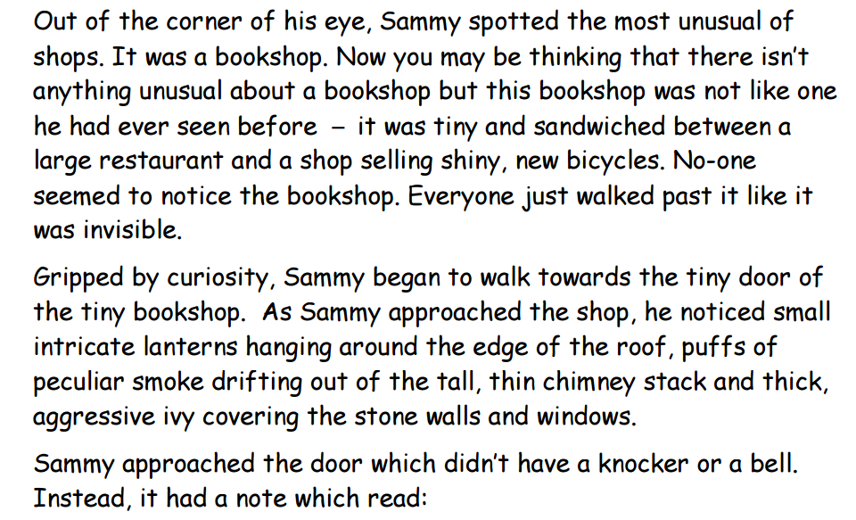

Slide 6
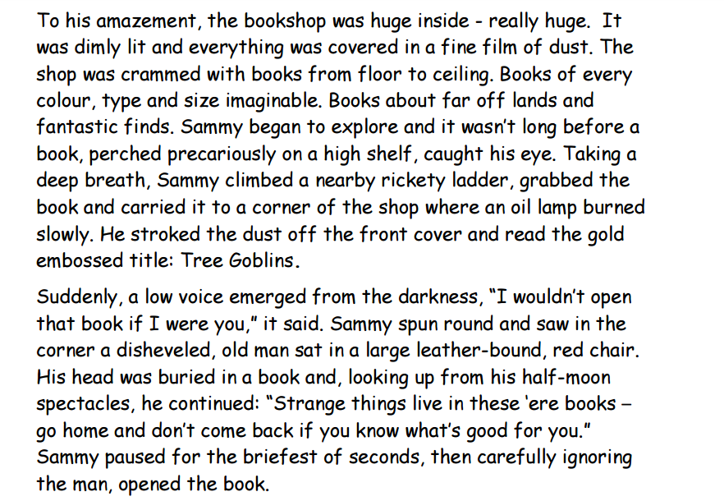

Slide 8
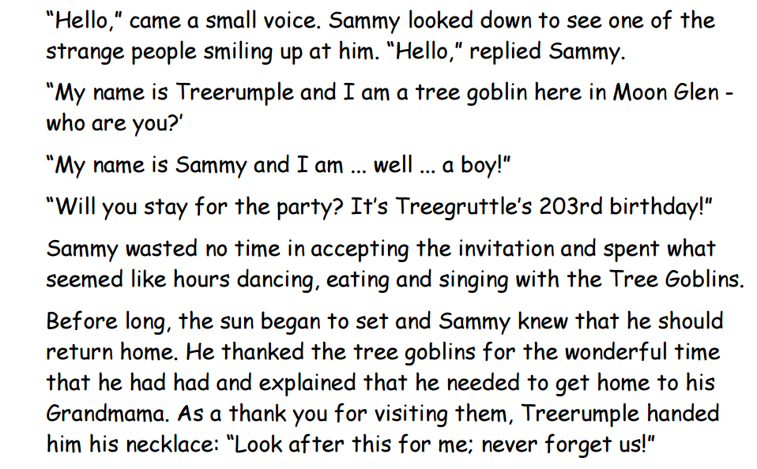

Slide 10
English – Day One

Slide 13
Spellings – Week 3
Group 1: Recap of ‘ou’ words
ground, course, hour, thousand, crouch
Group 2: Recap of tricky words
possess, possession, probably, possible, purpose, potato, potatoes, quarter, pressure, question

Slide 14
Spelling activities for week 3
Try and learn the words for 5 – 10 minutes each day. Break down the words into syllables and/or use the ‘Look, Say, Cover, Write, Check’ method to help you learn them. Complete one of the activities below during the week:
Write your words using one colour for the vowels and another colour for the consonants
Word classes – sort your spelling words into nouns, verbs, adjectives, adverbs etc
Find an antonym (opposite) for each of your spelling words
Write your words, then write them again with the letters mixed up. Can you unscramble them the next day and spell them correctly?
Write your words. Then use a coloured pencil to divide your words into syllables, e.g. sen-tence, re-mem-ber
Use a thesaurus to find some synonyms
X words – write 2 words with 1 letter in common so that they cross over each other, as if they were on a scrabble board
Type out your words on the computer – try to use at least 4 different fonts
Set a timer for 2 minutes. See how many times you can write each word perfectly during that time.
Ask an adult to test you at the end of the week. Good luck!

Slide 15
Monday 15th June 2020 - WALT: Use charts and tables.
What types of chart are shown here?
What can you tell from the charts?
What do you think half a symbol stands for?

Slide 16
How can you work out the value of a bar halfway between 2 points?
Can you work out which is the most popular item without working out the value of each bar?

Slide 17
How can you work out a ¼ of the symbol?

Slide 19
Are you ready to Battle?
Back by popular demand – The Battles will begin 8.30am to 2pm on Tuesday 16th June and every Tuesday until the end of term. Therefore, practise your tables to build up your timetable strength and become the Times Tables Legends you are!
https://ttrockstars.com/

Slide 20
Extract 1
Over the next 2 weeks you are going to have the chance to read this fantastic book written and illustrated by Sabina Radeva.
It explains Darwin’s book “The Origin of the Species” simply and accurately .
There may be a few questions to answer on each extract you read.
If you are able to access the pdf version of each extract on the Year 4 learning page ,you will find that they are much nicer to read and see the illustrations. Enjoy!

Slide 21
Questions Extract 1
1. What can you infer about Charles Darwin from how he has been illustrated by Sabina Radeva?
2. What facts do you learn about Charles Darwin in Extract 1? List at least three.
3.What do you think the term “ English naturalist” means in Extract 1?

Slide 22
Outdoor Home Learning
Mindful Mandalas
Collect some loose materials indoors or out – you could even use free-pouring sand, salt or flour and get creative with mindful, intricate circular patterns called mandalas from the Sanskrit for circle.
https://www.ltl.org.uk/resources/buddh ism-outdoors/
Open the link to investigate this further…

Slide 23
Can you help to create a wellbeing activity calendar?
It was lovely to see you all in our Zoom meetings last week. In our PHSE lesson we had a quick look at the Wellbeing Calendar posted on our learning page. Take a look at it, if you haven’t already.
We all have times in this different and difficult period where we get bored or fed up or feel worried. So we think it would be nice to come together again as a class and are asking for your suggestions for activities as “mood-boosters.”
Have a think and it would be lovely if
everybody made a suggestion……….

Slide 24
Your suggestions for mood-boosting activities might be:
Funny, to make you & your family laugh
Something new for your classmates to try
Creative
Help you get fitter or more skilled in a sport
Teach a new skill
A kind deed for someone else

Slide 25
Who will be the best people to know a great
mood-booster for your age group?
YOU!
Some tips:
Fun!
Easy for everyone to try, no expensive equipment, skill needed.
Email in your ideas to your teacher or be ready to share in our next PHSE Zoom
Can be tried at home or completed within the rules of the lockdown

