Slide 1
English – Day Three
Read the final 4 slides of the story, ‘Staying Out’.
Finish your story using a similar structure:
Paragraph 7 – How did you solve the mystery of what the noise was?
Paragraph 8 – explain where the noise was coming from.
Paragraph 9/10 – back at home and talking about the night before. Did the adult guess what had happened or realise that you had been worried?

Slide 6
Wednesday 10th June 2020 - Maths Investigation
In number pyramids, numbers next to each other are added together to make the number above it. Can you work out what the missing numbers are?
Level 2
Level 1
Level 3
Can you now create 3 of your own number pyramids, some of you might want to use 4 or 5 digit numbers!

Slide 7
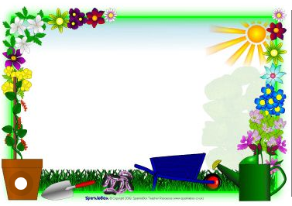
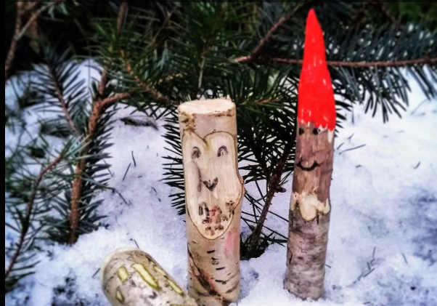
Outdoor Home Learning
Whittle a Critter
Find yourself a stick and use a potato peeler to whittle a critter. Use sharpies to add detail to the creation. If you can’t get outside make a temporary creation from a carrot or a potato, take a photo before it gets eaten!
Open the link to investigate this further…
https://www.ltl.org.uk/resources/a-little-whittling/

Slide 8
Farnborough Dance Routine
Mrs Humphries has created our very own Farnborough Dance Routine!
It has five parts and every day this week we are going to start the day by being active and joining in.
Click on the link below:
http://farnboroughprimary.co.uk/farnborough-dance

