Slide 1
English - Day 4
https://www.bbc.co.uk/bitesize/articles/zknnf4j
Click on the above link or copy and paste it to reach the video of Joanna Lumley reading the second extract of, ‘You’re a bad man, Mr Gum,” by Andy Stanton. There is also the written part of the extract to read.
Complete activity 2 where you are looking at how the author uses humour in the text.
Choose 4 examples of humour to write about: ideas could include: the fairy, the way Mr Gum gets out of bed, surfing in the kitchen, something under the tree and the monstrous dog.

Slide 2
Day 4 continued
Look back at yesterday’s work where you carried the story on. Find at least 2 places within it where you can add your own humour in the style that Andy Stanton has used.

Slide 3
Maths Investigation Day 4

Slide 5
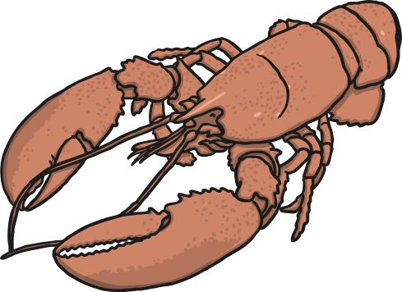
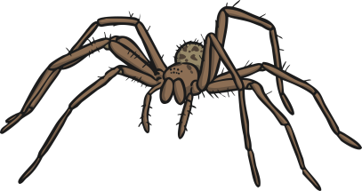
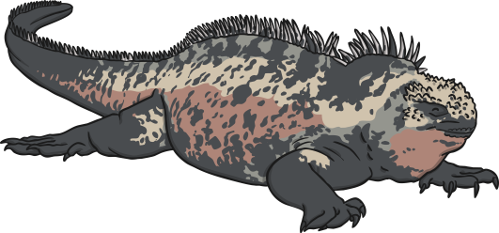
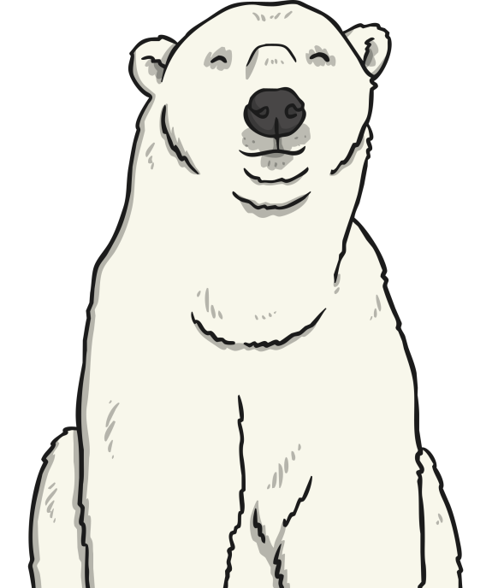
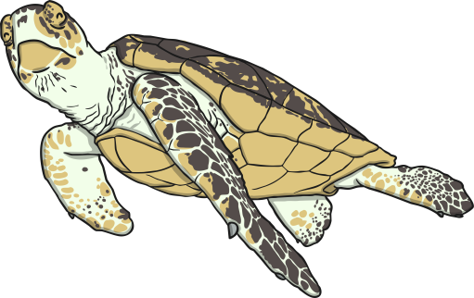
Let’s recap characteristics from last lesson
Today we are going to create our own branching keys to identify living things by looking at their characteristics.
The characteristics of a living thing are what make it similar or different to other living things.
All species of living thing have a unique set of characteristics.
Species with similar characteristics are put into groups. This is how we classify living things.

Slide 6
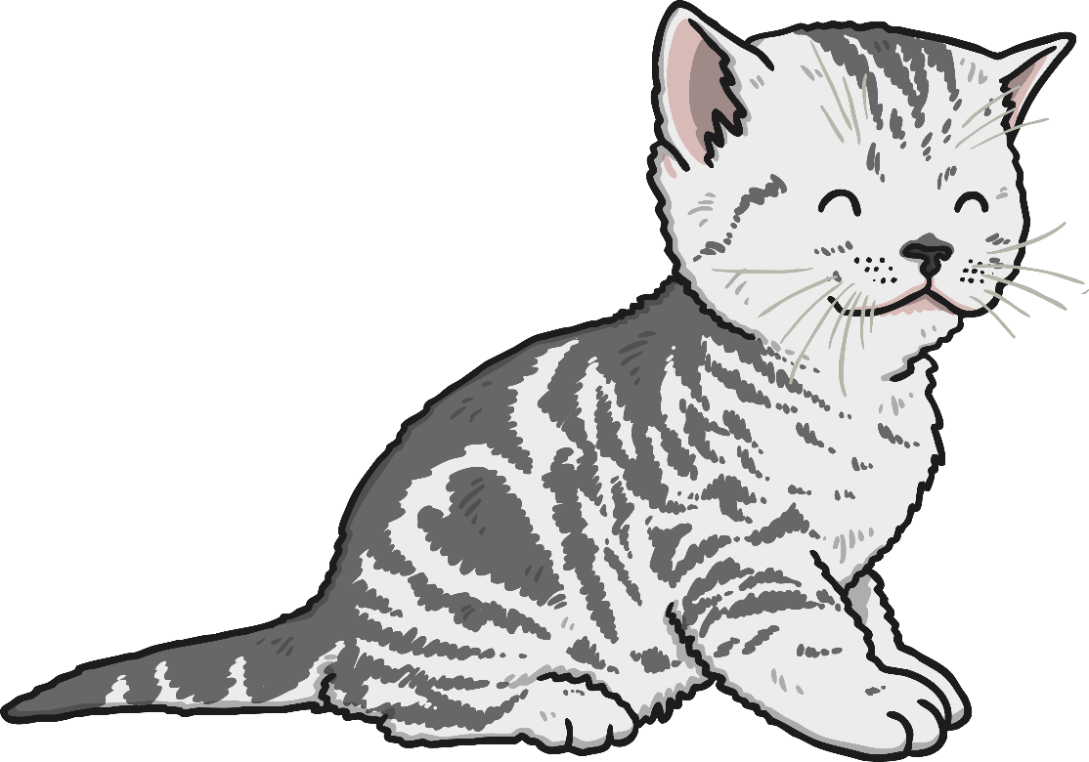
Characteristics
These are some of the characteristics of the domestic cat:
Has whiskers
Has four legs
Has fur
Is a carnivore
Has a tail
These are not characteristics of the species:
Is awake
Is cute
Likes milk
Is a baby
Plays with string
Why not?

Slide 7
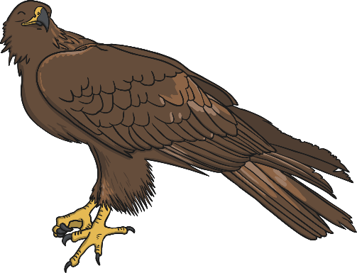
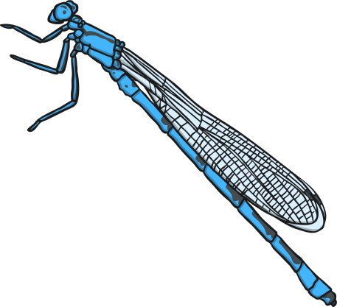
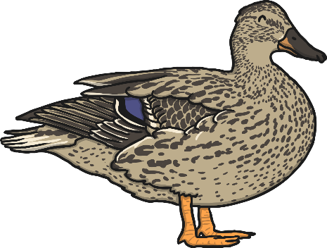
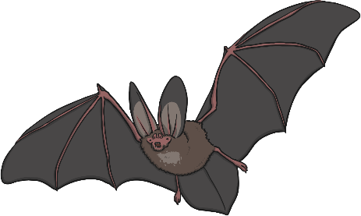
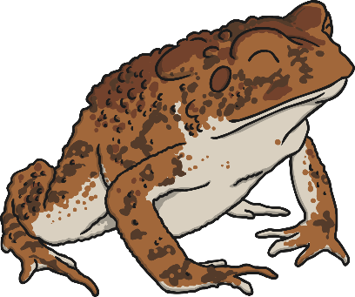
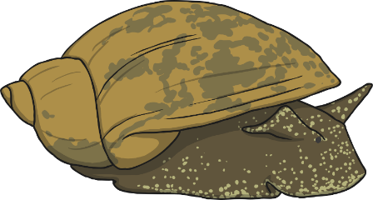
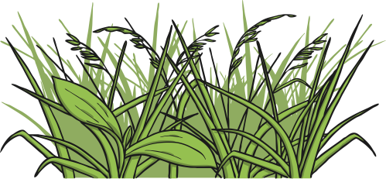
Classification Keys
You are going to create a classification key to sort your living things.
Look carefully at these living things. What question could you ask to split them into two groups?

Slide 8
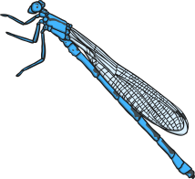
Classification Keys
Is it a vertebrate?
yes
no
Choose one set of living things.
What question could you ask to split these living things into two groups?

Slide 9
Classification Keys
Does it have feathers?
yes
no
Does it have webbed feet?
yes
no
When you reach the end of the key, move on to the next group of living things. Choose a question that lets you sort them into two sets as before.

Slide 10
Classification Keys
Does it have feathers?
yes
no
Does it have webbed feet?
Does it lay eggs?
yes
no
yes
no

Slide 11
Classification Keys
Have a go at arranging your living things into classification keys by choosing questions that let you split each group into two.
You can choose the questions on the slides or write your questions on sticky notes and draw arrows to show how you move down the key.
Use the questions on your classification tables as a starting point if you need to.
Be sure to test your key at the end to make sure that the path works correctly for each living thing.

Slide 12
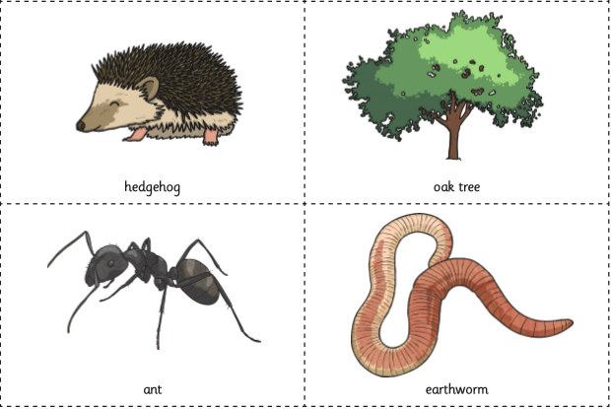
Let’s focus on a woodland habitat What lives there?

Slide 13
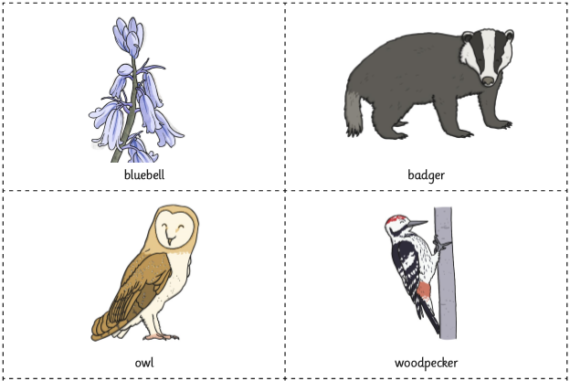
Let’s focus on a woodland habitat What lives there?

Slide 14
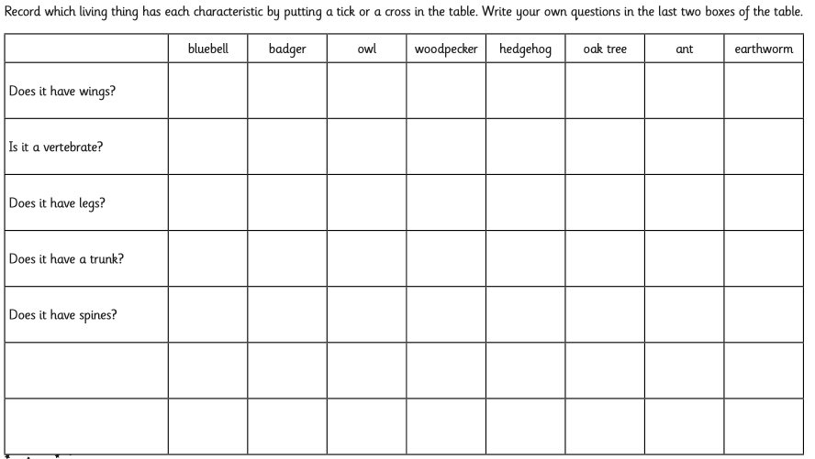
Woodland Habitat

Slide 15
Can you create a classification key to sort animals in a woodland habitat? You can either sort the selection of animals using the questions you used on the previous slide or make up your own, it’s up to you.

Slide 16
Testing and Evaluating
Follow the path that leads to each living thing.
Does each path work correctly?
Do the questions used in the key describe the characteristics of the living things?
What could make this key better?
What has been done well?

Slide 17
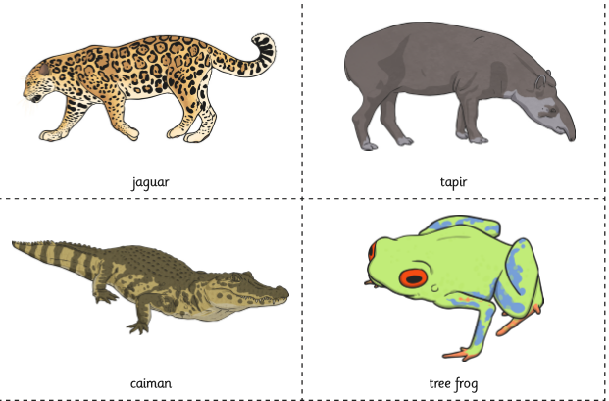
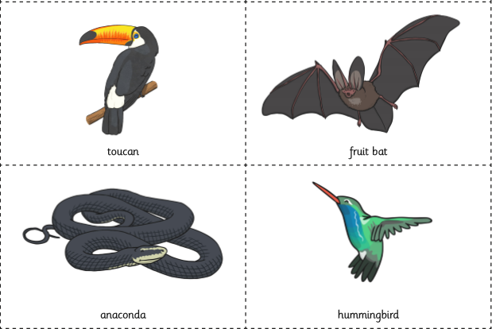
Challenge! Create a classification key for a group of rainforest animals
Select some animals that live in the rainforest, think of your own or use the ones on this slide.
Have a go at arranging your living things into classification keys by choosing questions that let you split each group into two.
Write your questions on sticky notes and draw arrows to show how you move down the key.
Be sure to test your key at the end to make sure that the path works correctly for each living thing.

