Slide 1
Day Three

Slide 2
Let’s keep going!
Today you are going to write the middle section of your story.
Paragraph 3 – where does your MC end up? Describe the setting
Paragraph 4 – is there a party happening? Who do they meet?
Keep referring to the checklist to make sure you have applied the statements.

Slide 3
Writing Checklist
Use some powerful description at times (not all the time though as you want it to be effective). Use an online or paper thesaurus to help you.
Apply a wide range of punctuation including . CL ? ! “ ”,
Think about different sentence starters, e.g. Feeling intrigued, Gingerly, Wondering what on earth she should do next….

Slide 4
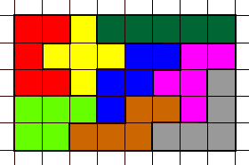
Wednesday 1st July 2020 -Challenge 3
Have a go at making rectangles or other shapes using just some of your pentominoes.
For example, this rectangle only uses 8 pentominoes.

Slide 5
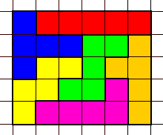
Challenge 3
And here is another rectangle that only uses 6 pentominoes.

Slide 6
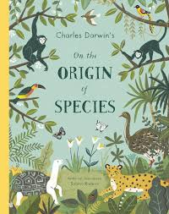
Read extract 6 of Sabina Radeva’s Origin of the Species on our learning page.

Slide 7
Reflect on your learning
What have I learnt from reading Sabina Radeva’s book on Charles Darwin’s The Origin of the Species?
One thing I learnt about Variation is………….
One thing I learnt about Natural Selection is ….
One thing I learnt about Adaptation is………….
Write, draw or discuss what you have learnt. Re-read the book again if you need to.

