Slide 1

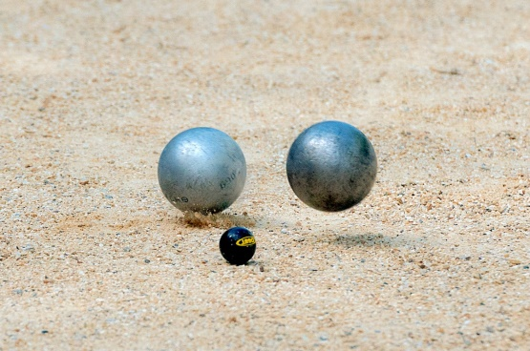
Hopefully the weather is amazing now that we are in July, if it is, try and go outside and play some French Sports!
How to play French Cricket:
https://www.youtube.com/watch?v=PMNlgIiF61g
How to play Petanque:
https://www.youtube.com/watch?v=VxXUEWgpIOs

Slide 2
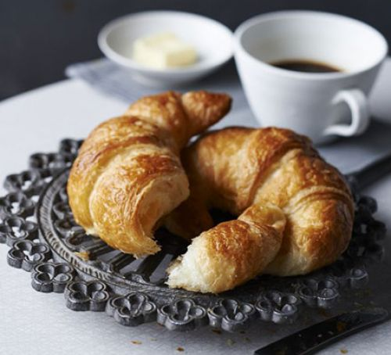
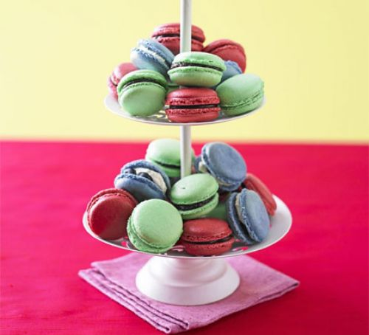
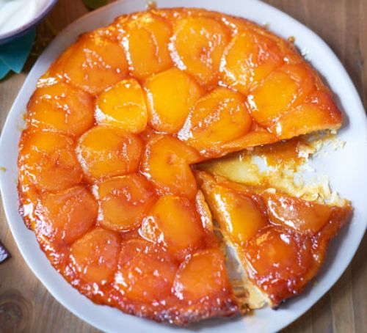
Have a go at your own French Recipe:
Croissants: https://www.bbcgoodfood.com/recipes/croissants
Macarons: https://www.bbcgoodfood.com/recipes/macarons
Tarte tatin
https://www.bbcgoodfood.com/recipes/tarte-tatin

Slide 3
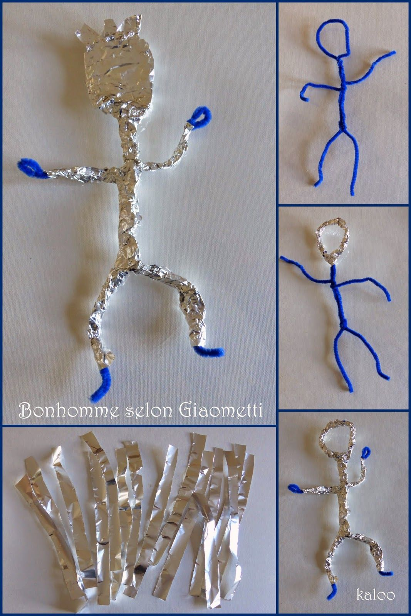
Learn about Alberto Giacometti and look at some of his art work that exists in Centre Pompidou in Paris.
Try quick figure sketching, thinking about how we position our bodies, and how they can show our emotions.
Use kitchen foil to create a sculpture inspired by Giacometti’s bronze figures.

Slide 4
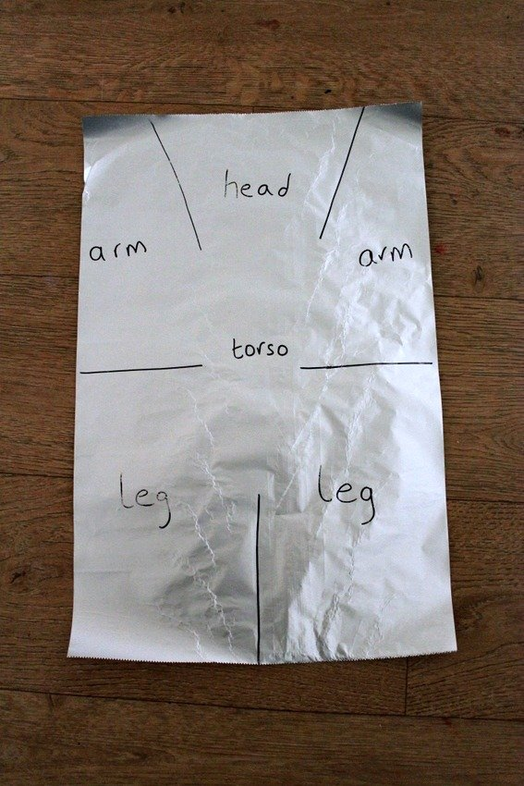
For this art lesson you will need:
- paper
- pen or pencil
- kitchen foil (tin foil / aluminium foil)
- scissors
Have a look at the photo below to see how you can segment the foil into pieces that will become the head, arms, legs, and torso of your person. Draw out the guide lines on your own piece of foil, and then cut along them. Next, used your hands to scrunch up the foil sections to make your person.

Slide 5
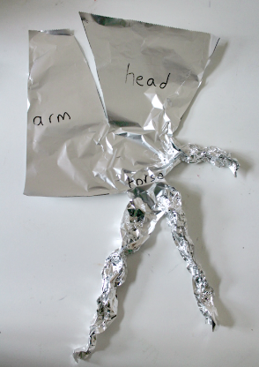
Once you’ve got the idea of how the flat kitchen foil can be sectioned out and scrunched up, you can have fun creating all sorts of different figures.

Slide 6
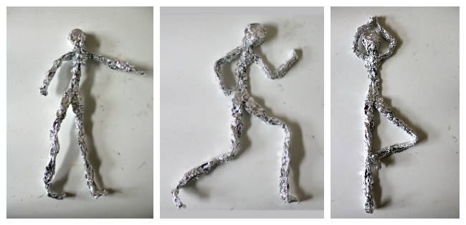
Move your foil figure to create some stick figures . The arms, legs, back, and neck will all bend easily so you can carefully re-position your person.
You can also use additional pieces of foil to make more people.
Try to make your figure stand, run, even do yoga!

Slide 7
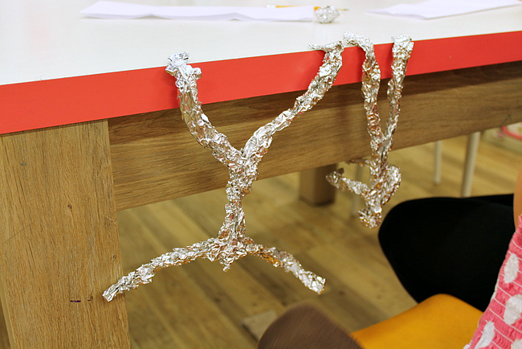
Work in pairs if you like: one person uses their own body to strike a pose, the other person re-creates the pose in their sculpture.
Maybe you can get your sculpture to stand up on its own? This is quite hard, as you need to play around with the balance of your person and their centre of gravity.
Your figure might like to hang upside down from the table!

Slide 8
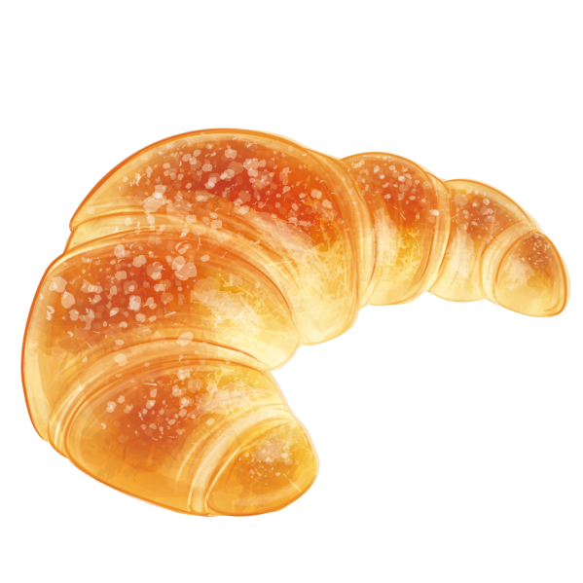
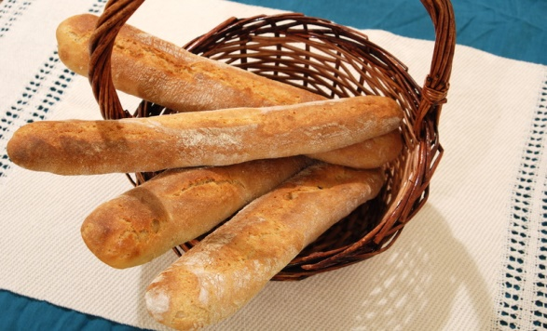
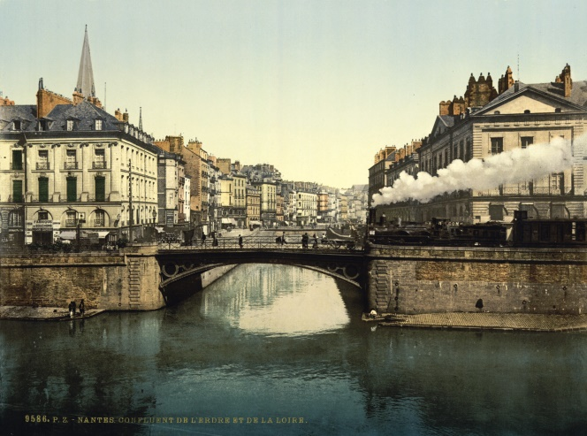
We hope you enjoyed French Day! Don’t forget to send in lots of photos of what you did to your class learning email! We look forward to seeing all your amazing creations. Have a brilliant weekend!

