Slide 2
English
We are going to continue to use the Night Zookeeper for our English activities this week.

Slide 4
Do you know any other spies like the mysterious giraffes mentioned in the story. Make a list.
What tasks do you think the Day Zookeepers have to do to care for the animals in the zoo?
Would you like to be a Day or Night Zookeeper? Explain you reasons why.

Slide 5
Guided Reading
Purple Group –1-2 Questions
Blue – 2-3 Questions
Green – 3-4 Questions
Orange –4 Questions
What will he do with the ship now that it has magically appeared?
‘He loved this moment, seeing his creations come to life’. The story starter refers to George’s creations in the plural. What does this tell you?
What other drawings might George have done in the past? Where are they now?
If you could draw anything (knowing it would come to life) what would you draw?
What was George’s magic word?

Slide 6
Maths
Complete the coloured work you would normally do in class. If you want to try the other challenges, please feel free ☺
Purple group: challenge one
Blue group and green group: challenge two
(blue group, you can also finish off your maths workbook if you haven’t already, one page for each maths lesson instead of or as well as the challenge)
Orange group and red group: challenges two and three

Slide 7
Challenge One
We are building our maths knowledge.

Slide 8
Challenge Two

Slide 9
Challenge Three

Slide 10
Active Learning
Farnborough Dance Routine
Mrs Humphries has created our very own Farnborough Dance Routine!
It has five parts and every day this week we are doing this as our active learning.
Click on the link below:
http://farnboroughprimary.co.uk/farnborough-dance

Slide 11
Reading Independently
Read for at least 15 minutes independently. You can read a book of your choice.
If you would like to read ‘The Week Junior’ follow this link.
If you would like to read an online book, follow this link.

Slide 12
The story of Boudicca!

Slide 13
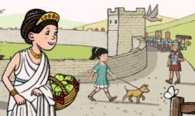
Boudicca lived over 2000 years ago in a Celtic tribe called the Iceni.
She was married to a powerful man named King Prasutagus and had two daughters.

Slide 14
These were dangerous times to live in because the Roman army were very strong.
King Prasutagus made an agreement with the Romans to keep peace and the land the tribe lived on.

Slide 15
Time passed, and King Prasutagus passed away.
BUT! He left a will…

Slide 16
WILL
I will leave half of my kingdom to my Queen, Boudicca.
I will leave the other half of my kingdom to the Roman Emperor.

Slide 17
The Romans laughed at this!
They wanted all of the kingdom, more taxes and Boudicca to not be Queen!
So they took away all the tribes’ farms and animals!

Slide 18
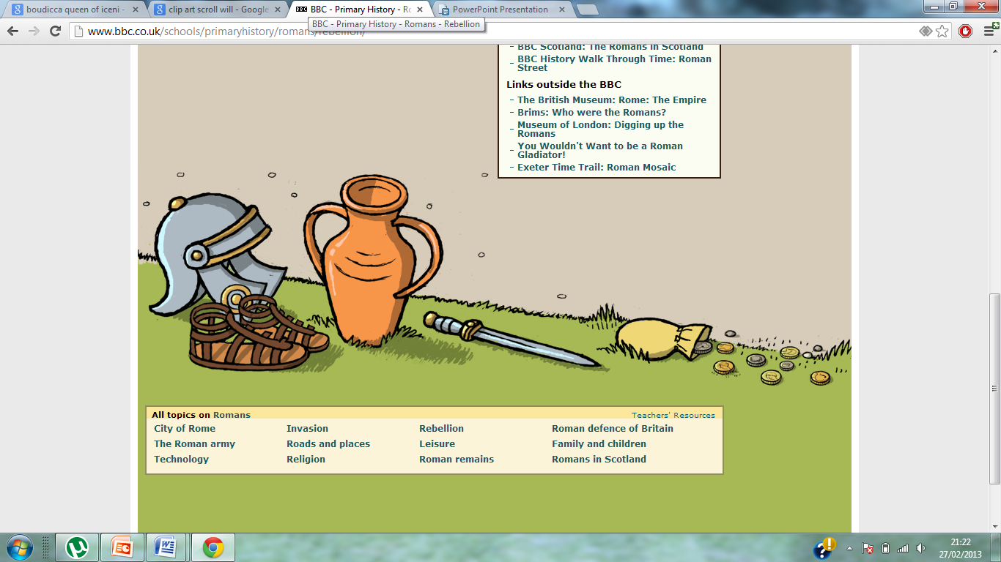
Boudicca vowed to fight back!
Warriors from other armies joined her Iceni tribe and they marched to their first battle.
They were victorious in their first battle in Colchester but as they headed to London, they soon realised why the Romans were so hard to defeat!

Slide 19
The Romans were highly trained warriors with very good battle plans!
Boudicca had too much pride to be taken captive by the Romans so instead she drank a deadly poison!

Slide 20
So what did Boudicca look like?
A Roman writer named Dio Cassius wrote…
She was a tall woman with piercing eyes and a loud voice. A great mass of red hair hung down below her waist. Round her neck was a large gold band. She wore a long, flowing tartan dress, and over it a thick cloak fastened with a brooch.

Slide 21
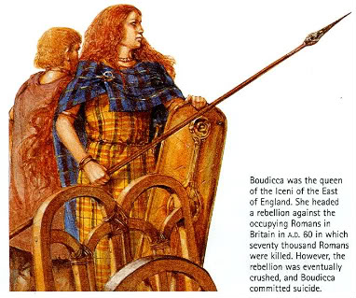

Slide 22
Here is Boudicca’s story from her perspective (from Horrible Histories)

Slide 23
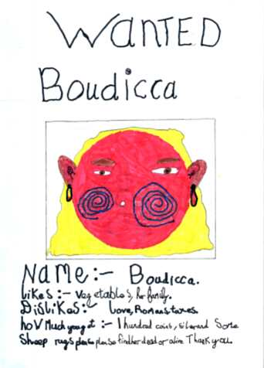
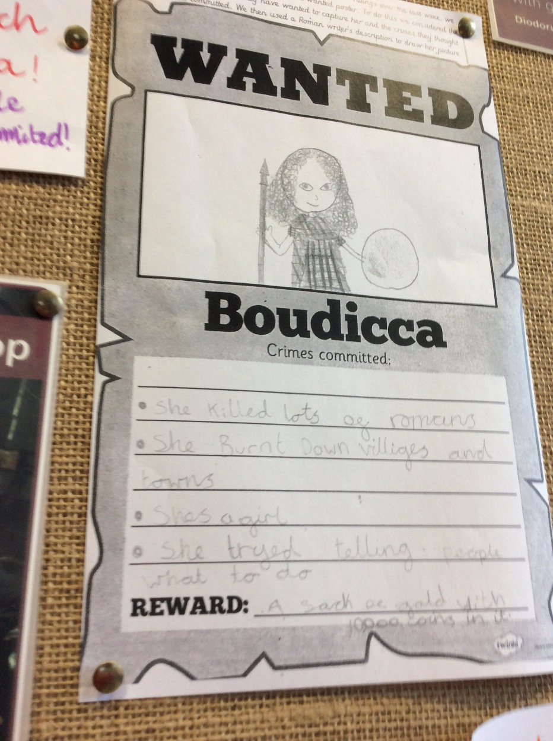
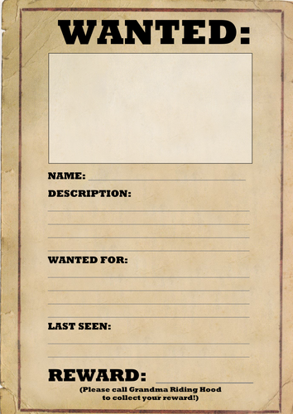
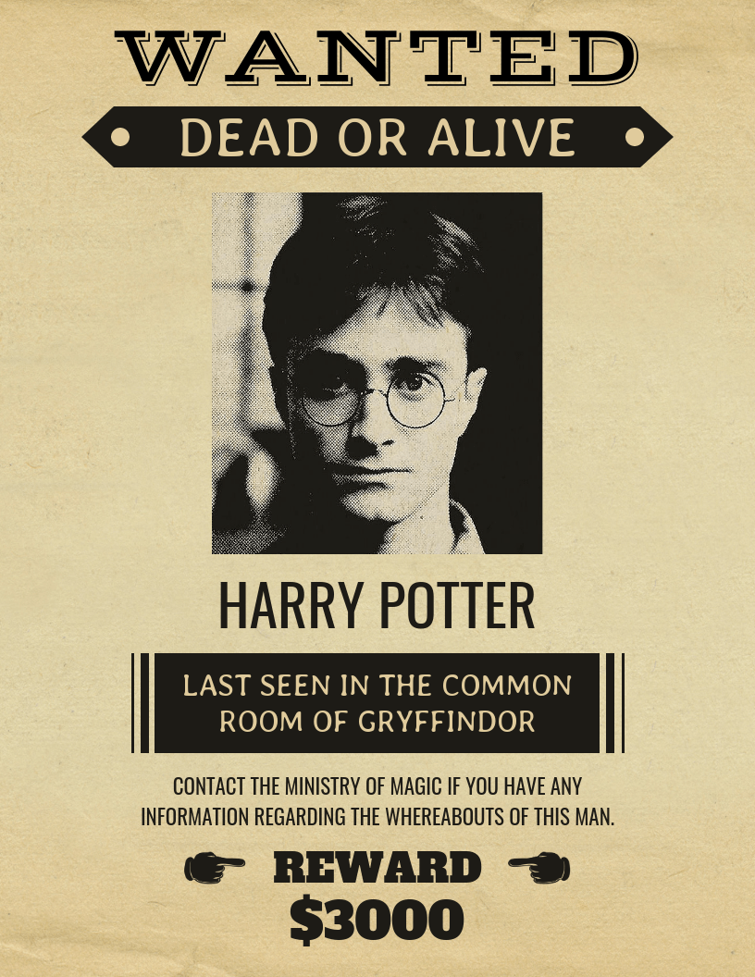
Imagine you are part of the Roman army.
Create a wanted poster for Boudicca. Use the information about what she looked like to help you create your poster.

