Slide 2
English Thursday 2nd July 2020 Journey to the Jungle

Slide 3
Visiting a jungle Let’s revisit my diary entry. Listen to a recording of the text below here: https://soundcloud.com/talkforwriting/jungle/s-4Ye8khPyx1x

Slide 4
Jungle Log: 18th April, 2020
Today has been an amazing day of discovery! I woke early and got ready for my trek into the Atlanti Jungle. I was excited and couldn’t wait to see what lay ahead of me. I packed my rucksack and put on my sturdy walking boots. I made sure my camera was working because I wanted to record as much of the day as possible. I left the camp at 6am.

Slide 5
First, I trudged through the dense forest and collected samples of the plant life. My favourite was a thorny bush. It had tiny, yellow flowers growing on it, which smelt like ice cream! Next, I studied some of the mesmerising insects that were crawling up the rough bark of every tree. One insect looked like a caterpillar but had 2 sets of wings and tiny hands on the ends of its 20 legs. Excitedly, I photographed as many creatures as I could because I wanted to show my explorer friends what I had discovered.

Slide 6
After a short tea break, I measured the circumference of the tallest trees to work out how old they were. One measured 10 metres around and was so tall that I couldn’t see the top of it. It reminded me of the beanstalk in a famous children’s story. Next, I trekked to a clearing and found a beautiful plunge pool. The water was turquoise and tiny neon fish were splashing on the surface. I tried to catch one, but they were too fast for me. Then it was time for a rest. I lounged on pink grass, soaking up the purple sun beams and listened to the strange jungle noises around me.

Slide 7
Finally, I headed back to camp because the sun began to set. It sets quickly in Oreno and I was worried I might get lost. When I got to my tent, I unpacked my rucksack and stored my plant samples safely. I’m really looking forward to where my wardrobe will take me next week!

Slide 8
Write away!
Now you’re ready to write your first Jungle Log!
★ Use your plan (and the model for Atanti if it helps) to draft your log on a separate piece of paper.
Remember to:
add detail to your sentences by using and or but;
add explanation to your sentences using because;
use fronted adverbials like After that or because, to start some
sentences;
check your capital letters at the start of sentences, full stops at the end
and commas after a fronted adverbial or the phrase introduced by the fronted adverbial.
★Don't forget to read your work and check it flows and makes sense.
Today you are going to write the last 3 paragraphs from your plan.

Slide 9
Underlying structure | New ideas
State when the exploring happened, sum up the day & tell reader how you felt, e.g. Today has been amazing. I was so ...
What you did before you set off, e.g. I put on my ...
Event 1 – what happened? First, ...
Event 2 – what happened? Next, ...
Event 3 – what happened? After a short break, ...
Event 4 – what happened next? Following that, ...
Round off your report and tell the reader what you did at the end of the day. Finally, ... When I got back ...
Today you are writing the sections with the stars next to them.

Slide 10
Guided Reading 2nd July 2020
Perfect picture!
Can you draw a picture of something Batman might have done that day?
Now you have drawn something write a paragraph about this part of the story.
Can you continue and finish Batman’s adventure.
Mind Map your ideas to help you complete the story.

Slide 11
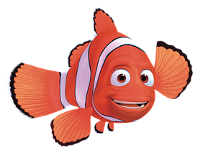
Active Learning

Slide 12
Maths
Complete the coloured work you would normally do in class. If you want to try the other challenges, please feel free ☺
Purple group: challenge one
Blue group and green group: challenge two
(blue group, you can also finish off your maths workbook if you haven’t already, one page for each maths lesson instead of or as well as the challenge)
Orange group and red group: challenges two and three

Slide 13
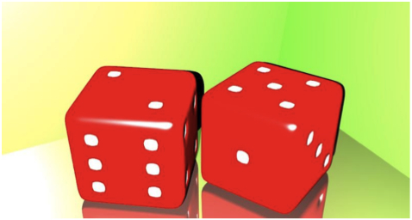
Challenge One
We are building our maths knowledge.
Here are two dice.
If you add up the dots on the top you'll get 7.
Find two dice to roll yourself. Add the numbers that are on the top. What other totals could you get if you roll the dice again?
Click here for an online dice you could use.

Slide 14
Challenge Two
Here are four threes: 3 3 3 3
And here are four signs: + − × ÷
See if you can make all of the numbers from 0 to 9 using all four 3s and any or all of the signs.
Examples to make 0 and 9:
3 + 3 – 3 – 3 = 0
3 x 3 + 3 - 3 = 9
Is it possible to make all the numbers from 0 to 10? How do you know?

Slide 15
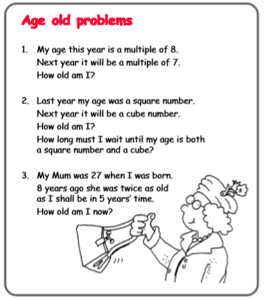
Challenge Three

Slide 16
Reading Independently
Read for at least 15 minutes independently. You can read a book of your choice.
If you would like to read an online book, follow this link.
When you have finished a book, use the book review template on the Year 3 learning page to write a book review to send to us.

Slide 17
How to draw the Eiffel Tower

Slide 18
Steps 1 and 2

Slide 19
Steps 3 to 5

Slide 20
Steps 6 to 8

Slide 21
Voilà!

