Slide 2
English Wednesday 1st July 2020 Journey to the Jungle

Slide 3
Visiting a jungle Let’s revisit my diary entry. Listen to a recording of the text below here: https://soundcloud.com/talkforwriting/jungle/s-4Ye8khPyx1x

Slide 4
Jungle Log: 18th April, 2020
Today has been an amazing day of discovery! I woke early and got ready for my trek into the Atlanti Jungle. I was excited and couldn’t wait to see what lay ahead of me. I packed my rucksack and put on my sturdy walking boots. I made sure my camera was working because I wanted to record as much of the day as possible. I left the camp at 6am.

Slide 5
First, I trudged through the dense forest and collected samples of the plant life. My favourite was a thorny bush. It had tiny, yellow flowers growing on it, which smelt like ice cream! Next, I studied some of the mesmerising insects that were crawling up the rough bark of every tree. One insect looked like a caterpillar but had 2 sets of wings and tiny hands on the ends of its 20 legs. Excitedly, I photographed as many creatures as I could because I wanted to show my explorer friends what I had discovered.

Slide 6
After a short tea break, I measured the circumference of the tallest trees to work out how old they were. One measured 10 metres around and was so tall that I couldn’t see the top of it. It reminded me of the beanstalk in a famous children’s story. Next, I trekked to a clearing and found a beautiful plunge pool. The water was turquoise and tiny neon fish were splashing on the surface. I tried to catch one, but they were too fast for me. Then it was time for a rest. I lounged on pink grass, soaking up the purple sun beams and listened to the strange jungle noises around me.

Slide 7
Finally, I headed back to camp because the sun began to set. It sets quickly in Oreno and I was worried I might get lost. When I got to my tent, I unpacked my rucksack and stored my plant samples safely. I’m really looking forward to where my wardrobe will take me next week!

Slide 8
Write away!
Now you’re ready to write your first Jungle Log!
★ Use your plan (and the model for Atanti if it helps) to draft your log on a separate piece of paper.
Remember to:
add detail to your sentences by using and or but;
add explanation to your sentences using because;
use fronted adverbials like After that or because, to start some
sentences;
check your capital letters at the start of sentences, full stops at the end
and commas after a fronted adverbial or the phrase introduced by the fronted adverbial.
★Don't forget to read your work and check it flows and makes sense.
Today you are going to write the 1st 4 paragraphs from your plan.

Slide 9
Underlying structure | New ideas
State when the exploring happened, sum up the day & tell reader how you felt, e.g. Today has been amazing. I was so ...
What you did before you set off, e.g. I put on my ...
Event 1 – what happened? First, ...
Event 2 – what happened? Next, ...
Event 3 – what happened? After a short break, ...
Event 4 – what happened next? Following that, ...
Round off your report and tell the reader what you did at the end of the day. Finally, ... When I got back ...
Today you are writing the sections with the stars next to them.

Slide 10
Guided Reading 1st July2020
After work, Batman always called in at his favourite café in Gotham City. We all have different ways of relaxing; a game of sport, watching television, going for a bike-ride…Batman’s was enjoying a steaming hot cup of coffee whilst reading the newspaper.
Batman looked forward to having an evening off, however evenings off didn’t always tend be that relaxing.
Ring ring…Ring ring…Ring ring…There was a call from the phone behind the counter…
Think back to your next part of the Batman story and answer these questions.
1.Does it turn out to be relaxing or does he have to go out and save lives?
2.Who is on the end of the phone?
3.Gotham City (where Batman lives) is a place where everyone always seems to be sad or in trouble. Do you think that in our world there is more happiness or sadness? Explain why.

Slide 11
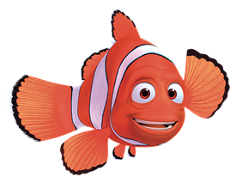
Active Learning

Slide 12
Maths
Complete the coloured work you would normally do in class. If you want to try the other challenges, please feel free ☺
Purple group: challenge one
Blue group and green group: challenge two
(blue group, you can also finish off your maths workbook if you haven’t already, one page for each maths lesson instead of or as well as the challenge)
Orange group and red group: challenges two and three

Slide 13
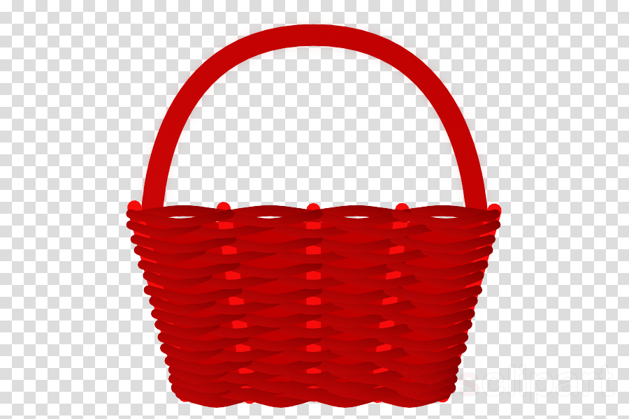
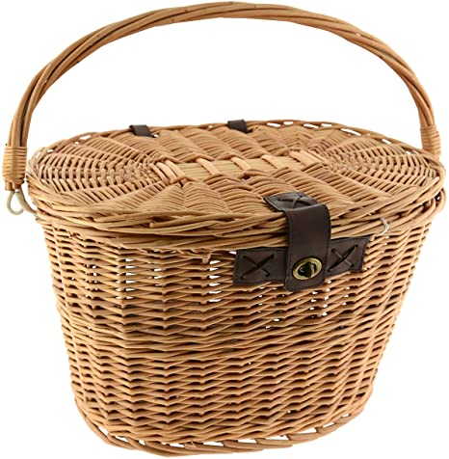
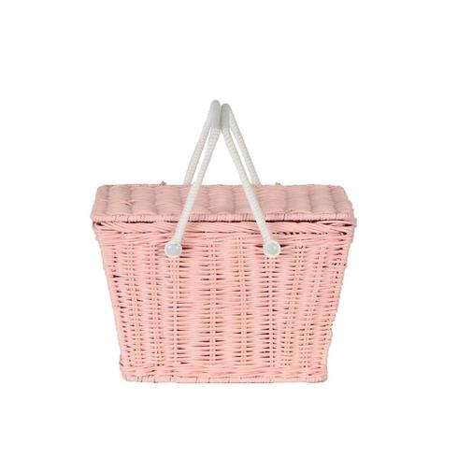
Challenge One
We are building our maths knowledge.
There are 3 baskets: a brown one, a red one and a pink one. Altogether they are holding 10 eggs.
The brown basket has one more egg in it than the red basket.
The red basket has three less eggs than the pink basket.
How many eggs in each basket?

Slide 14
Challenge Two

Slide 15
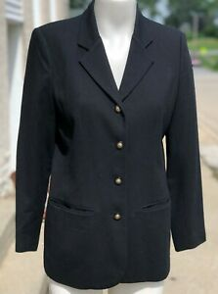
I have a jacket which has four buttons. Sometimes, I do the buttons up starting with the top button. Sometimes, I start somewhere else. How many different ways of buttoning it up can you find?
CHALLENGE: Look back at the number of different ways you found for buttoning up four buttons. Can you predict the number of ways of buttoning up a coat with five buttons? Six buttons ...?
Challenge Three

Slide 16
Reading Independently
Read for at least 15 minutes independently. You can read a book of your choice.
If you would like to read an online book, follow this link.
When you have finished a book, use the book review template on the Year 3 learning page to write a book review to send to us.

Slide 17
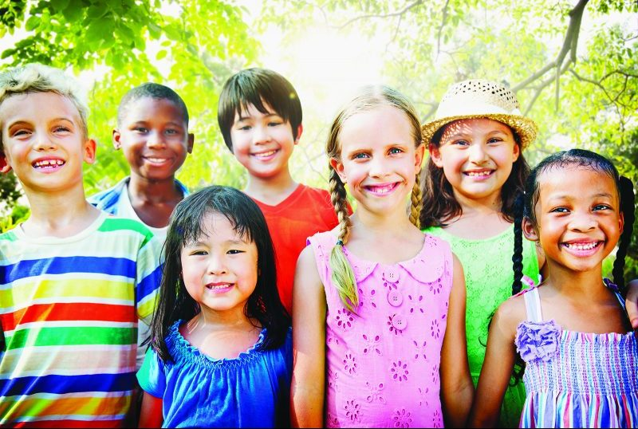
Who are you?

Slide 18
What is it like to be YOU in the World?

Slide 19
Create a list with your name, your favourite game, favourite music and favourite hairstyle.
You could add your best thing about weekends, your future ambition and a dream for our future world.
Record your ideas with drawings, sound, photography or video. There are many things that make you different to other people.

Slide 20
There are also many things that make you the same. Some differences can be seen, and some cannot. Some similarities can be seen, and some cannot. Think for a minute about everything that makes you YOU, the visible and invisible things.
Make a mind map with you in the middle. List everything that makes you YOU!
You
How many things can you think of that make you YOU?

Slide 21
Now think of a friend. Think about everything that makes them THEM, the visible and invisible things. Think for example of the clothes they like wearing or the things they carry with them, something nice they did for you or what games they like.
Make a mind map with your friend in the middle. List everything that makes them THEM!
Friend
How many things can you think of that make them THEM?

Slide 22
Draw all of the things from your mind map to create a portrait of your friend.
There is no right or wrong way to do this activity.
This is for YOU.
YOUR voice, ideas and feelings matter.

