Slide 2
English Tuesday 23rd June 2020 Journey to the Jungle

Slide 3
Visiting a jungle Let’s revisit my diary entry from yesterday. Listen to a recording of the text below here: https://soundcloud.com/talkforwriting/jungle/s-4Ye8khPyx1x

Slide 4
Jungle Log: 18th April, 2020
Today has been an amazing day of discovery! I woke early and got ready for my trek into the Atlanti Jungle. I was excited and couldn’t wait to see what lay ahead of me. I packed my rucksack and put on my sturdy walking boots. I made sure my camera was working because I wanted to record as much of the day as possible. I left the camp at 6am.

Slide 5
First, I trudged through the dense forest and collected samples of the plant life. My favourite was a thorny bush. It had tiny, yellow flowers growing on it, which smelt like ice cream! Next, I studied some of the mesmerising insects that were crawling up the rough bark of every tree. One insect looked like a caterpillar but had 2 sets of wings and tiny hands on the ends of its 20 legs. Excitedly, I photographed as many creatures as I could because I wanted to show my explorer friends what I had discovered.

Slide 6
After a short tea break, I measured the circumference of the tallest trees to work out how old they were. One measured 10 metres around and was so tall that I couldn’t see the top of it. It reminded me of the beanstalk in a famous children’s story. Next, I trekked to a clearing and found a beautiful plunge pool. The water was turquoise and tiny neon fish were splashing on the surface. I tried to catch one, but they were too fast for me. Then it was time for a rest. I lounged on pink grass, soaking up the purple sun beams and listened to the strange jungle noises around me.

Slide 7
Finally, I headed back to camp because the sun began to set. It sets quickly in Oreno and I was worried I might get lost. When I got to my tent, I unpacked my rucksack and stored my plant samples safely. I’m really looking forward to where my wardrobe will take me next week!

Slide 8
Read my diary again. Underline any other words you don't know the meaning of. Can you find out what they mean? You could ask someone else in your home to tell you, use a dictionary or search the internet. Write your definitions out on a separate piece of paper and try to use them in a sentence.
What can you remember now?
★ Underline the correct definition of the words below.
Does mesmerising mean ‘something that is boring’ or ‘something that is really
exciting’?
Is turquoise close to the colour blue or close to the colour red?
Does trek mean ‘to run quickly’ or ‘to go on a difficult journey’?
Does discovery mean ‘something you do all the time’ or ‘finding something for the first time’?

Slide 9
Challenge: Now write some sentences using any of our new words. I have done one for you:
The sky looked turquoise this morning.
Words
Mesmerising
Turquoise
Trek
Discovery

Slide 10
Jungle Comprehension
Which jungle is going to be explored?
List two things the explorer did before he left camp.
Give two reasons why the explorer left early at 6am?
Which word in the text means the same as prickly?
What did the tiny, yellow flowers smell of?
The fish in the plunge pool were hiding. True or false?
What useful things might the explorer have in his rucksack for exploring?
Why did the explorer measure the trees?
The explorer says: It reminded me of the beanstalk in a famous children’s story. What story do you think he is talking about?

Slide 11
Guided Reading - 23rd June 2020
Sentence challenge!
Can you make a list of things the Mad Hatter might be thinking?
The use your list to help you write a 2nd paragraph of your character description.

Slide 12
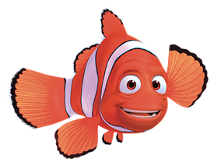
Active Learning

Slide 13
Maths
Complete the coloured work you would normally do in class. If you want to try the other challenges, please feel free ☺
Purple group: challenge one
Blue group and green group: challenge two
(blue group, you can also finish off your maths workbook if you haven’t already, one page for each maths lesson instead of or as well as the challenge)
Orange group and red group: challenges two and three

Slide 14
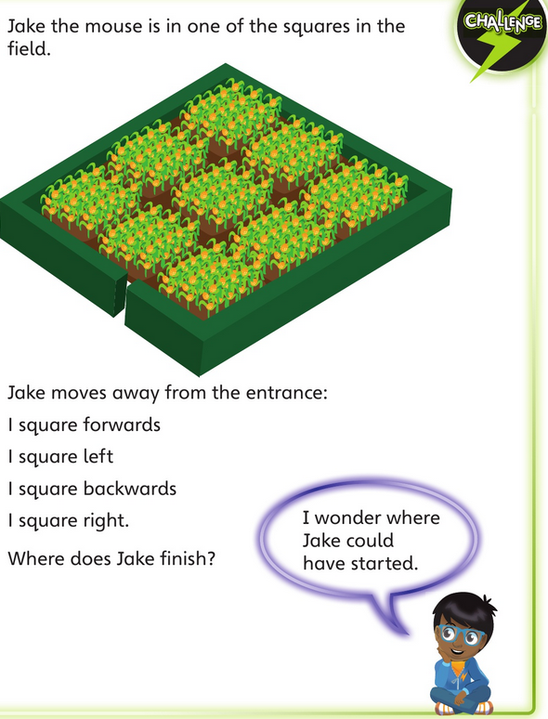
Challenge One
We are building our maths knowledge.

Slide 15
Challenge Two
Look at this Venn diagram (watch this video to remind you about Venn diagrams). Can you work out what each circle should be labelled as? Can you add more numbers into each part of the diagram? Can you make your own Venn diagram?
These numbers are all….
These numbers are all….
38
30
78
165
85
210
22
25
136
27

Slide 16
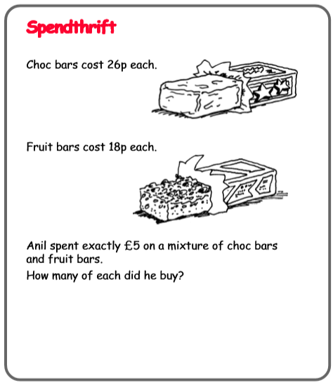
Challenge Three

Slide 17
Reading Independently
Read for at least 15 minutes independently. You can read a book of your choice.
If you would like to read an online book, follow this link.
When you have finished a book, use the book review template on the Year 3 learning page to write a book review to send to us.

Slide 18
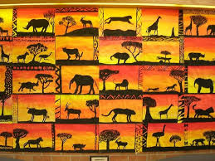
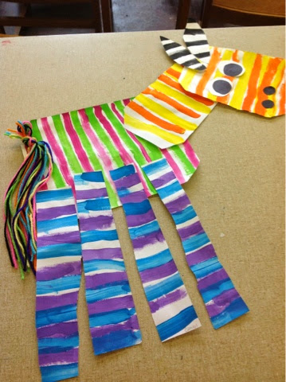
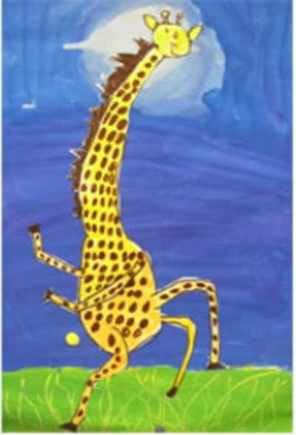
Carnival of the Animals An Art festival
For the next few weeks we are going to run a series of art lessons based around animals.
So whether you are working at home or in school you can create some great pictures. We would like to fill the Farnborough Art Gallery with your work to create a “Carnival of the Animals.”
If you are home learning, you can scan your work and send it in to your teacher.
Good luck, have fun and we want you to be creative, so if you have your own ideas we would love to see your artwork!

Slide 19
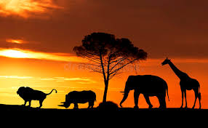
African Sunsets
And
Silhouettes

Slide 20
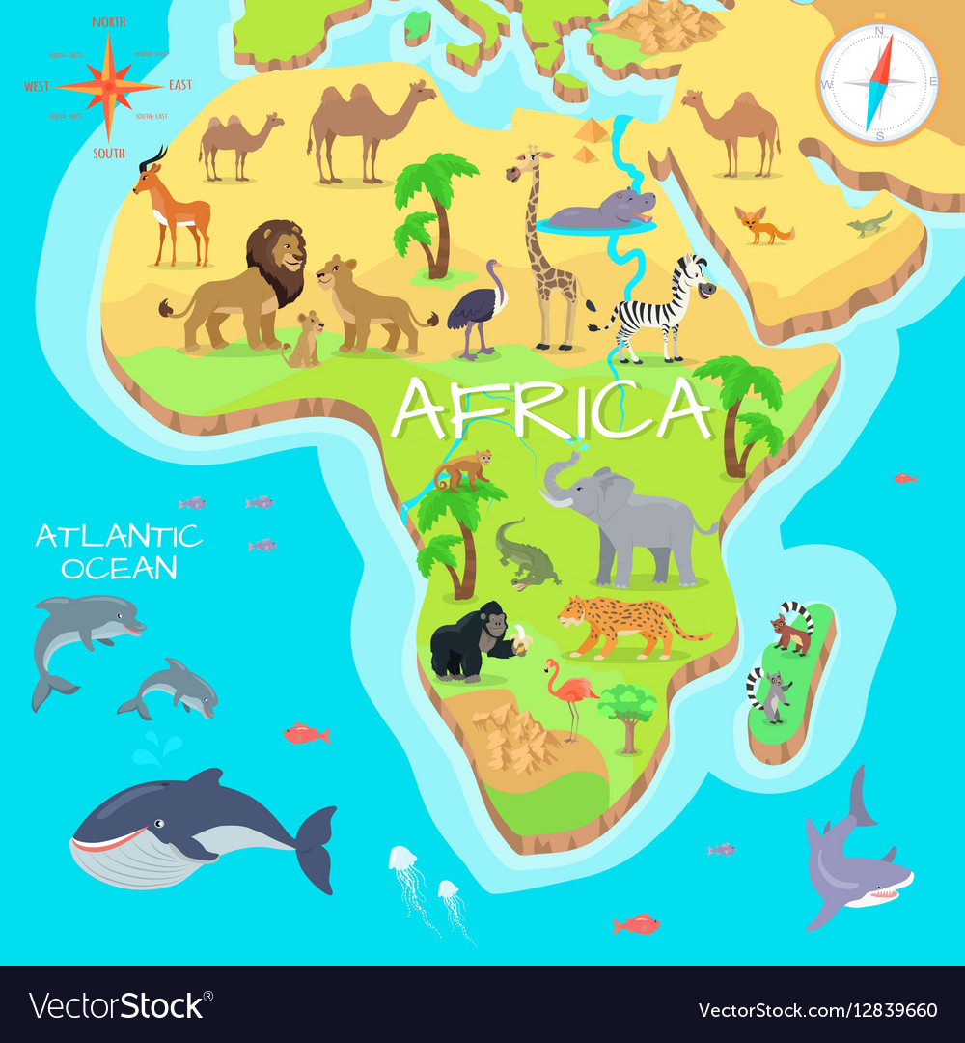
1. Choose your animal
Africa is a huge continent of 54 countries and different physical regions. National parks and game reserves are home to thousands of different species. Think about which one you want in your picture……

Slide 21
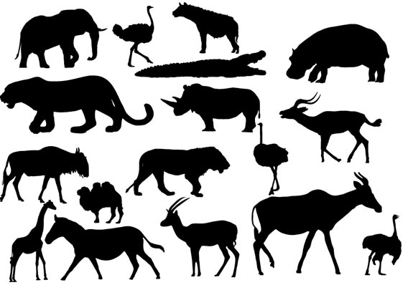
A silhouette is the outline of a shape. You don’t need to add the details.

Slide 22
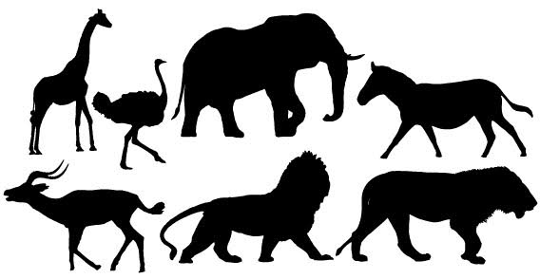
More ideas to get those great brains thinking creatively………..

Slide 23
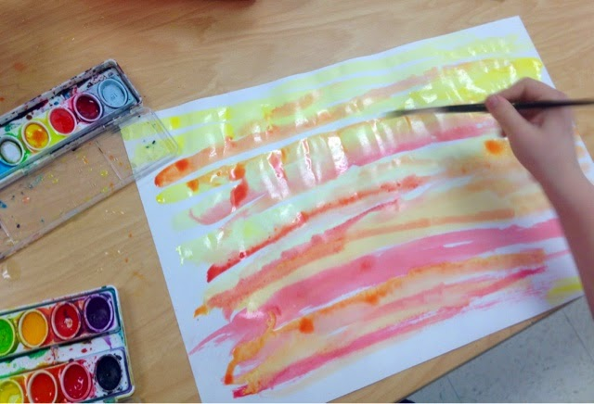
2.Make your beautiful African Sunset
What can I use?
Watercolours
Pastels
Colouring pencils
Homemade ink from very diluted red/orange/yellow food colouring!
Miss Pattison will show you how to do this on Zoom on Tuesday afternoon. You are all invited! Looking forward to seeing you!

Slide 24
What can I do if I can’t make the Zoom?
Use yellow and red paint.
Paint a thick, yellow stripe horizontally across the bottom of the paper.
Then use a small amount of red paint to paint across the page and blend into the yellow. You will make orange where the two paints mix.
Then do a sweep of red paint.
Mix the colours as you sweep across so that you don’t end up with separate strips of colour.
No problem! Use these instructions!

Slide 25
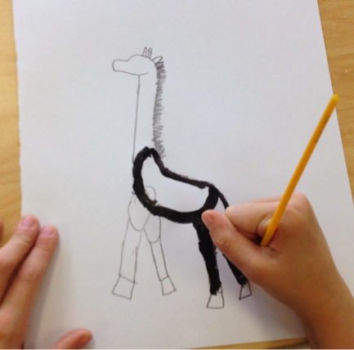
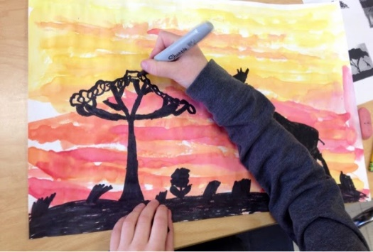
3. Drawing your animals. You have different options……..
You could draw your animal freehand, cut it out and stick on your sunset, once dry.
Or wait for your sunset to dry then draw straight on. Practise drawing your animal whilst your sunset drying.
Or if you are finding drawing animals tricky, use one of the animals from the templates attached on your learning page or from the previous slides.

Slide 26
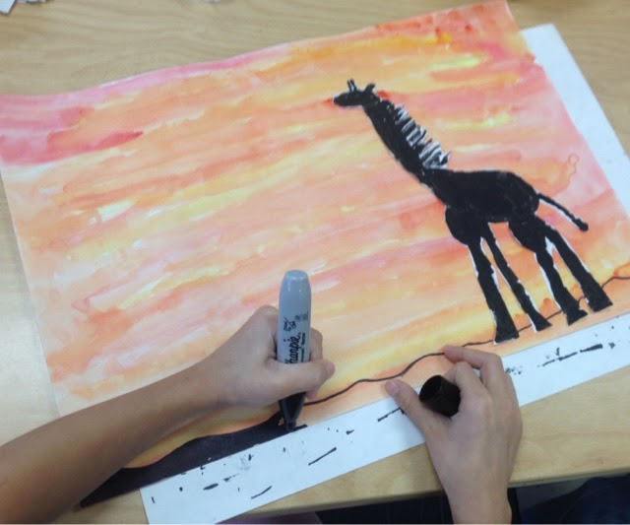
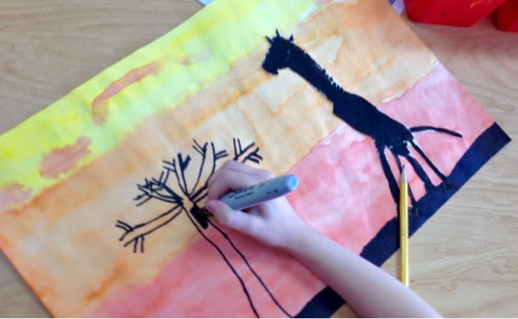
Once your main animal is on the paper, you just add details such as grasses and a tree .
You could add more animals to create a scene. It’s up to you!

Slide 27
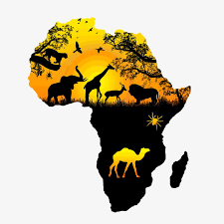
Enjoy your art this afternoon!

