Slide 2
English

Slide 3
Why does the Night Zookeeper have a pair of binoculars?
What happened to the tree when the Night Zookeeper rested against it?
How would you feel if a tree spoke to you? Explain your answer.
Have a look at home for an object that might come to life –what do you think it might say to you?
Write a short dialogue between you and the object – don’t forget to use speech marks.
E.g. “Hello Night Zookeeper” said the giraffe.

Slide 4
Guided Reading
Sick sentences!
These sentences are ‘sick’ and need help to get better. Can you help?
George drew a picture. It was a ship.

Slide 5
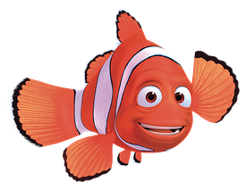
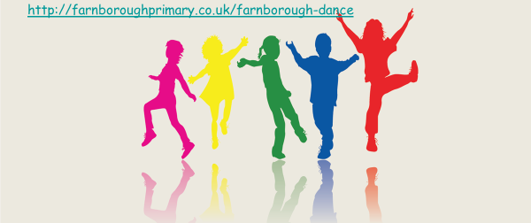
Active Learning
Farnborough Dance Routine
Mrs Humphries has created our very own Farnborough Dance Routine!
It has five parts and every day this week we are doing this as our active learning.
Click on the link below:
http://farnboroughprimary.co.uk/farnborough-dance

Slide 6
Maths
Complete the coloured work you would normally do in class. If you want to try the other challenges, please feel free ☺
Purple group: challenge one
Blue group and green group: challenge two
(blue group, you can also finish off your maths workbook if you haven’t already, one page for each maths lesson instead of or as well as the challenge)
Orange group and red group: challenges two and three

Slide 7
Challenge One
We are building our maths knowledge.

Slide 8
Challenge Two

Slide 9
Challenge Three

Slide 10
Reading Independently
Read for at least 15 minutes independently. You can read a book of your choice.
If you would like to read ‘The Week Junior’ follow this link.
If you would like to read an online book, follow this link.

Slide 11
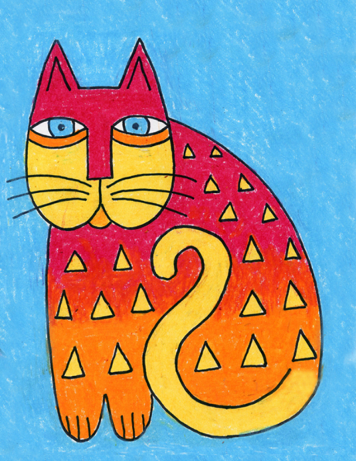
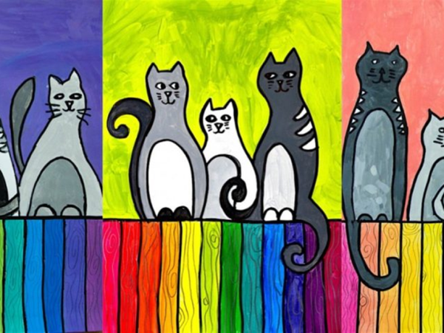
Carnival of the Animals An Art festival
For the next few weeks we are going to run a series of art lessons based around animals.
So whether you are working at home or in school you can create some great pictures. We would like to fill the Farnborough Art Gallery with your work to create a “Carnival of the Animals.”
If you are home learning, you can scan your work and send it in to your teacher.
Good luck, have fun and we want you to be creative, so if you have your own ideas we would love to see your artwork!

Slide 12
Cats on the Fence
Can you see that in these pictures primary colours and secondary colours are used for the fence and the neutral colours for the cats? For this activity you can use paint, felt tips or coloured pencils. It’s up to you!

Slide 13
First draw the fence made from around 12 planks, each one about 2 cm wide with a pencil. Then draw three or more cats, with simple lines and stylised shapes.

Slide 14
Next retrace the lines so they stand out. If you plan to use paint you will need to use a black permanent marker such as a sharpie or if using pencil you can use a felt tip.
Top Tip: If outlining in black felt pen leave outlining to the end, so you don’t get black felt tip pen on the other colours.

Slide 15
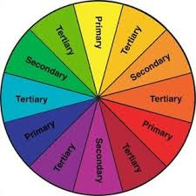
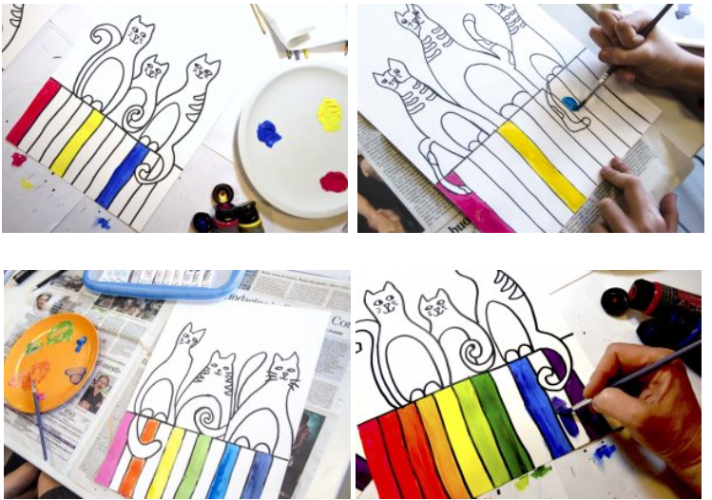
An idea for you to try…. Use the 12 planks as if they were the 12 wedges of the colour wheel: Start by painting the primary colours, and then mix the paints two by two creating secondary colours. The tertiary colours are created mixing a primary with a secondary colour. Use the colour wheel to help you.
Or just colour as a rainbow, it’s your picture, so your choice!

Slide 16
The cats are painted with a neutral colour. If using paint , create a scale of 5 or 6 different greys just mixing black and white. The background is painted with a solid colour.

Slide 17
At the end, if you have time, you could retrace the lines with a black permanent marker, covering possible flaws on the edges, and draw the wood grain of the planks with a pencil. It’s up to you!
Good Luck and enjoy!

Slide 18
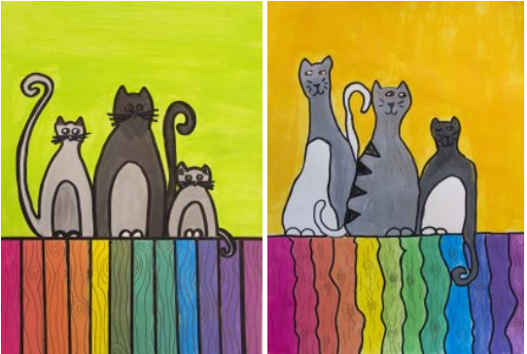
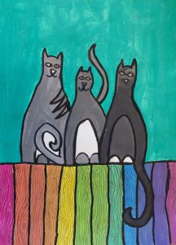
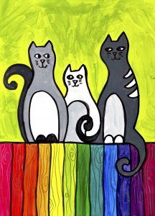
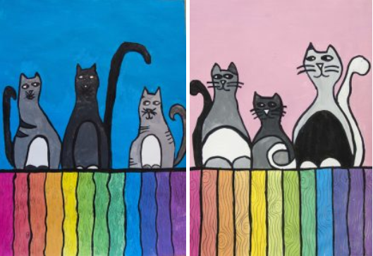
Want to listen to The Carnival of the Animals by Camille Saint-Saëns?
Click below: https://www.youtube.com/watch?v=1L993HNAa8M

