Slide 1
Maths
Hi Red group ☺
WALT: find angles in a triangle.

Slide 2
Warm-up

Slide 3
If video does not play, follow this link and click Summer Term week 1 lesson 2 – angles in a triangle

Slide 4
If video does not play, follow this link and click Summer Term week 1 lesson 2 – angles in a triangle

Slide 5
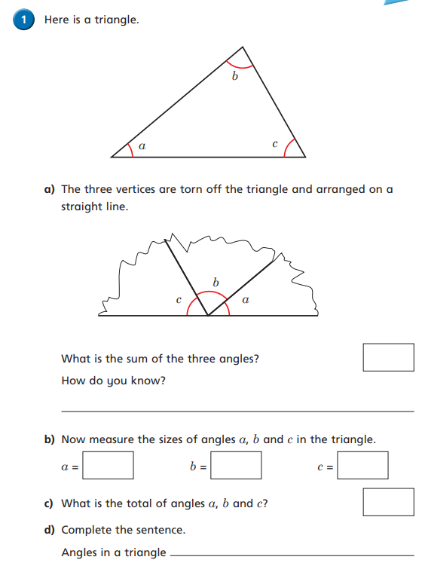

Slide 6
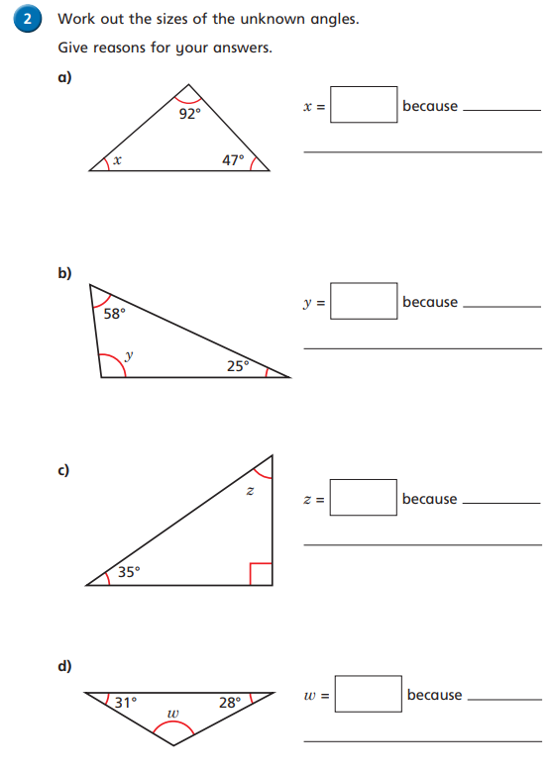

Slide 7
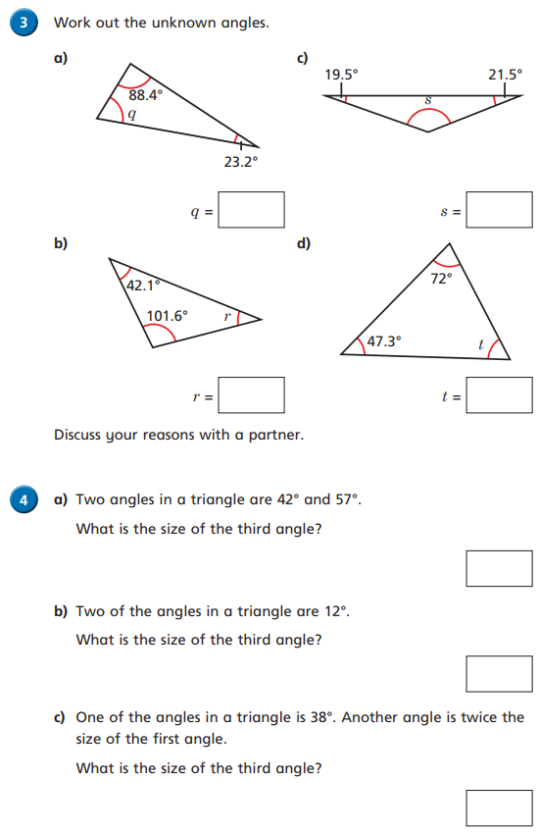

Slide 8
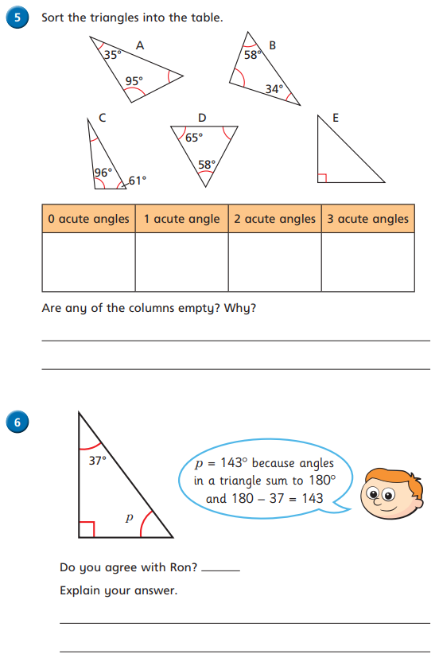

Slide 9
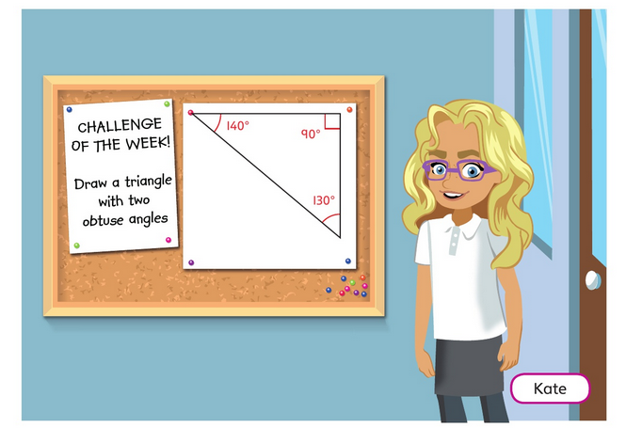
a) Is the challenge possible?
b) Has Kate correctly solved the problem with her answer?

Slide 10
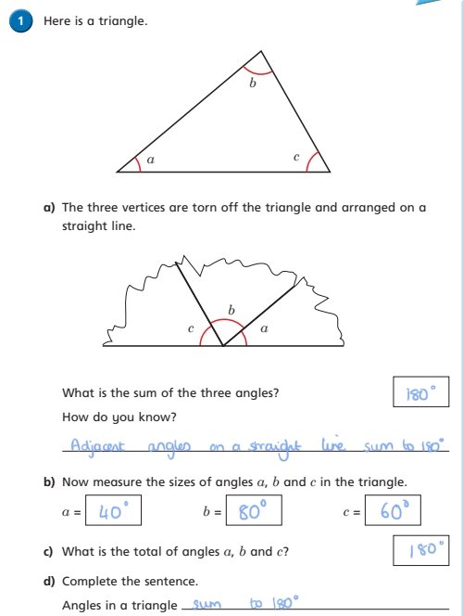
Answers:

Slide 11
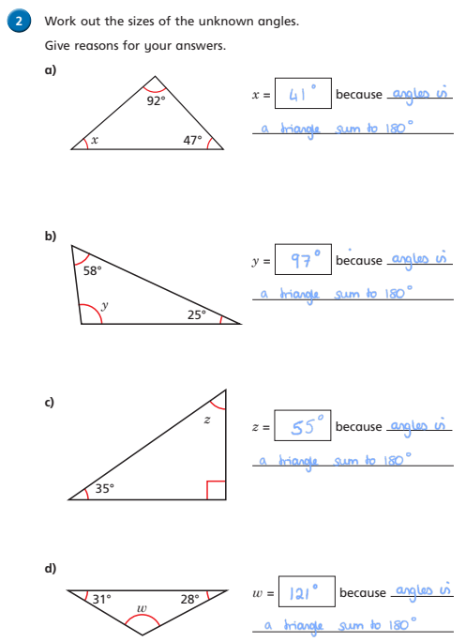
Answers:

Slide 12
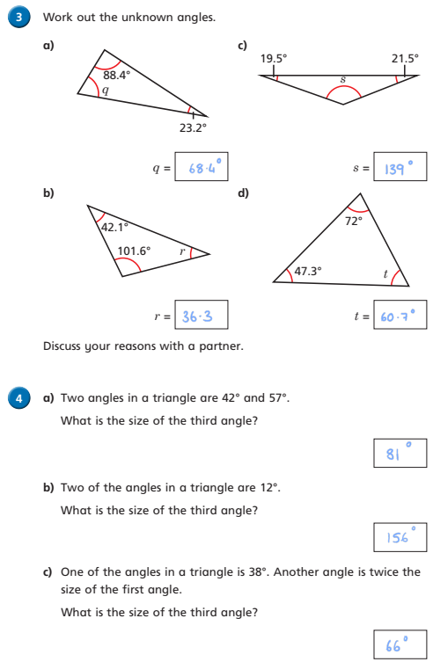
Answers:

Slide 13
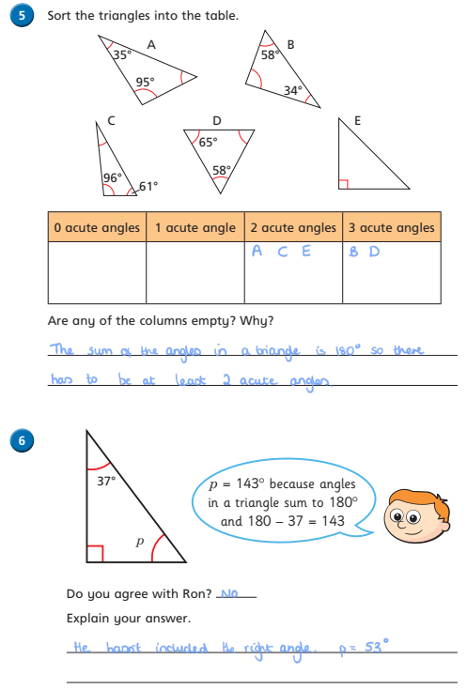
Answers:

Slide 14
Answers:

