Slide 1
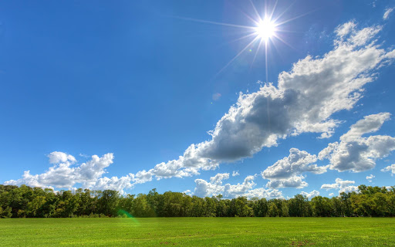
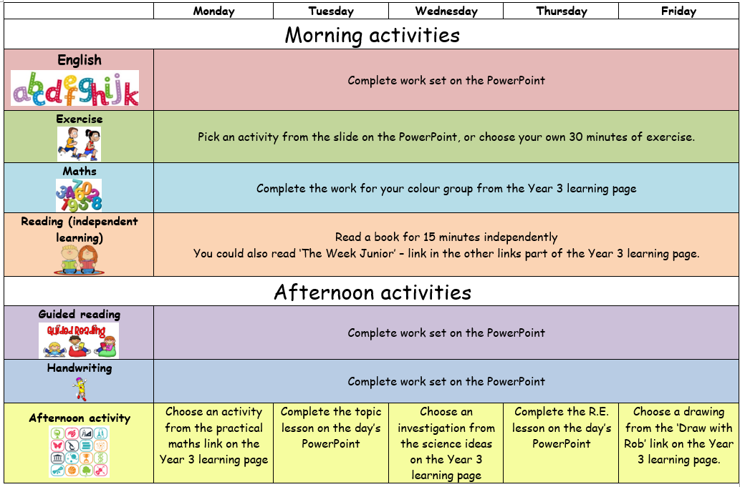

Slide 2
English
This week we are going to continue revisiting information texts.

Slide 3
Let’s recap our model text
You can listen to it and draw pictures to help you remember it, just like we would in the classroom
Or
Read it and draw pictures to help you remember it.
You can listen to a recording of the story of The Truth about Trolls text below here: https://soundcloud.com/talkforwriting/trolls

Slide 4
The Truth about Trolls
Many people believe trolls are angry, mean beasts that terrify goats and people. However, this is not true. Here is the truth about trolls.
What do trolls look like?
Like the ogre, trolls are huge. They look fierce and ugly but to another troll they are kind and beautiful. The adult troll has small, beady eyes, a bulbous, warty nose and sharp, yellow teeth. Most trolls have long, curly horns on their heads similar to a goat. Interestingly, a few trolls do not have any horns at all. No one knows why.

Slide 5
Where do trolls live?
Trolls are usually found in very cold countries like Iceland. They make their homes in caves near volcanoes which provide both warmth and shelter. They live peacefully in small family groups, hidden away from people. One troll, who was very grumpy, lived alone under a wooden bridge. Because he bullied the local goats, he gave all trolls a very bad name.

Slide 6
What do trolls eat?
Trolls enjoy eating all types of seafood. Trolls fish in total darkness so that they are not seen by anyone. They mostly eat their food raw. Sometimes, when the volcanoes have erupted, they cook their food on the hot rocks. In addition, they gather large mushrooms and dig up juicy roots that grow in the forest. Surprisingly, goats are not on the menu!
Did you know?
Amazingly, trolls like to have fun. They love singing and dancing. When they sing, it sounds like a rumble of thunder. When they dance, it feels like an earthquake. Sadly, because of the troll that upset the goats, all trolls now hide away from view.
They can still be seen, though, if you look really hard and believe. The rocks here are actually just sleeping trolls!

Slide 7
This week we are going to plan and write our own information text about trolls.
★ Use the planner below to jot down some ideas for your information on trolls.
★ You can use the ideas from the word and sentence games. Remember you are the new expert!
Today I would like you to plan the next 2 boxes.
The ones with the stars next to them.

Slide 8
★ Challenge: What other sections could you add?
What is troll school like?
What jobs do trolls do?
How do trolls look after their babies?
What do trolls do on holiday?
What is in a troll’s cave?
As a challenge, did you think of another section you would like to write about?
Can you plan that section too?

Slide 9
Physical activity – minimum 30 minutes each day | Link to resource
5 a day User Name: FPS53 / Password: JFz4XqG7 | https://player.5-a-day.tv/
Joe Wicks – PE sessions | https://www.youtube.com/channel/UCAxW1XT0iEJo0TYlRfn6rYQ
Cosmic Kids Yoga | https://www.youtube.com/user/CosmicKidsYoga
PE Hub Parents Portal | https://pehubportal.co.uk/
Go Noodle | https://www.gonoodle.com/good-energy-at-home-kids-games-and-videos/
Go for a walk/run. You must go with an adult from your home and make sure you stay 2 metres away from other people.

Slide 10

Maths
Complete the coloured work you would normally do in class.
Purple group: continue using the purple slide to help complete your work ☺
Blue group: continue using the blue slide to help complete your work ☺
Green group: continue using the yellow slides to help with your learning and then complete the work which is on the green background ☺
Orange group: continue using the yellow slides to help with your learning and then complete the work which is on the orange background ☺
Red group: use the red slides further on in this PowerPoint to help with your learning ☺

Slide 11
Purple group
We are recapping our knowledge of shape.
What is a 3D shape?
Recap 3D shapes
Can you describe the difference between a cuboid and a cube?
Now complete page 34 of your workbook.

Slide 12
Blue group
Today we are recapping our knowledge of time.
If you want to practise telling the time, there is an analogue clock you can move if you follow this link.
Complete page 38 of your workbook

Slide 13
WALT: find equivalent fractions.
We are going to learn about fractions over the next few weeks.
Look at the yellow pages to help you, then complete the work
for your group.
Green group – green background
Orange group – orange background

Slide 14
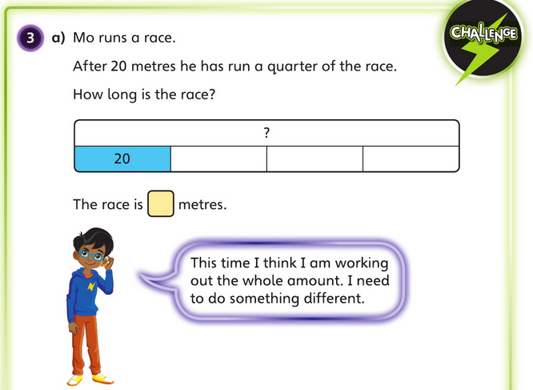
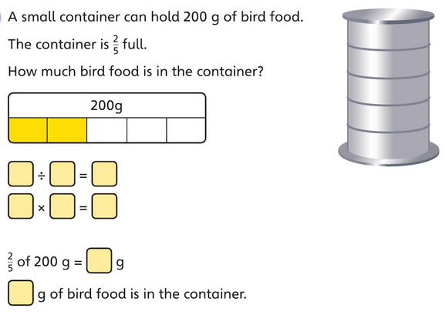
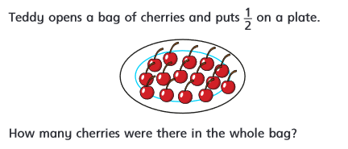
Monday’s answers:
80g of bird food
The race is 80 metres.
30 cherries in the bag.

Slide 15
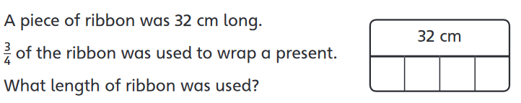
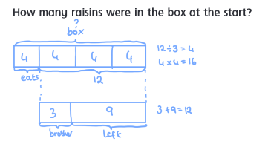
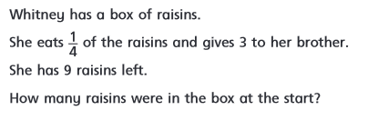
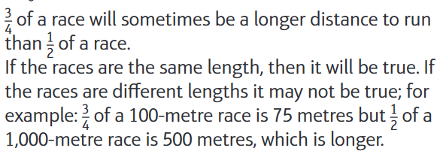
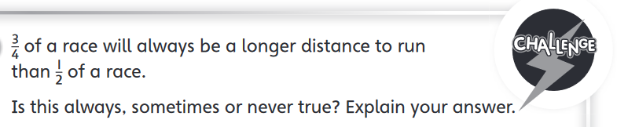
Monday’s answers:
24cm of ribbon was used.
There were 16 raisins in the box.

Slide 16
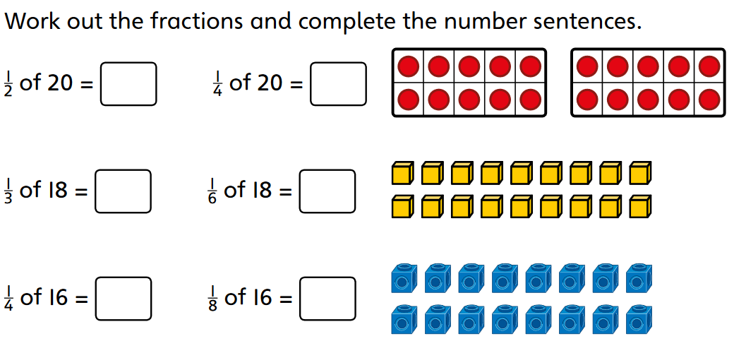
Green and orange warm-up
Can you see any patterns?

Slide 17
What does equivalent mean?
It means they are the same.

Slide 18

If video does not play, follow this link and click Week 2 – equivalent fractions (1) – the video continues on the next few slides.

Slide 19


Slide 20
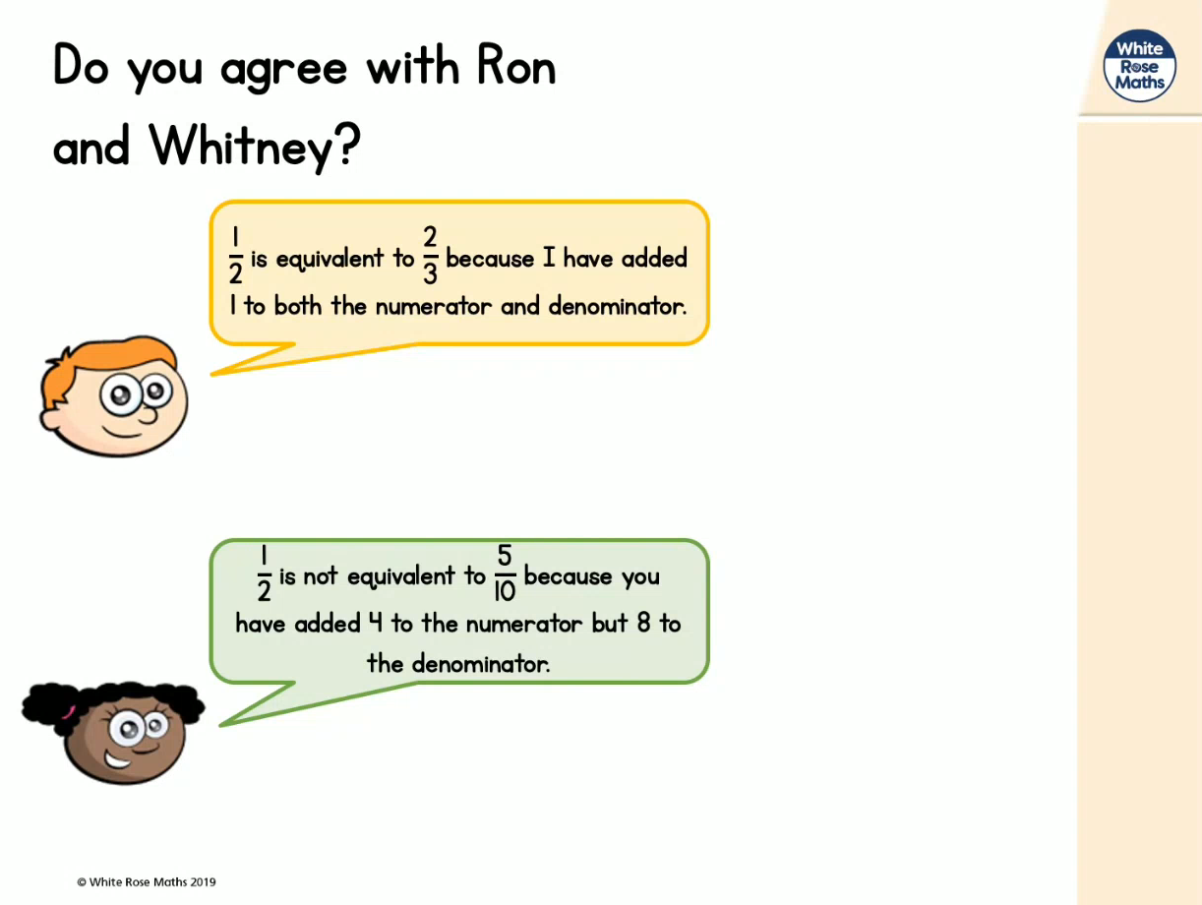

Slide 21
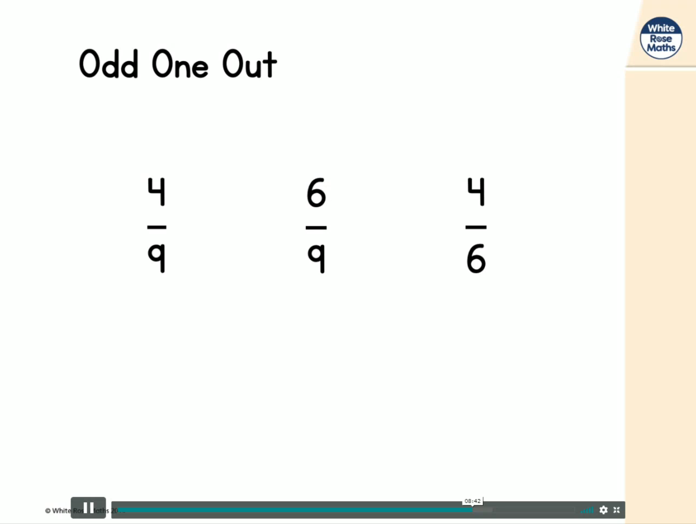

Slide 22
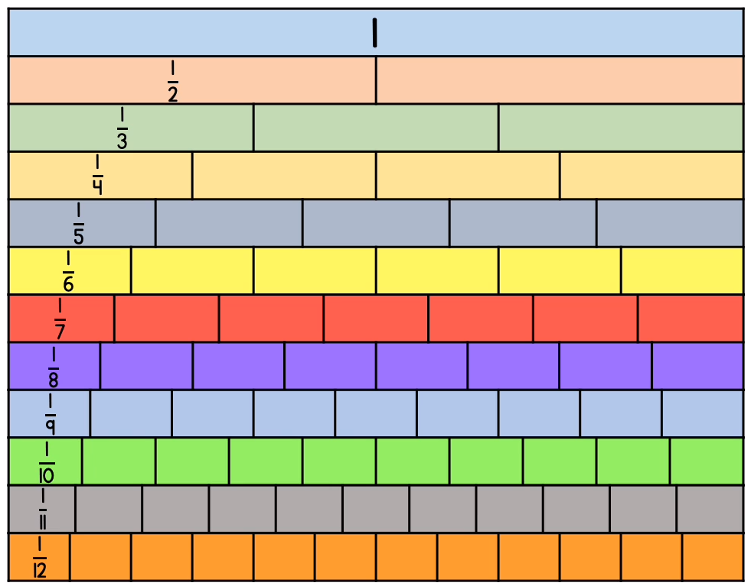
A fraction wall is really useful for this lesson. Use the one below or follow the link for an interactive fraction wall: Interactive Fraction Wall

Slide 23
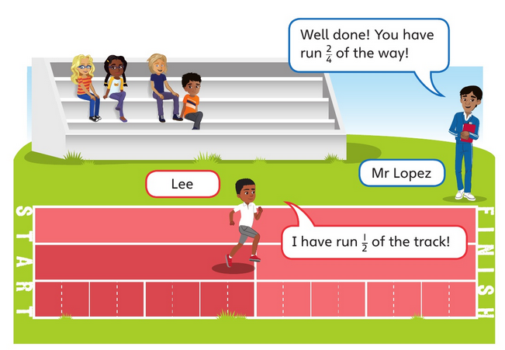
Who is correct, Mr Lopez or Lee?

Slide 24
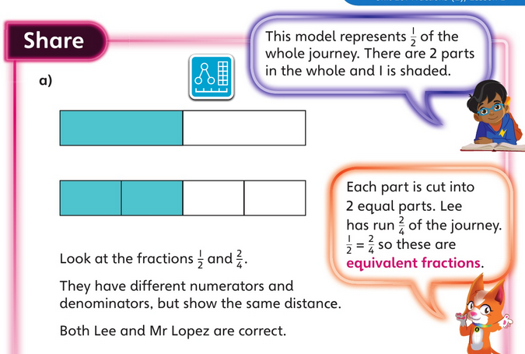
The answer:

Slide 25
Look at the lines drawn on the track.
Write two or more fractions that are equal to ½.

Slide 26
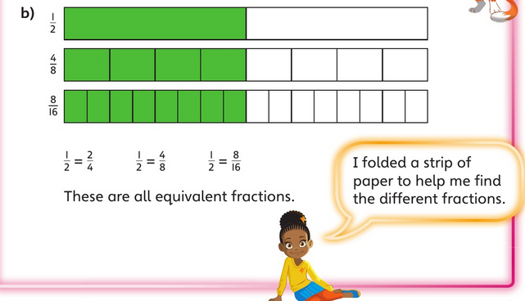
The answer:
Can you see a link between the numerator and denominator to help you find more equivalent fractions for ½ ?

Slide 27
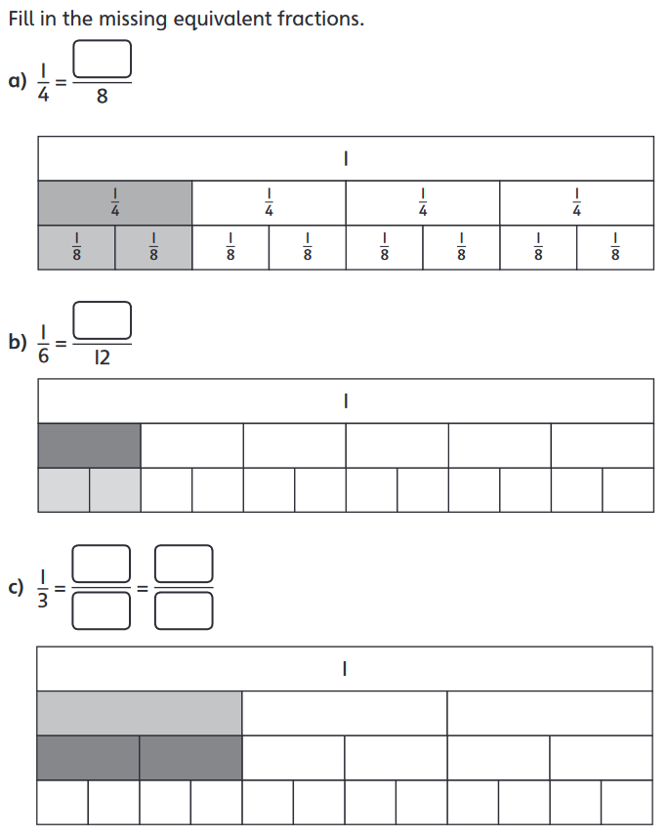

Slide 28
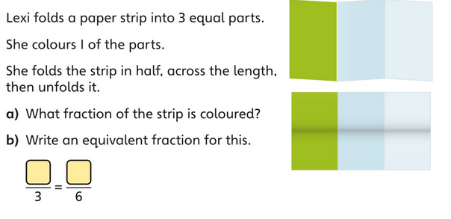

Slide 29
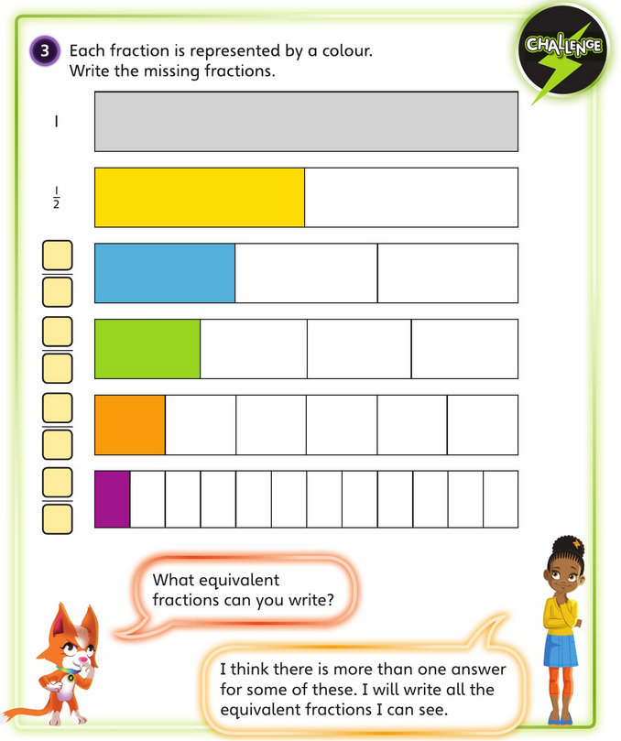

Slide 30
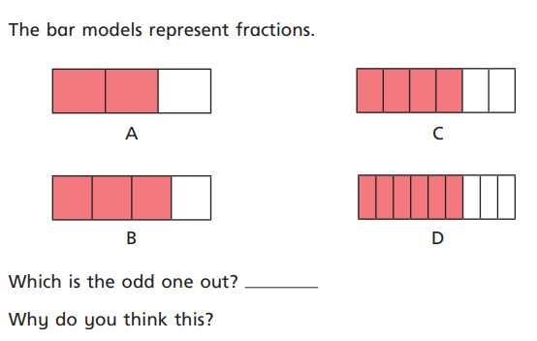

Slide 31
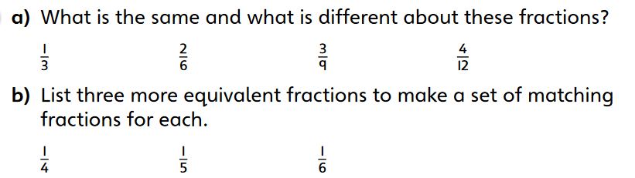

Slide 32
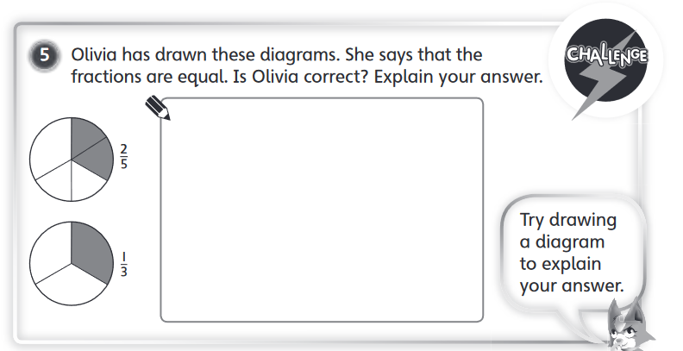

Slide 33
Red group
WALT: find angles in special quadrilaterals.

Slide 34
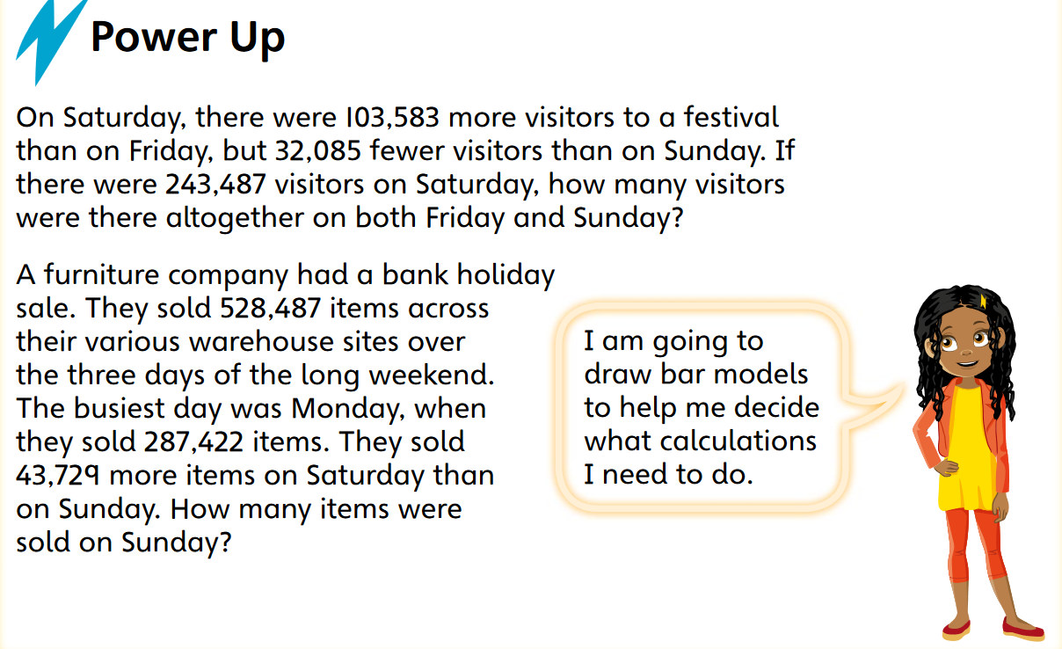
Warm-up

Slide 35
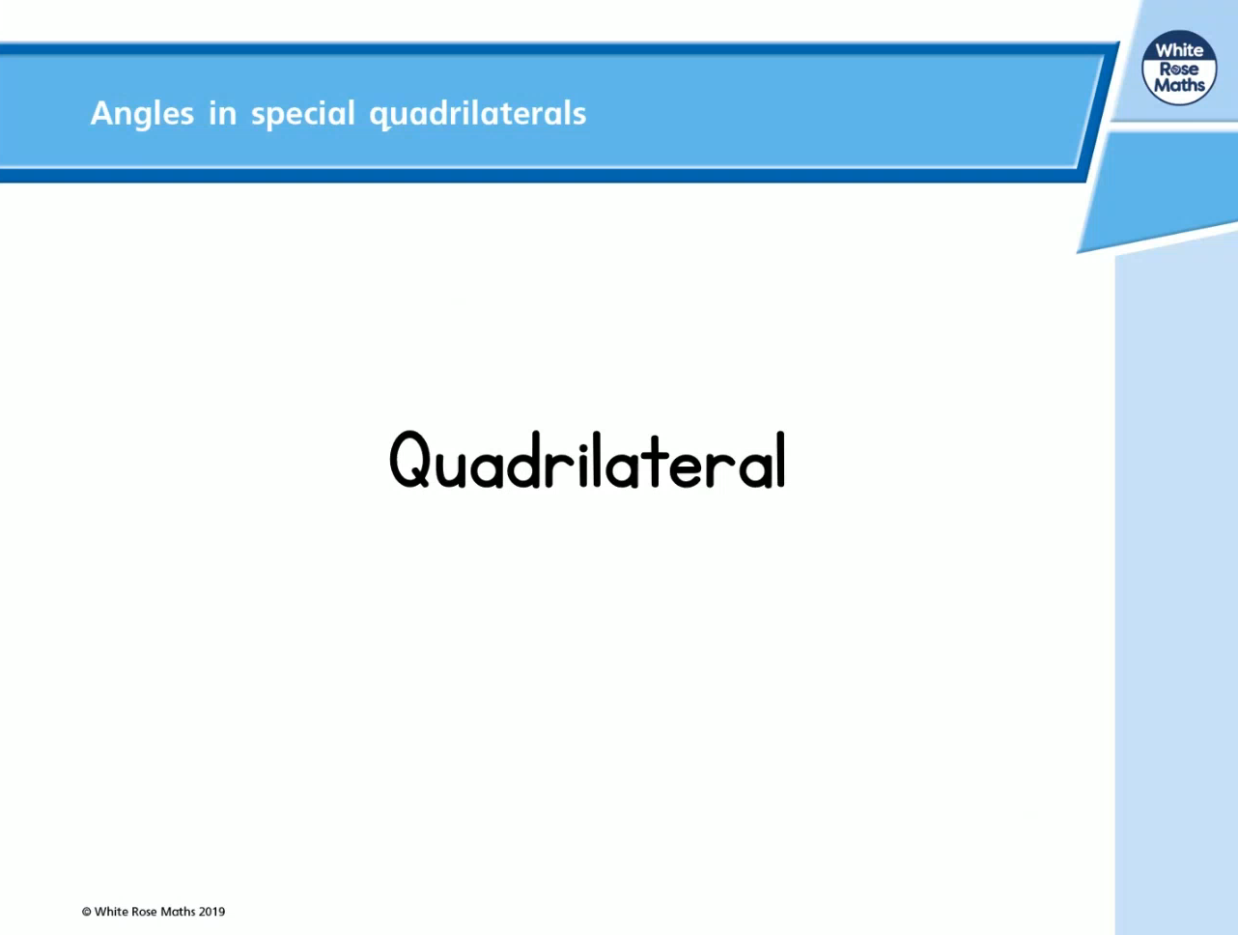
If video does not play, follow this link and click Summer Term week 2 lesson 1 – angles in special quadrilaterals

Slide 36
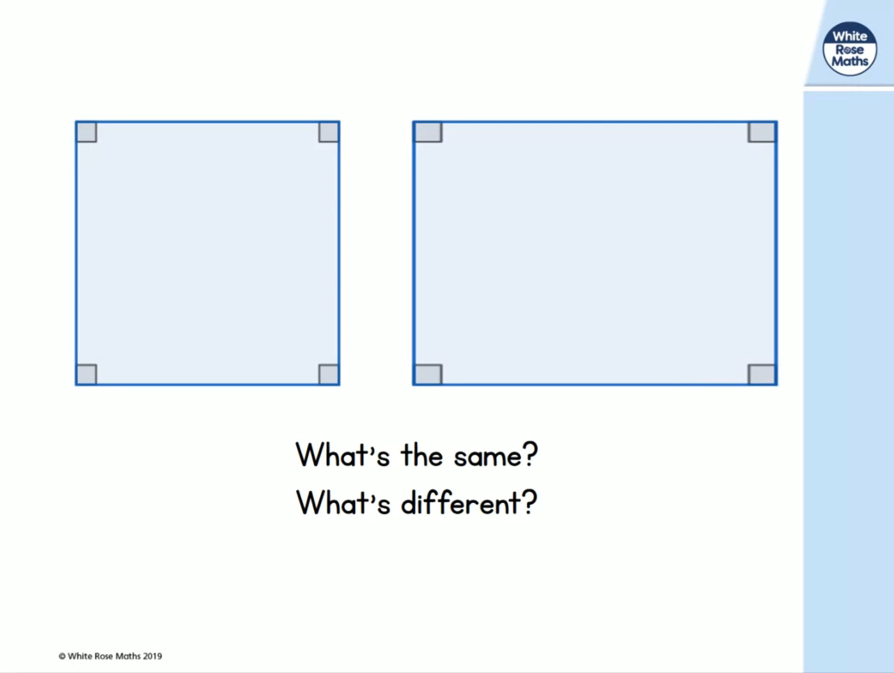

Slide 37
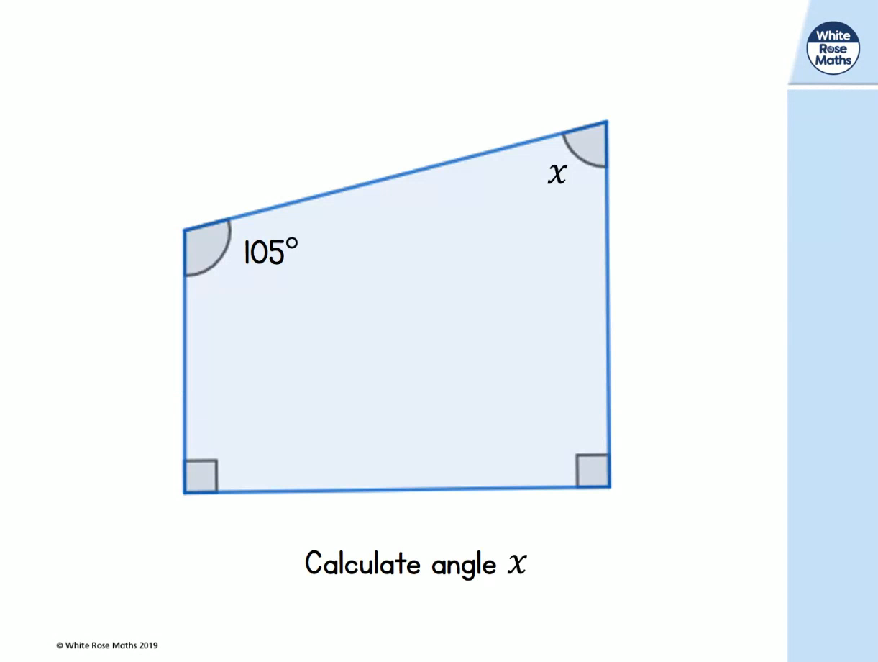

Slide 38
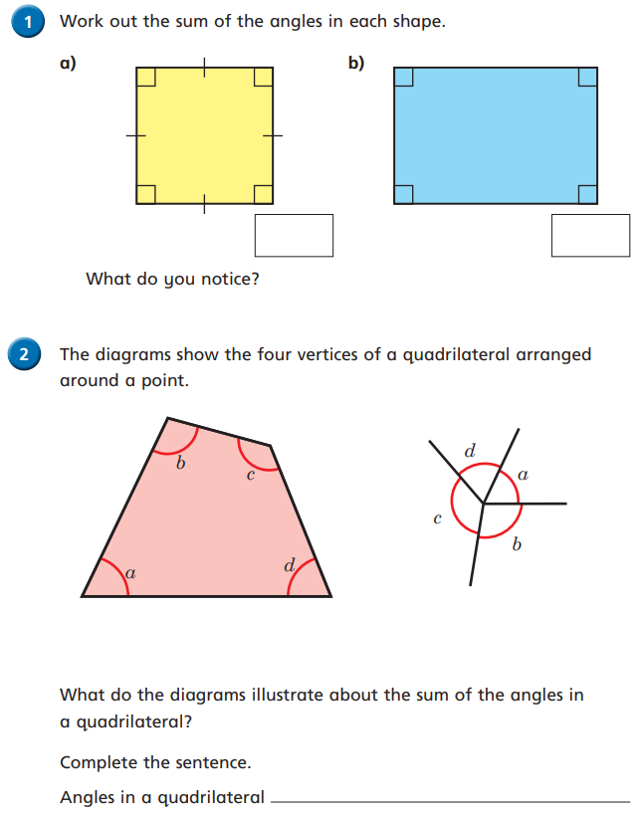

Slide 39
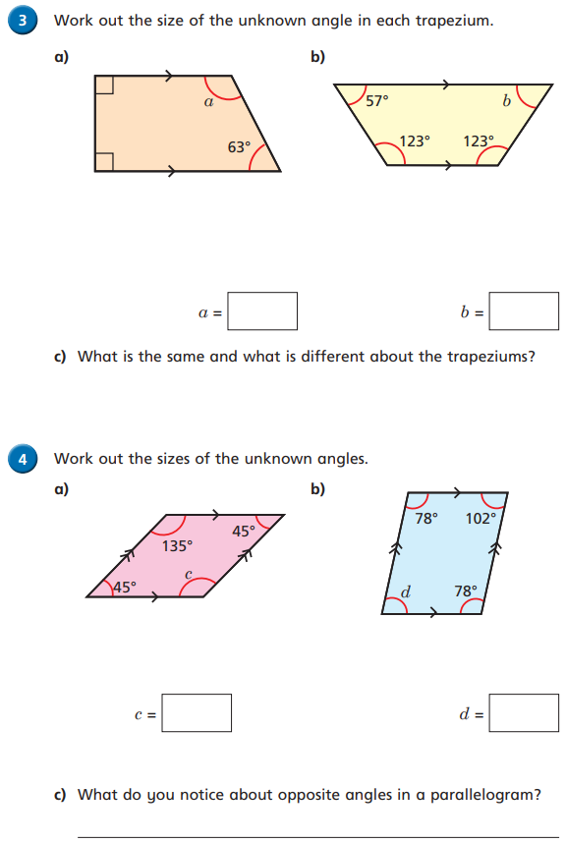

Slide 40
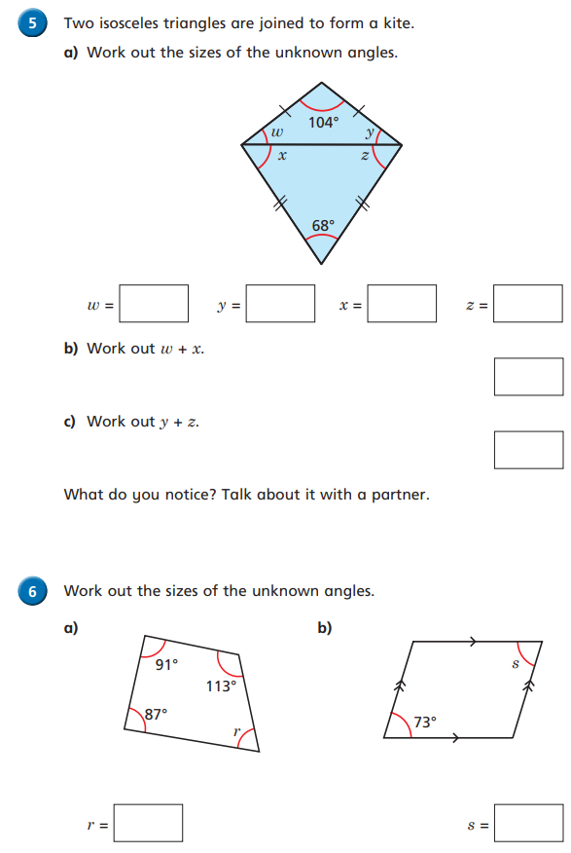

Slide 41
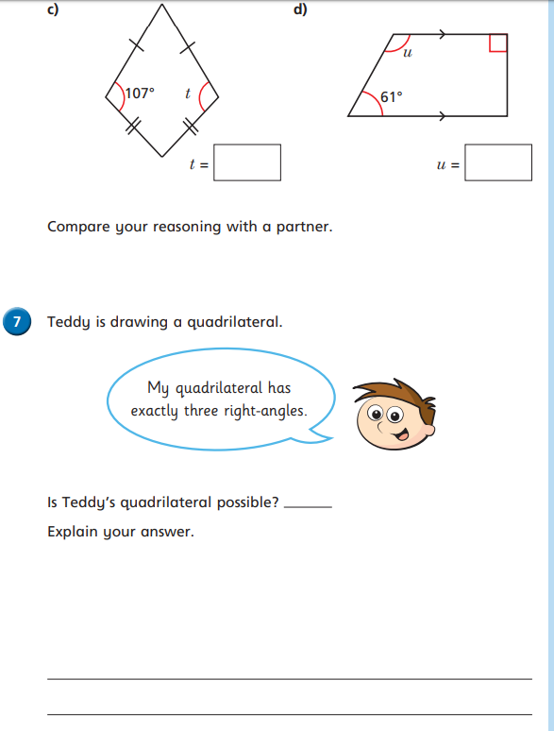

Slide 43
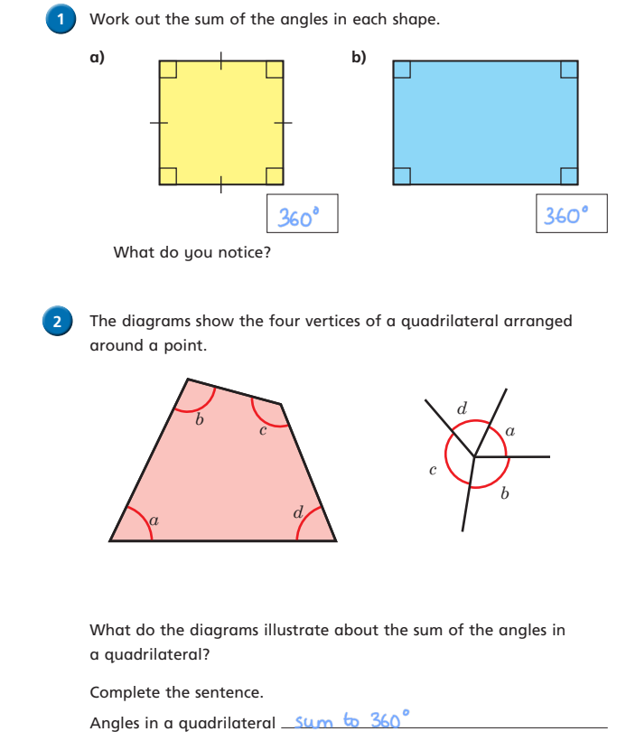
Answers:

Slide 44
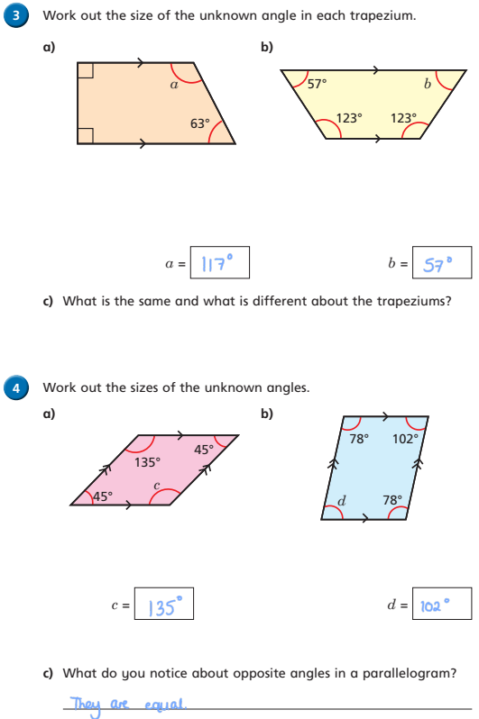
Answers:

Slide 45
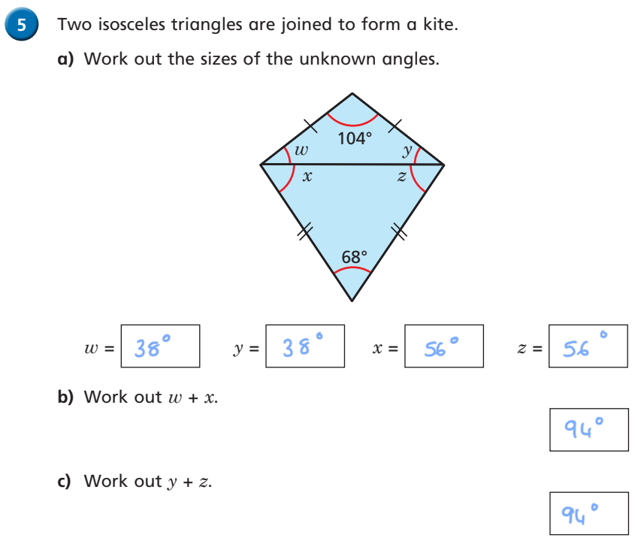
Answers:

Slide 46
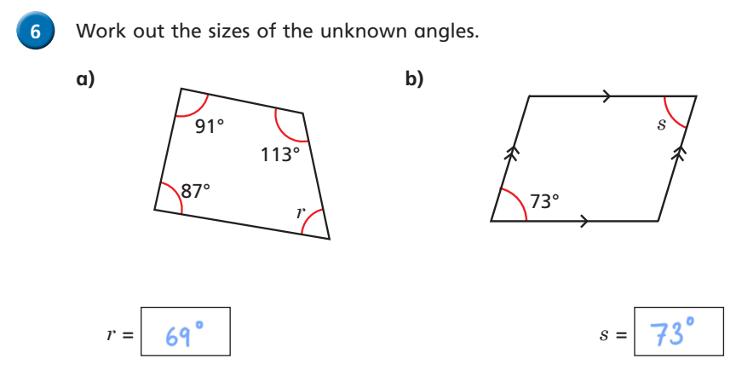
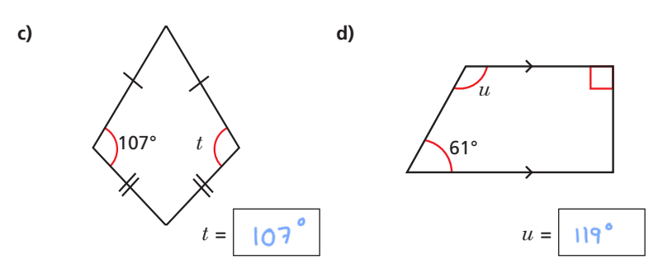
Answers:

Slide 47
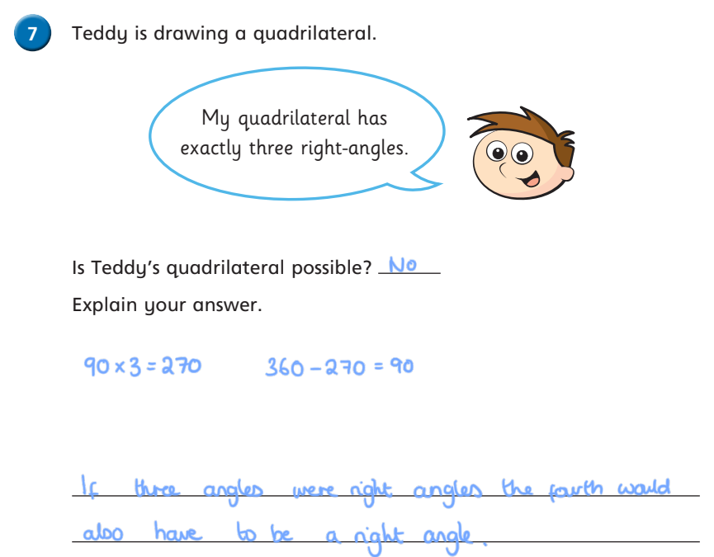
Answers:

Slide 48

Guided Reading

Slide 49
Complete the coloured work labelled on your pack.
If you want a challenge, or have some extra time, please feel free to try another group’s work ☺

Slide 50
Purple Group
Question time!
Where is the pup’s mother?
What animal is she?
What might she have learnt already from her mother?
Remember to write in full sentences.

Slide 51
Blue Group
Question time!
How old is the pup?
Do you remember learning to swim? What were the biggest challenged you had to overcome?
Will the pup be brave enough the enter?
Remember to write in full sentences.

Slide 52
Green Group
Question time!
Do you remember learning to swim? What were the biggest challenged you had to overcome?
Will the pup be brave enough the enter?
How is it that some animals are better swimmers than others?
Remember to write in full sentences.

Slide 53
Orange Group
Sick sentences!
These sentences are ‘sick’ and need your help to get better. Can you help?
The pup lay on the snow.
She looked at the water.
It was a sunny day.
It was cold.
Challenge:
Can you include a relative clause in your improved sentences?
https://www.bbc.co.uk/bitesize/topics/zwwp8mn/articles/zsrt4qt
Here is the video to remind you what a relative clause is.

Slide 54
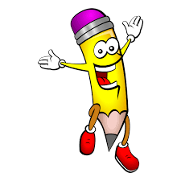
Handwriting

Slide 55
Afternoon activity
Topic lesson (next slide)

Slide 56
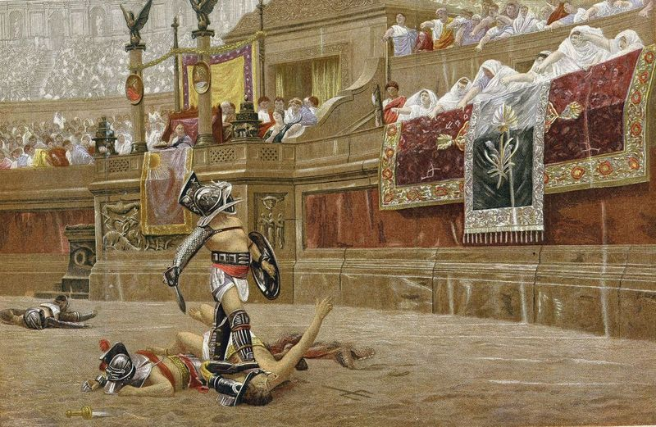
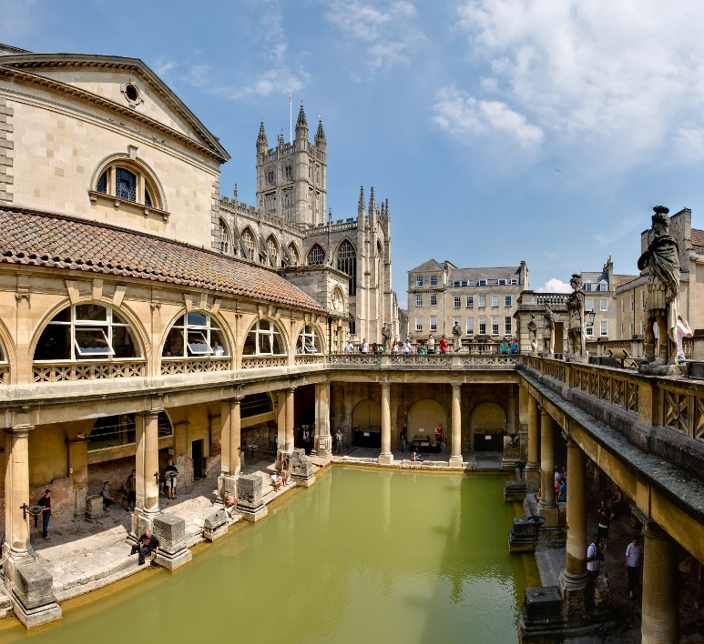
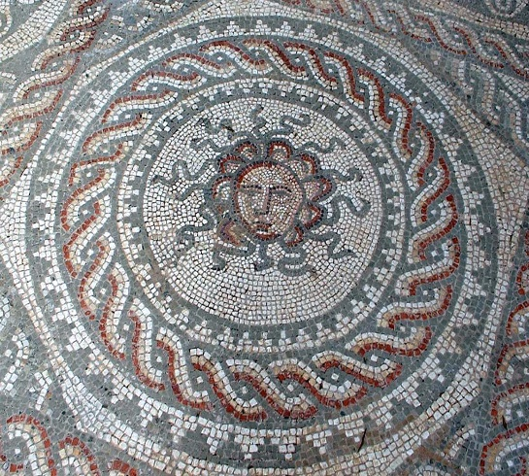
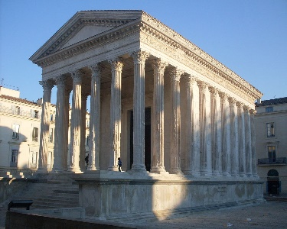
Topic - The Romans
How did Britain become part of the Roman Empire?

Slide 57
Before the Romans invaded Britain, there were lots of tribes living in Britain during the Iron Age.
Watch the video to find out a little bit about what Celt life was like.
Click here to find out about Celtic life.

Slide 58
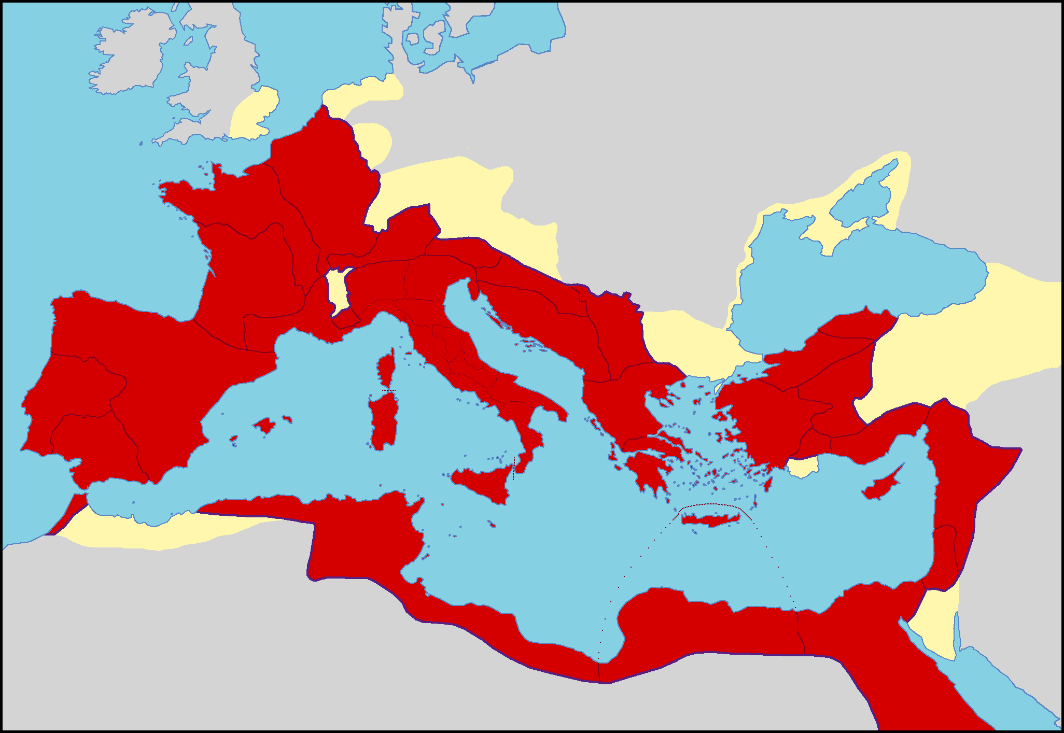
While this was life in Britain, the Roman Empire had been expanding across Europe and its territory included Gaul (the Roman name for France), which was governed by Julius Caesar. The Romans had heard about Britain, which they called Britannia, and Caesar began to think about invading.

Slide 59
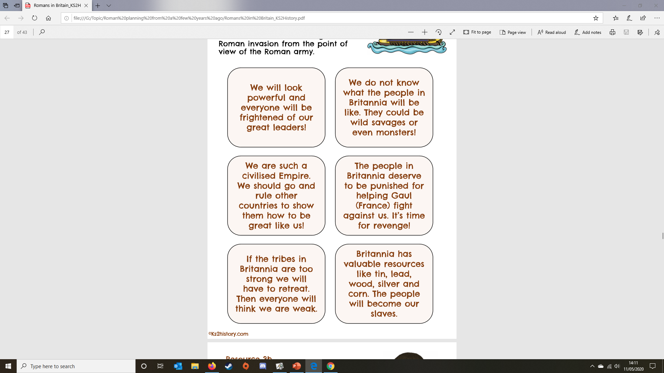
Imagine you are a Roman planning the invasion of Britain. Can you think about why you might want to conquer Britannia? Can you think of any obstacles?
Sort the statements into pros and cons about invading Britannia.

Slide 60
Pros Cons

Slide 61
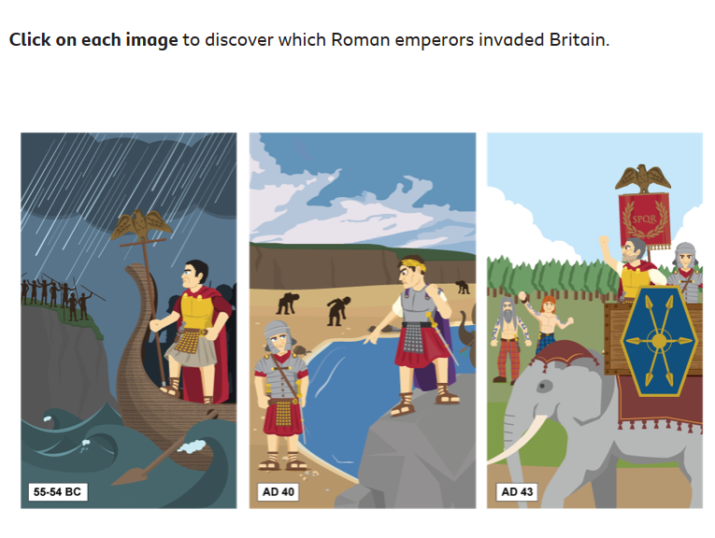
The Romans took more than one attempt before they were successful in conquering Britannia.
Click this link and scroll down to these 3 pictures to find out about the different invasion attempts.

Slide 62
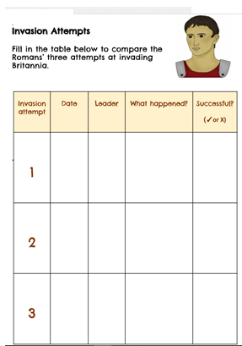
Fill in this information sheet (or write it in your book) about each of the three invasions:

